Slide 1

人的資源スライド 1
Tax Crime in Cash Economy
NTA, Tokyo Regional Taxation Bureau,
Criminal investigation Department

Slide 2
人的資源スライド 2
Contents
Tax crime investigation in Japan
Overview on Japan’s Cash Economy
Tax Crime in Cash Economy
Hidden Cashes

Slide 3
人的資源スライド 2
Tax crime investigation in Japan
Overview on Japan’s Cash Economy
Tax Crime in Cash Economy
Hidden Cashes

Slide 4




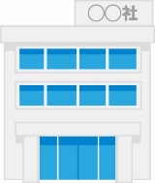
National Tax Agency（NTA）’s Organizational Structure
Total of 56,000 tax officials
Criminal Investigation Division (28 members)
NTA
Regional Taxation Bureaus(Office)
Tax Offices
Criminal Investigation Departments
(1,500 investigators)
Intelligence Team (inspective investigation)
Operational Team
(on-site investigation)
Notes:
日本の税務職員数は約56,000人います。職員は、国税庁及び国税局又は税務署に分かれて勤務しております。
①There are 56,000 tax officers in Japan. They are allocated to National Tax Agency, Regional Taxation Bureaus, Tax Offices.
査察調査に従事する職員は約1,500人おり、税務署には査察調査を実施する職員はおりません。
②About 1,500 officers are engaged in criminal investigation group, there is no criminal investigators in Tax Offices.
査察調査に従事する職員は大きく分けて内偵調査に従事する職員と、内偵調査を受けて実際に査察調査を行う職員に分かれております。
③The criminal investigators are almost halved into the “Information Group” in charge of secret investigation etc. and the “Investigation Group” in charge of field investigation such as compulsory investigation.

Slide 5
Differences between Tax examination and Tax criminal investigation
Voluntary Basis Only
Administrative Procedure based on Act on General Rules for National Taxes
Taxpayer and those involved
Procedures, equivalent to normal Criminal investigation ,based on Act on General Rules for National Taxes
and
TAX EXAMINATION (Civil Tax Investigation)
CRIMINAL CASE INVESTIGATION
Voluntary Basis
Criminal suspects
Compulsory Basis
Conspirator, etc.
Notes:
税務調査と犯則調査の違いを示すと表のとおりとなります
The difference between ordinary tax examination and our tax crime investigation is like this, as you can see in this table.
査察制度の目的を達成するために、一般の税務調査における任意調査とは別に、脱税嫌疑者には、強制的権限を行使するなど犯罪捜査に準ずる方法で強制調査を行い、
To complete our investigating mission, in addition our voluntary basis tax examination, we also conduct compulsory investigation using methods equivalent to normal criminal investigation toward the suspects of tax evade.
強制調査等によって収集した証拠に基づき、正しい税金を課すほか、検察官に告発し、公訴の提起を求めています。
and based on the evidences collected by our compulsory investigation, we impose additional taxes on tax evaders and in addition to that, we accuse them of violation of tax law to public prosecutor’s office and then prosecutors prosecute them to a court.

Slide 6


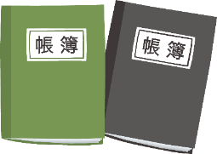

Why do the National Tax Agencies conduct Tax Crime Investigation instead of the Police?
Different types of Evidences
There is a considerable differences between the types of evidences we obtain.
Special Skills Required to Collect and Evaluate/Analyze the Evidences
Special skills and professional knowledges on tax and accountings would be required as a set skill for tax crim investigation
Unlike general criminal cases ( weapons etc.) Tax crime evidences are usually are books and documents.
Notes:
ではなぜ、警察官のような捜査機関の職員でもない国税職員が、脱税という犯罪の取締に携わる必要があるのでしょうか。
Then, why should tax investigators be involved in combatting tax crimes even though we are not police.
脱税とは、不正の行為によって、故意に、税額を免れる犯罪であるため、証拠が一般の刑事事件とは相当異なるものがあるという特殊性が、理由のひとつです。
One reason is peculiarity of evidence. The evidences from tax evasion are peculiar unlike other general criminal cases because tax evasion is where there is a deliberate attempt not to pay the tax which is due.
もうひとつの理由は、証拠の収集や、証拠に対する価値判断を行う際に、特別の経験と知識を必要とすることです。
The other reason is demand for specialized knowledge. Tax evasion is where there needs special experiences and knowledges on collecting evidences and valuing those evidences.
具体的には、「行為者を取調べる技術」のほかに、「税・会計に関する知識」など専門的かつ高度な能力が必要となります。
Specifically, in addition to “ interrogation technique”, highly professional and advanced knowledge, such as tax and accounting knowledge are needed.
また、国税庁は国の機関として、「税制を適正に維持」し、「適正な課税を実施」する責任を負っていることから、その責任を果たすために、悪質な脱税者の取り締まりを実施しています。
Also, as a government authority, the mission of our National Tax Agency is to “maintain appropriate tax system” and “ implement fair taxation” so that, in order to fulfill those missions, we are pursuing malicious tax evaders.
これらの理由から、国税職員が脱税の取締りに携わっています。
For these reasons, we are combatting tax evasions

Slide 7
What is Tax Crime?
What consists a Tax Crime
What are the Acts
What are the types of Crimes
Notes:
それでは、具体的な脱税の方法や、脱税犯罪の特徴について見ていきましょう。
Now, let’s move on to the explanation of the types of tax crimes and the specific acts conducted by the suspects.

Slide 8
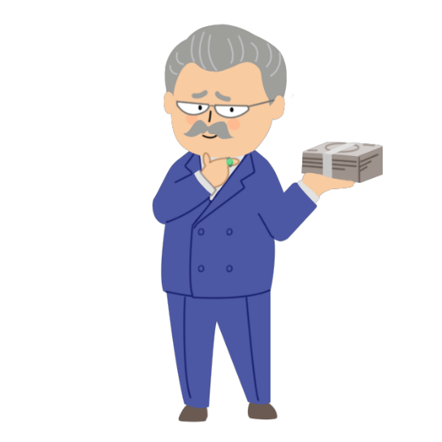

What consists a Tax Crime
Deception
Intention
Tax Evasion
Under-Reporting
No filing
Tax Crime
lead to
Decrease of Tax Revenue
Create unfairness among the people
Cause distrust towards the government
Notes:
租税犯罪とは一般的は、「納税義務者が不正の行為により、故意に、その納税義務を減少させる不法な行為」による犯罪です。
In general, tax crime is “where tax payers intentionally reduces their tax liability with fraudulent act”. Therefore, when there is tax evasion with intent and deception, it is considered as Tax Crime.
脱税をする者が大勢いますと、「国家の租税収入の減少」を招き、「国民感情として不公平感」が生じ、
The increased number of tax evaders leads to a decrease of Tax revenue and outburst of “unfairness among people”.
結果として、「国家への不信感を招く」など、国家存続上の大きな脅威につながりかねません。
Eventually, this cause the distrust towards the government from the citizen and lead to a national crisis
そのような観点から、脱税は国家財政を根幹から揺るがしかねない犯罪であるため、厳しい取締りが求められます。
From such a point of view, we have to regulate tax crime strictly because tax evasion is the crime which might be crucial threats to our nation

Slide 9

What are the typical methods
Sales
Costs
Expenses
How about I deduct my sales for the tax return?
How about I book fictitious expenses
Profits
Losses
Maybe I can secretly decided not to file a tax return
Deductions
Notes:
典型的な脱税の方法についてご説明します。
Here, I would like to share some typical acts conducted when committing tax crime.
典型的な脱税の方法としては、「売上などを故意に少なく」したり、「架空の経費を故意に計上」するなど、不正な会計計算に基づく納税申告書を提出し、納税額を少なくする方法があります。
①The typical method of tax evasion is the method to file tax return based on fabricated accounting and reduce substantial amount of tax by “ Intentionally underreporting sales or other profits” and “ Intentionally exaggerating expenses” , etc.
また、「故意に納税申告書を提出せず」に、納税義務があること自体を隠している場合もあります。
②In addition, there is a method of “ Intentional no tax-return filing” and it’s aim is to hide their tax liability.

Slide 10
人的資源スライド 4
What are the types of Crime
Traditional
Types
  Conducted by SMEs and
  wealthy individuals
Recent trends
Related to
illegal income
  ・ Tax evasion through international transactions
Such as frauds, embezzlements and money laundering
  ・ Fraudulent refund
  of Consumption tax
10
Notes:
日本における脱税の特徴です。
What are the features of tax crimes in Japan.
特徴のひとつは、従来型の、中小企業の会社経営や個人で行う商売によって得た利益等、合法的に得た利益を脱税するケースです。
①One of the characteristics of Japan’s tax evasion is so-called conventional tax evasion which evades legally gained profit, such as SMEs and wealthy individuals earn through their business.
詐欺や横領などの他犯罪から発生した違法所得を脱税するケースもあります。
②Also, there is tax evasion which evades illicit profit gained through other crimes like fraud or embezzlement.
また、最近の傾向として、査察官の調査権限が国外には及ばないことに着目して、海外業者との取引を除外したり、隠匿財産を海外に留保するケースが増えています。
③Also, there is another trend right now that excludes transaction with overseas entities or conceal hidden assets in foreign countries, taking advantage of the fact that our investigation power cannot be executed overseas.
このような場合には、査察調査の権限は海外に及ばないものの、日本は150ヵ国以上の国と地域と租税条約等を締結しておりますので、同条約等に基づく情報提供要請により種々の回答得て、調査に役立てています。
In this case, even though our judicial power doesn’t reach overseas but we concluded tax treaties with over 150 countries and regions so that we could gain information through the network and make use of them in our investigation.
また、ご存じのとおり、外国の金融機関等を利用した国際的な脱税や租税回避に対処するため、OECDにおいて、非居住者の金融機関口座を税務当局間で定期的に交換するための国際基準である「共通報告基準（CRS）」が策定されており、我が国も、この枠組みに基づき、諸外国の税務当局との間で、情報交換を実施しています。国税庁では、国外送金等調書や国外財産調書などその他の資料情報等と併せて分析を行った上で、海外にある金融資産及びそこから生じる所得や、課税上問題のある海外取引の把握・解明などに活用しています。
In addition, as you know, to address international tax evasion and avoidance performed through foreign financial institutions, the OECD formulated the Common Reporting Standard (CRS) which is the international standard for regularly exchanging financial account information of non-residents with the tax authorities of other jurisdictions. Japan also exchanges relevant information with other foreign tax authorities based on this framework. The NTA uses the information received to detect and identify financial assets located overseas and income generated through those assets, and cross-border transactions with taxation issues after analyzing the information together with other documents and information, such as records of remittances and receipts related to foreign countries and foreign asset statements.
そして、最近、特に多いケースが、消費税の還付を不正に受けようとするものです。これは、国庫金の詐取ともいえるもので、極めて悪質性が高い事案であるため、厳正に対処していく必要があります。
④Recently, Fraudulent consumption tax refund cases have been increased. This wrongdoing can be said “ Fraud to Nation’s money (Malicious act classified fraud of treasury money)”.
We have to take rigorous action against it because this case is extremely a vicious tax evasion case.

Slide 11
Types of tax criminal & Punishments
By deception or wrongful acts
Tax refund by deception or other wrongful acts
No filing returns with intention (without other wrongful acts )
No filing returns (without intention)
Imprisonment up to 10 years /fined up to 10mil. JPY/ or, both.
Statute of limitations: 7 years
Imprisonment up to 10 years /fined up to 10mil.JPY/ or, both.
Statute of limitations: 7 years
Type of
Acts
Imprisonment up to 5 years /fined up to 5mil.JPY/ or, both.
Statute of limitations: 5 years.
Imprisonment up to 1 years /fined up to 500thou.JPY/
or, both.
Statute of limitations: 3 years
Notes:
では、日本の査察制度について具体的に説明します。
査察制度は、悪質な脱税者に対して刑事責任を追及し、それにより多くの人に注意を促す一罰百戒の効果を通じて、適正・公平な課税の実現と申告納税制度の維持に資することを目的としています。
Now I‘d like to explain in detail the Tax criminal investigation system in Japan.
Tax criminal investigation system aims to pursue criminal responsibility of malicious tax evaders and to contribute both to realize proper and fair taxation and to maintain the self-filling system by taxpayers through the effect of “punishing one to serve as a warning to all”.
租税犯の類型及び刑罰は、次のとおりです。
過少申告ほ脱犯及び無申告ほ脱犯及び受還付犯については、刑罰は10年以下の懲役または1,000万円以下の罰金,提訴期限は7年です。
単純無申告ほ脱犯については、刑罰は5年以下の懲役または500万円以下の罰金,提訴期限は5年です。
申告書不提出犯については、刑罰は1年以下の懲役または50万円以下の罰金,提訴期限は3年です。
And as you can see on this power point, there are 4 types of tax crime.
Types of crime and each of punishment and statute limitation are following.
①②First as regards Tax evasion by deception or other wrongful act and Tax refund by deception or other wrongful acts,
their punishment is imprisonment up to 10 years or a fine up to \10,000,000, or both and it’s Statute Limitation is 7 years.
③As regards Tax evasion by no filing returns without other wrongful acts, it’s punishment is imprisonment up to 5 years or a fine up to \5,000,000, or both and it’s Statute Limitation is 5 years.
④And regarding only filing no returns without intention about Tax evasion, it’s punishment is imprisonment up to 1 years or a fine up to \500,000, or both and it’s Statute Limitation is 3 years.

Slide 12
Flow of Tax Criminal Investigation
Stage of Preliminary Investigation
Collecting information
Analyzing contents
TV, Newspaper, Internet,
Anonymous letter, CRS, Surveillance, Report of
Foreign Assets
Requesting search warrants to a court
Start an investigation
12
Notes:
査察調査の流れについて説明します。
内偵調査においては、
テレビ・新聞・インターネットやCRS情報等により情報を収集し、事案を選定します。ここでは、活況を呈している業界や社会的波及効果の高い案件に着目します。
事案の選定後、調査対象者の申告内容について検討し、時には調査対象者を張り込みすることもあります。
十分な調査を行った後、強制調査に着手するため裁判所へ許可状を請求します。
I’ll explain flow of tax criminal investigation.
At the stage of preliminary investigation,
we collect information from TV, newspapers, the Internet, CRS information, etc., and select cases.
At this stage, we focus on business that are booming industries and cases with high social ripple effects.
After selecting a case, we consider contents of tax return of the target, and sometimes stake out the target.
After conducting a thorough investigation, we request search warrants from the court to conduct a compulsory investigation.

Slide 13
Stage of Actual Investigation
Compulsory investigation
Seizing evidences
Examining evidences
Digital Forensics
Exchange of Information
based on tax Treaty
Accusation to prosecutors
Organizing
investigation results
Interrogation
Notes:
着手日当日においては、
代表者からの聞き取りを行うと同時に、証拠物件の差押えを行います。
その後、繰り返し、関係人に対し質問調査を行うとともに、証拠物件の検討を行います。
国内では調査不能な海外資産に関する調査は、租税条約に基づき情報提供要請を行うほか、
デジタルフォレンジックを活用し、スマートフォンやパソコンの電子情報解析を行います。
これらの調査結果をまとめ、検察官へ告発を行います。
On the day of start an investigation,
we conduct interviews with tax evaders and related parties while simultaneously seize evidences.
After that, we repeatedly conduct interviews with related parties and examine evidences.
Regarding investigation on overseas assets that cannot be investigated in Japan, we request information based on tax treaties,
and use digital forensics to analyze electronic information on smartphones and personal computers.
We summarize these investigation results and make an accusation to the prosecutors.

Slide 14
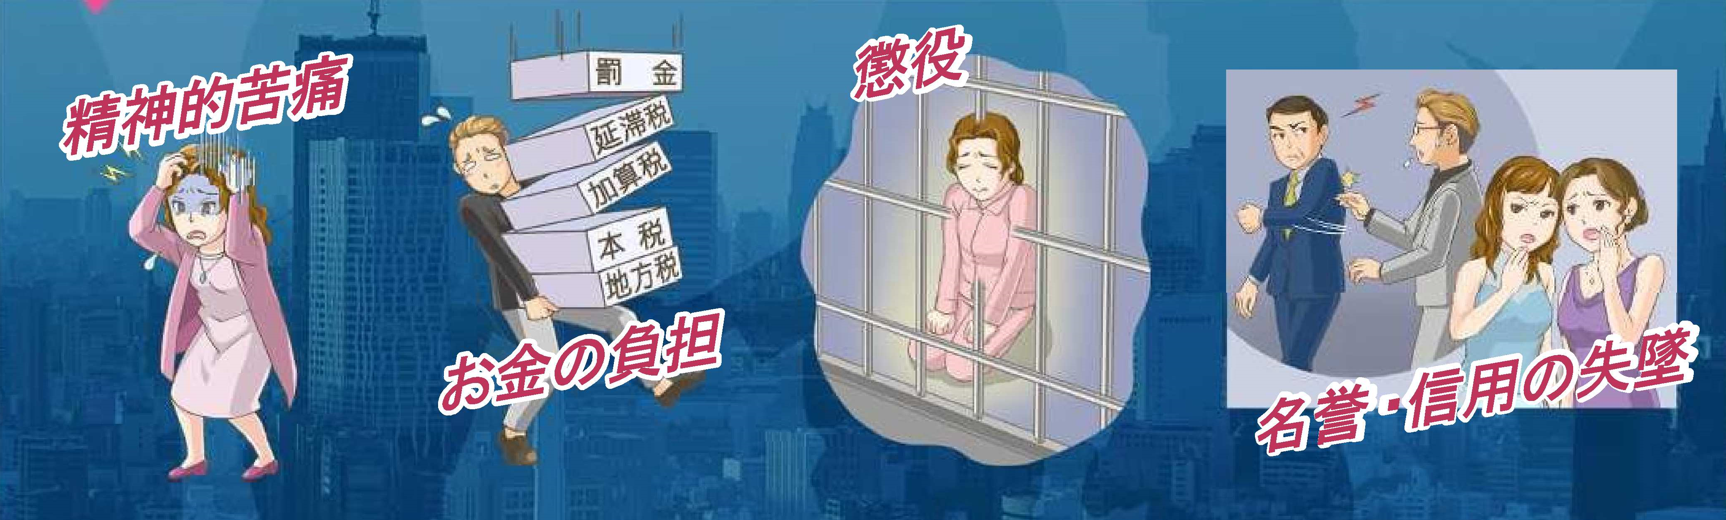
After the Accusation
Investigation by prosecutors
Filing an indictment to a court
Judgement
Mental Distress
Baring Expense
Imprisonment
Destroying one’s
reputation and credibility
Notes:
検察官への告発までが、我々査察調査官の仕事です。
告発以降は検察官によって、捜査・起訴が行われます。
Tax investigator’s job is to handle the case until it is reported to the prosecutor.
After the accusation, prosecutors investigate the tax evasion and file an indictment against the evader in the district court.

Slide 15

Burden of Proofs in Tax Crime
The burden of proof
Structural Elements of the Crime
Typical Defenses made by the suspect
Collection of Evidence
NTA’s Approach
Notes:
続きまして、脱税犯罪の立証責任について説明します。
Next, I would like to explain burden of prrofs in tax crimes.

Slide 16
Burden of Proof
As required in criminal cases, the burden of proof on tax crime cases is also on the prosecutor
Facts that prove the committing of tax crime
Suspicion of tax crime
Prosecutors and investigators must prove, beyond a reasonable doubt, by providing evidence to show that the suspect committed the Tax Crime.
Notes:
日本では、刑事事件における立証責任は検察当局が負うこととなっておりますので、脱税に関しても裁判において立証責任を負うのは、検察当局となります。
In Japan, in every criminal case, the burden of proof is imposed solely on prosecutor. This is the same even in cases of tax crimes.
したがって、国税査察官が脱税事件を検察当局に告発する段階においても、検察当局が公訴を維持できるだけの証拠の有無が問われることとなるのです。
Therefore, even at the stage of where the investigator bring accusations to the prosecutor, investigators must submit the case with reasonable evidence to prove that the case holds enough evidence to sustain conviction.

Slide 17
Structural elements of the crime
Tax Crime
Taxpayer
Guilty action
Result
Cause and Effect
Guilty mind
Notes:
脱税は、刑法上の殺人罪や窃盗罪と同様に犯罪ですから、犯罪を立証するためには、法律が規定する犯罪の成立要件を立証しなければなりません。
Not to mention, tax evasion is also a crime like homicide or theft. To prove tax evasion, certain necessary conditions －structural elements that constitutes the crime－must be shown as specified in the law.
脱税を犯罪として立証するためには、記載の５つの点を証拠によって立証する必要があります。
To prove tax evasion as a crime, you should indicate 5 points as written in this slide by each evidence.
１点目は、税法において、納税義務があると定められた者であるということです。
First point is a Taxpayer, an entity or a person who is defined as a taxpayer in tax law.
2点目の実行行為ですが、これは、「偽りその他不正の行為」があったかどうかということです。具体的には、二重帳簿の作成や、正規の帳簿等の破棄などが、これに該当します。
Second point is Guilty action. Whether or not “deception or other wrongful act” such as making fake ledger or discarding true ledger exist is important factor in this point.
3点目は、結果の発生ですが、これは、「税を免れた」という結果が発生しているかということです。「税を免れた」とは、一般的には、税の収納を減少させる事実があったということとされています。
Third point is Result. Whether those guilty action results in “tax evasion” or not is also important. In this sense, “tax evasion” is an illegal activity in which a person or entity deliberately reduces the amount of tax revenue.
４点目は、因果関係です。税法の規定を踏まえると、「実行行為」と税を免れたという「結果」との間に因果関係が必要であるとされています
Forth point is cause and effect. Based on the provisions of tax law, there must be cause and effect between guilty action and tax evasion.
最後に、故意があったかどうかということです。故意があったというためには、納税義務、不正行為、結果について、全て認識していたことが必要になります
Final point is whether there is intention or not. In order to prove the intension to commit a crime, you must prove that tax evaders should have recognized all of their tax liability, illegal action and results.

Slide 18
Typical defenses made by the suspect
Case1. Denial by claiming other fund sources
Case2. Denial by claiming existence of a transaction
Case3. Denial by claiming no intention
Case4. Obstructing the investigation
Notes:
脱税嫌疑者は、様々な言い訳を次から次へと繰り出し、何とか刑事訴追を免れようとしてきます。言い訳や抵抗の例を４つご紹介します。
Frequently, a suspect of tax evade would make an excuse one after another in order to escape prosecution somehow.
１ 本当は売上の除外で得た資金であるものを、他人から借りた資金であるとか、親から相続した財産であるなどと偽るケースです。
Firstly sales exclusion cases. Tax evaders insist the funds gained by excluding sales money are funds gained by other fund sources like borrowed money from friends or heritage assets from parents.
２ 本当は架空経費であるものを、取引を示す書類がないだけで、実際に取引があったと主張するケースもあります。
Also, in other cases, particularly fictitious expenditure cases. Tax evaders sometimes claim their expenses are true and originally there ware actually transactions but just records do not exist.
３ また、そもそも税を免れる意図はなかったなどと、故意ではないことを主張するケースもあります。このケースにおいては、主張が真実か否か調査を通じて確認しなければなりません。
証拠とともに事実の積み重ねが必要です。
Moreover, sometimes tax evaders claim that they originally has no intention to evade tax from the start.
In this case you have to confirm whether the claims are true or not through investigation and pile the facts with evidence.
４ そのほか、脱税嫌疑者の協力者などに対する調査において、脱税を立証する重要な証拠が捨てられてしまう等の調査妨害に遭うこともあります。
このような妨害に対しては、無予告による臨場調査が証拠収集のために必須となります。
Other than that, there are situations where, during the course of investigation, the accomplices of the suspect obstruct the investigation by concealing or destroying important documents and evidences. Therefore, to avoid such obstruction, it is crucial to conduct the investigation without an advance notice on the suspect.
このほかにも驚くべきエピソードがありますので紹介します。
着手日当日、調査対象法人の実質経営者は、我々の突然の臨場に対し、マンションの15階であったにも関わらず、
ベランダを伝って隣の家のベランダに隠れました。
同人は調査対象法人及び関係会社の印影、預金通帳及び高級腕時計21本をバッグに入れ逃亡を図ったのです。
There are other amazing episodes, so I would like to introduce one of them.
On the day of the starting investigation, in respond to our sudden presence, the beneficial owner of the investigated corporation climbed along the balcony railing and hid on the neighbor’s balcony, despite being on the 15th floor of the apartment.
He tried to escape carrying his bag with seals, banknotes of the investigated cooperation and affiliated cooperation, and 21 luxury watches.
国税査察官は、脱税者の抗弁内容を確認するために、証拠に基づいた事実を証明することが求められることから、関係箇所の一斉調査を強制的に行って、ありのままの真実の証拠を収集する必要があるのです。
Investigators must certify the fact based on the evidence in order to make sure the contents of tax evaders’ plea. Therefore, we have to collect true evidences by conducting compulsory search simultaneously for every places and properties related to the crime.

Slide 19
Collection of evidences
Fraudulent funds
gained by tax evasion
Off-the-book
expense
Japan
【EOI】
Overseas
【Japanese entities】
【Foreign entities】
Income and expenditure
Increase/
decrease
assets
Income and expenditure
Increase/
decrease
assets
Notes:
犯則調査においては、より厳格な証拠収集が求められます。
In a criminal case, stricter evidence collection is required to pursue the criminal responsibility of tax evaders.
特に、脱税により得た不正資金が簿外の経費に充てられていないことを立証するために、それらがどのように費消または留保されているかを把握する必要があります。
①In particular, in order to prove that the funds gained by tax evasion have not been used for off-the-book expenses, we must reveal how such fraudulent funds are consumed or reserved in details.
さらに、調査対象者やそれに関係する法人及び個人の収入・支出、資産の増減を正確に把握することで、それらの者の資金が、調査対象者の簿外の経費に充てられていないことを立証する必要があります。
②In addition, we must prove that the funds are not being used for off-the-book expenses of the Target by accurately grasping the income and expenditure, increase/decrease assets of the Target, the companies and the individuals related with Target.
そのため、我々は国内外における取引や資産について調査する必要があります。国外の情報については、租税条約に基づき情報提供をお願いしております。いつもご協力いただき大変感謝しております。
③For such reasons, we have to investigate their transactions and assets both inside and outside Japan. Regarding overseas information, we request the information in accordance with the exchange of information provisions for our income tax convention.

Slide 20
Collection of evidences
This amount is to be denied if we can not prove that
this is NOT off-the book expense
illicit profit or loss identified by evidence
Fictitious
purchase
Amount of illicit income proved by evidence
Illicit balance identified by evidence
20
Notes:
犯則調査においては、より厳格な証拠収集が求められます。
In a criminal case, stricter evidence collection is required to pursue the criminal responsibility of tax evaders.
特に、脱税により得た不正資金が簿外の経費に充てられていないことを立証するために、それらがどのように費消または留保されているかを把握する必要があります。
①In particular, in order to prove that the funds gained by tax evasion have not been used for off-the-book expenses, we must reveal how such fraudulent funds are consumed or reserved in details.
さらに、調査対象者やそれに関係する法人及び個人の収入・支出、資産の増減を正確に把握することで、それらの者の資金が、調査対象者の簿外の経費に充てられていないことを立証する必要があります。
②In addition, we must prove that the funds are not being used for off-the-book expenses of the Target by accurately grasping the income and expenditure, increase/decrease assets of the Target, the companies and the individuals related with Target.
そのため、我々は国内外における取引や資産について調査する必要があります。国外の情報については、租税条約に基づき情報提供をお願いしております。いつもご協力いただき大変感謝しております。
③For such reasons, we have to investigate their transactions and assets both inside and outside Japan. Regarding overseas information, we request the information in accordance with the exchange of information provisions for our income tax convention.

Slide 21


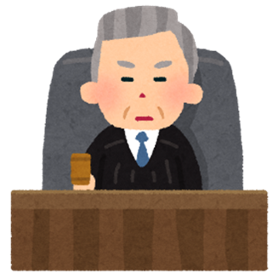
NTA’s Approach
Better understanding of the Law/Legal Procedure
Thorough Inspective Investigation
Stronger relation with other Agencies
Notes:
脱税の手段・方法が複雑・巧妙化している昨今では、脱税方法等の変化に的確に対応していくために多くの課題に取り組んでいます。
In recent tax evasion cases, the means and methods are getting more and more complicated. Therefore, we are now tackling with many challenges in order to respond appropriately to the changes of the methods of tax evasion
裁判は徹底した法的審査であるため、判例、裁判例の研究や、検察官との意見交換を行い積極的に学んでいくことが重要です。
①Trials are done under legal procedure. Therefore, it is important that we fully understand the courts decisions and the case laws. Also, it is important that we create a good relationship with the prosecutors so that we can have an actively exchange and share opinions on a regularly basis with the prosecutors.
一斉調査をより一層効果的に実施するため、徹底した内偵調査を行い、一斉調査の綿密な準備を進め、戦略的な指揮監督による調査を行うことも重要です。
②To carry out the simultaneous investigation more effectively, thorough internal investigation, exhaustive preparation and strategic operations on site must be imperative.
そして、検察庁などの捜査機関と連携し、法的問題の相談、情報・意見の交換を行い、検察官と査察官が合同で捜査を実施することも必要となっています。
③Today, also, cooperation with other law enforcement agencies such as prosecutor’s office is extremely necessary. Consulting legal problems, exchanging information or idea and joint investigation with them become increasingly meaningful action for us.

Slide 22
Status of tax evasion control in Japan
Portion of national tax revenue
Notes:
次に、日本における脱税の取り締まりの状況を説明します。
Next, I would like to introduce current situation of tax evasion control in Japan.
まず、2023年の日本の総国税収入は、約480Billion dollarsで、税目別に収入の割合をご説明しますと、消費税が32.0％と一番多く、次いで個人所得税が30.5％、法人税が22.0％を占めています。
First of all, the gross national tax revenue of Japan in 2023 is 480 Billion dollars and the percentage of each tax are Consumption Tax is on top for 32.0% and Individual Income Tax is in second place for 30.5% and Corporation Income Tax is in third place for 22.0%.
消費税の税収は日本にとって最大となっているため、我々は消費税の調査についても積極的に取り組んでおります。
Since the Consumption Tax Revenue is the largest, we are actively engaged in the investigation.

Slide 23
Status of tax evasion control in Japan
Table 1. No. of our criminal tax cases
 |  | 2021 | 2022 | 2023
No. of Cases Handled |  | 116 | 145 | 154
No. of Cases Disposed |  | 103 | 139 | 151
 | No. of Cases Accused | 75 | 103 | 101
 | Accusation Ratio | 72.8% | 74.1% | 66.9%
Total Amount of Tax Evaded, etc. (Million dollars) |  | 68 | 85 | 80
 | Total Amount Accused | 40 | 67 | 60
Notes:
この表が、日本における査察事件の処理件数です。
Please look at the table 1. This shows the number of our criminal tax cases of each year.
2023年においては、全国の国税局で154件の査察調査に着手しました。
In 2023, we started 154 criminal investigations cases in Japan.
処理件数は151件で、そのうち101件を検察官へ告発し、全国平均の告発率は約67％でした。
and we processed 151 cases and 101 cases were actually brought to public prosecutor’s office, resulting in the ratio of accusation filed reached 67 percent.

Slide 24
Table 2. Status of the judgements in the first instance
Classification |  | year 2021 | year 2022 | year 2023
Judgments |  | 117 | 61 | cases 83
(2) Conviction cases |  | 117 | 61 | cases 83
Convicted persons without suspension of punishment |  | 5 | 3 | person 9
Rate of conviction (%) [(2) / (1)] |  | 100.0 | 100.0 | % 100.0
Per case | Amount of purposely evaded tax | 427 | 314 | ‘000 USD 387
Criminal sanctions (average) | Penal servitude | 15.7 | 13.6 | months 15.6
 | Amount of fine | 100 | 80 | ‘000 USD 100
Notes:
これは、全国の脱税事件に係る2021年から2023年の一審判決状況であり、有罪割合は100％となっています。
This table shows the situation of verdicts at courts of the first instance regarding tax evasion case from 2021 to 2023. In each year, the rate of guilty verdict is 100%.
これで査察制度の概要説明は以上です。
This is the end of my presentation regarding “tax criminal investigation in Japan”.
Thank you for listening.

Slide 25
人的資源スライド 2
Tax crime investigation in Japan
Overview on Japan’s Cash Economy
Tax Crime in Cash Economy
Hidden Cashes

Slide 26
人的資源スライド 8
Banks with private saving accounts
Bank (total）
90.6
City Bank
49.6
Local Bank
52.2
International Bank
0.7
Internet Bank
39.0
Japan Post Bank
72.1
No Bank Accounts
0.4
Source: A excerpt from「Survey report (2021)by Japanese Bankers Association」
0
10
20
30
40
50
60
70
80
90
100
26
Notes:
全国銀行協会のアンケート調査によれば、日本国内居住者の99%超は、いずれか金融機関に預貯金口座を保有している。
According to a survey conducted by Japanese bankers association, almost 100% of Japanese people has any bank account in Japan.

Slide 27

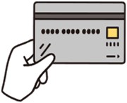



人的資源スライド 4
Impact of cash payments on the shadow economy
Comparison about payment methods by private consumers
（％）
80
70
〜1,000yen
60
1,000〜5,000yen
5,000〜10,000yen
50
10,000〜30,000yen
40
30,000〜50,000yen
50,000～100,000yen
30
100,000yen～
20
10
0
Source: Ministry of finance
Fact-finding survey on
currencies (2023)
Cash
Credit Card
Debit Card
Other IC
ＱＲ・Barcodes
27
Notes:
スライドは個人の決済手段の利用状況比較表ですが、日本では、少額金額の決済の場合は、現金のほか電子マネーやコード決済が多く、金額が大きくなればクレジットカード決済が多くなっている傾向があります。
This slide shows the usage status of individual payment methods. In Japan, as you can see, in the case of small-scale payments, electronic money and code payments are more common, and large-scale payments, credit card payments tend to increase.

Slide 28

人的資源スライド 3
Source: Payments Japan Association「cashless roadmap 2024」
Notes:
また、日本では2018年４月、世界最高水準のキャッシュレス決済比率80％を目指して必要な環境整備を進めることを発表し、2019年には、2025年６月までに、キャッシュレス比率を４割程度とすることを目指すことを発表しました。
In April 2018, Japan announced that it would aim to achieve the world's highest cashless payment ratio of 80%, and in 2019, it announced that it would aim to increase the cashless ratio to around 40% by June 2025.
2018年のキャッシュレス決済比率は約24％でしたが、スライドの表のとおり、2022年には36％まで比率が上昇し、本年３月には約42％と目標を達
成する等、日本のキャッシュレス比率は順調に伸びているものの、世界主要国においては、まだキャッシュレス利用率は低いのが現状です。
The ratio of cashless payments in 2018 was approximately 24%, but as shown in the table on this slide, the ratio rose to 36% in 2022 and in March this year, the ratio achieved its target of approximately 42%. However, our ratio of cashless payment is still lower than other countries.

Slide 29
人的資源スライド 3
Bills and Coins in circulation in Japan
Source: BIS Red Book statistics for CPMI countries
Notes:
他方、我が国は他国に比べて通貨流通高対名目ＧＤＰ比が高くなっており、依然として、通貨流通が多い状況も分かります。
On the other hand, the ratio of currency circulation to nominal GDP in Japan is higher than in other countries.

Slide 30
人的資源スライド 4
Trust
Low-interest rates and cash withdrawal costs
Fewer counterfeit JPY banknotes are detected compared to other major currencies.
\
Interest rates remain low, while cash withdrawal fees are rising, discouraging individuals and businesses from making deposits.
Preparedness for emergencies
Cash as a store of value
Japan experiences occasional natural disasters, which can sometimes lead to IT system failures.
Some people prefer storing their assets physically rather than depositing them in banks.
Why is Cash more prevalent?
30
Notes:
日本では他国と比べ通貨流通が多いところ、現金が好まれる理由は様々あると思料されますが、一般的な理由として、スライドに記載の点が考えられると思料されます。
While there is more currency circulation than other countries in Japan, there are various reasons why cash is preferred, but the general reason is that the points described in the slide are considered.
１点目は紙幣に対する信頼性です。
2021年の数値となりますが、我が国の紙幣流通枚数100万枚あたり、約13枚の偽造紙幣が警察により発見されておりますが、当該数値はユーロ紙幣の1,200枚等と比べ、割合は低くなっており、紙幣に対する信頼性が高いことが挙げられます。
The first point is the reliability of banknotes.
As for 2021, about 13 counterfeit banknotes have been discovered by the police per 1 million banknotes in Japan, but this figure is lower than 1,200 euro counterfeit banknotes, etc. It is highly reliable for banknotes.
２点目は、自然災害時における現金の便利性です。
日本はしばしば自然災害にみまわれますが、その際、インフラ設備がダメージを受け、IT設備等が使えなくなることもあります。そんな際にも、現金は影響を受けず、利用できます。
The second point is the convenience of cash in the event of a natural disaster.
Japan often suffers from natural disasters, but at that time, infrastructure equipment may be damaged, and IT equipment may become unusable. In such a case, cash is not affected and can be used.
３点目は、預金金利の低さ及び現金引出し時の手数料の高さです。
預金をしても金利は低く、他方、出金に係る手数料は高いため、現金でそのまま保有しているという可能性があります。
The third point is the low deposit interest rate and the high commission for cash withdrawal.
Even if you make a deposit, the interest rate is low, and the fee for withdrawal is high, so it is possible that you hold it in cash as it is.
４点目は、現金を預金通帳の数字としてではなく、実体として保管するのを好む人たちもいるということです。
The fourth point is that some people prefer to keep cash as entities rather than as numbers in their passbooks.

Slide 31
人的資源スライド 2
Tax crime investigation in Japan
Overview on Japan’s Cash Economy
Tax Crime in Cash Economy
Hidden Cashes

Slide 32
人的資源スライド 8
Impact of cash payments on the shadow economy
The classical practice of excluding cash sales from tax declarations is still observed during tax audits.
Industries with lower rates of cashless payments continue to rank high in the list of “industries with large unrecorded income per case for individuals with business income”
e.g. restaurants, hostess clubs
32
Notes:
現金取引は、他の決済手段と比べて取引の証拠が残りにくいことが挙げられます。
Cash transactions are less likely to remain evidence of transactions compared to other payment methods.
そのため、税務申告書から現金売上を除外する典型的な脱税手法が、現在においても、税務調査等で把握されている。
Therefore, a typical tax evasion method that excludes cash sales from tax returns is still being understood through tax investigations.
個人事業者における大規模脱税事案では、キャッシュレスペイメントの決済率が低い業種、例えばレストランやキャバレークラブ等の業種がランク上位の位置づけとなっております。
In large-scale tax evasion cases involving sole proprietors, industries with low cashless payment settlement rate, such as restaurants and cabaret clubs, are ranked high.

Slide 33


人的資源スライド 4
Restaurant Industry
System Engineering
Temp agency
How we detect Tax Crimes
33

Slide 34
人的資源スライド 2
Tax crime investigation in Japan
Overview on Japan’s Cash Economy
Tax Crime in Cash Economy
Hidden Cashes

Slide 35
Some cases of hidden assets concealed by tax evaders
Notes:
只今から、脱税した資金の隠匿事例を紹介します。
From now on, I would like to show you some cases of hidden assets concealed by tax evaders.
脱税によって得た利益で蓄積した資金が誰に帰属するか調査することは、脱税の行為者を決定する上で重要になります。
It is important to find out the person who controls illicit funds accumulated by profits from tax evasions through investigation, and that helps identifying who is the actual performer.
資産の名義は、その資産の名義、例えば預金であればその名義人で判断するのではなく、誰がその資産を実質的に支配しているのかで判断しています。
Also, we identify the real owners of those assets not only by nominees of the assets, but also by beneficial owners who ultimately owns those assets.
したがって、資産がどこで発見されたかも重要な要素になります。
Therefore, the locations of discovery should be important factors.

Slide 36
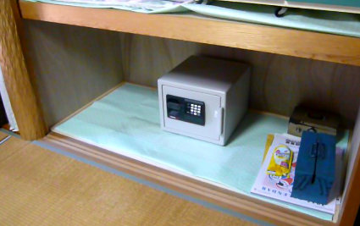
Case（１）－１
A closet in suspect’s house
Notes:
脱税者は脱税した資金を現金で保管していることが、時々あります。
From time to time, tax evaders keep assets gained by tax evasions in cash.
これから紹介する事例は、強制調査時に把握した、現金等の隠匿事例です。
Now, I would like to introduce some cases of hidden assets which we seized on the day of house search with warrant (compulsory day).
事例１は、居宅の押し入れに現金が保管されていました。
In case 1, some cash was hidden in suspect’s closet.
①は、居宅押入れの下段に、金庫が１つ置かれていたのを確認したところです。
Please look at the picture 1. As you can see, this was the moment we seized a safe placed in the bottom of the closet.
ここで、皆さんに質問したいと思います。この事例では、どこに現金が隠されていたか分かりますでしょうか？
I have a question for you. Do you know where the cash was hidden in this case?
正解です。現金は金庫の中にありました。
It's the right answer. The cash was in the safe.
しかしながら、我々は金庫を見つけたからと言って油断してはいけないことを学びました。
However, we have learned that we should not be careless just because we found a safe.
② リモコンを操作したところ、床が上にせり上がってきて、下から隠していた金庫２つが出てきました。
After operating remote control, the bottom of the closet gradually up, then we found two hidden safes.

Slide 37
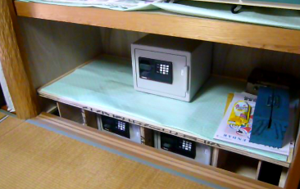
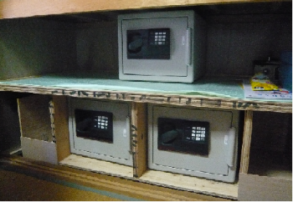
Case（１）－2
A closet in suspect’s house
Notes:
脱税者は脱税した資金を現金で保管していることが、時々あります。
From time to time, tax evaders keep assets gained by tax evasions in cash.
これから紹介する事例は、強制調査時に把握した、現金等の隠匿事例です。
Now, I would like to introduce some cases of hidden assets which we seized on the day of house search with warrant (compulsory day).
事例１は、居宅の押し入れに現金が保管されていました。
In case 1, some cash was hidden in suspect’s closet.
①は、居宅押入れの下段に、金庫が１つ置かれていたのを確認したところです。
Please look at the picture 1. As you can see, this was the moment we seized a safe placed in the bottom of the closet.
ここで、皆さんに質問したいと思います。この事例では、どこに現金が隠されていたか分かりますでしょうか？
I have a question for you. Do you know where the cash was hidden in this case?
正解です。現金は金庫の中にありました。
It's the right answer. The cash was in the safe.
しかしながら、我々は金庫を見つけたからと言って油断してはいけないことを学びました。
However, we have learned that we should not be careless just because we found a safe.
② リモコンを操作したところ、床が上にせり上がってきて、下から隠していた金庫２つが出てきました。
After operating remote control, the bottom of the closet gradually up, then we found two hidden safes.

Slide 38
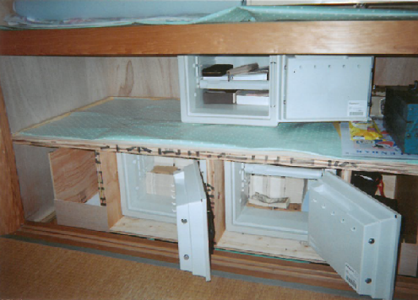
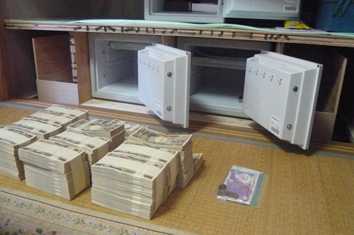
Case（１）－3
670,000 USD
A closet in suspect’s house
Notes:
③は、床が完全に上がり、金庫の扉を開いた状態です。
In picture 3, the bottom of the closet is completely up, and we could open the doors of those safes.
金庫の中には多額の現金が保管されていました。
And a bunch of cash was kept in those safes.
【参考】 【Reference】
金庫の大きさ The size of those safes
内寸：幅31×奥行29×高さ24 Inside dimension：width 31cm×depth 29cm×height 24cm
外寸：幅47×奥行42×高さ35 Outside dimension：width 47cm×depth 42cm×height 35cm
④は、金庫を開いて、現金を出した状態です。
Picture 4 shows the contents of the safes.
もともと見えていた上の金庫には、パスポートと宝石の鑑定書、下の２つの金庫の中には現金が約１億円保管されていました。
There were passport and gem certificate in the upper safe which we found in the first stage of the search, and 670 thousand dollars were kept in those safes secretly under the bottom of the closet.
この押入れのからくりは、査察官の捜索により、移動式床下金庫の設置業者との契約書を発見し、判明しました。
This mechanism of closet was revealed by an investigator who found a contract between the tax evader and an installer who invented this secret safe system.

Slide 39
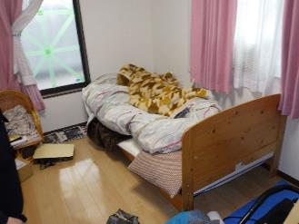
Case（２）－１
A bedroom in a house
Notes:
事例２は、寝室に、現金が保管されていました。
In case 2, there was a cash concealed in a bedroom.
この寝室において、どこに現金が隠されていたか分かりますか？
Do you know where the cash was hidden in this bedroom?

Slide 40
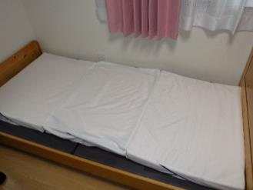
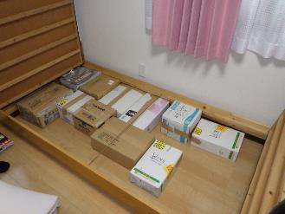
Case（２）－２
A bedroom in a house
Notes:
ベッドを見てください。一見、普通のベッドでした。
Look at the bed. It looks like an ordinary bed, however,
しかしながら、ベッドのマットや床板等をはがして見ると…
once we peeled mattress pad and floor boards…

Slide 41
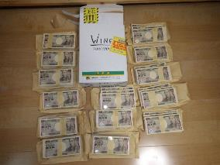
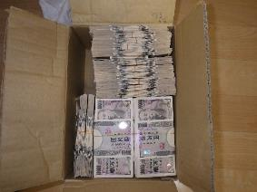
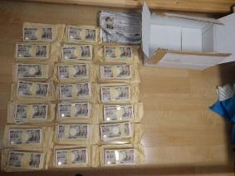
Case（２）－３
Notes:
③ 札束やバラ札がきれいに敷き詰められていました。
As you can see, there were bundle bills and loose bills spread out in good order.
ベッドの下には、全部で約６億円もの現金が保管されていました。
Under the bed, 4 million dollars were concealed.

Slide 42
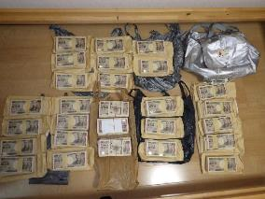
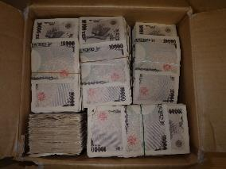
Case（２）－３
Total 4,000,000 USD
Notes:
③ 札束やバラ札がきれいに敷き詰められていました。
As you can see, there were bundle bills and loose bills spread out in good order.
ベッドの下には、全部で約６億円もの現金が保管されていました。
Under the bed, 4 million dollars were concealed.

Slide 43
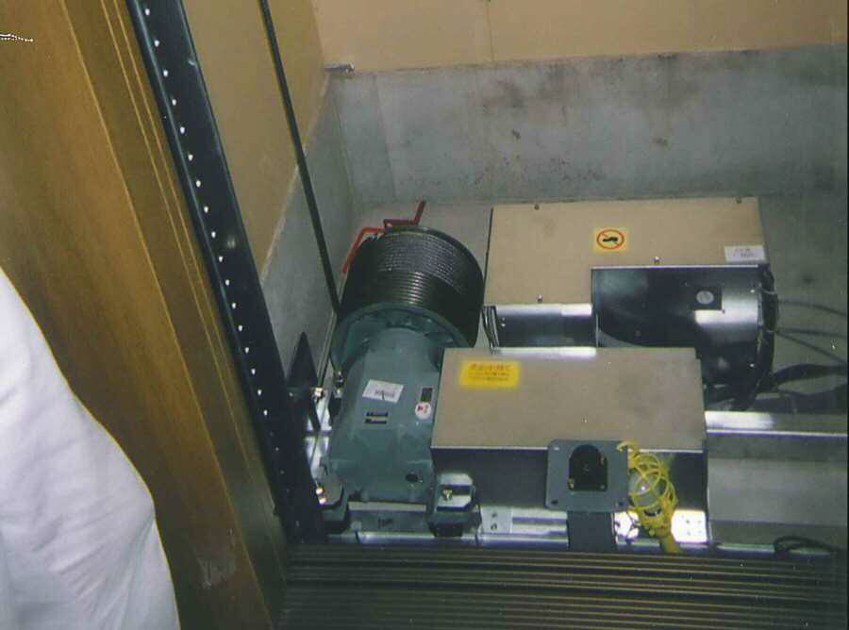
Case （３）-1
In the mechanical device of
the elevator in the suspect’s house
Notes:
事例３は、嫌疑者の居宅に備付のエレベーターの機械装置内に現金を隠していた事例です。
In case 3, suspect concealed cash in the mechanical device of the elevator in the suspect’s house.
① この写真は、嫌疑者の居宅のエレベーターを動かす機械装置です。
Picture 1 is the mechanical device that activates the elevator.
② この機械装置の隙間に、紙袋に入れた現金が隠されていました。
Picture 2, there was the cash in paper bags hidden between mechanical devices.
③ 隠されていた現金は１億5,000万円（約100万米ドル）ありました。
The amount of hidden assets was almost one million dollar.

Slide 44
Case （３）ー２
In the mechanical device of
the elevator in the suspect’s house
1,000,000 USD
Notes:
事例３は、嫌疑者の居宅に備付のエレベーターの機械装置内に現金を隠していた事例です。
In case 3, suspect concealed cash in the mechanical device of the elevator in the suspect’s house.
① この写真は、嫌疑者の居宅のエレベーターを動かす機械装置です。
Picture 1 is the mechanical device that activates the elevator.
② この機械装置の隙間に、紙袋に入れた現金が隠されていました。
Picture 2, there was the cash in paper bags hidden between mechanical devices.
③ 隠されていた現金は１億5,000万円（約100万米ドル）ありました。
The amount of hidden assets was almost one million dollar.

Slide 45
Case（４）－１
A chest under a telephone stand
Notes:
事例４は、嫌疑者の居宅電話台下に置かれた収納箱に、金地金が隠匿されていました。
In case 4, we found gold bullions in the box put under a telephone table in suspect’s house.
① この写真は、嫌疑者の居宅にあった電話台です。この下の部分にガラスの花瓶２個を乗せた収納箱があります。
The picture 1 is the telephone table in the suspect’s house. Under it, there was a box on which there were two flower bases.
② この収納箱を開けると、金地金が隠されておりました。
Picture 2: When we opened the box, there were gold bullions.
③ 隠されていたのは、１キログラムの金地金が10枚、計10キログラム、金額に換算して約3,000万円でした。
Picture 3: There were 10 gold bullions weighted 1 kilogram of each so that in total 10 kilograms of gold bullions worth of about 200 thousand dollars.

Slide 46
Case （４）ー２
A chest under a telephone stand
200,000ＵＳＤ
Notes:
事例４は、嫌疑者の居宅電話台下に置かれた収納箱に、金地金が隠匿されていました。
In case 4, we found gold bullions in the box put under a telephone table in suspect’s house.
① この写真は、嫌疑者の居宅にあった電話台です。この下の部分にガラスの花瓶２個を乗せた収納箱があります。
The picture 1 is the telephone table in the suspect’s house. Under it, there was a box on which there were two flower bases.
② この収納箱を開けると、金地金が隠されておりました。
Picture 2: When we opened the box, there were gold bullions.
③ 隠されていたのは、１キログラムの金地金が10枚、計10キログラム、金額に換算して約3,000万円でした。
Picture 3: There were 10 gold bullions weighted 1 kilogram of each so that in total 10 kilograms of gold bullions worth of about 200 thousand dollars.

Slide 47
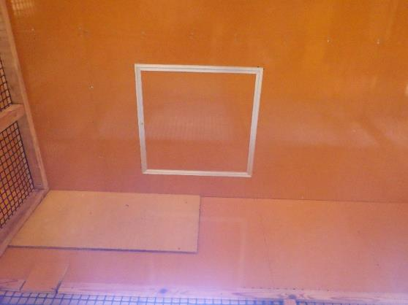
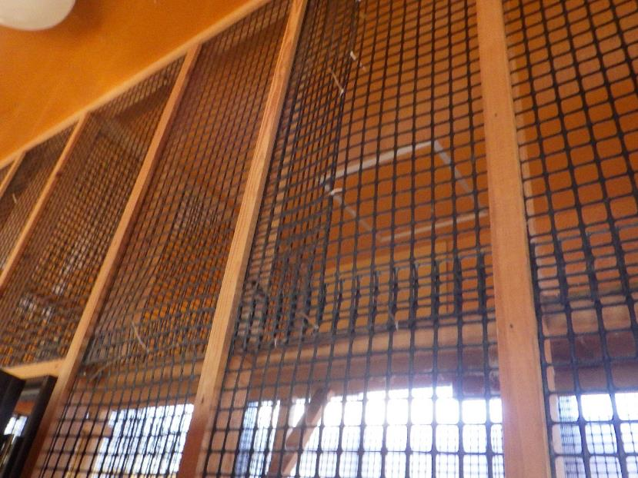
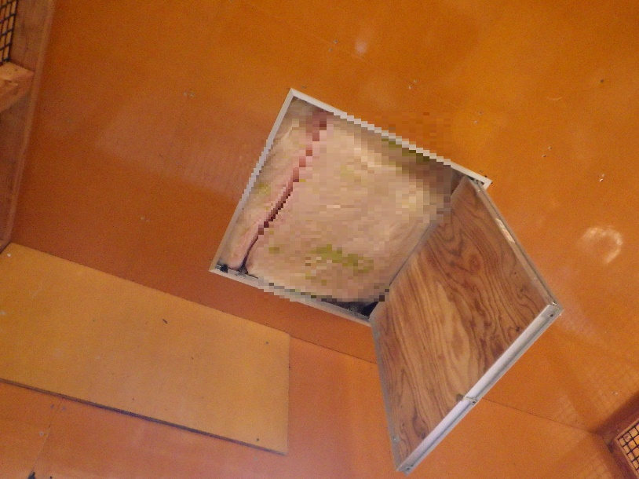
Case（５）－１
A hut in the office premises
Notes:
事例５は、事務所敷地内の小屋に現金が隠匿されておりました。
In case 5, we found a lot of cash in a hut in the premises of the suspects office.
これらの写真は、小屋内、天井の扉を開いたところまでの写真となります。
These photos are the inside of the hut, up to the point where the ceiling door is opened.
ご覧のとおり、入口が断熱材で塞がっていることが確認できます。
As you can see, the entrance is blocked with insulation.

Slide 48
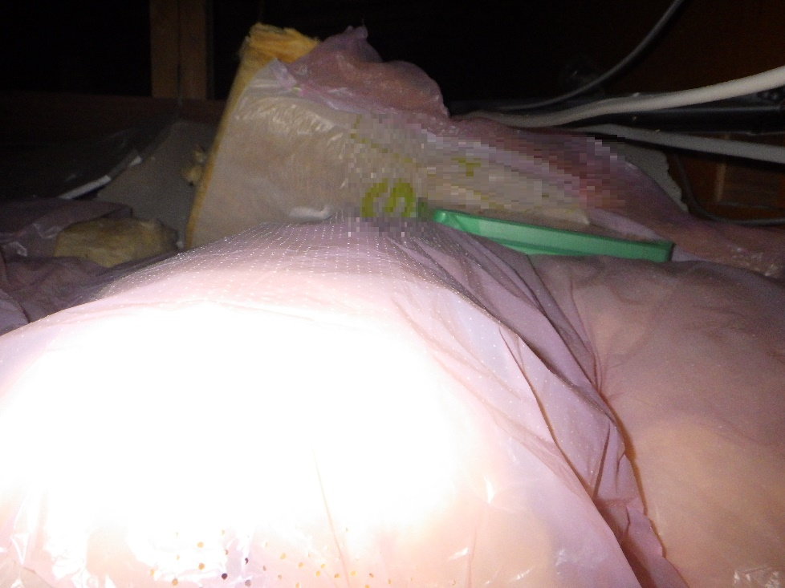
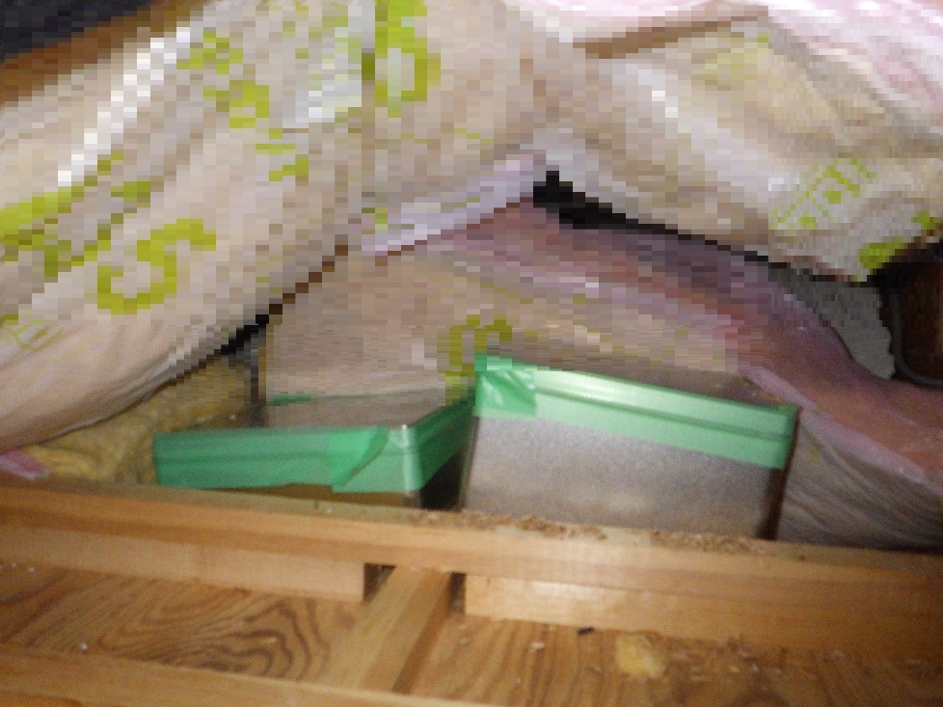
Case（５）－２
A hut in the office premises
Notes:
断熱材を除いて、天井裏に入りますと、左の写真のとおり、緑色の物が確認でき、更に確認しますと、銀色の缶が２つ把握されました。
We removed the insulation and enter the attics, you can see green things as shown in the photo on the left, and if you check it further, you can see two silver cans.

Slide 49
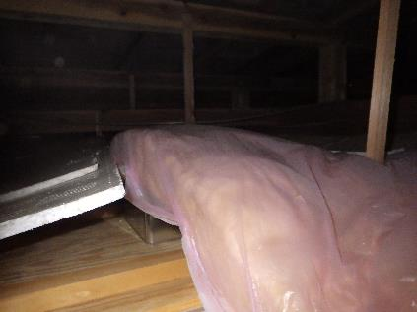
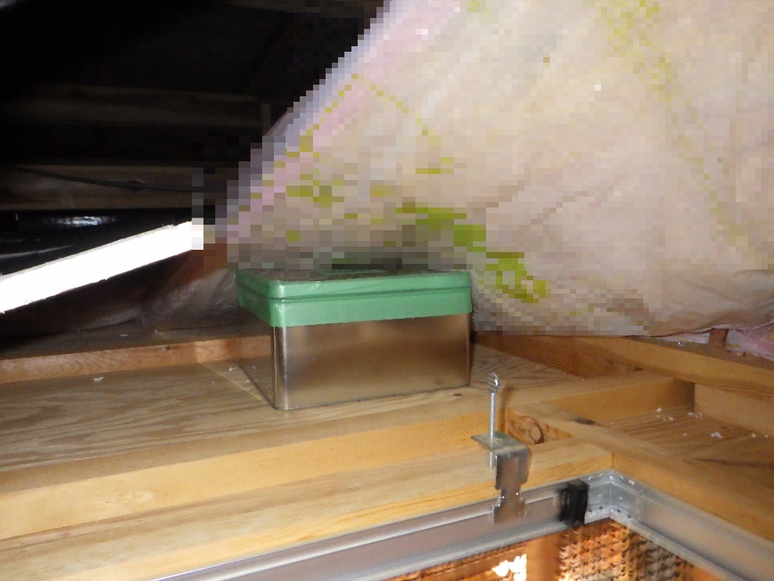
Case（５）－３
A hut in the office premises
Notes:
また、こちらの写真は天井裏を別のアングルから撮影したものであり、断熱材の下から、銀色の缶が一つ把握されました。
In addition, this photo was taken from another angle, and one silver can was found under the insulation.

Slide 50
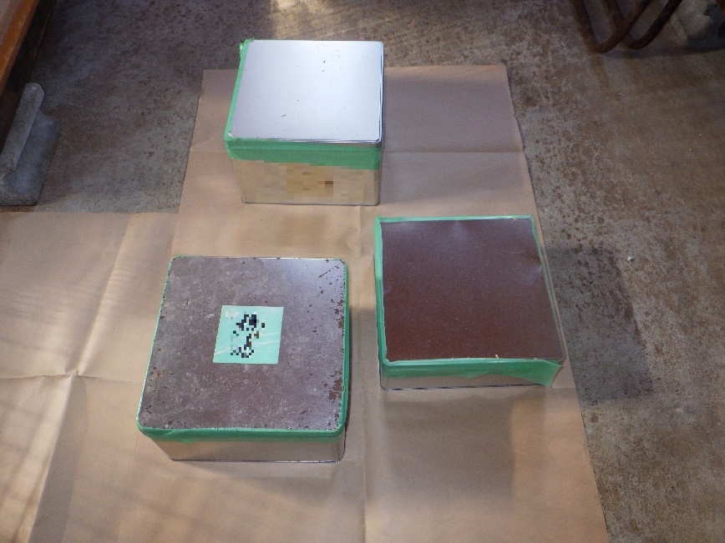
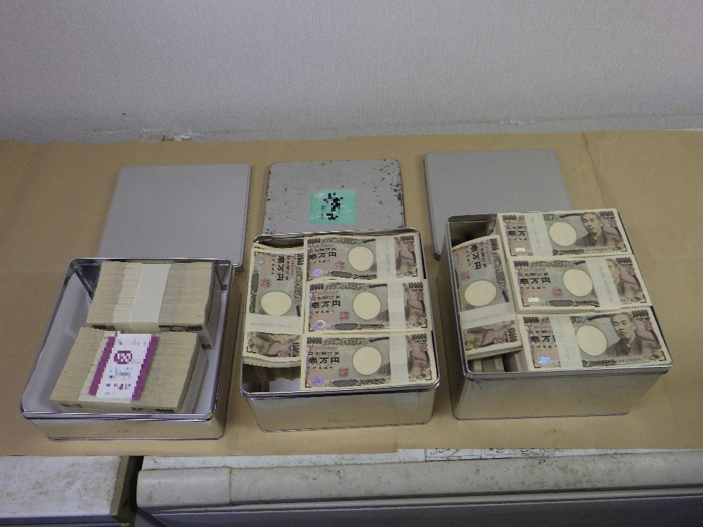
Case（５）－４
660,000 USD
A hut in the office premises
Notes:
写真のとおり、天井裏から３つの缶が発見され、中には現金が入っていました。
As shown in the photo, three cans were found in the ceiling, and cash was inside.
これらの３つの缶には現金が合計約１億円（約６６万米ドル）入っていました。
These three cans contain a total of about 100 million yen (approximately US$660,000).

Slide 51
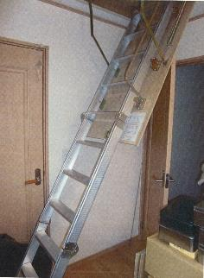
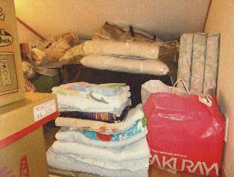
Case（６）- 1
A loft in a house
Notes:
事例６は、居宅屋根裏物置に置かれた鞄の中に現金が隠匿されていました。
In case 6, suspect concealed cash in the bag which is put at the storage of attic.
①は、屋根裏物置へ続く階段を降ろした状態です。
Picture 1 shows that there is a hidden ladder which leads attic.
②は、屋根裏部屋の奥には、隠すように黒い鞄が置かれていました。
At the back of attic, there was a black bag under other things.
③は、鞄の上に置かれていたものを、動かした状態です。
Picture 3 shows the situation of removing other things.
④は、鞄を開けた状態です。いくつもの封筒が入っているのが分かります。
Picture 4 shows there are many envelopes in the bag.
⑤ 鞄の中には18の封筒が入っていました。
It revealed that there was 18 envelopes in the bag.
封筒の中には現金が入っており、合計1,800万円（約12万米ドル）の現金が隠されていました。
There were a lot of cash in the envelopes and the amount of hidden cash was almost 120 thousand dollars.

Slide 52
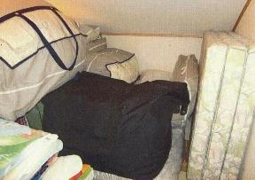
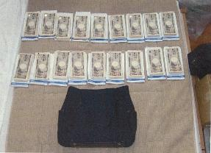
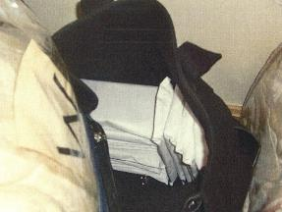
Case（６）ー2
120,000 USD
A loft in a house
Notes:
事例６は、居宅屋根裏物置に置かれた鞄の中に現金が隠匿されていました。
In case 6, suspect concealed cash in the bag which is put at the storage of attic.
①は、屋根裏物置へ続く階段を降ろした状態です。
Picture 1 shows that there is a hidden ladder which leads attic.
②は、屋根裏部屋の奥には、隠すように黒い鞄が置かれていました。
At the back of attic, there was a black bag under other things.
③は、鞄の上に置かれていたものを、動かした状態です。
Picture 3 shows the situation of removing other things.
④は、鞄を開けた状態です。いくつもの封筒が入っているのが分かります。
Picture 4 shows there are many envelopes in the bag.
⑤ 鞄の中には18の封筒が入っていました。
It revealed that there was 18 envelopes in the bag.
封筒の中には現金が入っており、合計1,800万円（約12万米ドル）の現金が隠されていました。
There were a lot of cash in the envelopes and the amount of hidden cash was almost 120 thousand dollars.

Slide 53
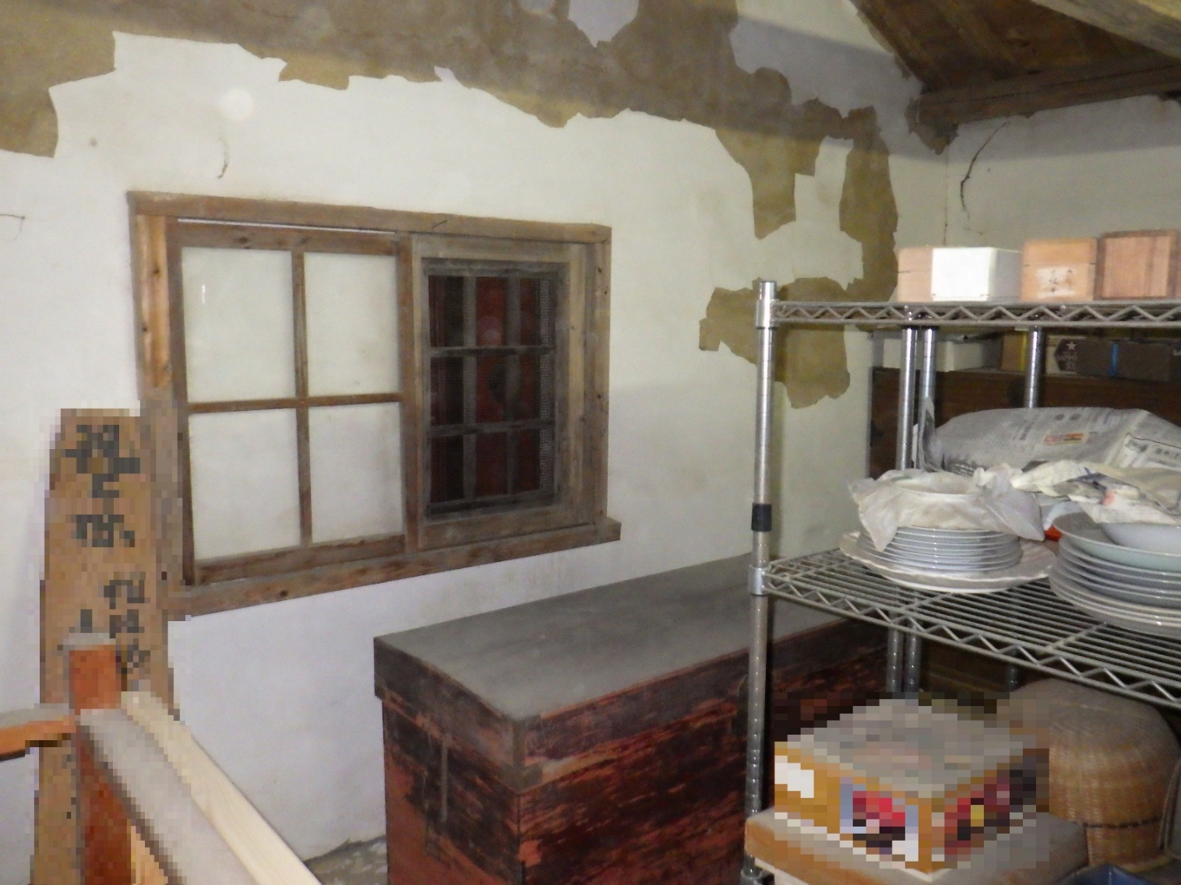
Case （７）－１
In the warehouse
Notes:
事例７は、蔵に現金が隠されていた事例です。
In case 7, cash was hidden in the warehouse.
写真は蔵の中を撮影したものであり、壁側に木箱が置かれていることが確認できます。
The photo is taken inside of the storehouse, and you can see that a wooden box is placed on the wall side.

Slide 54
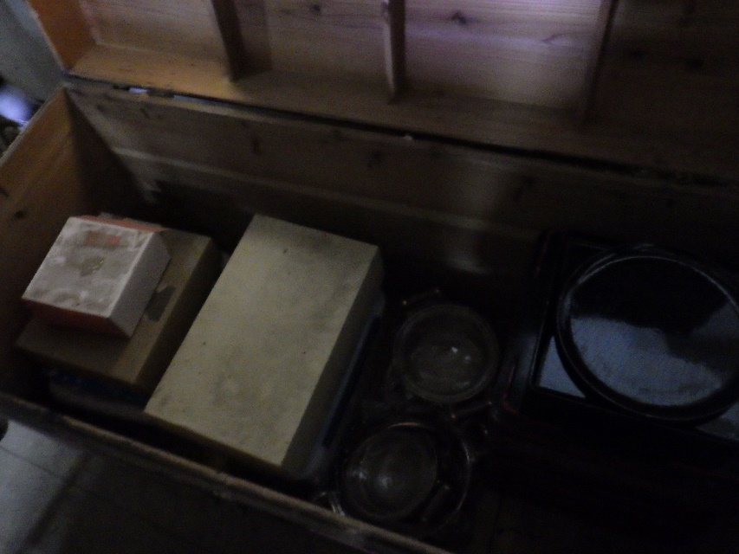
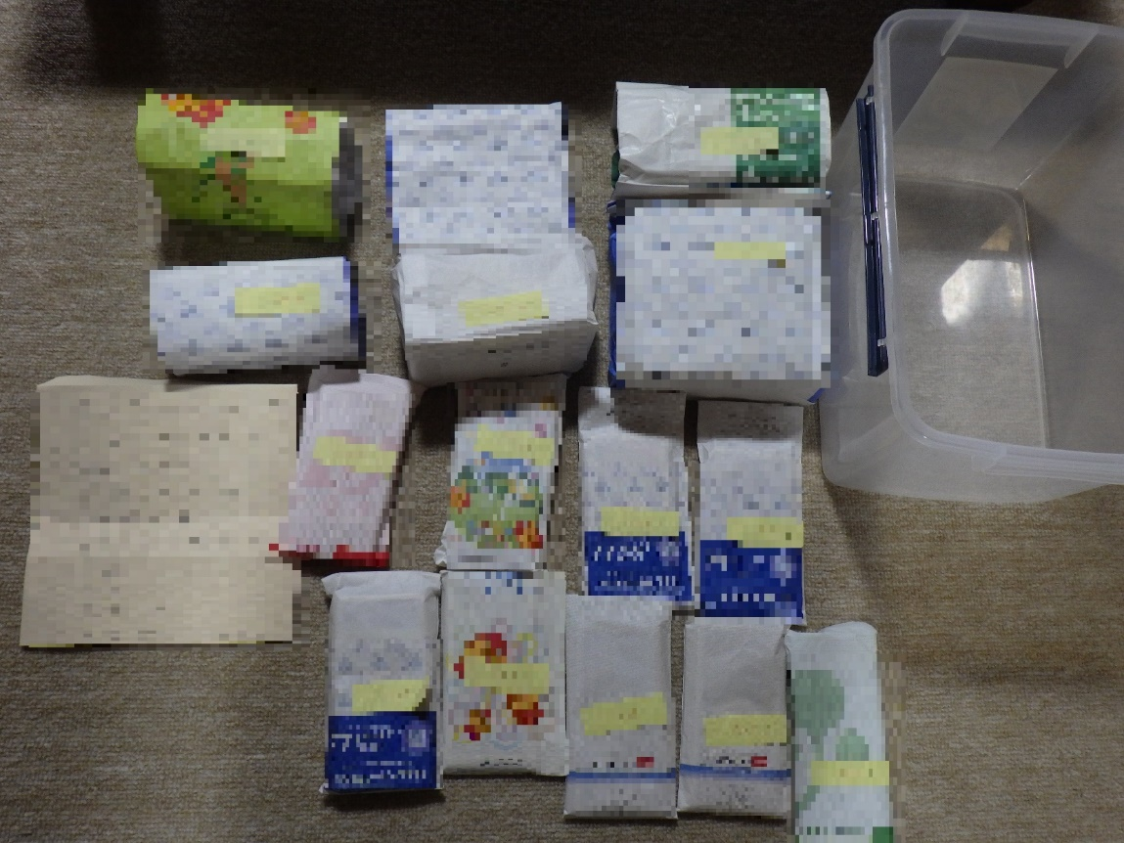
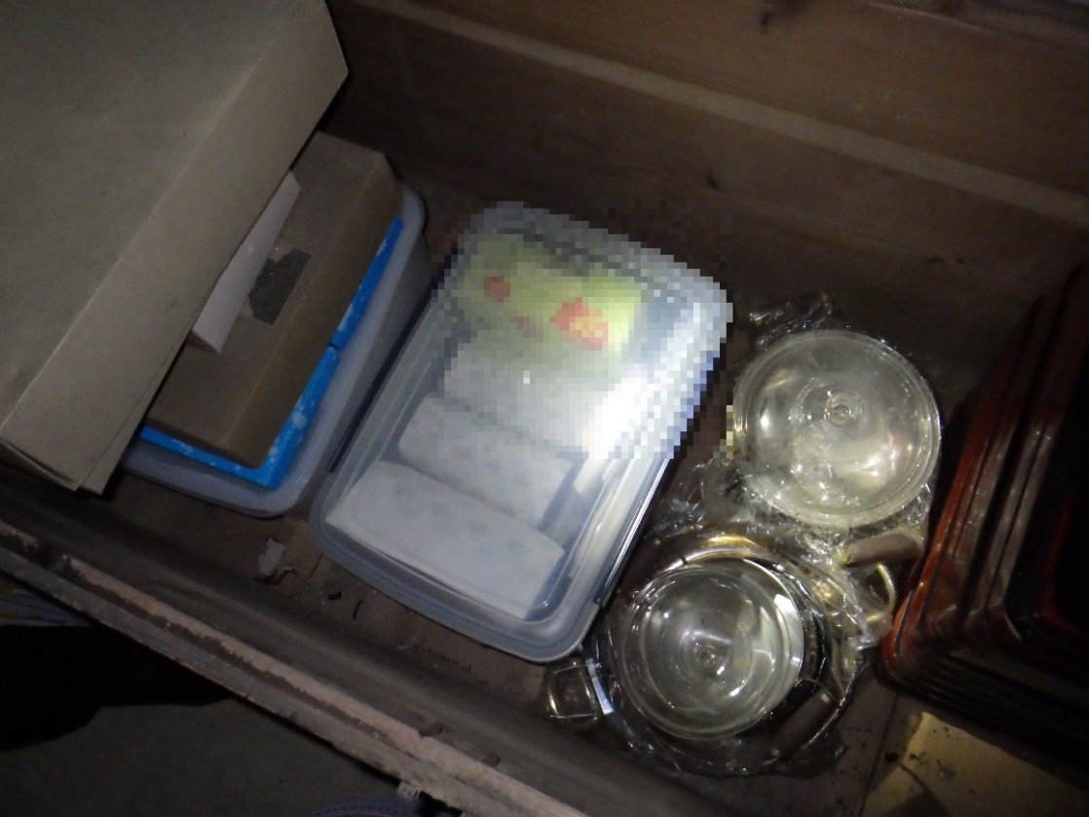
Case（７）－２
In the warehouse
Notes:
木箱を開けますと、中には透明のケースが入っていました。
When I opened the wooden box, there was a transparent case inside.
透明のケースには、封筒が多数入っていました。
In the transparent case, there were many envelopes.

Slide 55
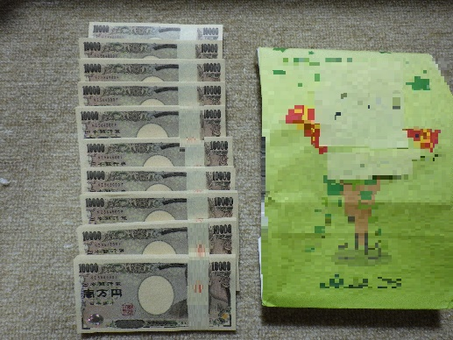
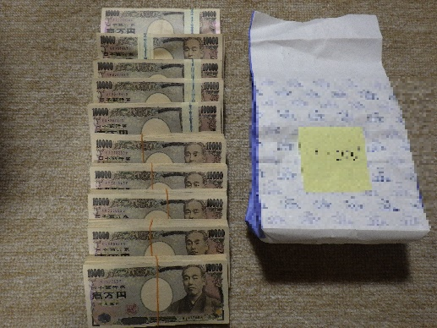
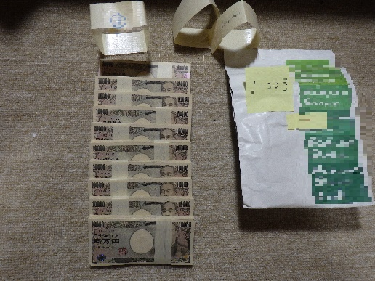
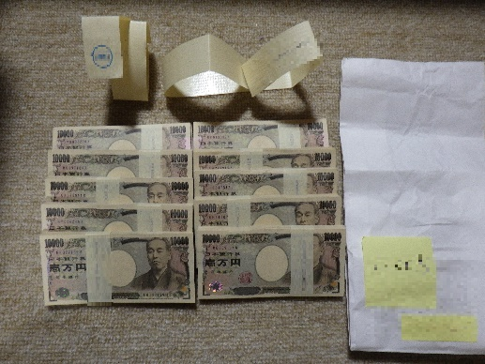
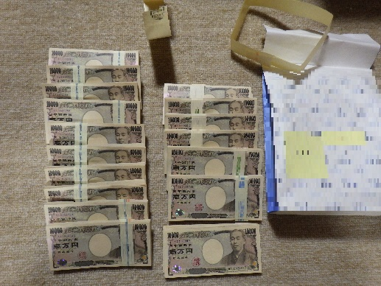
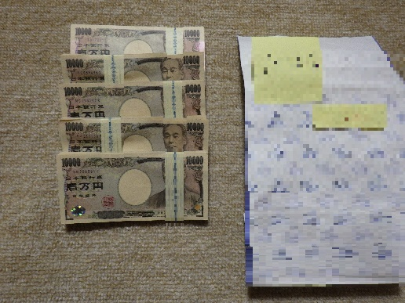
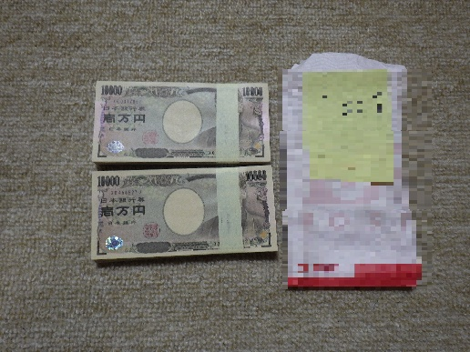
Case （７）－３
270,000ＵＳＤ
Notes:
封筒の中を広げた写真であり、合計約4,000万円（約27万米ドル）ありました。
It was a photo of the envelope, totaling about 40 million yen (approximately US$ 270,000).
その他写真にないものも合わせると、先程の透明のケースには現金約7,300万円（約48万米ドル）入っていました。
In addition to the other items not in the photo, the transparent case mentioned earlier contained approximately 73 million yen in cash (approximately US$ 480,000).
なお、木箱からは、先程の透明ケースの他にもう一つ、透明のケースが確認され、２つ目のケースには１つ目と同様に、封筒が多数入っていました。
In addition, from the wooden box, another transparent case was confirmed in addition to the transparent case, and the second case contained many envelopes as in the first case.
２つ目の透明のケースには現金約6,900万円（約46万米ドル）入っていました。
The second transparent case contains about 69 million yen in cash (approximately US$460,000).
そのため、木箱の中からは合計約１．４億円（約93万米ドル）が把握されました。
As a result, a total of about 140 million yen (approximately US$ 930,000) was found in the wooden box.

Slide 56
Case （８）－１
Under the floor of the suspect’s warehouse
Notes:
事例 ８は、嫌疑者の倉庫の床下にプラスチック製ケースに入れて、現金や金地金を隠していた事例です。
In case 8, suspect concealed cash and gold bars in plastic cases under the suspect’s storage.
①は、嫌疑者の２階建倉庫の１階部分です。床の一部がベニヤ板で覆われています。
Picture 1 shows the 1st floor of two storied storage. There is the specific point in the floor that was covered by plywood.
② ベニヤ板を取り除くと床の一部に切断した後の切れ目がありました。
When we removed the plywood, we found that there were cracks on the floor.
③ 切断された床を剥がすとプラスチック製のケースが入っていました。
Then we took floor plates away along cracks, there were plastic cases under the floor.

Slide 57
Case（８）－２
Under the floor of the suspect’s warehouse
Notes:
④ 床下には大きなケースが３箱、小さなケースが５箱入っていました。
Picture 4 shows that there were three big boxes and five small boxes under the floor.
⑤は、大きなケース１箱分の中身です。現金が入っていました。
Picture 5 shows there is a lot of cash in one big box.
⑥は小さなケース１箱分の中身です。金地金が入っていました。
Picture 6 also shows there are many gold bars in one small box.
⑦ 床下に隠されていた現金は全部で３億円（約200万米ドル）、金地金は全部で50キログラム、金額に換算して１億3,000万円（約89万米ドル）ありました。
The amount of hidden assets was almost 2 million dollars in cash and 890 thousand dollars in golden bars.

Slide 58
Case （８）－3
Under the floor of
the suspect’s warehouse
2,000,000USD
890,000
USD
Notes:
④ 床下には大きなケースが３箱、小さなケースが５箱入っていました。
Picture 4 shows that there were three big boxes and five small boxes under the floor.
⑤は、大きなケース１箱分の中身です。現金が入っていました。
Picture 5 shows there is a lot of cash in one big box.
⑥は小さなケース１箱分の中身です。金地金が入っていました。
Picture 6 also shows there are many gold bars in one small box.
⑦ 床下に隠されていた現金は全部で３億円（約200万米ドル）、金地金は全部で50キログラム、金額に換算して１億3,000万円（約89万米ドル）ありました。
The amount of hidden assets was almost 2 million dollars in cash and 890 thousand dollars in golden bars.

Slide 59
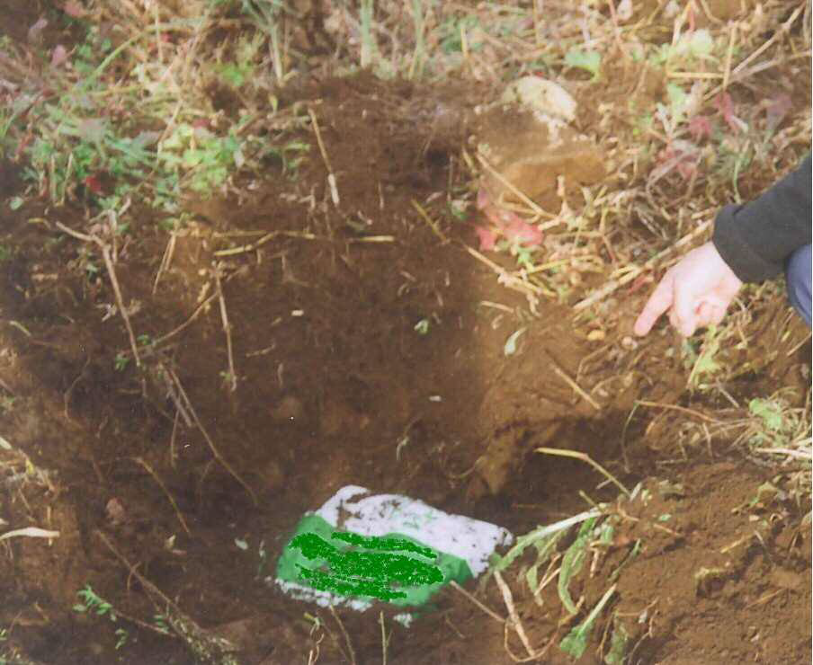
Case（９）-1
In the ground in suspect’s field
Notes:
事例９は、嫌疑者所有の畑の土中に現金を隠していた事例です。
In case 9, suspect concealed cash in soil of field owned by suspect.
① この写真は、嫌疑者が所有する畑を掘り返した状況です。
Picture 1: In this picture, you can see a scene we dug the very field.
② 土中にビニール袋に包んだブリキ缶が埋められていました。
There was a tin can covered by plastic bag buried in the soil.
③ ブリキの缶の中には、現金7,200万円が入っていました。
In the tin can, there was 480 thousand dollars in cash.

Slide 60
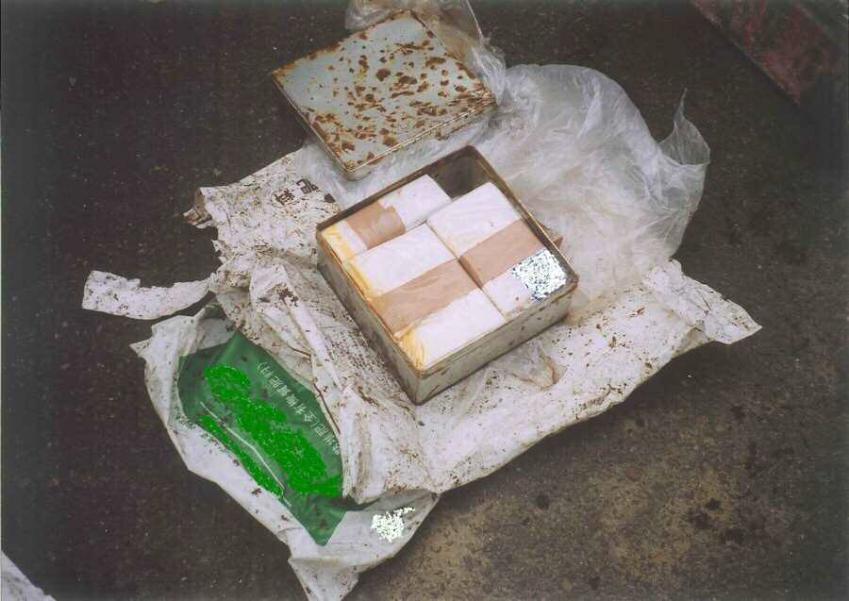
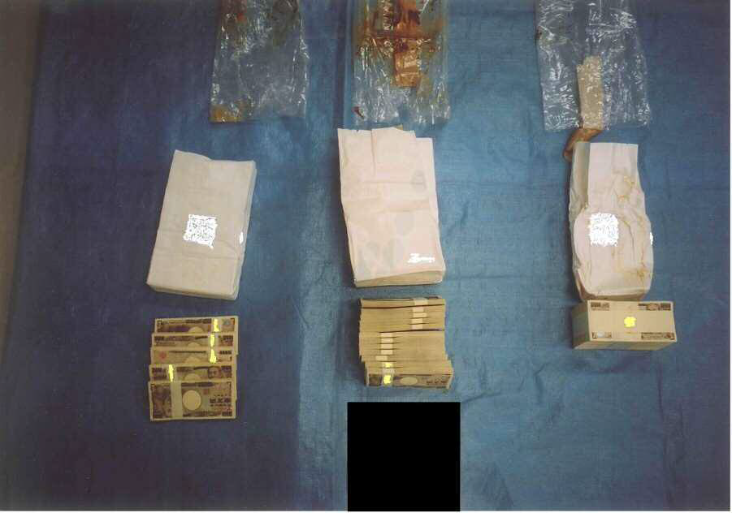
Case（９）ー 2
In the ground in suspect’s field
480,000ＵＳＤ
Notes:
事例９は、嫌疑者所有の畑の土中に現金を隠していた事例です。
In case 9, suspect concealed cash in soil of field owned by suspect.
① この写真は、嫌疑者が所有する畑を掘り返した状況です。
Picture 1: In this picture, you can see a scene we dug the very field.
② 土中にビニール袋に包んだブリキ缶が埋められていました。
There was a tin can covered by plastic bag buried in the soil.
③ ブリキの缶の中には、現金7,200万円が入っていました。
In the tin can, there was 480 thousand dollars in cash.

Slide 61
At the end‥
We never live in the world where honesty doesn't pay.
Thank you for your attention
Notes:
いずれも、徹底した捜索と関係者を追及することで発見したものです。
The results of all cases came from exhaustive search and questioning the people involved by criminal investigators.
以上で説明を終わります。ご清聴ありがとうございました。
That’s all for my presentation, thank you for listening.

Slide 62
人的資源スライド 10
Thank you !

