Slide 1
Compliance Division
Investigative Techniques for the Cash Economy
TOPIC: TACKLING CASH TRANSACTIONS IN FIJI – INDIRECT APPROACH
Presenter:
Shivneet Chand
[Fraud & Evasion]
May 20-2025

Slide 2
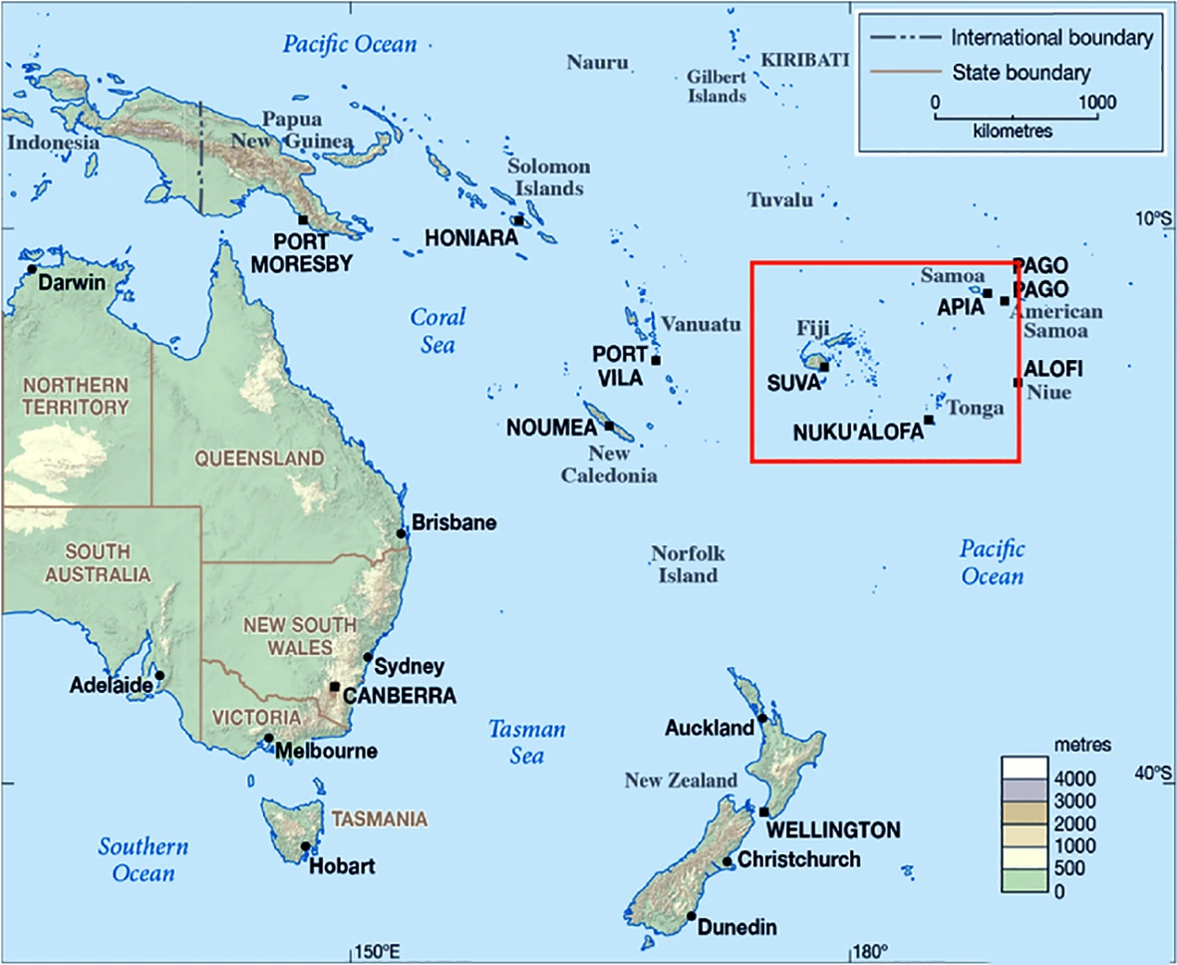
Introduction
Pacific Island Country
Developing Country
Population 930,000
Tax Revenue – USD 1.32 billion
Current revenue target USD 1,44 billion
VAT rate – 15%
Cooperate tax rate – 25%
Notes:
Fiji is a small island country located in the Pacifc Ocean.

Slide 3

Fiji's Cash Economy - A Double-Edged Sword
Cash is integral to daily life, especially in:
  Villages and rural areas
  The informal sector
Advantages of Cash:
  Immediate accessibility –
  Informal sector has quick access.
  Ease of use – traditional method
Challenges of Cash:
  Hinders economic development (less formal financial inclusion)
  Complicates governance (tracking economic activity)
  Increased risk of tax evasion due to lack of digital trails
Notes:
The villages Fiji does not have receptions/network. These individuals do not have smart phones as well. Though after COVID government has been providing subsidy through Mpaisa/My Cash (mobile money services), some prefer withdrawing cash from the service provider as they do not have smart phones make payments through QR codes. In other instances, employers may wages in cash. Usually in informal sectors and where casual laborers are involved.

Slide 4
The Audit Focus - Cash-Intensive Businesses
This presentation discusses a tax audit of a cash-intensive car rental business.
Case identified through Whistleblower.
  Two sales invoice books are kept – to evade tax from the second book sales
  Books are burnt.
Risk profiling was conducted.
Third Party Searches:
  Bank Searches
  Credit providers
  Property search
  Supernation Fund – voluntary contribution
  Mobile service provider – mobile wallet
  Land Transport Authority – Direct Access

Slide 5
The Car Rental Business - Initial Findings
Request: The taxpayer was requested to provide sales reports for 2018-2020.
Taxpayer’s Records: A summary of all cash deposits into the business bank account and cash purchases.
Key Issue 1: "Cash Purchase" Entries: Significant business transactions occurred outside the formal banking system.
Key Issue 2: Off-Book Cash Transactions: Loan repayments were identified as being paid in cash, indicating further financial activity outside the declared sales.
Notes:
Based on the risk profiling we identified it is highly likely that the sales has been underdeclared considering cash business being high risk industry.

Slide 6
Audit Methodology - Tracing the Cash Flow
Identified All Cash Expenses/Payments:
  Profit & Loss statement (P&L) expenses.
  Adjusted for creditor balances to reflect actual cash outflows (cash expenses paid).
  Included all other identified cash payments (loan repayments, proprietor drawings).
Calculated Total Cash Outflows: Summed all the identified cash outflows from Step 1.
Determined Cash Purchases or outflows:
  Compared total cash outflows/payments with total withdrawals from the business bank account.
  The difference represented the amount of cash used for purchases/not declared.
Adjusted Declared Sales: Added the variance (representing undeclared sales) to the initially declared sales to arrive at a more accurate representation of total revenue
Notes:
Indirect audit method

Slide 7
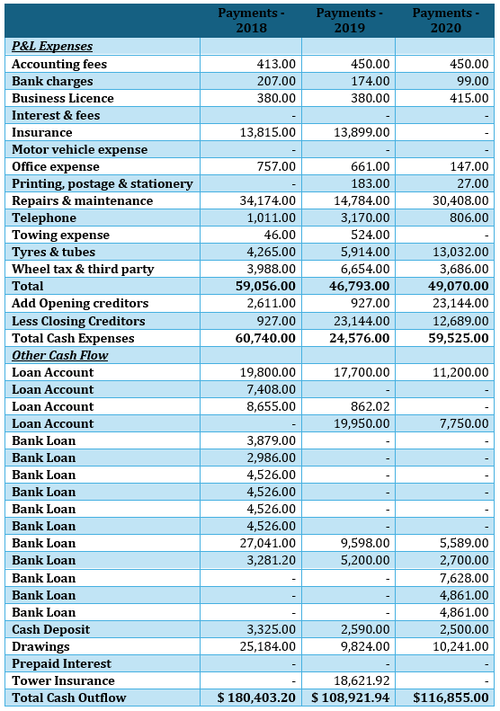
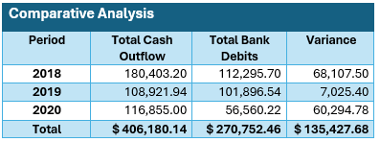
Notes:
The table on the right shows the total cash outflows compared with total bank debits/withdrawals. The variance on the right indicated undeclared sales, that was used by business to purchase.

Slide 8
Key Findings and Implications
The variance indicated significant underreporting of sales revenue.
Implications:
  Tax Evasion: The business was likely evading a considerable amount of tax.
  Poor Record Keeping: hinders tax audit and investigations
  Systemic Issue: There are similar underreporting prevalent in other cash-intensive sectors in Fiji.
  Importance of Indirect Audit Methods: Demonstrates the effectiveness of analysing cash flows to uncover hidden revenue in cash-based economies.
Notes:
The audit revealed a substantial discrepancy between the declared sales (based solely on bank deposits) and the actual economic activity evidenced by the total cash outflows.

Slide 9
Conclusion
This case underscores the challenges and opportunities in auditing cash-intensive businesses in Fiji.
The prevalence of cash necessitates the use of indirect audit methods.
  Increased Audits: Targeted audits of cash-intensive sectors.
  Imposition of Audit penalty – VAT evasion has 200%
  Taxpayer Education: Programs underway to educate businesses on proper record-keeping practices for cash transactions.
  Digitilization: current movement towards digital payments and function, however challenges are being faced.

Slide 10
Thank You

