Slide 1

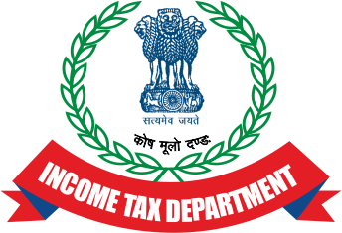

Case summary
By:
Atul Kumar Pandey, IRS
(Indian Revenue Service),
Addl Commissioner of Income Tax,
India

Slide 2
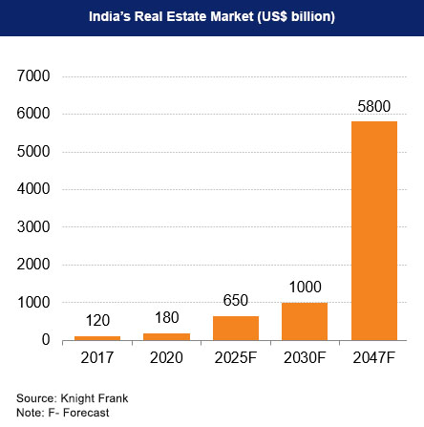
Status of Real Estate sector in India and utilization of Black money.
Increase in the number of real estate projects- commercial and residential in India.
Utilisation of black money in the construction of the projects by the developers.
Investment of the black money by the buyers in the purchase of such properties.
Generation of black money at the hands of developers on sale of the properties

Slide 3
Utilisation of cash/ black money in Real Estate Sector
Particulars | Case-1 (without cash transaction) | Case-2 (with cash transaction)
Sale price per flat | 1,00,000 USD | 1,00,000 USD
Discount given to buyer | - | 5000 USD
Amount payable | 1,00,000 USD | 95,000 USD
White Component | 1,00,000 USD | 75,000 USD
Black Component | 0 | 20,000 USD
Taxes & Duty paid by customer @ 11% | 11,000 USD | 8,250 USD
Total Sale price | 1,11,000 USD | 83,250 USD
Savings made by buyer using black money | 0 | 27,750 USD
Profit declared by Developer (per Unit) – Developer declares less profit to evade taxes in case-2 | 30,000 USD | 5,000 USD
Taxes paid by Developer | 9000 USD | 1500 USD
Savings made by developer by declaring low profit | 0 | 7,500 USD
Net savings ( Tax savings – Discount given to buyer ) | 0 | 2,500 USD
Total Black money with developer ( 100 Units ) | 0 | 2,50,000 USD

Slide 4
White money Part of the sale consideration is disclosed to the Government agencies.
2. Duties and taxes are paid to various establishments on this part only.
1.Black money part of the sale consideration which is neither disclosed to the Government nor tax is paid on this part.
The above arrangement is beneficial to the purchaser, as he gets to utilize his black money amassed in cash which was not declared for taxation and is out of the tax net.
Similarly, this is also beneficial to the seller for generation of undisclosed black money which is again outside the purview of the tax net.

Slide 5
On the basis of strong field input and subsequent discreet enquiry, it was ascertained that the use of cash is being done at a broad gaze in a real estate project by XYZ Private Limited in Uttar Pradesh, India.
Also, the group owning the real estate company has been growing rapidly in a short period of time, with expansion of its business into other businesses which caught the attention.
Real Estate
Jewellery Retail Business
Hotels & Hospitality
Books Publications & Printing business

Slide 6
Reconnaissance & Gathering of evidence
For confirmation, one departmental person was sent to the project office in the guise of a buyer who is willing to make payment in cash.
The manager of the real estate project was contacted regarding all the aspects of cash payment and part of the total payment which can be made in cash.

Slide 7
Such discreet enquiry by the income-tax department not only confirmed the field information, but also provided a clear picture of the quantum of the transactions of undisclosed income in the form of cash in the real estate project.
To unearth this tax evasive practice, an income-tax search action was planned and conducted on XYZ Private Limited and the associated business group.
During the course of the search action, the total movable assets valuing USD 8,39,027/- were seized.

Slide 8
Tax Evasions and Findings
Undisclosed cash and unexplained jewellery that was purchased from undisclosed income.
Parallel books of accounts- The actual books and the manipulated books ( that are submitted to the government for taxation purposes ).
Documentary evidences like receipts of on- money(cash) transactions with regard to the sale of apartments.
Digital evidences demonstrating cash payments.
Statements of the staff of the company that was recorded during the operation, corroborating the digital and documentary evidence.

Slide 9
Continued…
Unrealised Cheques resembling promissory notes that were issued to the customers were found and seized. Once the cash component is paid, the cheques are destroyed by the real estate company.
Digital evidence like mails, chats in messengers supporting cash transactions were found.
Evidence regarding Unaccounted sales and bogus purchases were found.
Unaccounted sales decreases the sales turnover and thus the tax to be paid to the government.
On the other hand, Bogus purchases reduces the net profit and thus the tax to be paid.

Slide 10
Investigation Techniques
Verification of sales and purchases
Verification of the expenses claimed by the company inorder to reduce the net profit.
Valuation of the cash and jewellery found and seized and the source of investment made in those assets.
Use of Digital forensics and analysis of the books of accounts maintained in the digital format.
Other Undisclosed investments like in other businesses, stocks.
Verification of the incriminating data (documentary as well as digital) regarding cash transactions

Slide 11
Inter-agency Cooperation & Case Recovery
Business Data furnished by the XYZ Private Limited to Indirect taxes department was also sought through inter agency co-operation, as sometimes taxpayers furnish different data to different agencies for tax evasion purpose.
On the basis of above enquiries, total unaccounted cash transaction and undisclosed income to the tune of 1,28,46,771/- USD was unearthed.

Slide 12
Thank You

