Slide 1

Tax Evasion Case:
Ms. Diamond

Slide 2

Introduction to the Case
Entrepreneur Profile: Ms. Diamond, is the owner of one of the leading skincare and cosmetics brands in the Philippines(?). She started her business at a young age, initially selling beauty products online before establishing her own brand.
Brand Leadership: She owns a top skincare and cosmetics brand, rapidly growing and shaping regional beauty standards effectively.
Market Impact: Her brand’s significant influence stems from strategic alignments with consumer trends and digital marketing mastery.

Slide 3
Business Background
Founding Story and Timeline: Ms. Diamond launched her skincare business in 2017.
Product Line Specialization: She developed comprehensive skincare and cosmetic products emphasizing quality ingredients targeting young consumers.
Marketing Through Social Media: Her marketing strategy excelled by utilizing influencers and viral campaigns across Instagram, TikTok, and Facebook platforms.

Slide 4
Triggering Event
YouTube Interview Claim: Ms. Diamond declared herself billionaire at 21 during a widely viewed YouTube interview, sparking public interest.
Showcased Luxury Possessions: She prominently displayed luxury cars, designer bags, and high-end jewelry evidencing significant wealth accumulation.
Attracted BIR Scrutiny: This public flaunting of wealth triggered investigation by Bureau of Internal Revenue into her financial declarations.

Slide 5

Initiation of Investigation
NID's Investigative Authority: The National Investigation Division (NID) initiated case examining Ms. Diamond's financial records and public claims.
Formal Preliminary Investigation: NID filed a report establishing preliminary tax evasion allegations, triggering procedural investigation requirements legally.
Preliminary Evidence Review: A thorough preliminary audit was conducted assessing potential discrepancies prior to issuing official investigative directives.
Ms. Diamond

Slide 6
Data Gathering Methods
Social Media Analysis: Investigators meticulously analyzed Ms. Diamond’s social media to track financial status and lifestyle displays.
Review of Public Records: Comprehensive examination of property ownership and income filings.
Interagency Collaboration: Sent letter to the various Government Agencies/Authority to verify or to get list of subject taxpayer’s properties.

Slide 7
Prima Facie Evidence
Income vs. Lifestyle Discrepancy: Ms. Diamond’s declared income starkly contrasts with her lifestyle and asset portfolio, indicating unreported earnings.
Asset Acquisition Analysis: Luxury real estate and vehicle acquisitions exceed income statements, revealing substantial undeclared financial sources.
Financial Reporting Gaps: Documented income underrepresents true cash flow, highlighting deliberate inconsistencies in financial disclosures during audits.

Slide 8
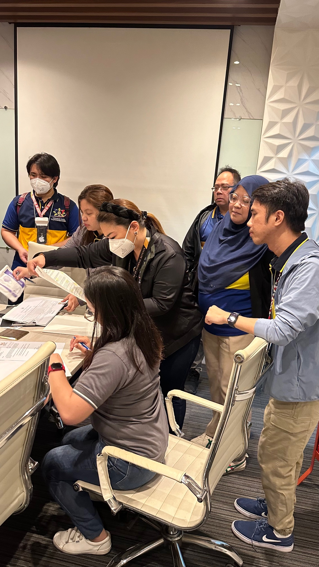
Actions Taken
Letter of Authority (LOA) Issuance: BIR's LOA legally empowers auditors to access taxpayer records and conduct thorough tax examinations.
Mission Order (MO) Purpose: MO authorizes specific investigative missions for surveillance and evidence collection in tax-related probes.
Legal Weight of LOA and MO: Both LOA and MO serve as binding documents ensuring investigatory compliance and validating procedural enforcement.

Slide 9

Surveillance Operation
Comprehensive 60-Day Surveillance: BIR operatives conducted continuous 60-day observation focused on all aspects of Ms. Diamond’s business activities.
Sales Monitoring Techniques: Detailed tracking of daily sales transactions identified volume, customer flow, and revenue patterns consistent with business operations.
Operational Transaction Observations: Investigators recorded cash flow and inventory movement during regular business hours to detect undervaluation and omissions.

Slide 10
Seizure of Documents
Scope of Seizure: BIR authorities confiscated diverse physical and digital records crucial for authenticating financial activities and operations.
Types of Documents: Seized items included accounting ledgers, bank statements, electronic invoices, contracts, and summary of sales.
Investigative Significance: Secured documents provide essential evidentiary basis enabling verification of declared income against actual financial records.

Slide 11
Evidence of Tax Evasion
Underreported Sales Quantification: Analysis revealed only twenty percent of actual business sales were declared, highlighting extensive underreporting.
Electronic Records Analysis: Digital transaction logs contrasted with declared income exposed deliberate omission of substantial revenue streams.
Implications of Findings: Discrepancy magnitude strongly supports intentional tax evasion, influencing subsequent assessment and legal proceedings.

Slide 12
Outcome of the Case
Notice of Discrepancy(NOD)/Preliminary Assessment Notice Issued(PAN): The Bureau of Internal Revenue formally issued NOD and PAN showing assessment amounting to ₱1.2 billion (21.5 Million USD or 3 Billion Yen) tax deficiency against Ms. Diamond.
Settlement and Compliance: Ms. Diamond agreed to settle the substantial tax deficiency, reflecting acknowledgment of tax obligations amid investigation conclusions.

