Slide 1
Organized Crime Groups
Victoria Merchán

Slide 2


Definition of
Organized Crime
The Convention against Transnational Organized Crime, better known as the Palermo Convention, is a multilateral treaty sponsored by the United Nations against transnational organized crime, it was adopted on December 15, 2000, and held in the city of Palermo, Italy. It currently has 190 member States of the 193 members of the United Nations.
“Organized criminal group” means a structured group of three or more persons existing for a period of time and acting in concert with the purpose of committing one or more serious direct crimes or offenses established in accordance with this Convention with a view to obtaining, or indirectly, an economic or other material benefit”

Slide 3

Palermo in Venezuela
United Nations Convention Against Transnational Organized Crime
Is a legally binding instrument for the Venezuelan State, which results in compliance with the provisions on the matter
It entered into force through the Official Gazette No. 37,357 of January 4, 2002
Organic Law against Organized Crime of Official Gazette No. 5789 dated October 26, 2005.
Repealed by the Organic Law against Organized Crime and Financing of Terrorism of Official Gazette No. 39,912 dated April 30, 2012.

Slide 4

LOCDOFT
Article 4, establishes Organized Crime as:
“The action or omission of three or more persons associated for a certain time with the intention of committing the crimes established in this Law and obtain, directly or indirectly, an economic gain or benefit or of any kind for themselves or third parties. Likewise, organized crime is considered as the activity carried out by a single person acting as an organ of a legal or associative person, with the intention of committing the crimes provided for in this Law.”

Slide 5

ONCDOFT
The LOCDOFT, in its Article 5, reads:
“The National Office against Organized Crime and Terrorism Financing is the governing body in charge of designing, planning, structuring, formulating and executing public policies and strategies of the State against organized crime and Terrorism Financing, as well as the organization, that controls and oversee at a national level of everything related to the prevention and suppression of said crimes, and also international cooperation in this matter.”

Slide 6
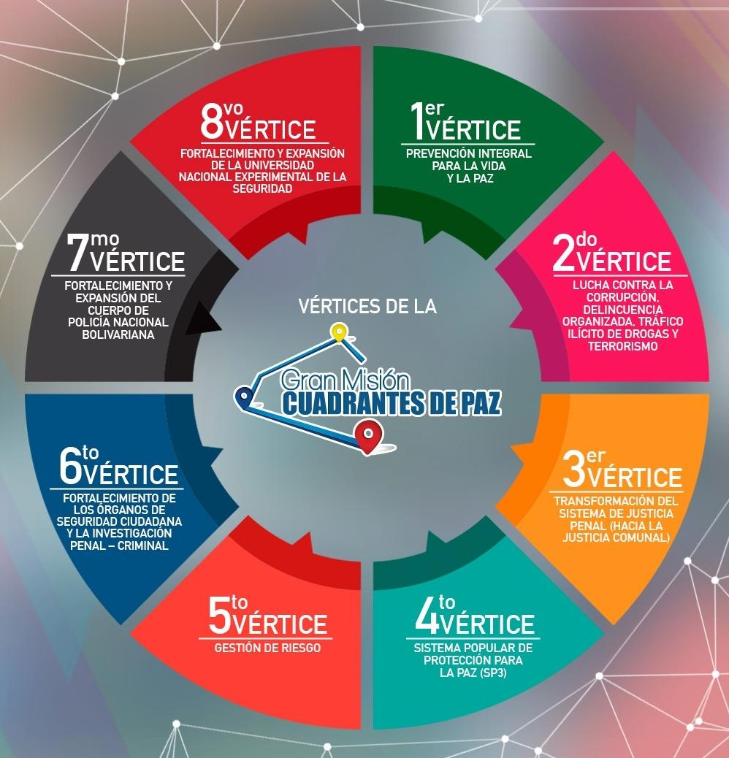
Great Mission Quadrants of Peace

Slide 7




National Plans
The following are contemplated in Vertex 2 of the Great Mission Quadrants of Peace:
National Plan Against Corruption
National Anti-Drug Plan.
National Plan Against Criminal Gangs
National Plan Against Terrorism
National Plan Against Trafficking in Persons and Illicit Smuggling of Migrants.
National Anti-kidnapping Plan.
National Plan Against Computer Crimes.
National Plan Against Robbery, Theft and Trafficking of Resources or Strategic Materials.

Slide 8

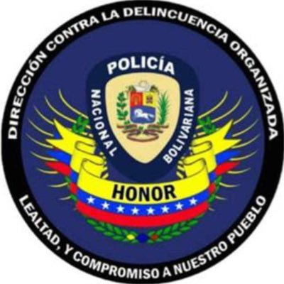
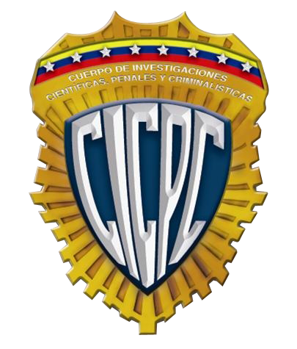
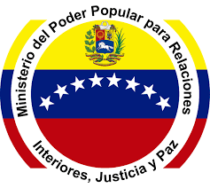
Organisms with competence in the matter
Ministry of People's Power for Internal Relations, Justice and Peace
Ministerio Público (Attorney General’s Office)
Supreme Justice Court
National Anti-Drug Superintendence
Anti Corruption Superintendence
Vice Ministry of the Integrated Criminal Investigation System (Visiip)
National Office against Organized Crime and Terrorism Financing (ONCDOFT)
General Directorate of Military Counterintelligence (DGCIM)
Body of Scientific and Criminalistic Investigations (CICPC)
Bolivarian National Police Corps (CPNB)

Slide 9
Thank you!
Victoria Merchán
victoriamerchan.oncdoft@gmail.com

