Slide 1
Digital techniques:
Margin comparison
Gains comparison
Business figures
Cost structures compared – eg employees - turnover
Special different business database- crosschecks

Slide 2
Digital Techniques:
Margin comparison
Gains comparison
Business figures at all
Cost structures compared – eg employees visa turnover
Special different business database- crosschecks of databases

Slide 3
Other / New Digital Techniques:
Visualization of business figures
Technical check tools / for failure detection out of high volume data bases – Monetary Unit Sampling
Summarised Risk Audit (SRP) based on the principle of a
„Time Series Analyses“

Slide 4
Examples for Other / New Techniques :
Definition MUS – Monetary Unit Sampling:
MUS
Monetary Unit Sampling, also known as probability proportional-to-size (PPS) or dollar unit sampling (DUS), is a statistical sampling method used to determine if the account balances or monetary amounts in a population contain any misstatements. Each individual dollar (i.e. monetary unit) in the population is considered a sampling unit, thus account balances or amounts in the population with a higher value have a proportionately higher chance of being selected.

Slide 5
Examples for Other / New Techniques:
Definition SRP Summarized Risk Audit
SRP = Time Series Analysis
Any metric that is measured over regular time intervals forms a time series. Analysis of time series is commercially importance because of industrial need and relevance especially w.r.t forecasting (demand, sales, supply etc).

Slide 6
Examples for Other / New Techniques:
SRP Summarized Risk Audit
Case example
Hotel with restaurant
Outside area
Christmas celebrations
New year celebrations
Additional participation on different markets

Slide 7
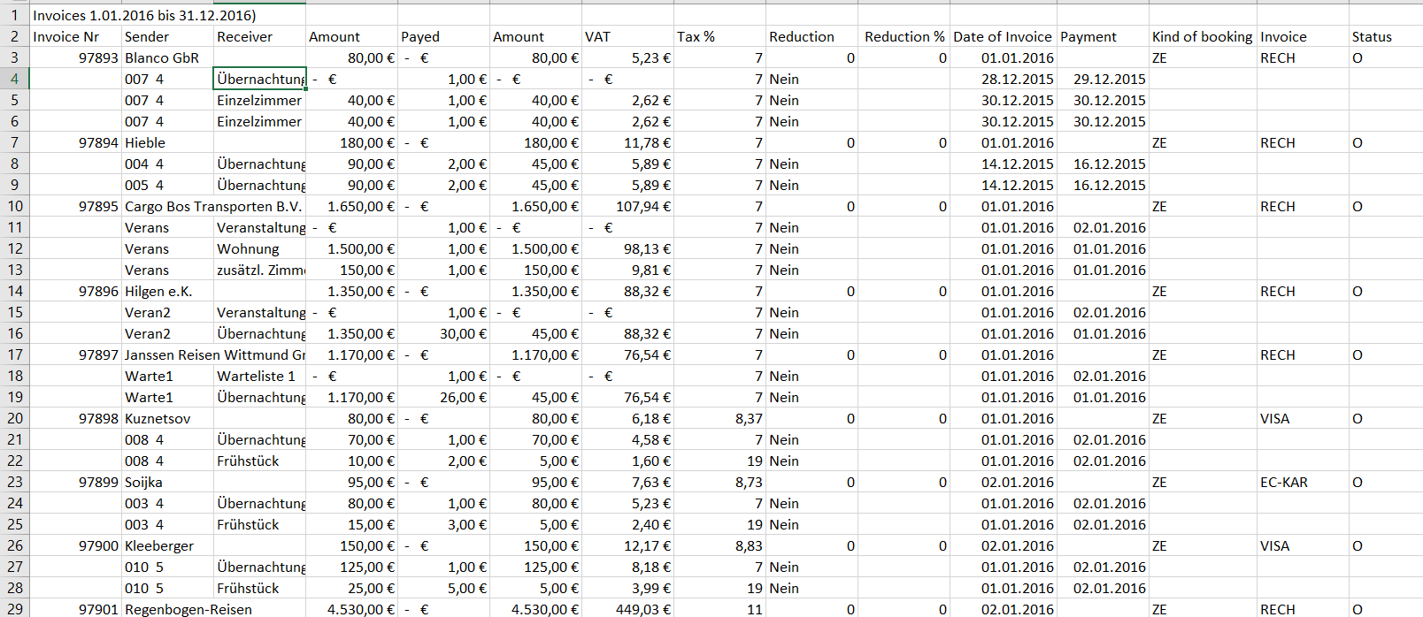
Examples for Other / New Techniques:
SRP Summarized Risk Audit
Invoice database out of hotel software

Slide 8
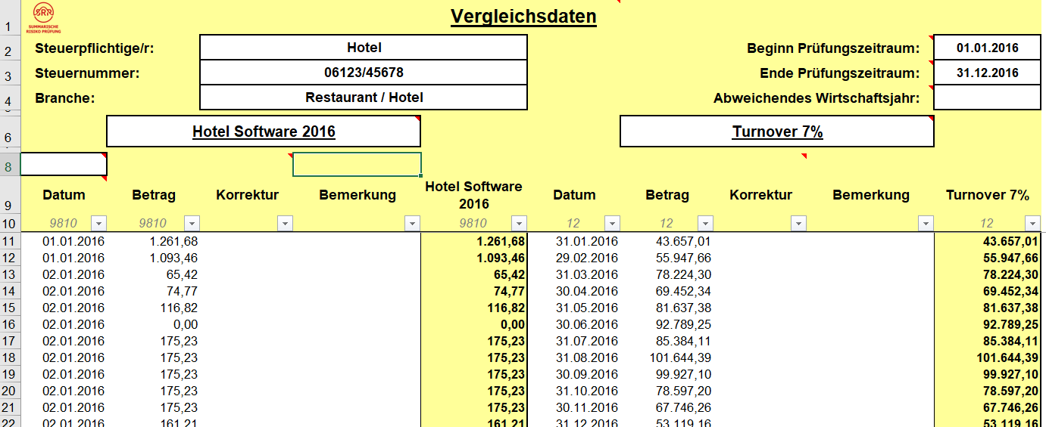
Examples for Other / New Techniques:
SRP Summarized Risk Audit
Invoice database out of hotel software
Import in summarized risk audit tool

Slide 9
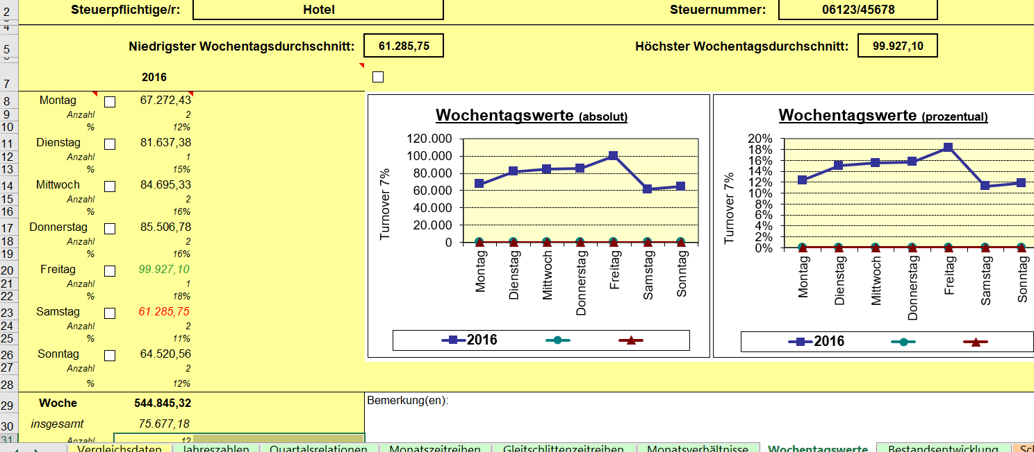
Examples for Other / New Techniques:
SRP Summarized Risk Audit
Invoice database out of hotel software
Import in summarized risk audit tool

Slide 10
Examples for Other / New Techniques:
SRP Summarized Risk Audit
Indicators
Reduced turnover on weekends
Usually busiest time for hotels in tourist areas
Restaurant evaluation:

Slide 11
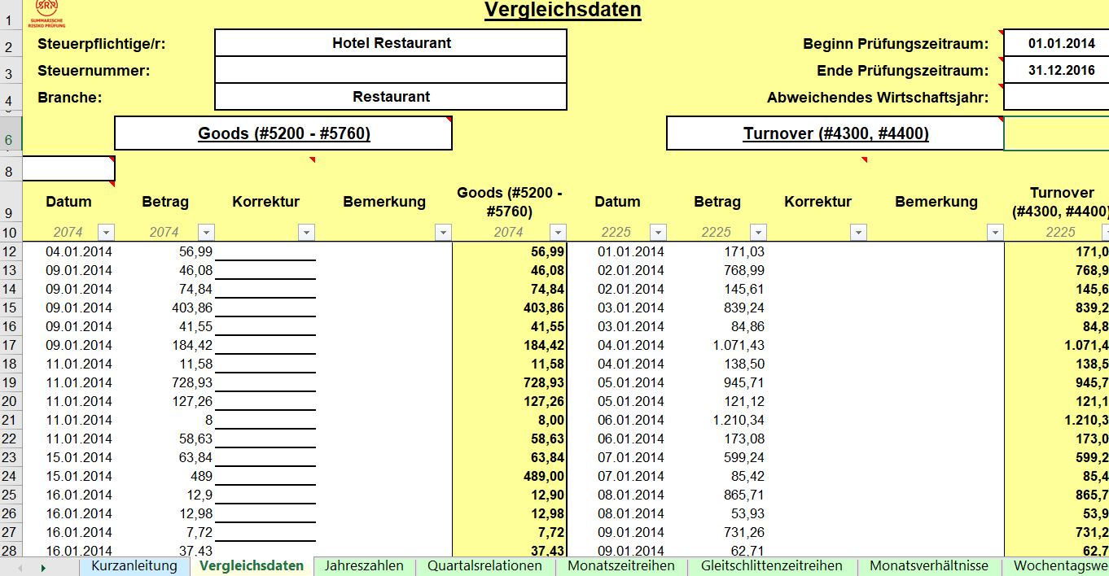
Examples for Other / New techniques:
SRP Summarized Risk Audit
Restaurant Data

Slide 12
Examples for Other / New techniques:
SRP Summarized Risk Audit
Evaluation based on time series analysis
Time series analysis
Average margin comparance
Cutting the pics 16 %
Calculation of available goods
RESULT:
No goods available for turnover ????

Slide 13
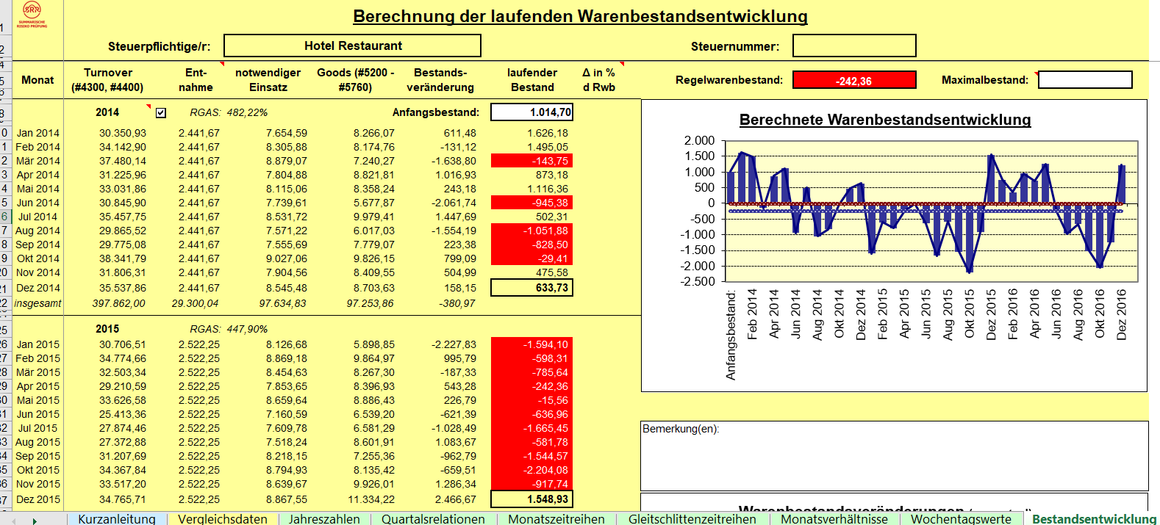
Examples for Other / New techniques:
SRP Summarized Risk Audit
Evaluation based on time series analysis

Slide 14
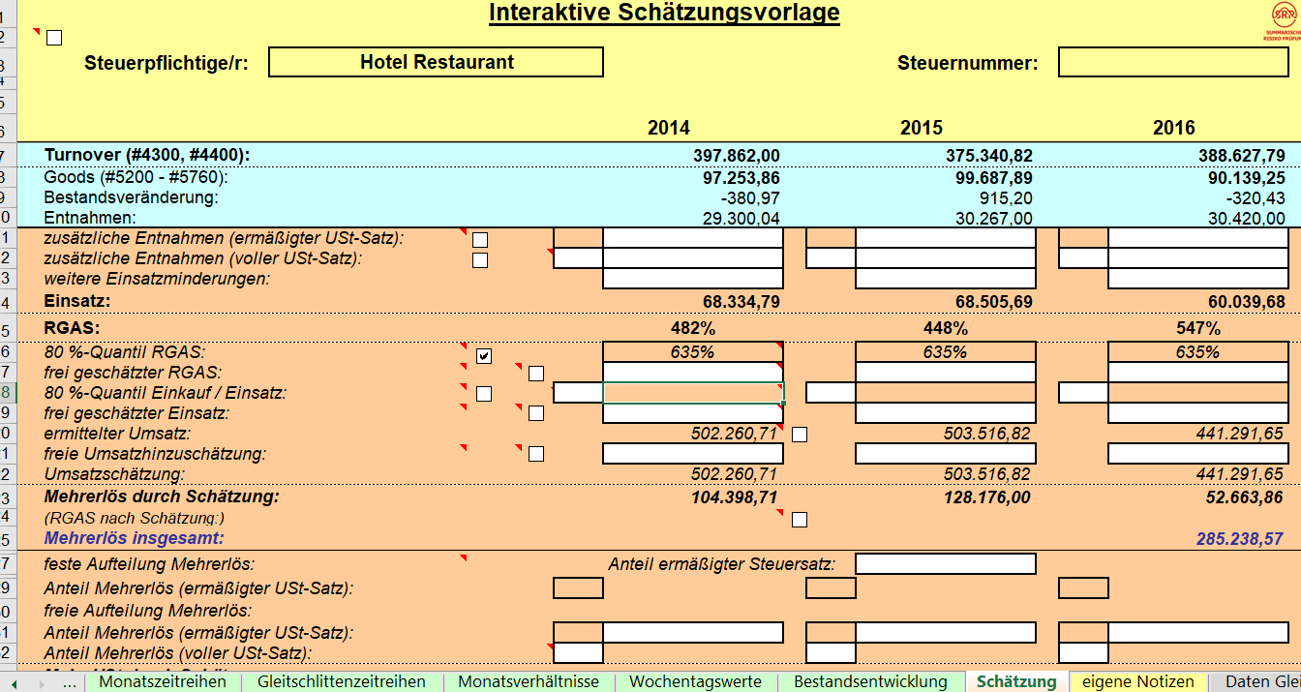
Examples for Other / New Techniques:
SRP Summarized Risk Audit
Estimation of turnover based on time series analysis – more € 285.238,57

Slide 15
Examples for Other / New Techniques :
Visualization of data
Visualization is often excel based or other software / a tool to visualize different figures / data sources in relation to each other in various diagrams

Slide 16
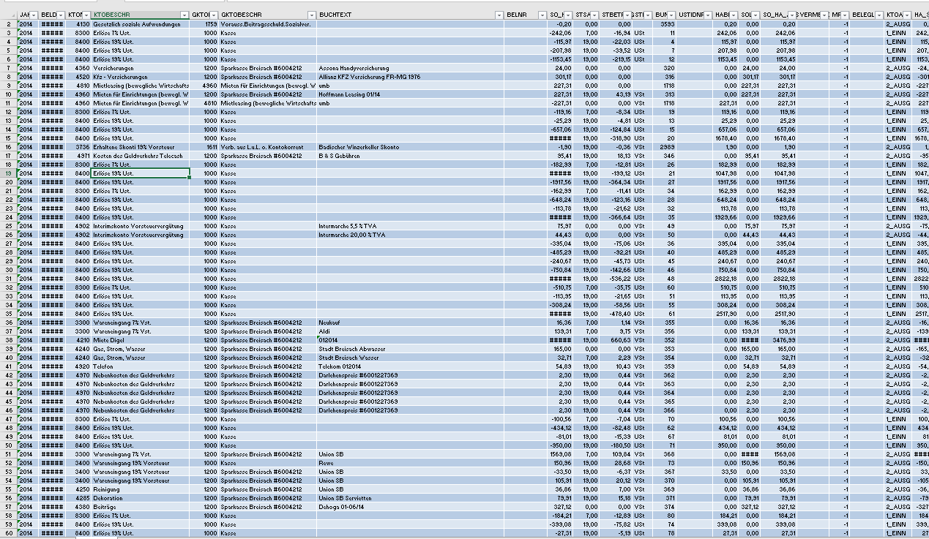
Examples for Other / New Techniques :
Visualization of data – Bookkeeping Data

Slide 17
Examples for Other / New Techniques :
Visualization of data – problems?
420.000 data sets?
How to explore?
Where to start?
Searching?
What kind of parameters?
Where are the indicators?

Slide 18
Examples for Other / New Techniques :
Visualization of data – example
Restaurant
Outside area
Christmas celebration
New year celebrations
Additional participation on different markets
No remarkable changes in business (same size, … employees, … suppliers….)

Slide 19
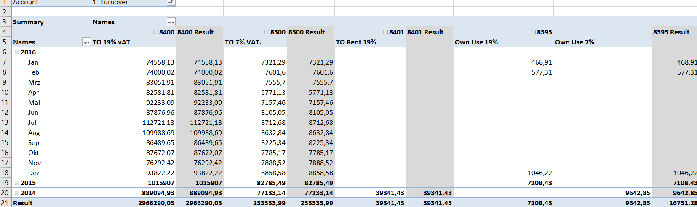
Examples for Other / New techniques :
Visualization of data
Edit data

Slide 20
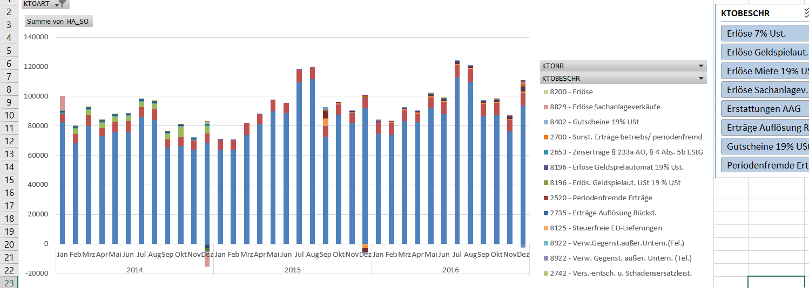
Examples for Other / New Techniques :
Visualization of data
Edited data – visualized

Slide 21
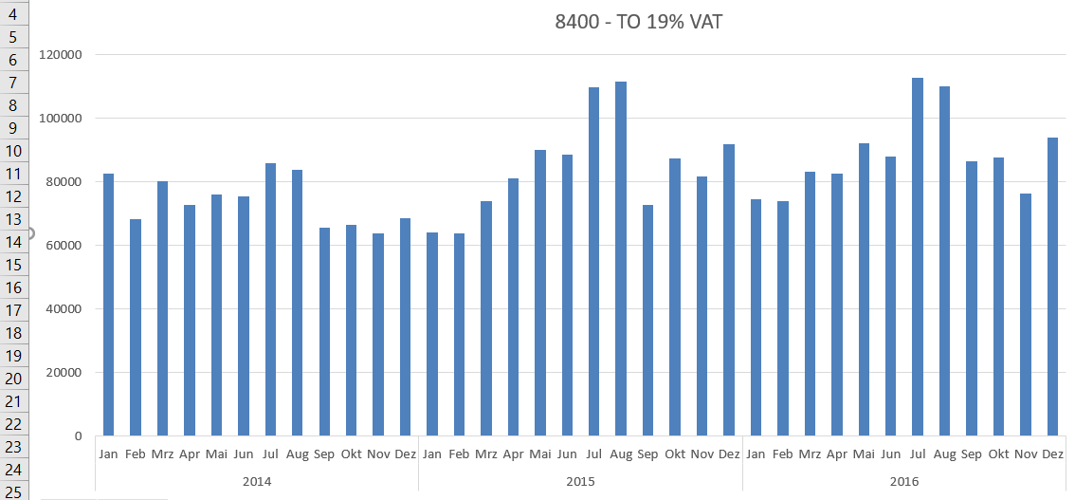
Examples for Other / New Techniques :
Visualization of data – account selection

Slide 22
Examples for Other / New Techniques :
Visualization of data – example
Indicators for problems
Summertime
- reduced turnover compared with other years
Christmastime
- reduced turnover – usually the busiest time of a year for restaurants

Slide 23
Examples for Other / New Techniques :
Visualization
Any expenditures
Turnover
Any other account like input VAT – output VAT
Almost everything could be visualized
…………………..

