Slide 1
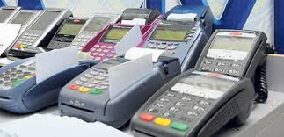

CASE STUDY
Celal ŞAHİN
CASE STUDY ON POS USURY

Slide 2

BIG DATA ANALYSIS
Importance to reveal the harmony or incompatibility between the person's asset values ​​and legal income.
For example, it may be noteworthy that someone who only earns minimum wage income has a large amount of assets or credit card expenditures that do not match their income, except in exceptional cases.

Slide 3
BIG DATA ANALYSIS
*A person: monthly income of $ 1.000
paying a monthly loan installment of $ 1.500
having a monthly expenditure of around $ 1.100
and purchasing 10 luxury villas,
*It is not in line with the normal flow of life and economic necessities.

Slide 4

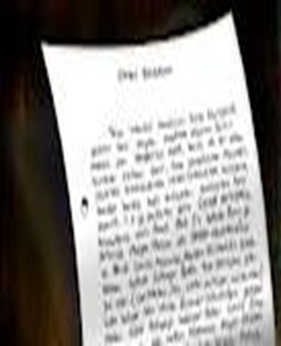
SOURCE OF THE AUDIT
The source of the audit is the letter of the N District Chief Public Prosecutor's Office dated November 2012.

Slide 5
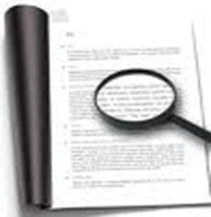
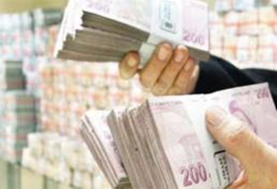

MATTERS IDENTIFIED BY THE PROSECUTION
Analysis Report was issued.
According to the aforementioned report, the issues identified about Mr. M are as follows;
2011 calendar year without any sale of goods or services,
to settle customers' credit card debts or to provide cash in hand to those in need of cash,
Credit Cards are charged through POS devices as if they have made a sale in exchange for a certain commission,

Slide 6

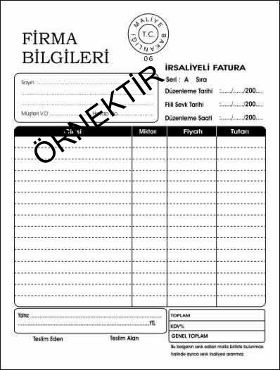
MATTERS IDENTIFIED BY THE PROSECUTION
Mr. M issued invoices as if he had sold airtime minute in order to
conceal POS usury,
These documents, which are not based on a real delivery of goods or
performance of services, are false and misleading documents,
A criminal complaint was filed for the offenses of issuing and using forged documents in the calendar year 2011 in order to conceal usury activities.

Slide 7
MATTERS IDENTIFIED BY THE PROSECUTION
The issues included in the Report prepared as a result of the examination by the Chief Public Prosecutor's Office are as follows:
Taxpayer M issued top-up invoices for credit card transactions in order to legalize the sale of money in return for commission (interest) and to avoid VAT liability,
Mr. M also obtained fake top-up purchase invoices in his name from individuals and companies operating in the same sector,
He issued false invoices amounting to $ 52.000 and used fake invoices amounting to $ 51.000 in the same year,
Within the scope of Article 359/b of Tax Procedure Law, it was determined that he committed the offense of issuing and using false invoices and a laundering crime investigation was requested.

Slide 8


ASSIGNMENT OF TAX INSPECTORS
Request for audit staff
Tax Inspector Assigned

Slide 9
FINDINGS ON PREDICATE OFFENSE IN THE REPORT
Findings made in the Tax Technique Report on Mr. M:
XX.06.2011-YY.09.2011 did not establish transactions in its own activity type
Selling airtime minutes in order to conceal his usury activities
Total amount $ 50.000 from POS devices in 3 months
2% COMMISSION from individuals in need of cash
Taxpayer's required income tax base $ 1.000 commission income from POS usury activity

Slide 10
FINDINGS ON PREDICATE OFFENSE IN THE REPORT
Findings made in the Tax Crime Report on Mr. M:
In the calendar year 2011, he was engaged in POS usury activities
Determination that it was made without obtaining authorization from the Undersecretariat of Treasury
241 articles of the Turkish Penal Code no. 5237
To file a criminal complaint to N District Chief Public Prosecutor's Office

Slide 11
TURKISH PENAL CODE (NO.5237)
Article 282 - Laundering of assets derived from crime:
(1) Any person who takes the assets resulting from a crime punishable by imprisonment of six months or more shall be sentenced to imprisonment from three years to seven years and to a judicial fine up to twenty thousand days.
(2) Whoever, without participating in the commission of the offense referred to in the first paragraph, knowingly purchases, accepts, possesses or uses the asset value constituting the subject matter of this offense, knowing this characteristic, shall be sentenced to imprisonment from two to five years.

Slide 12
FINDINGS ON LAUNDERING CRIME IN THE REPORT
Mr. M made it look like a airtime minutes sale in order to conceal usury income
There is no money transfer to companies that buy and sell airtime minutes (from banks)
Examination of BA-BS forms reveals that the majority of the companies buying and selling airtime minutes are the same companies.
Forging counterfeit airtime minutes purchase and sale documents and transferring them to legal books and records (Tax Procedure Law 359/b)
Analysis of bank accounts Mr. M's cash withdrawals total $ 49.000
Commission income $ 1.000 (50.000 x 2%) INCOME SUBJECT TO LAUNDRY.

Slide 13
MATERIAL/MORAL ELEMENTS OF THE OFFENSE OF
MONEY LAUNDERING IN THE REPORT
MATERIAL ELEMENT:
For the purpose of concealing POS usury activity, presenting usury activity as the sale of phone airtime minutes
MORAL ELEMENT:
Committed knowingly and intentionally (willfully).

Slide 14
RESULT OF THE REPORT
1- Mr. M knowingly and willingly made various transactions in order to conceal the source of the assets derived from crime and to create an opinion that they were obtained through a legitimate way, and these transactions constituted the crime of “laundering of assets derived from crime” in Article 282 of the TPC.
2- It is necessary to take action in accordance with Article 54-55 of the Turkish Penal Code regarding $ 1.000 which we have concluded was subjected to the act of laundering by Mr. M.
3- As a result of the research and examination of the assets of Mr. M's relatives and descendants included in our investigation after the year in which the act of laundering was committed; suspicious element was found in the income/earnings of the persons in question.
4- A copy of the report should be sent to the relevant Chief Public Prosecutor's Office requesting an investigation on the subject.

Slide 15
LEGISLATION WITHIN THE SCOPE OF POS USURY
Legal Regulations in Tax Laws
Legal Regulations in the Turkish Penal Code
Legal Regulations in the Banking Law No. 5411 & Bank Cards and Credit Cards Law No. 5464
Legal Regulations in the Financial Leasing, Factoring and Financing Companies Law No. 6361
Legal Regulations on Banking and Insurance Transaction Tax

