Slide 1

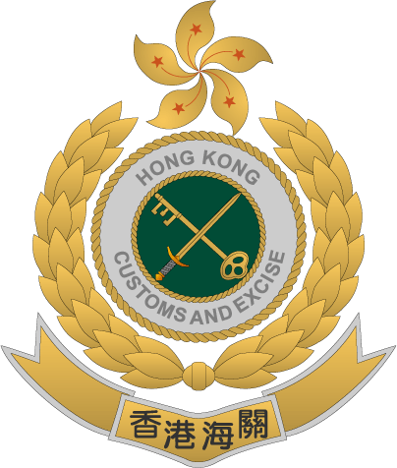
Yip-Kan, POON
Investigator
Customs Financial Investigation Bureau
Customs & Excise Department (C&ED)
Hong Kong, China

Slide 2
Enforcement Work by Hong Kong Customs
Smuggling
Money Laundering
Intellectual Property Rights Infringement
Illicit trade of Dutiable Goods
Drug Trafficking
Enforcement against

Slide 3


Money Laundering Legislation in Hong Kong
Maximum Penalty
14 years imprisonment
HKD 5,000,000 fine
(~USD 640,000)

Slide 4






Case Background
Enormous bank transfer from a crypto trading platform
Mr. A
Mr. B
Mr. C
Logistics
Wine Trading
Health Product Trading

Slide 5
Hallmark of Money Laundering
Enormous bank transfer from a crypto trading platform
No genuine business operation (from company document & address)
No trade declaration filed
Using the same secretarial firm
Time of company incorporation
Pattern & Time of account opening
Inter-transfer
Common Counterparties
Common Account signatory
Tax return
Incommensurate financial background

Slide 6
What we did
Surveillance
Obtained records from banks & crypto trading platform for Fund flow analysis
  Bank accounts – approx. USD 45 million
    Remitters: From Mainland China & Overseas
    Beneficiaries: Local/ Overseas
  Crypto trading account – approx. USD 110 million
    Extremely frequent and large amount of transactions
    Almost all USDT (stable coin)
    Temporary repository of funds
    Received from unidentified wallets
    Either sent to other digital wallets OR converted into fiat currency
    Inter-transfer of crypto
Intelligence exchange with overseas LEAs

Slide 7

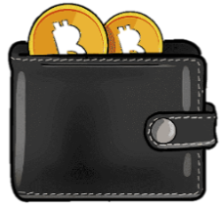













ML Scheme
Crypto
Trading Platform
?
?
?
110M
19M
?
Digital wallets
Digital Wallets
Digital Wallets
Traditional Banking
91M
Bank Accounts
Local/ Overseas
Companies
MSO
Real Estate
Investment
45M
136M
Individuals/
Companies
Bank
Individuals
Laundered Period: 2020 - 2021

Slide 8
Challenges and Difficulties
First time to handle ML case involving crypto
Liaison with the crypto trading platform
Complex source of funds
Unknown identity of wallet holders
Features of Custodial Wallet
Enforcement Results
Arrest the mastermind & 3 syndicate members
Freeze USD 2.5 millions bank balance

Slide 9
Key Takeaway
Nature of Crypto
Transfer of fiat currency & crypto (exchanges, bank, ATM, OTC, P2P)
Cooperation (Int’l)

Slide 10

ありがとう!

