Slide 1
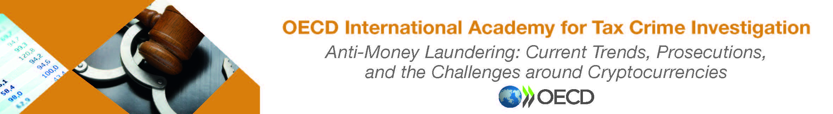
Money Laundering Methods

Slide 2
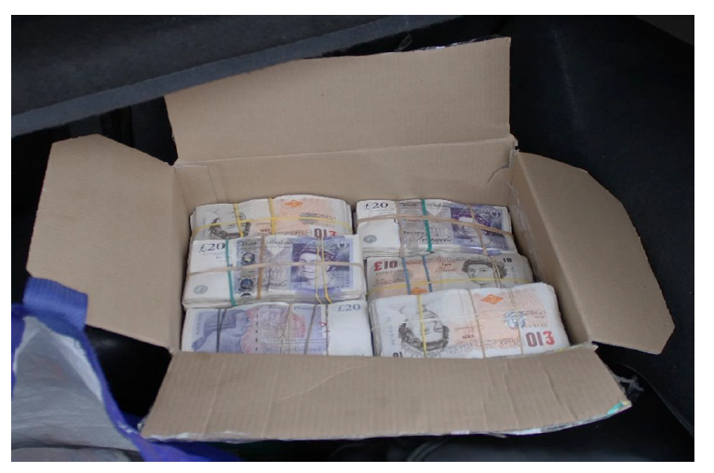
Cash
Cash allows its origin and true ownership to be concealed
Cash can easily be controlled and moved
It is relatively durable
It always has value (even in an economy with rampant inflation – Argentina example)
Easy to change or convert (ie: £ to $, or £ to goods)

Slide 3
Street Cash in the UK
Normally packaged in £20 and £50 notes
Bundles are made up of £1,000 and then packed as multiple bundles of £5,000 or £10,000
Most commonly observed/seized currencies – Sterling, US Dollars and Euros

Slide 4
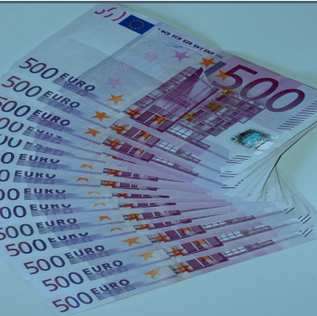
500 Euro Notes
In 2018 the European Central Bank (ECB) stopped issuing the 500 Euro bank notes.
This was over fears that the bills were being used by criminals as a convenient way to launder money and potentially finance terrorism.
According to ECB statistics the 5oo Euro note accounted for just 3% of total number of bank notes in circulation, but accounted for 28% of the total value
One million Euros made up of 500 Euro notes weighs 2.2 Kilograms and would fit inside a laptop bag.
The 500 Euro note reportedly trades above its face value and is used more as a means of hiding value

Slide 5
Breakout Session £1M Cash
Consider what methods you could use to move the physical cash? Choose one.
What other methods could you launder the money?
List the risks involved in these methods, if any? (These should align with your choices)
As a LEA Officer, how would you go about investigating this?

Slide 6
Common Ways of transporting cash
Using the services of a cash courier
Hide it in a concealment within a mode of transport
Place it in with other forms of cargo inside a container
Use post or mail parcels
Hidden in “plain sight” – Bank to Bank bulk exports

Slide 7
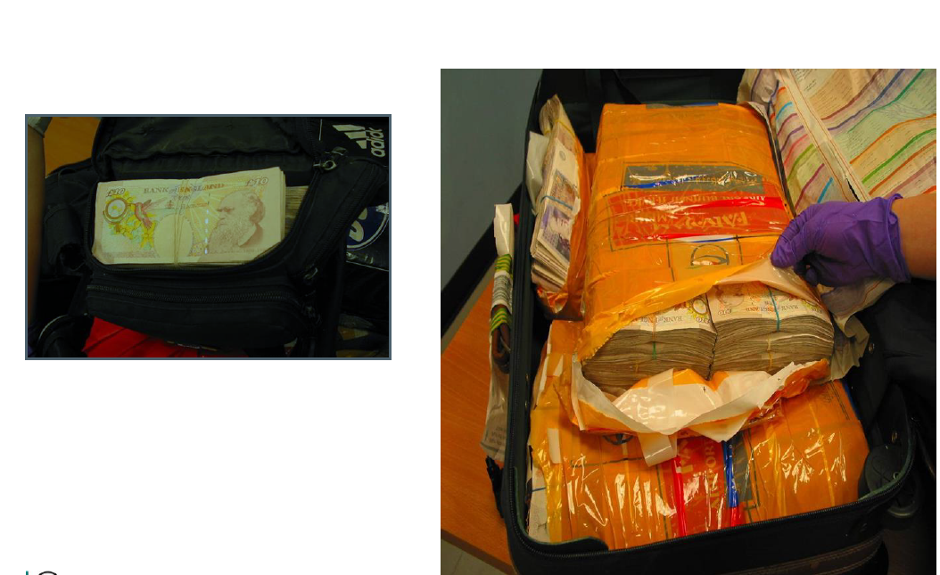

Slide 8
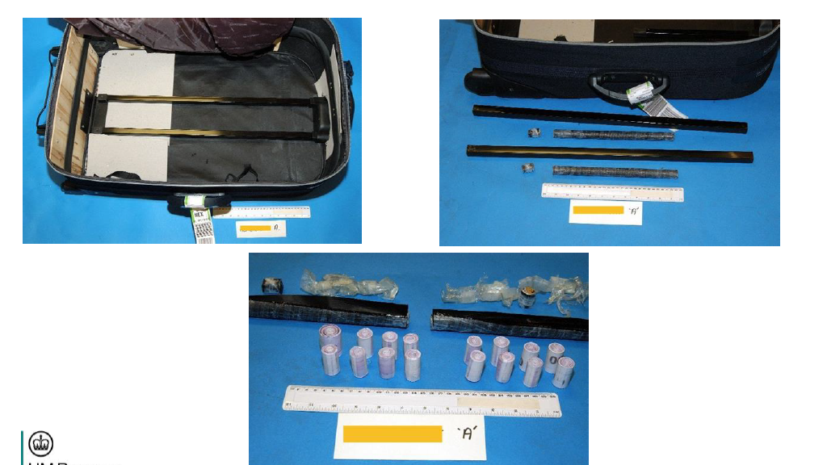

Slide 9
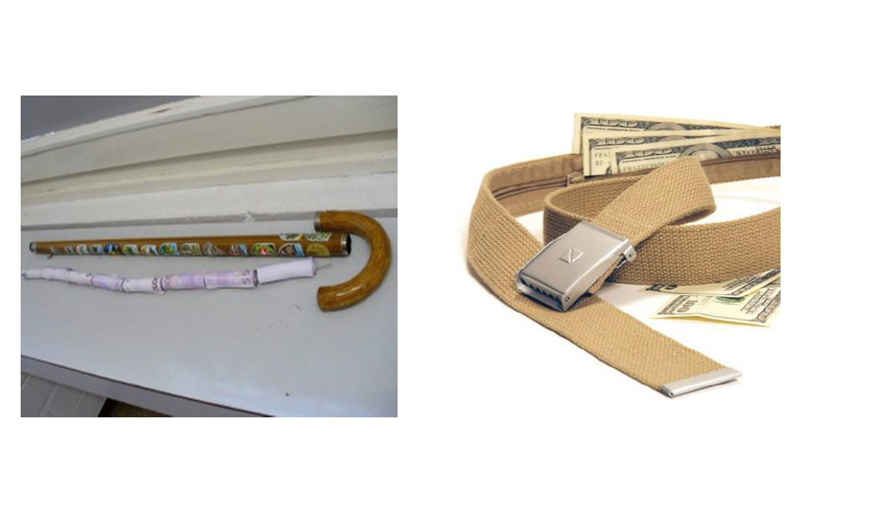

Slide 10
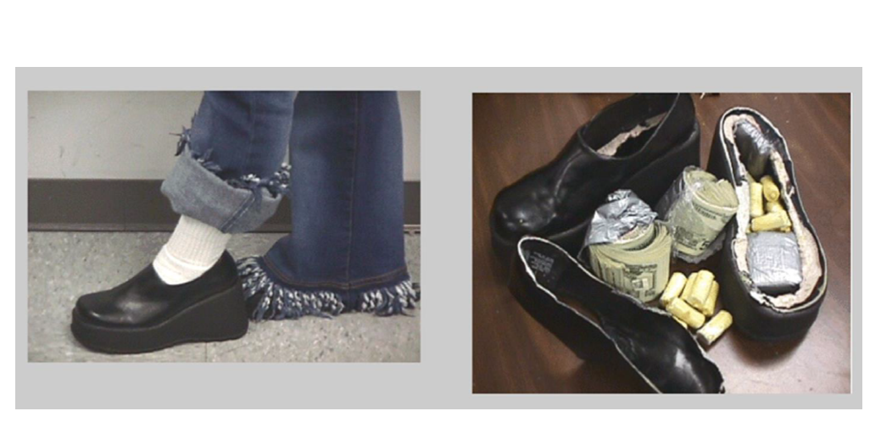

Slide 11
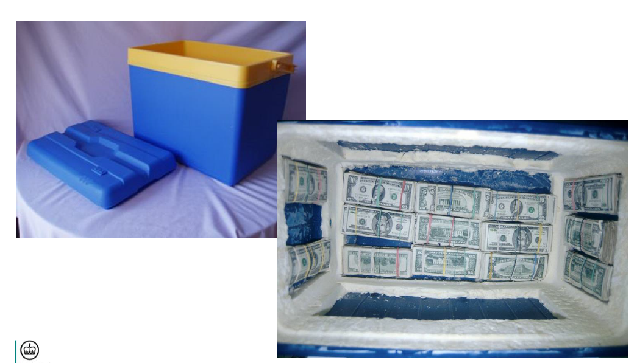

Slide 12
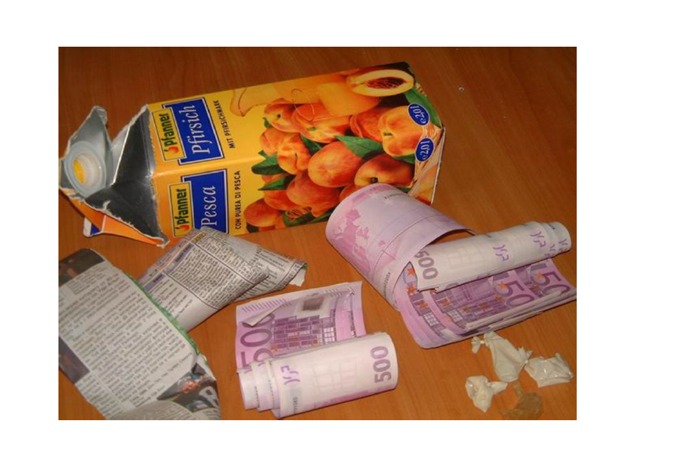

Slide 13
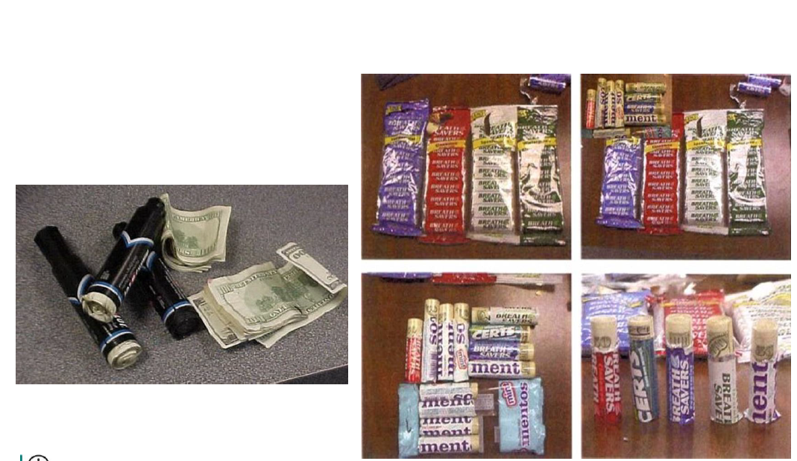

Slide 14
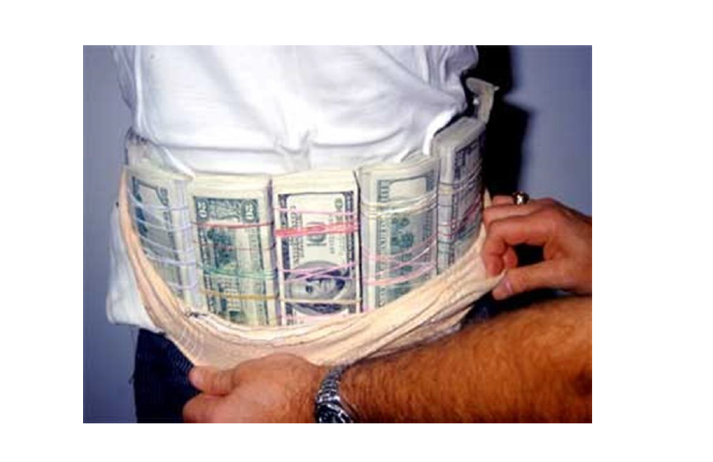

Slide 15
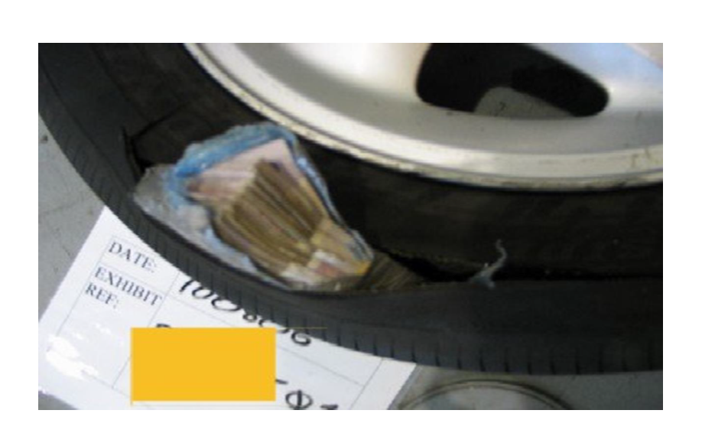

Slide 16
Key Methods for moving cash
Smurfing (Structuring)
Controller led Money Laundering networks
Cuckoo Smurfing

Slide 17
Smurfing
Definition – evasion of scrutiny by breaking up a transaction involving a large amount of money into smaller transactions, which are below the reporting threshold for the jurisdiction
Cash collectors are instructed to make multiple payments into various regulated sector businesses/locations
Use of quick drop banking facilities – this minimises the risk of seizure and disclosure by banks or institutions
Co-mingling – involves the mixing of proceeds from both legitimate and illegitimate sources
Refining – this involves changing small denominations into higher value notes often in alternative currencies ie: Sterling into Euros.

Slide 18
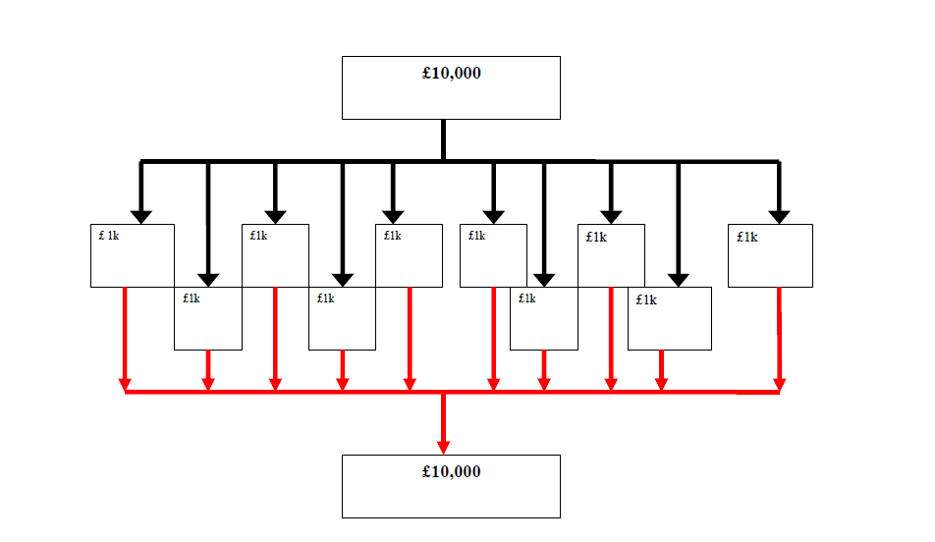

Slide 19
Controller led Money Laundering Networks
Criminal proceeds are moved globally through a network of cash couriers
The “token” system is still widely used by illegally operating Hawaladars, or other illicit money remitters, who are known as “Controllers”
This method is used to verify transactions and ensuring handovers are conducted accurately, between parties who may have no prior knowledge of each other

Slide 20
Roles of Network Members
Money Broker or Controller – this is a trusted person who collects the street cash and remits the equivalent value to the ultimate global destination.
Collector - he is instructed by the Controller to collect cash from other criminals and dispose of it according to their instructions.
Coordinator – this is an intermediary who manages some of the money laundering process, for one or more Controllers.
Transmitter – he receives and dispatches the money as advised by the Controller

Slide 21
The Handover
Controller requests a token number from Collector
Collector sends a unique serial number
This is sent onto criminals bringing the cash to the handover
At handover criminals examine the token to ensure they have the right person
The criminals exchange the cash for the token (a receipt)

Slide 22
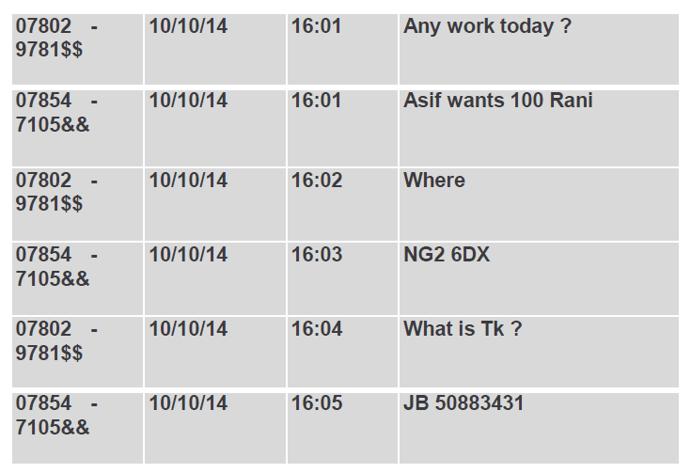
So what is a “Token”?
In use since ancient times as a method of identification

Slide 23
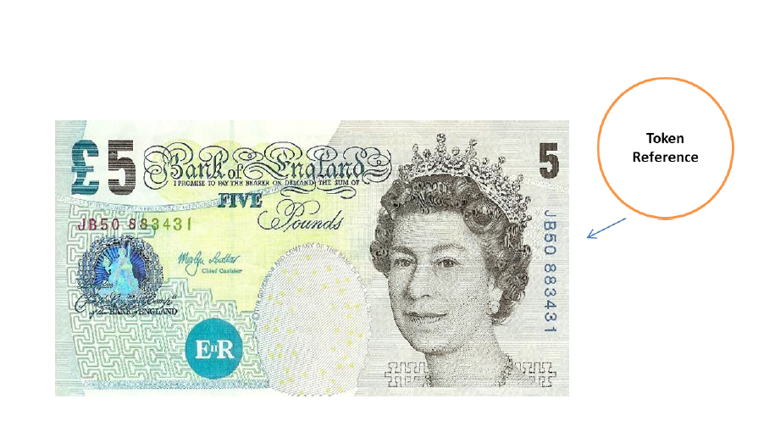

Slide 24
Alternative Remittance Systems
Used to facilitate trans-national transfers of value outside of banking system constraints
They have their legitimate uses
They are open to misuse by criminals and terrorists
They can operate in areas where banking system is poor and provide access to financial facilities for many

Slide 25
Benefit to the criminals?
Most cases funds passed through these systems is more difficult to regulate and control
They can be
Faster
Easier
Less auditable

Slide 26
Hawala - HOSSPS
Known by different names in different communities
Mostly low value remittances – cash in/cash out
Community based and visible and accessible to all
KYC – adequate accounting records – low running costs
Basic Records – name, contact number and transaction number
Many operate other businesses as well as Hawala
Part of a network of similar businesses in other countries
Notes:
HOSSPS – Hawala and Other Similar Service Providers – FATF term

Slide 27
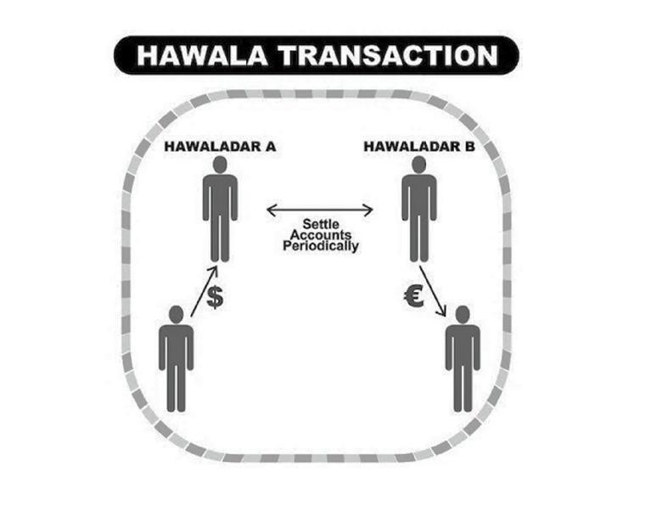

Slide 28
FATF Report
The Role Of Hawala And Uther Similar Service Providers (October 2013 – revisited 2016)
The Financial Action Task Force (FATF) is an independent inter-governmental body that develops and promotes policies to protect the global financial system against money laundering, terrorist financing and the financing of proliferation of weapons of mass destruction. The FATF Recommendations are recognised as the global anti-money laundering (AML) and counter-terrorist financing (CFT) standard.
Notes:
UNODC (United Nations Office on Drugs and Crime – Report “The Hawala System – Its operation and misuse by opiate traffickers and migrant smugglers” - 2023

Slide 29
Report Results (based on surveys of countries)
Most countries stated their Hawaladars operated in illegal or unlicensed ways
Most Hawaladars operated primarily outside of regulated banking system
Around 80% used net settlement – no money transferred internationally between parties – occasional net payments made
Around 68% used Trade Settlements – settling through equivalent value in merchandise rather than cash
Around 32% of countries reported that their Hawaladars only appeared to serve specific communities

Slide 30

MPESA – Phone banking (Vodafone Cash)
Launched in 2007 by Safaricom, and later joined byVodafone, in Kenya
By 2012 – 17 million accounts had been registered in Kenya
By 2024 – 66.2 million customers registered in 10 countries
Allows users to deposit, withdraw, transfer money, Pay for goods/services, access credit and savings all with mobile device
Originally designed to permit the unbanked to pay micro finance loans through their phones
Later adapted to permit money transfers
59% of Kenya’s GDP flows through MPESA – 2023 there were 20 Billion transactions
Notes:
From Statista.com (May 2024)
Also known as Vodafone Cash in Ghana and Egypt
Can be used via a Super App – which is free MPESA makes money by taking a share of each transaction performed
Additional information from Warwick Business School article 27th August 2024
Customers can hold up to 500,000 KES ($3,480) in their MPESA wallet

Slide 31
Risks to LEAs?
Offers instant peer to peer transactions
Difficult to effectively regulate
High risk for micro-smurfing transactions
Notes:
2017 – US Department of State – International Narcotics Control Strategy – “MPESA vulnerable to money laundering activities”
Mozambique has daily limit of $390 transactions before need for additional approval

Slide 32
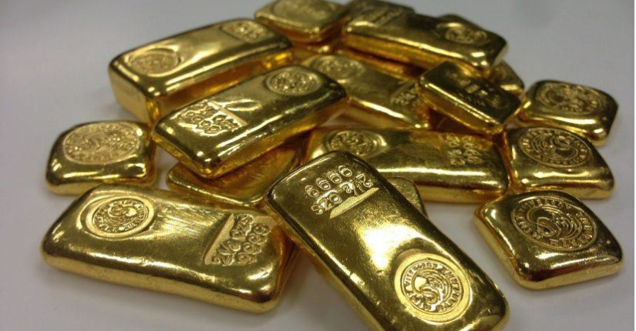

Slide 33
Why is Gold popular?
It holds a significant place in many cultures and religions
Price fixed daily with a constant worldwide value
Its form can be altered – so it can be disguised or hidden
It can be used to avoid sanctions
It is used as a base value to underpin many Alternative Remittance Systems

Slide 34
Greg Kelly
Senior Investigative Officer
HMRC Fraud Investigation Service
Economic Crime Operations Unit

