Slide 1
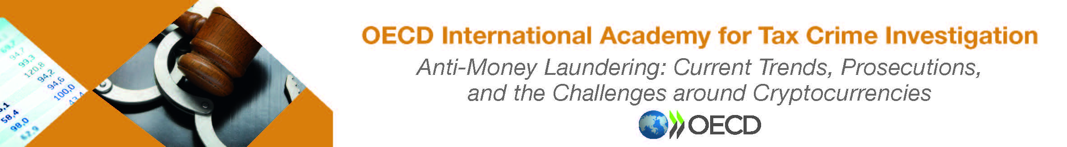
Trade Based Money Laundering

Slide 2
Definition of TBML
“the process of disguising the proceeds of crime and moving value through the use of trade transactions in an attempt to legitimise their illicit origins. In practice, this can be achieved through the misrepresentation of the price, quantity or quality of imports or exports” (FATF 2006).
“Laundering the proceeds of crime through trade in real or imaginary goods or services, either internationally or domestically.” (HMRC)

Slide 3
So how does it work?
Trade Based Money Laundering (TBML) involves the misrepresentation of price, quantity or quality of goods moved through international trade.
Value Transfer without money transfer
Breaking the audit trail
Disguise of beneficial ownership/ Use of Corporate Identities
Often simultaneously facilitates other crime –evasion of currency controls, tax/duty evasion etc.
Burying the transaction within the of millions of other trade transactions

Slide 4
Manipulation of Invoices
This is where the price of the goods or service are misrepresented on invoices, in order to transfer the value.
For this type of arrangement to be conducted it is essential that the person exporting the goods and the person importing the goods are both complicit in the misrepresentation.

Slide 5
Over Invoicing
Describing the goods correctly on customs documentation, (i.e. the correct number being sent) but overstating the value of each item
Under Shipping –Valuing the goods correctly but deliberately overstating the amount shipped on the invoice –achieves the same aim.

Slide 6

Under Invoicing
Describing
Describing the goods correctly on customs documentation, (i.e. the correct number being sent) but understating the value of each item
Shipping
Over Shipping –Valuing the goods correctly but deliberately understating the amount shipped on the invoice –achieves the same aim.

Slide 7
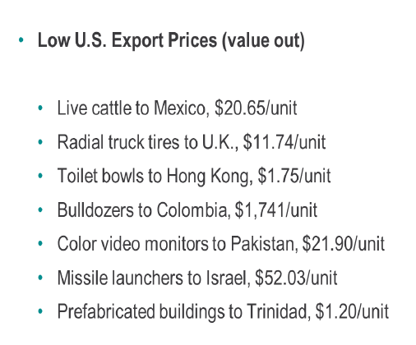
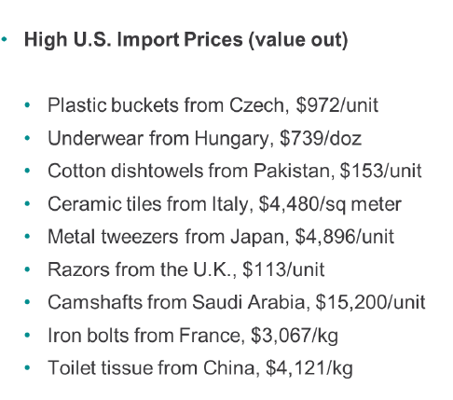
True Examples of Abnormal US Trade Prices (Dr John Zdanowicz 2009)

Slide 8

Mis-description of Goods
Mis-description is often used to evade customs duties at import, or VAT levies
Goods liable to one rate of tax or duty are described on the invoices as being goods taxable at a different rate of duty
The description may also permit the under or overvaluation of the consignment
This could shift value in either direction
As well as adding value by cheating taxes or duties

Slide 9

Multiple Invoicing
A person/company issues several invoices for the same consignment of goods. This has several outcomes:
Firstly, it can result in an overpayment and the transfer of value to the supplier of the goods.
Secondly, the recipients of the invoices can abuse them by making false VAT claims or they can use them to reduce their Corporation Tax liabilities

Slide 10
Fictitious Trading
Also known as “ghost shipping” or “phantom shipping”. The exporter might not ship any goods at all, but simply collude with the importer to ensure that all shipping and customs documents associated with the trade are completed and filed.

Slide 11
Open Account
An open account transaction is a sale where the goods are shipped and delivered before payment is due.
International terms this is usually 30, 60 or 90 days. The customer pays within an agreed period.
Standard international trading practice which can cause problems for banks when it comes to assessing their customer’s transactions under MLR.

Slide 12
Documentary Collection (Trade Finance)
An exporter’s bank forwards documents to an importer’s bank and collects payment for shipped goods
Neither sides bank assumes any financial responsibility in this transaction
Documents are not always standardised, increasing the risk of TBML through fictitious or false invoicing.

Slide 13

Shell Companies
They are incorporated, but have no significant assets or operations
Often used as part of an opaque supply chain
They are used to obscure the monetary transaction movements
They hide the amount of value transferred

Slide 14
Third-party Companies
Another red flag for potential TBML
Often based in jurisdictions, which are beneficial to their privacy
Appear in Open Account trades or Documentary Collection trades
They appear in the process of invoice settlement

Slide 15
Infiltration of Legitimate Supply Chains
Criminals can purchase a shareholding in a legitimate company
This gives them the opportunity to introduce their illicit funds into the supply chain
This in turn moves their funds into the regulated financial sector as part of a genuine business
The introduction into a legitimate business can also be made via Alternative Remittance Systems – Hawaladars
As a body not over-burdened with regulatory compliance issues they would be less aware of the process of TBML

Slide 16

The Risks of TBML
Every country in the world is susceptible to TBML as they are all engaged in cross jurisdiction trade
Corporate structures are open to abuse in any country, but especially in those countries where their regulatory controls are not stringent
The best way to combat TBML is via a national risk assessment, where a country considers its exposure to risks in terms of threat and vulnerability.

Slide 17
Products Attractive to TBML Activity.
Gold& Precious Metals (High-value, low volume)
Second-hand Clothing & Textiles (Low-value, high volume)
Used Vehicles and Auto Parts
Agricultural Products and Foodstuffs
Mobile Phones & Portable Electronic Devices)
Notes:
Gold is also a proxy for moving cash, as explained in the ML section, as well as being a commodity
2nd hand clothes allows for an extended chain of supply, which is attractive for TBML
Vehicles are declared at correct value at export point and lower value at importation point
OCGs infiltrate genuine supply chains for foodstuffs, etc. Introduce criminal funds into chain and use the supply chain to transfer value to different countries. Especially useful for perishable goods – fruit and vegetables
Portable electronics and phones are easily abused via misdescription or misrepresentation and under valued

Slide 18
Other Business Sectors open to TBML Abuse
Construction materials
Plant machinery
Scrap metal dealers
Fuel and energy products
Alcoholic or soft drinks

Slide 19

Indicators of TBML
Use of letters of credit, unusual payment methods
Payments received or made through third parties
Unusual deposits of cash or negotiable instruments in round figures
Payments made from or into multiple accounts
“Goods” shipped to or from a high-risk jurisdiction
Shipment through or from Free Trade Zones
Routing is inconsistent with normal geographic trade
Goods inconsistent with transit documents
Consignment is not consistent with the capacity of the exporter
Presence of shell companies in the supply chain

Slide 20

Further Indicators of TBML Abuse
Rapid growth of newly formed companies into existing markets
Evidence of consistent and significant cash payments, including those directed towards previously unknown third-parties. These businesses may also receive unexplained third-party payments;
Un-necessary complicated and complex supply chains, involving multiple transhipments;
Previously established companies specialising in one sector that unexpectedly pivot into an entirely unrelated sector.
Companies simultaneously involved in more than one unrelated sector.

Slide 21
End of Session
Greg Kelly
Senior Investigation Officer HMRC Fraud Investigation Services Economic Crime Operations Unit

