Slide 1
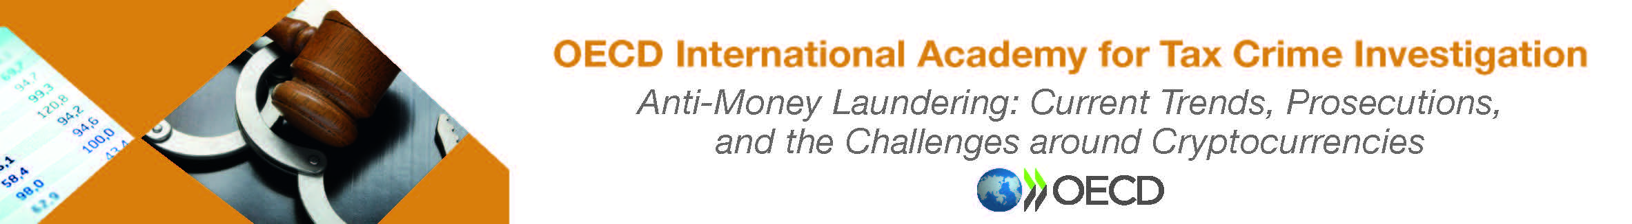
Bribery & Corruption
“The true measure of crimes is … the harm done to society”
-Cesare Beccaria

Slide 2
What links these five lethal events ?
1904
New York Ferry sinks killing 1000 people
1995
Russia: Chechen Terrorists kill 100 people in Budennovsk
1999
Turkish Earthquake kills 17,000 people
2002
Russia: Chechen Terrorists besiege Moscow Theatre ends with 129 hostages killed
2004
Russia: Chechen Suicide bombers destroy two planes in- flight killing 90 people

Slide 3
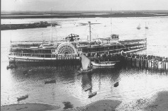
1904 : The General Slocum
The Ship caught fire at sea
1000 people drowned or died in the fire
The crew had no fire-fighting training
Fire hoses were rotten
Lifeboats could not be launched
Life vests: made of cork had turned to dust
A Safety Inspector had issued a certificate one month earlier stating the ship was sea-worthy and the crew were trained.
He must have taken a bribe

Slide 4
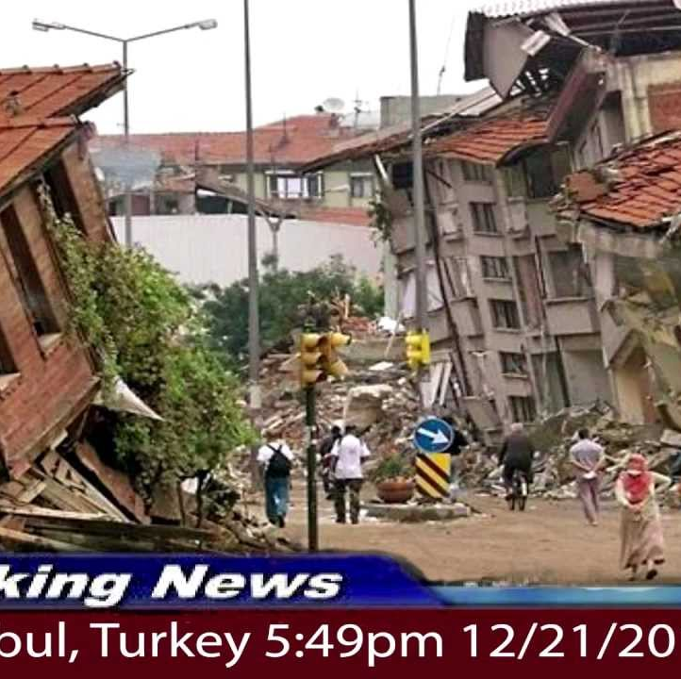
1999 Turkish Earthquake : Over 17,000 Dead
7 New “Earthquake proof” buildings collapsed
Builder had publicly boasted about boosting profits by using cheap substandard materials
Crowd tried to lynch him after they collapsed
Building inspectors had been bribed
Engineers had warned Ministers about the risks of corruption
No investigation had been launched

Slide 5
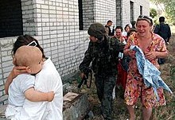
Russia: the Chechen Problem
1995 Chechen Terrorists kill over 140 people in Budennovsk Russia with over 400 injured
The Chechen Commander Shamil Basayev was captured by Russian Police
He had paid $10,000 US in bribes to pass Army Checkpoints
His original intention was to attack Moscow
He only attacked Budennovsk ….because he ran out of money !

Slide 6
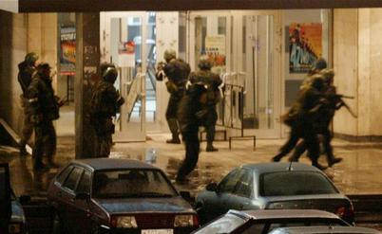
Second Chechen problem
Heavily armed Chechen Terrorists take hostages in a Moscow theatre. In the rescue attempt 129 people are killed
The attackers bribed Police Officers at checkpoints all over Moscow
They had an arsenal of guns and explosives in their car
They were allowed to pass freely, despite a heightened alert status
Simply because they paid bribes to low-ranking Officers

Slide 7
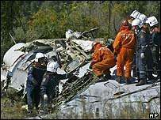
Chechen third problem
2004 Two Chechen “Black Widow” terrorists blow up two planes in flight killing 90 people
By now you will have guessed that they bribed their way onto flights
Boarding at the last minute
With no checks conducted
The airline did not even have the full name of one woman recorded
They detonated their suicide vests in flight

Slide 8
CORRUPTION
KILLS !
In each of these cases
Low level bribery of
Low Level Officials
Resulted in DEATH
In each case the deaths were innocent civilians
People going about their everyday lives
Low level bribery contributed to or indirectly caused those deaths

Slide 9
Other Corrosive Effects of Corruption
Corruption results in :
Reduced private investment
Poor public infrastructure
Reduced tax revenue,
Inefficient financial systems
Reduced human capital formation.
Lower literacy rates,
Higher mortality rates
Negative human development outcomes.
Deepens poverty by reducing public expenditures, by creating artificial shortages
Perpetuates unemployment. (FATF 2016)

Slide 10
Grand Corruption
“Power tends to corrupt and absolute power corrupts absolutely. Great men are almost always bad men, even when they exercise influence and not authority: still more when you superadd the tendency or the certainty of corruption by authority.”
- John Dalberg 1st Baron Acton

Slide 11
High Level Corruption
Grand Corruption
Influence Peddling
State or regulatory Capture
State – Corporate Corruption
Corporate Corruption
Self-Dealing

Slide 12
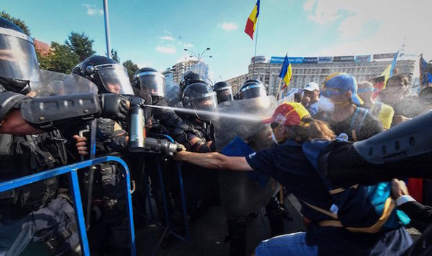
Grand Corruption: Romania August 2018
Nationwide Protests against alleged corruption of ruling PSD Party
2015 Investigations launched into political corruption
2017 Decree passed to free politicians and officials jailed for corruption
2018 President Iohannis sacks the anti corruption Prosecutor who was leading investigations into local and national politicians
Sparks riots and protests in cities across Romania
“We want to see modern roads and schools and above all not to have to pay bribes to the left and right” - Ilheana Angel protestor

Slide 13
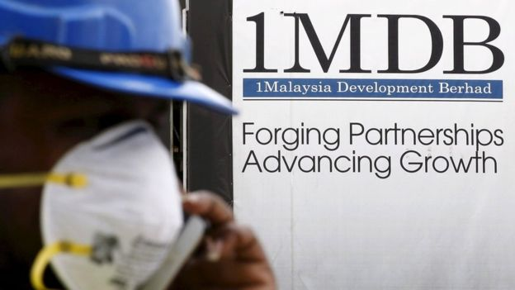
Grand Corruption : Malaysia April 2018
1MDB Fund set up in 2009 to make Kuala Lumpur a major financial centre and boost economy
2015 fund missed payments of $11 Billion
Accused of money laundering and diverting public funds
International investigations commenced
Prime Minister Najib Razak defeated in election in May 2018. It is believed he had suppressed the investigation.
Razak was charged with corruption in July 2018. Raids recovered cash and luxury goods worth over £273 million from him.

Slide 14
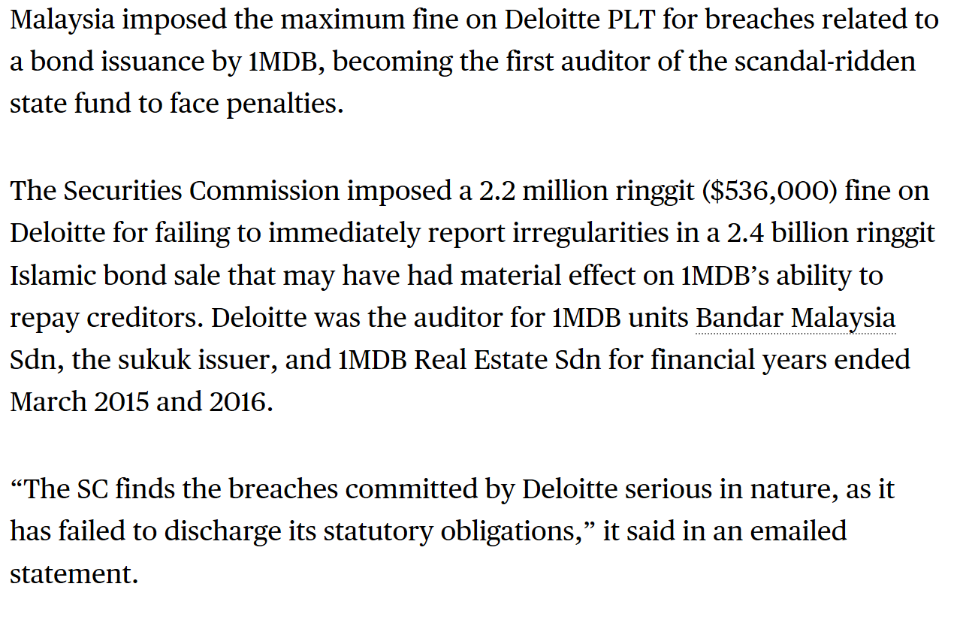
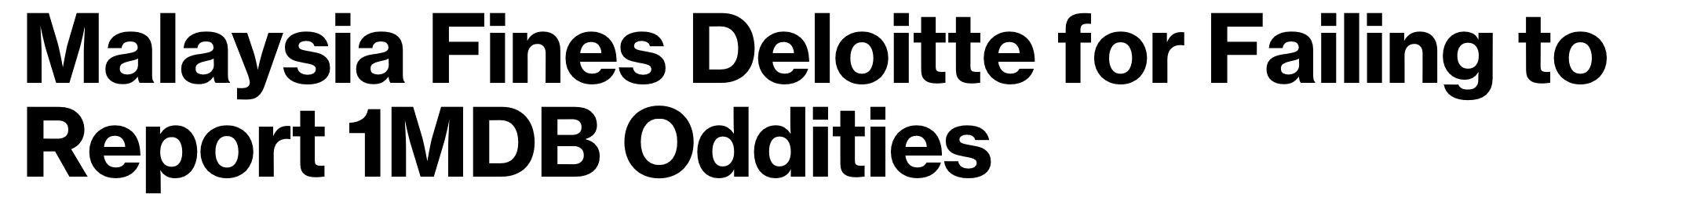
Malaysia fines Deloitte for failure to report 1MDB oddities

Slide 15
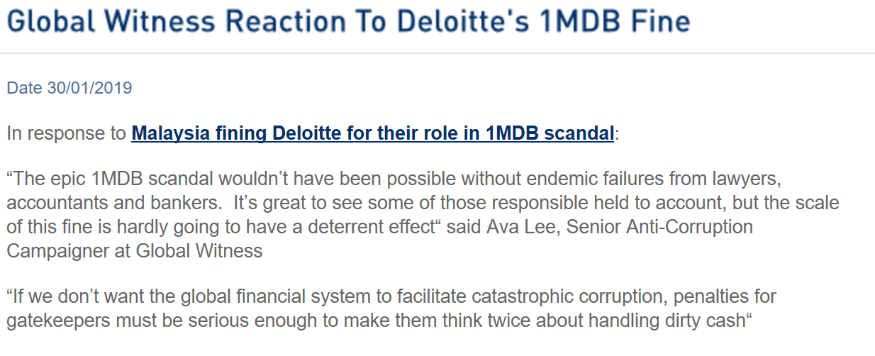

Slide 16
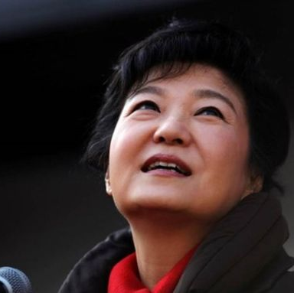
State-Corporate Crime: South Korea April 2018
Ex President Park Geun Hye sentenced to 24 years imprisonment for Corruption
She is the daughter of the Country’s former dictator
She had collaborated with a friend Choi Soon Sil to solicit bribes totalling over £25 million from the “Chaebol” a conglomerate of businesses which dominate the Korean economy
These included Samsung and Lotte
Companies were pressured to fund NPO’s operated by members of Choi’s family
Choi was also jailed for 20 years. The CEO’s of Samsung and Lotte received shorter sentences of around 10 years

Slide 17
State Capture
A situation where “…powerful individuals, institutions, companies or groups within or outside a country use corruption to shape a nation’s policies, legal environment and economy to benefit their own private interests”
Transparency International

Slide 18
South Africa 2018 the Gupta Scandal
Government Ombudsman Thuli Madonsela has alleged state capture of the Zuma Government and its institutions by the Gupta brothers.
Ajay Gupta allegedly offered Mr Zuma’s son the post of Finance Minister along with a bribe- indicating that he, made such decisions
Gupta businesses were allegedly connected with beneficial regulatory changes, such as the deregulation of the mining sector, and German software company SAP paid $6.6 million in “commissions” to Gupta owned companies to secure South African state contracts
$8 million was stated to have been diverted from a development grant, to a Gupta offshore company “Gateway” and then passed back to the South African “Linkway Trading”. This funded a lavish Gupta family wedding costing $2.8 million.
This transaction was written off as a business expense by the auditors KPMG
McKinsey were awarded a 1 billion Rand consultancy contract with state energy supplier Eskom, along with Trillian, a Gupta controlled company. When the deal fell apart 6 months later, 564 million Rand was paid to Trillian, as a kickback.

Slide 19
Regulatory Capture
Under-regulation and under-performance of regulatory agencies contribute massively to Corruption
In some cases regulators may be so influenced by the sectors they regulate as to be effectively controlled by them
Regulators are often funded by the sector the regulate not the state
For example, in the UK the Financial Conduct Authority which polices the conduct of the banking sector – is funded by the banking sector.
There may be a “Revolving door” in operation – where Senior figures create or influence legislation and then return to work in the sector they were regulating

Slide 20
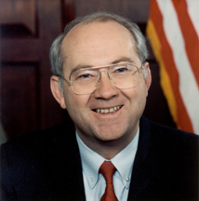
Regulatory Capture ?: Glass Steagal
After the Wall Street Crash in 1929 the US Government passed the Glass Steagal Act to ensure it could never happen again
In 2000 this was repealed by the Gramm-Leach-Billey Act
Senator Phil Gramm who was at the time the head of the Senate Banking Committee sponsored this act.
He had allegedly received $4.5 million in political campaign contributions from Wall Street financial institutions
This weakened regulation and contributed directly to the Ponzi finance and Casino banking practices that led to the global financial crisis in 2007

Slide 21
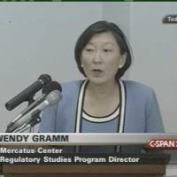
Regulatory Capture ? Mrs Gramm
Phil Gramm’s wife Wendy Lee Gramm headed the Commodity Futures Trading Commission under the US Reagan administration.
During this time campaign contributions of $were paid by Enron, a company in the sector she regulated.
This helped to push through legislation which deregulated the energy futures sector.
Having achieved this deregulation, Wendy Gramm was appointed to the board of Enron
Enron then mistraded energy futures leading to the largest corporate bankruptcy in US history at that time
Enron had concealed massive corporate looses from investors and regulators in over 400 offshore companies.

Slide 22
What is Corruption ?
What Corruption scandals have you seen in your country / region ?

Slide 23
State-Corporate Crime : Arms and Military Contracting
Documents released under the UK Freedom of Information Act show UK Government colluding in bribery to secure arms sales in the 1960’s

Slide 24
Arms and the Man: Don’t look won’t see
In 1967 in selling Alvis armoured cars to Venezuela, Attaches at the British Embassy in Caracas expressed concern that they were being asked to engage in bribery and received the following response from the British Ministry of Defence.
Document originally marked as “Secret” : declassified under Freedom of Information Act

Slide 25
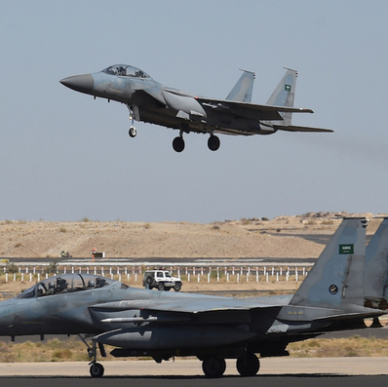
Britain, BAE Systems and the Al Yamamah deal
In 1985 a major arms contract was agreed between the UK and Saudi Arabia, which continued for over 20 years.
Britain supplied Tornado and Hawk warplanes, PC-9 trainers, and Eurofighter Typhoons.
The deal price was inflated by 32% to pay bribes to high ranking Saudis and finance kickbacks

Slide 26
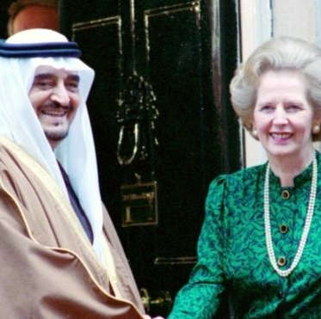
Britain, BAE Systems and the Al Yamamah deal
A USDOJ investigation established up to £15 million at a time was paid to a Saudi Royal, Prince Bandar, at the Riggs Bank in Washington DC.
At least £1 billion passed through the account of Poseidon Trading Investments Ltd (BVI) an offshore corporate vehicle set up to launder the proceeds of the deal and to divert funds for use as bribes and kickbacks
Another offshore company Robert Lee International billed BAE for up to £250,000 monthly for fictitious expenses, corruptly mis-described as “hospitality”.
Former BAE CEO Sir Richard Evans received two Mayfair apartments valued at £6 Million he is immune from prosecution in the UK.

Slide 27
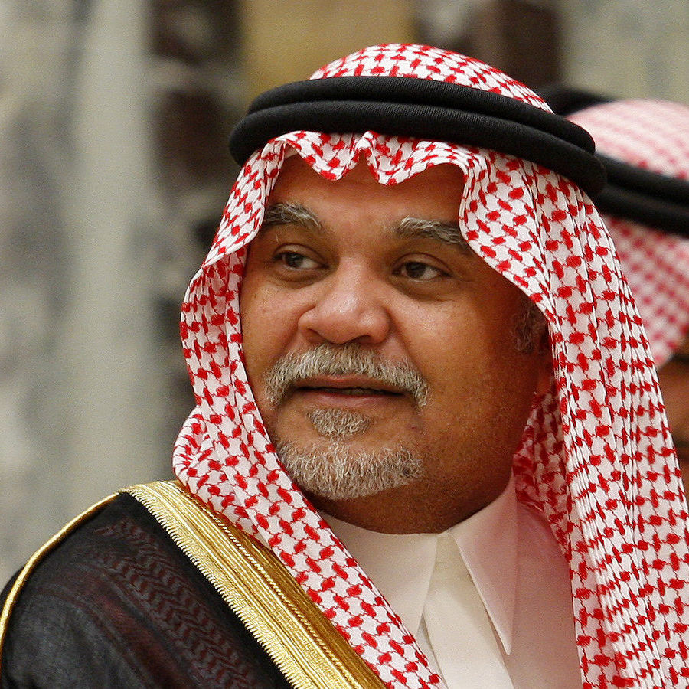
Prince Bandar Bin Sultan al Saud
Interviewed in 2001 Prince Bandar Bin Sultan , the former Saudi Ambassador to the USA, commented generally on corruption in Saudi Arabia
“If you tell me that building this whole country, and spending $350 billion [in the last 30 years] out of $400 billion, that we misused or got corrupted with $50 billion, I'll tell you, "Yes." But I'll take that any time…We did not invent corruption...This happened since Adam and Eve. ... I mean, this is human nature.”
http://www.pbs.org/wgbh/pages/frontline/shows/terrorism/interviews/bandar.html

Slide 28
How is corruption money laundered ?
Cash
Assets
Property / Financial markets
Front companies and shell companies
Enablers – Lawyers’ client accounts
Offshore Jurisdictions
Not for Profit Organisations (NPO’s)
Trade mispricing / Transfer Pricing Abuse

Slide 29
Cash
Teodoro Obiang Nguema the former dictator of Equatorial Guinea, operated over 60 accounts at Riggs Bank in Washington DC. On two occasions Riggs Bank staff collected bundles of $3 million in cash from the Washington embassy and banked it for him. Over $13 million in cash was banked in the US by him or members of his family.
Joseph Estrada, the former President of the Philippines, regularly received cash and cheques from members of the gambling industry, who he protected from arrest or enforcement action. These were banked domestically by his attorney using accounts opened in false names, or in the accounts of shell companies.
PEPs may abuse “diplomatic bags” to transfer illicit funds

Slide 30

Assets
Funds embezzled from the 1MDB scandal in Malaysia were allegedly used to purchase a super yacht.
Some of this money was used to buy works of art, including a Van Gogh and a Monet,
To purchase High-end real estate in New York
Ironically, funds from the fraud also partly bankrolled the Hollywood blockbuster The Wolf of Wall Street
This told the life story of notorious Wall Street fraudster Jordan Belfort

Slide 31
Property Markets
Global Witness provide
the following illustration in
their report Narco A Lago
(2018)

Slide 32

Property Markets
The report illustrates how a Panamanian resort the Trump Ocean Club in Panama
Has been used as a conduit for laundering Colombian and other cartel drug money
Proceeds of crime were laundered through the development by Colombian David Eduardo Helmut Murcia Guzman- subsequently convicted of money laundering in the US and imprisoned for 9 years
Around 400 of the units sold were brokered by Alexandre Henrique Ventura Noguiera- many to Russian investors- through anonymous offshore “special purpose vehicles”
Previously investigated for money laundering in his native Spain, Noguiera was soon arrested again for selling apartments to Guzman to help him because “He could not take his money to a bank”
Noguiera also embezzled deposits and commissions and sold the same unit to multiple investors. He was further indicted in Brazil on fraud and money laundering charges related to his Panamanian activities in 2013
For the use of his name Donald Trump received a cut of all funding he generated and a commission on every unit sold

Slide 33
Property Markets
The Global Witness report also identifies a similar licensing arrangement at the Trump Soho Tower in New York
The development was managed by two companies, one of which was Bayrock Group –linked to Viktor Khrapunov the fugitive former energy Minister of Khazakstan, and Mayor of its capital Almaty
Khrapunov is accused of looting millions corruptly from that state in what he claims are politically motivated charges.
Bayrock’s CEO was Felix Sater a Russian born convicted fraudster. In 1998 Sater was convicted in the US of running a $40 million “pump and dump” scheme for the Russian Mafia- turning informant to avoid prison time.

Slide 34
Property Markets
The report also suggests the Trump International Hotel and Tower in Baku, Azerbaijan – is largely controlled by shell companies ultimately controlled by senior members of Iran’s Revolutionary guard
The development was managed by an Azeri company controlled by the son of the Azeri transportation Minister Ziya Mammadov
US State Department documents describe Azerbaijan as
“…surrounded by corruption and predatory behaviour by politically connected elites”
Having reportedly received $2.8 million in royalties Donald Trump ended his association with this project when he took up the Presidency in 2016

Slide 35
Abuse of Client Accounts
Civil Recovery action in UK against assets of former Zambian
President Chiluba was taken in 2007
Lawyers set up multiple corporate vehicles nominally for the use of Zambian Security services
Millions of Dollars were also transferred to the lawyers client accounts then paid out to the order of Zambian PEP’s
One solicitor drew a cash sum greater than the President’s annual salary and delivered it to his house
No due diligence was performed on any of these transactions
Source FATF 2011 Laundering the Proceeds of corruption

Slide 36
Financial Markets
D, an investment representative at a large broker-dealer in the USA, helped a foreign PEP launder over US$10 million that they received from drug traffickers.
The PEP received these illicit assets as payment for allowing drug shipments to safely pass through his jurisdiction.
D helped the PEP establish numerous brokerage accounts at her firm in the name of various foreign shell companies and then deposited the illicit assets into these accounts.
Weeks before the PEP was to lose prosecution immunity, D assisted the PEP in wire transferring the illicit assets out of the brokerage account and into a foreign account. D then set up a fictitious account for the PEP and wire transferred all of the assets back to her firm.
Source FATF (2009)Money Laundering and Terrorist Financing in the Securities Sector

Slide 37
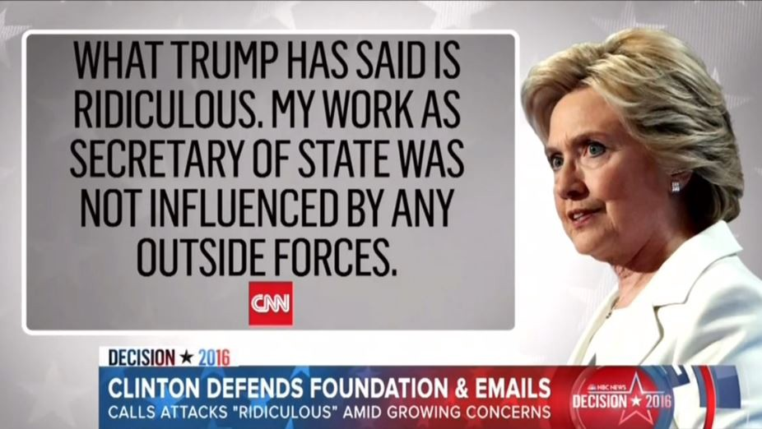
NPO’s and Corruption
Emerging press allegations against the Clinton foundation – a Not for Profit Organisation indicate that it has been used in a
“Pay to play” scandal .
During her tenure at the State Department suspicious donations were received which may have been related to influence peddling
In 2010, the foundation accepted $500,000 from the Algerian government, but they never disclosed the donation to State Department.
A $12 million donation from the King of Morocco was also not disclosed. Bill Clinton also received $1million “ birthday gift” from the government of Qatar .

Slide 38
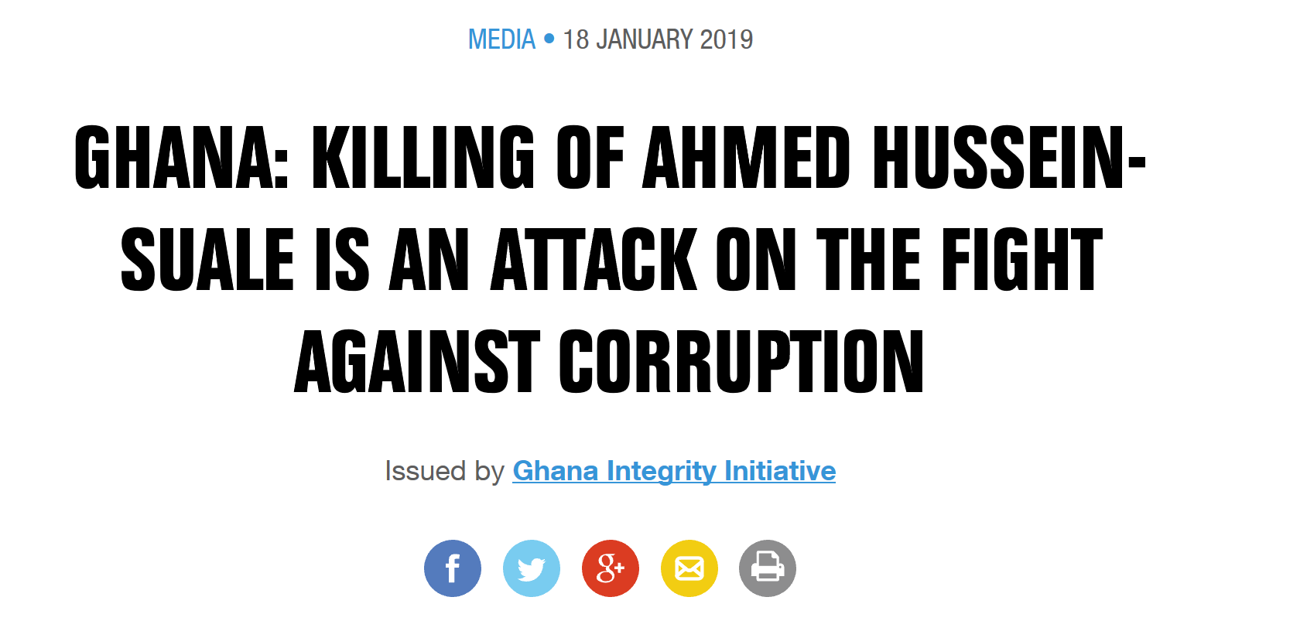
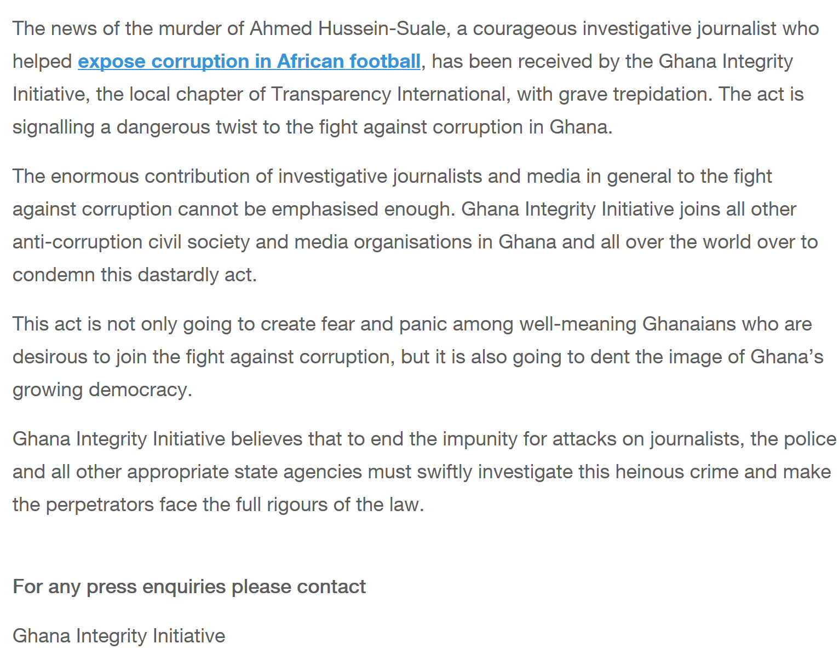

Slide 39
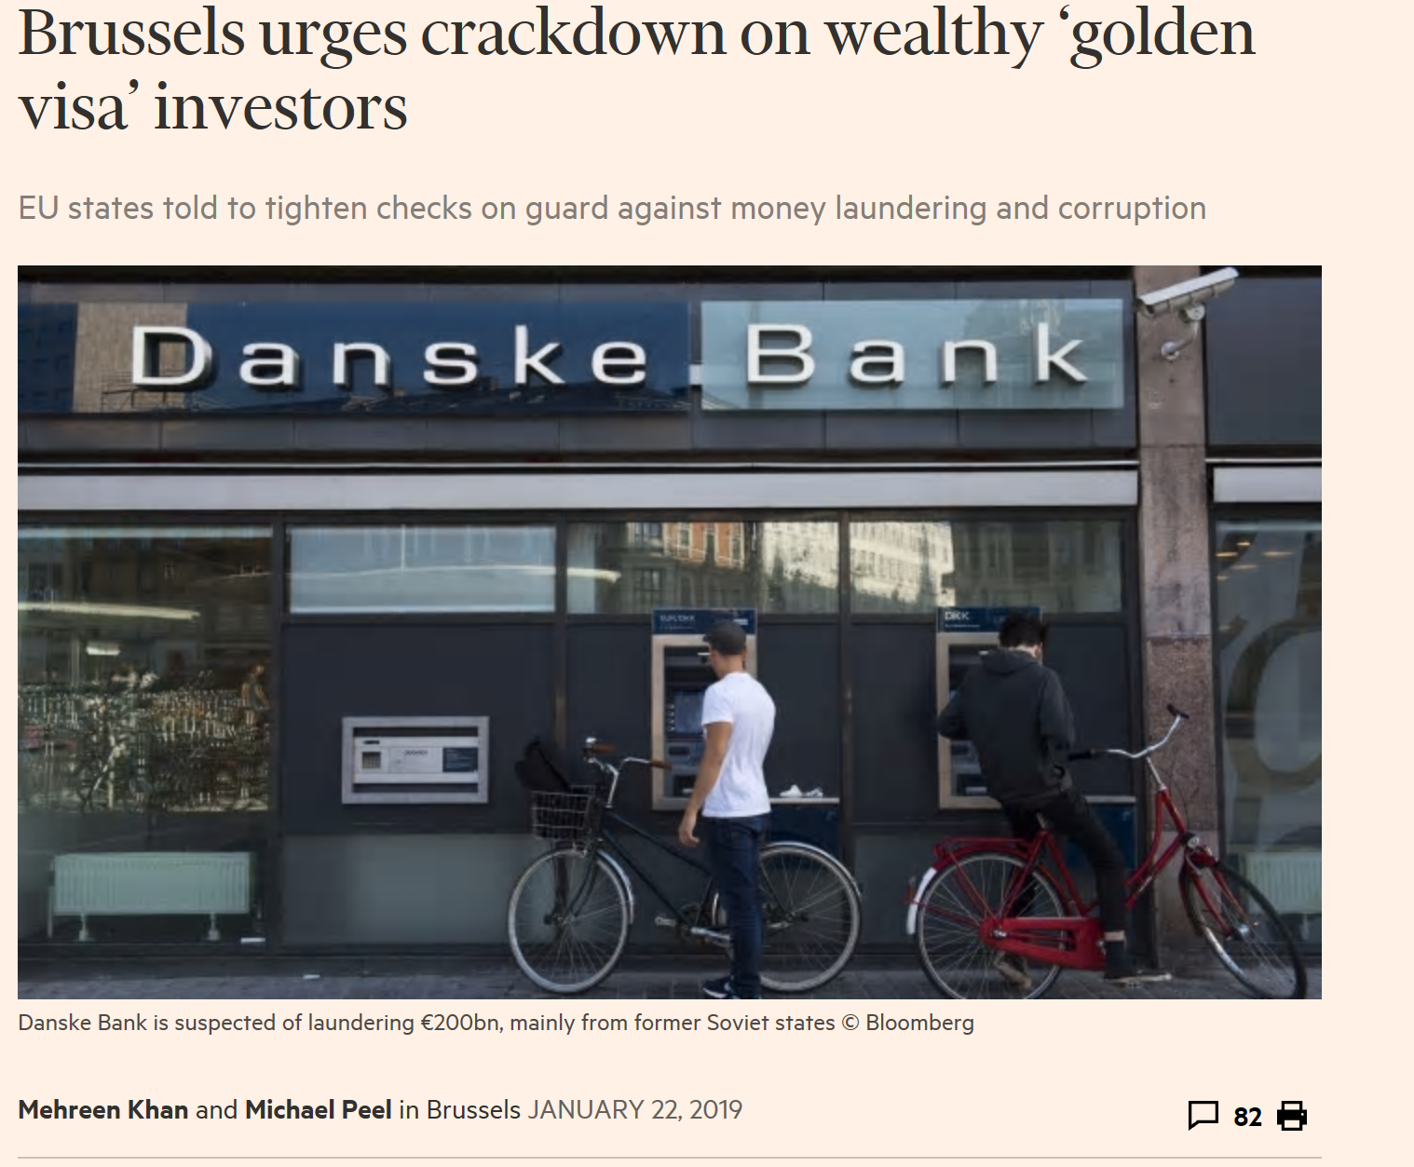

Slide 40
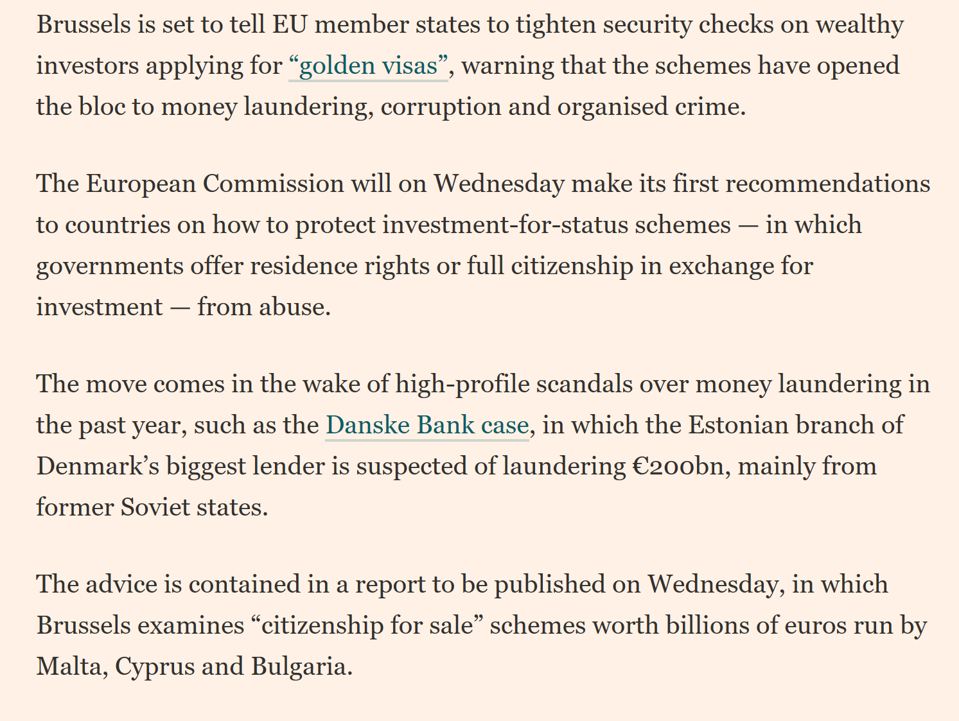

Slide 41
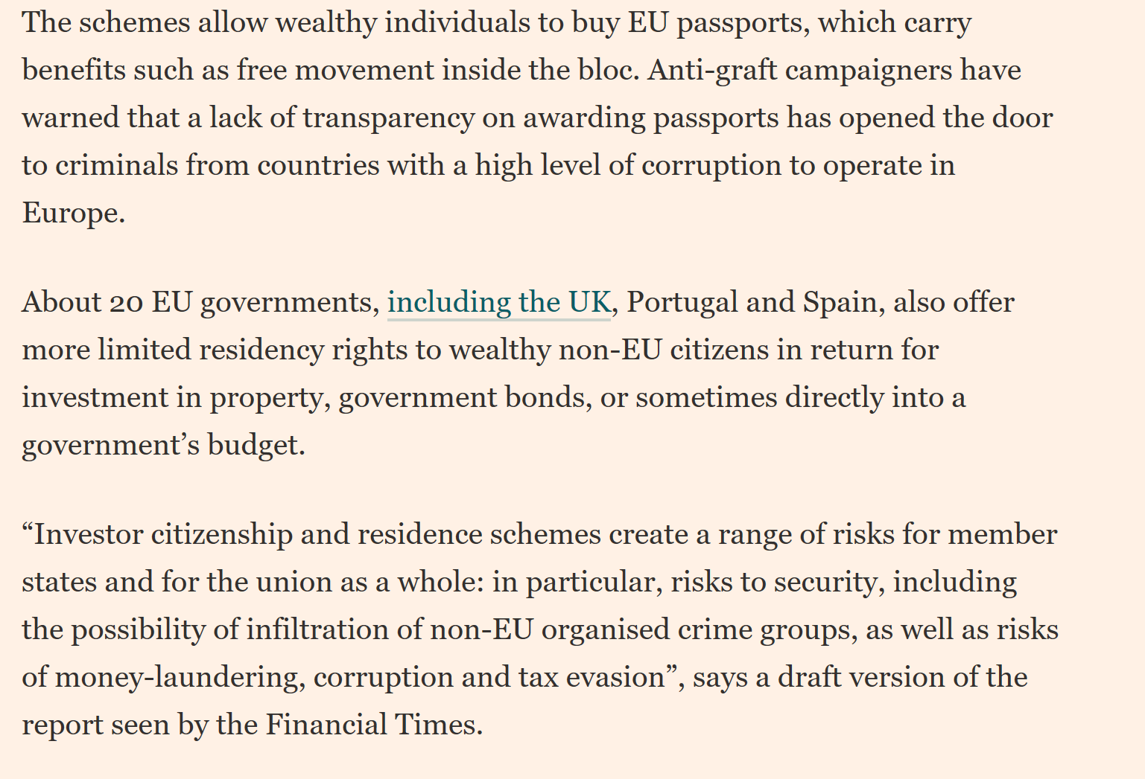

Slide 42
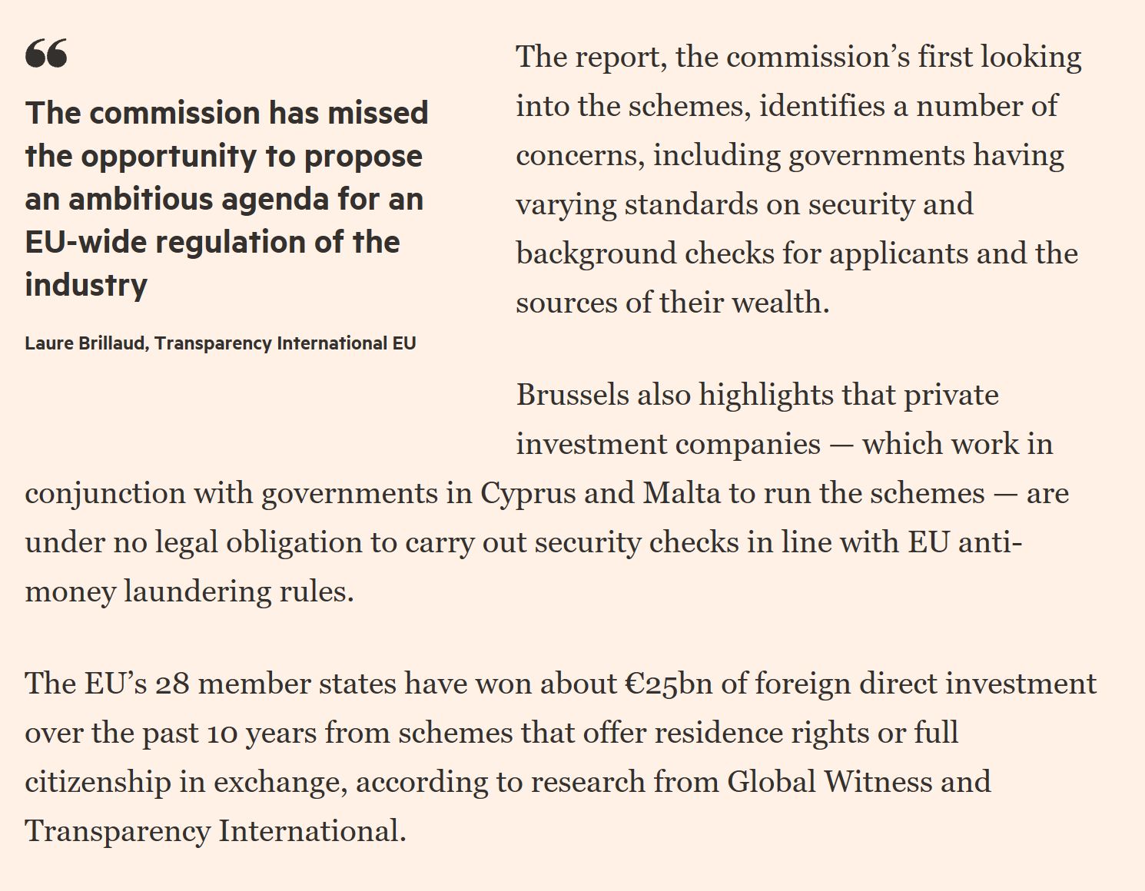

Slide 43
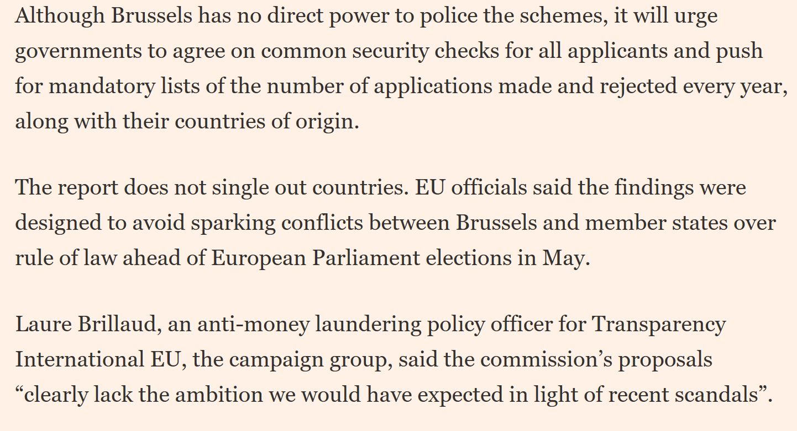

Slide 44
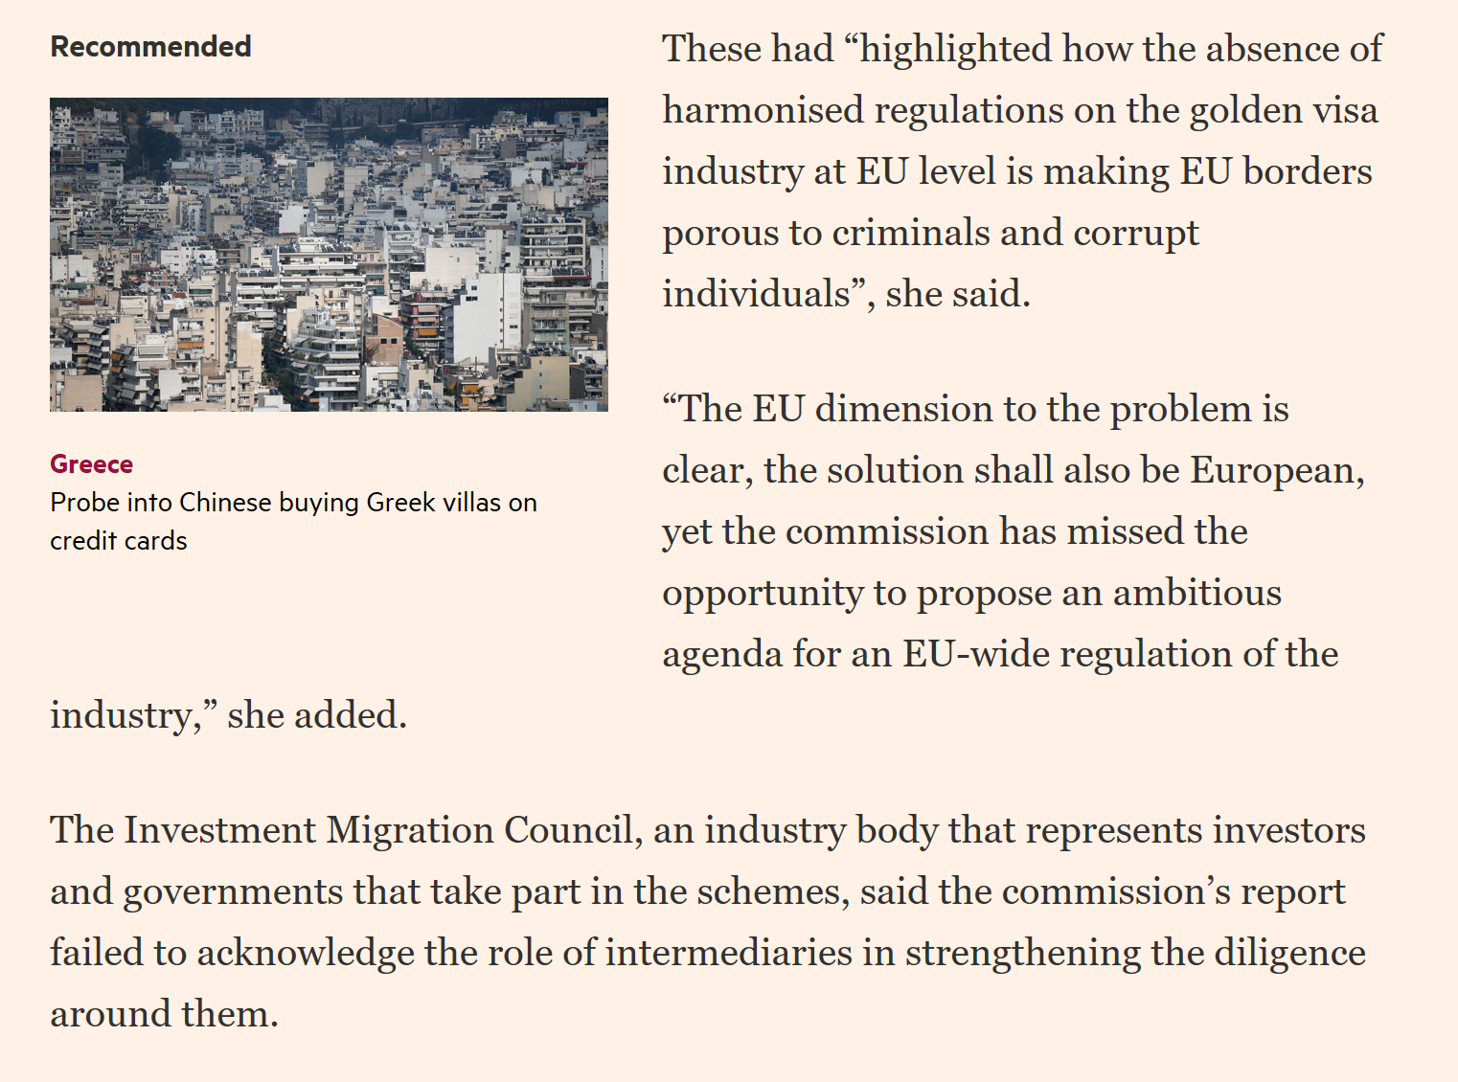

Slide 45
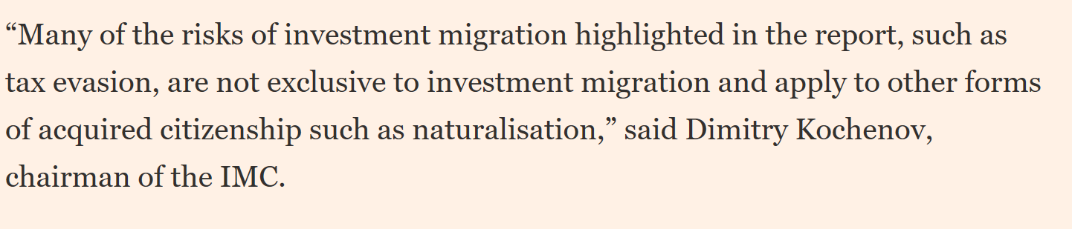

Slide 46
Session End
Greg Kelly – Senior Investigation Officer
HMRC Fraud Investigation Services – Economic Crime Operations Unit

