Slide 1

An Introduction to Money Laundering

Slide 2

What is Money Laundering?
The way in which funds derived from criminality are moved to make it difficult for LEAs to prove the links to where it originated from
It is a practice used to disguise the origins of the funds and to make it look like it has come from a legitimate source
Ie: the cleaning of “dirty” or “tainted” money in essence “legitimising the proceeds of crime”

Slide 3
FATF Definition
“money laundering is the processing of criminal proceeds to disguise their illegal origin.”
“This process is of critical importance, as it enables the criminal to enjoy these profits without jeopardising their source.”

Slide 4
Why is this important to criminals?
It allows them to have control of their money, whilst avoiding the suspicions of the regulated sector and Law Enforcement Agencies
It allows them to invest it to grow more money, either by introducing it into the mainstream legal procedures (buildings, land, etc), and/or,
It allows them the opportunity to reinvest it back into other criminal activity, which will yield further benefits to be laundered
It allows the criminal to spend their money without fear of reproach from LEAs

Slide 5
Why is it important to us?
Money Laundering has the potential to threaten:
The national security of a country
The national prosperity of a country
The international reputation of a country
Notes:
If a country relies on its financial sector as critically important to its economy, then high end money laundering ie: the laundering of large sums of illicit funds through the financial and professional services sector, can undermine the integrity and reputation of a country’s financial system and international reputation. This can affect investment into the country and have many other repercussions

Slide 6
Scale of Money Laundering globally
In 2023 it was estimated that a total of around $800 Billion to $2 Trillion is laundered each year
This is roughly equivalent to 2% to 5% of the gross domestic product (GDP)
Notes:
According to United Nations Office on Drugs and Crime – 28 May 2024

Slide 7
Money Laundering in the UK
Nearly 40% of the dirty money in the world is going through the City of London and other crown dependencies (1)
Up to July 2023 over 70% of Properties sold in Central London that year had been bought using cash ie: mortgage free
That compares with an average of the UK as a whole of 35%
Notes:
(1) Reported by The Guardian newspaper on 14th May 2024 as stated by the UK Deputy Foreign Secretary

Slide 8
Traditional Model of Money Laundering
Placement
Layering
Intergration

Slide 9

Placement
Street Cash is obtained from crime, selling drugs, stolen goods, non-duty paid goods etc.
These funds have to be “placed” into the regulated sector
This is the point of the process which poses the greatest risk to the perpetrator as they run the risk of discovery
Often cash is “structured” or “smurfed” to get it into the system
Making multiple small deposits instead of one large deposit
Repeatedly betting on the favourite /or red or black in casinos

Slide 10

Layering
Once inside the regulated sector the criminal property is moved around
May move from account to account in back-to-back transfers
Transferred from one company to another company
Transferred out of the jurisdiction to another country
Notes:
The hardest part after the funds have been placed into the regulated sector is moving the funds so as not to arouse suspicion from the institution

Slide 11

What is the purpose of these movements?
The hardest part after the funds have been placed into the regulated sector is moving the funds so as not to arouse suspicion from the institution
Firstly, it creates distance from the original deposit and thereby from the criminal source
Secondly, it “muddies the waters” for LEAs trying to investigate the source of the funds, which in turn creates barriers to conducting an effective investigation.

Slide 12

Integration
The criminal funds have now been successfully distanced from its origin
Deposited into a shell company in the Bahamas or BVI
Set up a fake company, who in turn make a loan to the criminal
They use the “loan” to purchase a new House, boat or a car
There is no oversight to check if he repays the loan
The fake company will never ask him to repay it
The cash derived from his crimes now appears to be a loan from an offshore company.

Slide 13
Money Laundering Cycle

Slide 14
Issues with the traditional Money Laundering model
Designed in the 1970’s to explain money laundering from drug trafficking
In over 70% of HMRC’s cases the criminal property is already in a bank account when the crime is committed
The model does not apply to Corporations or High Net Worth individuals who rarely use cash
Some elements of it apply to most of what is seen in money laundering systems where cash is obtained as benefit
Many systems of money laundering do not depend on the repeated movement of cash

Slide 15
Platt’s Model
Stephen Platt (2015) has produced a model which better explains high level money laundering (Criminal Capital –How the Finance Industry Facilitates Crime)
•It is more focused on Corruption, Fraud and Corporate Crime than street dealing
•It highlights the role played by Regulated businesses in enabling financial crime
•Better explains Money Laundering in a Globalised World

Slide 16
What do all criminals want?
Succeed in perpetrating the crime
Avoid detection
Benefit from the crime
Retain the benefit from the crime
Platt states that the financial sector can be exploited to achieve all these aims by:
Disconnecting the criminal from the crime
Disconnect the crime from the property
Disconnect the criminal from the property

Slide 17
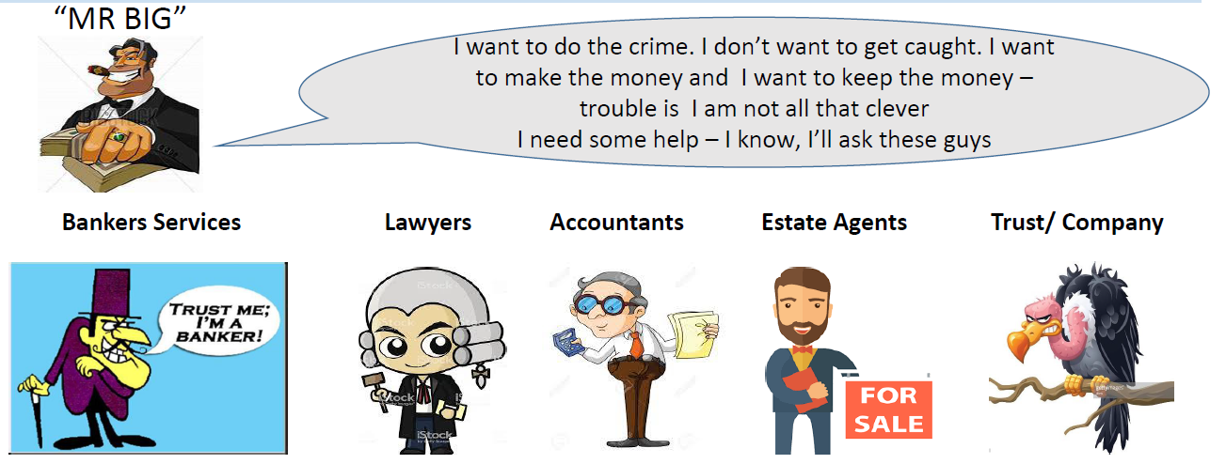
Criminal Objectives

Slide 18
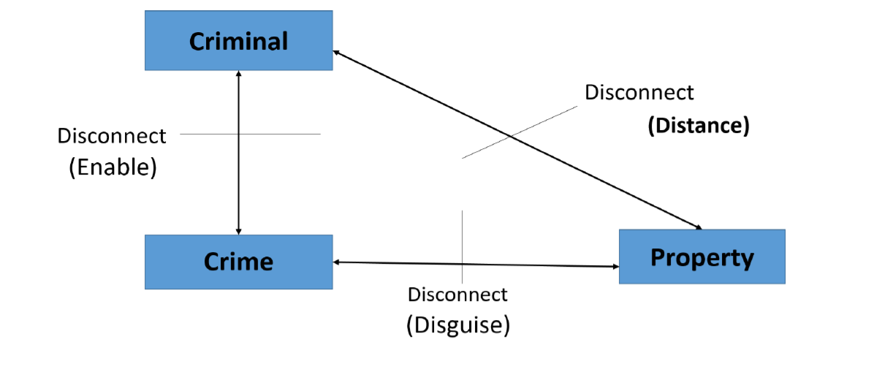
Enable, Distance and Disguise

Slide 19
Disconnecting
The Criminal, The Crime and the Property are connected by three axes
Financial Services can help the criminal by disconnecting each of these axes
Enabled crimes disconnect the criminal from the dirty act itself through corporate structures or Enablers
The criminal is Distanced from the property obtained through the financial sector
The link between the crime or the criminal and resulting property is Disguised

Slide 20

Enabling
Most serious financial crime is enabled by the financial sector
Companies protect the criminal’s identity
They create an appearance of legitimacy
If I request a £1,000,000 loan as an individual I am unlikely to get it
If Barclay Devere Holdings PLC tries to obtain the same loan it is more likely to succeed
Either of these may be a legitimate application or not –which one would you be more likely to grant?

Slide 21
Distancing
Having secured the loan the fraudster might open bank or brokerage accounts in the company name
The money can then be laundered through a series of share and currency transactions
The money in the company bank account is thus converted from a fraudulent loan
Through a series of share and currency deals
Into a Yacht moored off the Coast of Antibes

Slide 22
Disguising
Of course, the Criminal will not own the final benefit from his crime in his own name
The ownership of the yacht is vested in a Trust
In the British Virgin Islands
The criminal is free to enjoy the Yacht whenever he wishes
But on paper it is owned by a Trust on the other side of the World

Slide 23
How do we combat the use of the Regulated Sector?
Regulated businesses must make Suspicious Activity Reports (SAR)
If they suspect that any of their customers are involved in money laundering or terrorist financing
They are a primary source of financial intelligence
How many SARS/ STRS were produced in your country last year? (1)
What did you do with them ?
Notes:
(1) The UKFIU receives over 460,000 SARS a year, which they share with UK LEAs via a secure channel

Slide 24
Summary and where next?
Cash transactions
Front companies
3rdParty Payments
Cryptocurrencies
Gold
Shell companies
Charities / NPO’s
Trade
Trust Arrangements
Prepaid cards / Store cards

Slide 25
Session End
Greg Kelly (Senior Financial Investigator – HMRC Fraud Investigation Services – Economic Crime Operations Team)
Greg.Kelly@hmrc.gov.uk

