Slide 1

ARGENTINA
ACCOUNTING EXPERT OPINIONS

Slide 2
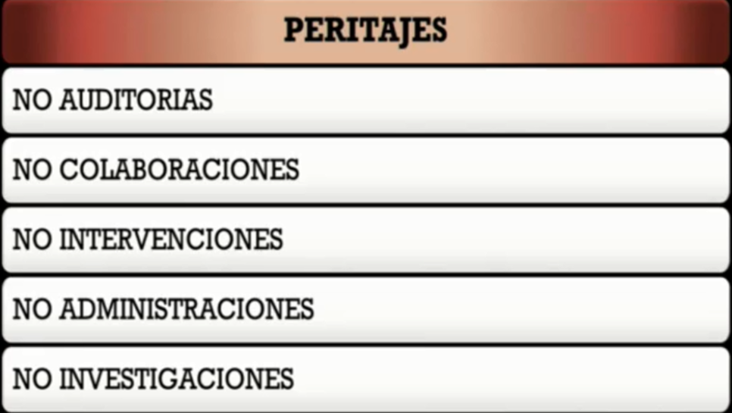
INVESTIGACIÓN vs. PERITACIÓN

Slide 3
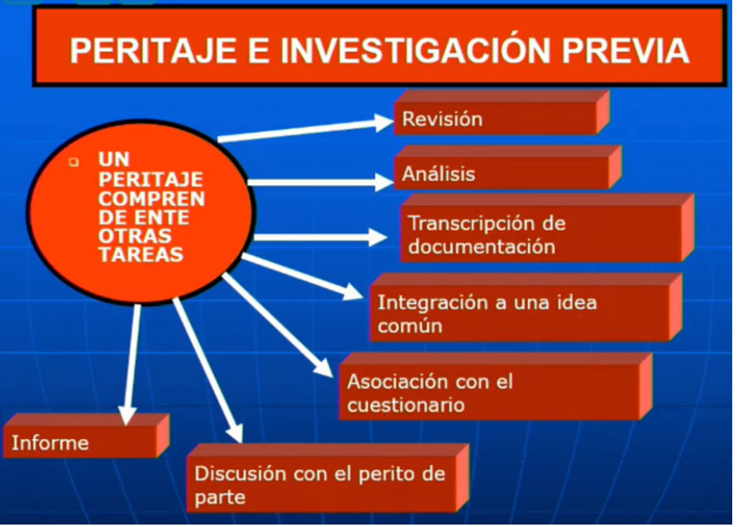

Slide 4
The majority of expert opinions in criminal investigations of facts related to so-called "white-collar" crimes are accounting-related.
Delays in criminal proceedings conspire against the establishment of the truth.
"AMIA bombing": Reports 1995 - Statement to the T.O. in 2004.
"Coimas en el Senado": Report June 2001. Statement before the T.O. in 2013.
Kohan: Reports in 1999/2006. Called to testify before the T.O. in 2013.
Granillo Ocampo: Reports and expert opinions in 2004 - Statement before the T.O. in 2018.

Slide 5
ACCOUNTING EXPERT OPINIONS
Depending on the proceedings, expert accounting evidence may be required. The investigating judge establishes the time at which the expert opinion is to be carried out and draws up the points of expertise.
Subsequently, he informs the parties so that they can suggest other points and, if they wish, propose a party expert.
To the extent that the judge considers them useful for the investigation, he accepts the incorporation of new questionnaires.
The party expert must accept the position, taking an oath to tell the truth.
Despite being linked to one of the parties, he or she must act independently and impartially, and be objective in his or her technical judgements.
This does not preclude that, while exercising his function as an Expert, he protects the interests of the party who has proposed or hired him, but without breaching his oath.

Slide 6
ACCOUNTING EXPERT OPINIONS
The official expert is a permanent judicial officer.
The central objective of the expert's work is to answer the questionnaire set and authorised by the court.
The analysis of the questions leads to the documents and records required. If he or she is unable to access the evidence deemed necessary, he or she will inform the court so that the necessary measures can be taken to obtain it,
It should not be forgotten that the experts need to know the accumulated evidence on the points that constitute the object of their expertise in order to form their judgement, and for this purpose they can request the judge to allow them to see, review and examine as many documents and objects as necessary.
The expert's work is carried out jointly, the experts shall examine together, deliberate in a secret session, which only the judge may attend, and if they are in agreement, they shall draw up their report jointly. Otherwise, they shall give their opinions separately.

Slide 7
ACCOUNTING EXPERT OPINIONS
The expert accountant decides what evidence is necessary to answer the questionnaire set by the judge. The books, registers and documentation required, as well as the working procedures and analysis of the documents.
In the performance of his duties, the expert will be free to examine the points submitted to his examination by means of the operations he deems convenient and with the methods he considers appropriate. This is what is known as the scientific freedom of the expert's task.

Slide 8
EXPERT'S REPORT
The conclusions reached in the report must be reasoned.
It shall consist of an explanation intended to demonstrate why the expert concludes as he does, based on principles, arguments or deductions of a scientific or technical nature. It shall constitute the logical link between the operations carried out and the conclusions reached by the Expert.

Slide 9
STRUCTURE OF THE EXPERT REPORT
The structure of the expert report should contain:
Title
Details of the court and the case
Experts involved
Proceedings carried out
Expert’s Plexus
Identification of the books and other documentation gathered
Response to each point of expertise and its conclusion. Dissent, if any
Place and date of the report.
The addressees of the reports are laypersons in accounting or technical matters, which is why it is necessary to use understandable language that allows the judge and lawyers to clearly understand the content of the report, especially the conclusions that are issued. In this way it will be easier for the judge to establish its impact on the process and its evidentiary value.
.

Slide 10
EXPERT PLEXUS
DEADLINE FOR THE APPOINTMENT OF AN EXPERT
JOINT DRAFTING - INTERDISCIPLINARY WORK
SPECIFICATIONS
ANY OTHER FACTS OR CIRCUMSTANCES
COMMON PROBLEMS
generic questionnaires
questionnaires that set expert accountants tasks or issues outside the scope of the expert's work
duration of the expertise
registration of Experts on lists
Expertise vs. investigation (investigation period)
Formal vs. material truth

Slide 11
PROFESSIONAL ACCOUNTING WORK
ESTABLISHMENT OF MARKET VALUES
ECONOMIC LOSS TO THE STATE (VALUATION)
SIGNIFICANT INCREASE IN WEALTH (“Appreciable”)

Slide 12
BODY OF EXPERTS - EXPERT COLLEGE
INCOMPLETE DOCUMENTATION (conspires against time)
NO INVESTIGATION - "FORENSIC" EXPERTS
DELIBERATIONS
SEPARATE REPORT

Slide 13
ACCOUNTING EXPERTISE
The evidential value of the expert opinion is the exclusive merit of the judge. Taking into account the expertise of the people, the principles on which it can be based, following the rules of reasoned judgmen, and other elements of proof, the judge will form his own conviction, assigning it the value he deems appropriate for the solution of the dispute.
It has been repeatedly stated that "The expert is an auxiliary of justice and his mission consists of contributing to the formation of the judge's conviction, which is why the expert's work does not, in principle, have a binding effect. However, the fact that the expert's opinion does not bind the judge, except in cases where the law so requires, does not mean that the judge can arbitrarily depart from the expert's well-founded opinion. In order for the judge to be able to deviate, he or she must give well-founded reasons. When the expert opinion appears to be based on technical principles and there is no other evidence to disprove it, reasoned judgmen recommend accepting the expert opinion because it is a matter that requires an eminently technical speciality, this expert opinion takes on greater hierarchy and decisive importance".

Slide 14
NATURE OF THE REPORT
IS ONE MORE PIECE OF EVIDENCE

Slide 15
EXPERT ACCOUNTANT - ORAL TRIAL
It is very likely that the expert accountant will be summoned to the oral trial to answer any questions that the parties may ask regarding his report.
The rules of perjury apply to the expert.

Slide 16
Body of Experts of the Judiciary of the Nation, Specialised in Cases of Corruption and Crimes against the Public Administration.
Created by Resolution 34/14 of the C.S.J.N., dated 21/10/14.
Its purpose is to provide specific assistance to the jurisdictional bodies of the criminal justice system, in cases in which crimes of corruption, crimes against public administration and economic crime are investigated.
Experts: Engineers, accountants, lawyers and professionals from other scientific disciplines who, in the opinion of the Supreme Court of Justice of the Nation, are necessary for the fulfilment of its objectives; they must have accredited experience in the field, in accordance with the provisions of the Inter-American Convention against Corruption and the United Nations Convention against Corruption.

