Slide 1
Cash Economy – Investigative Techniques
Ralf Oberle

Slide 2
Introduction into Cash Economy:
Part 1 - traditional cash businesses
Part 2 - cash business or cash-system used for other activities
  Part 2 Focus on ML
Part 3 - Risk indicators
Part 4 - Detection
Part 5 - Investigative Techniques
Part 6 - Money Laundring
Part 7 - Money Laundring

Slide 3
Practical Exercise:
Please define the 3 most risky cash economy or related areas in your countries (as explained in Part 1,2,3)!
Explain the related problems of detecting – investigating - finishing the cases!!
What could be defined as risk indicators?

Slide 4
Part 1:
What is traditonal cash economy – cash business?
The majority of turnover is generated with cash payments!

Slide 5
Cash business „risk“ areas:
Open markets
Newly founded companies
Tourist sector – Hotels / Bars / Red Light Districts / Restaurants / Dancing Bars /
Groceries, retail stores, supermarkets
Agricultural product sellers (farmers/…)
Construction sector ………….

Slide 6
Related problems:
Any kind of products / services possible
Usually services / products meant for final consumers
Cash is not traceable
No crosscheck possibility – leak of info
No regular prices – quality, region, other price influences
Apparently small businesses – front stores

Slide 7
Related problems:
No tax files – non declaration of taxes
Non regulated markets
International approaches
No bookkeeping
Use of front persons / strawmen
Fast business – different locations
No or not so high gains in general
Organized structures

Slide 8
Part 2:
cash business or cash-system is used for other activities“criminal“?
Use of at least one or more business sectors for criminal activities related / linked to / with cash-money!

Slide 9
Part 2:
The cash-payment-system itself is used for other criminal activities!
Different payment platforms
Currency exchange
E-commerce system (B2B payments..)
Etc……..

Slide 10
Cash business „risk“ areas:
Open markets
Newly founded companies
Tourist sector – Hotels / Bars / Red Light Districts / Restaurants / Dancing Bars /
Groceries, retail stores, supermarkets
Agricultural product sellers (farmers/…)
Construction sector ………….

Slide 11
Cash business „risk“ areas:
All traditional cash economy, cash business areas as described in Part 1!
All related problems

Slide 12
Related problems:
No tax files – non declaration of taxes
Non regulated markets
International approaches
No bookkeeping
Use of front persons / strawmen
Fast business – different locations
No or not so high gains in general
Organized structures

Slide 13
Other criminal activities:
Money laundering – trade based / merchant based (B2B payments)
Covering / hiding illegal income
Bribery and corruption
Tax fraud out of other non cash related activities
Terrorist financing
Fraud in other areas

Slide 14
The Cash system:
Use of cash payments
Different systems
Mixture of using the different systems
eG for Fraud / etc

Slide 15
Risk Areas:
Non-regulated, alternative payment platforms based on cash payments – Western Union, Hawala…
E-commerce B2B system
But also all the cash business areas described in Part 1

Slide 16
Part 2: Focus on money laundering:
Laundering of illegal money
Use of (semi-) legal business
  Mix of legal and illegal gained money (Service businesses are best suited to this method - little or no variable costs and/or a large margin between revenue and variable costs)

Slide 17
Part 2: Focus on money laundering:
Laundering of illegal money
  Use of digital electronic money
  electronic money provides as easy a method of transferring value without revealing identity, especially wire transfers involving anonymity-protecting numbered bank accounts – e.g. Liberty Reserve
  Online gaming/ - gambling
  E.G Second Life and World of Warcraft, it is possible to convert money into virtual goods, services, or virtual cash that can later be converted back into money

Slide 18
Part 2: Focus on money laundering:
Laundring of illegal money
  Reverse money laundering
  Reverse money laundering is a process that disguises a legitimate source of funds that are to be used for illegal purposes – eg collecting of funds for terrorist financing purposes

Slide 19
Part 3 - Risk Indicators:
Business areas themselves
Comparison business to business
Single products, goods, services, ….
Way of doing business – the flow of business
Non regulated markets/payments/systems
Location of business
Compliance behaviour
………………….

Slide 20
Risk Indicator Topics
Techniques to find risk indicators
Accounting and financial risk indicators
Risk indicators and challenges specifically in the cash economy
How to find Information – techniques, sources, databases
Profiling models – how to identify potential cases

Slide 21
Part 4 - Detection possibilities:
What do you think are the detection possibilities?
How do investigation units get notice of risk areas/problems/cases?
Group discussion!

Slide 22
Detection possibilities:
Informants
Whistleblower
Self case detection by evaluation of general infos – intelligence units
Audit activities
Random case selection in risk areas
Investigative techniques

Slide 23
Part 5 - Investigative Techniques eG:
Audits – get knowledge about the business
Surveillance, observation after getting notice of business
Information exchange national/internat.
Inter-agency co-operation police / customs / industry or business areas
Digtal techniques

Slide 24
Digital Techniques:
Margin comparison
Gains comparison
Business figures at all
Cost structures compared – eg employees visa turnover
Special different business database- crosschecks of databases

Slide 25
Other / New Digital Techniques:
Visualization of business figures
Technical check tools / for failure detection out of high volume data bases – Monetary Unit Sampling
Summarised Risk Audit (SRP) based on the principle of a
„Time Series Analyses“

Slide 26
Examples for Other / New Techniques :
Definition MUS – Monetary Unit Sampling:
MUS
Monetary Unit Sampling, also known as probability proportional-to-size (PPS) or dollar unit sampling (DUS), is a statistical sampling method used to determine if the account balances or monetary amounts in a population contain any misstatements. Each individual dollar (i.e. monetary unit) in the population is considered a sampling unit, thus account balances or amounts in the population with a higher value have a proportionately higher chance of being selected.

Slide 27
Examples for Other / New Techniques:
Definition SRP Summarized Risk Audit
SRP = Time Series Analysis
Any metric that is measured over regular time intervals forms a time series. Analysis of time series is commercially importance because of industrial need and relevance especially w.r.t forecasting (demand, sales, supply etc).

Slide 28
Examples for Other / New Techniques:
SRP Summarized Risk Audit
Case example
Hotel with restaurant
Outside area
Christmas celebrations
New year celebrations
Additional participation on different markets

Slide 29
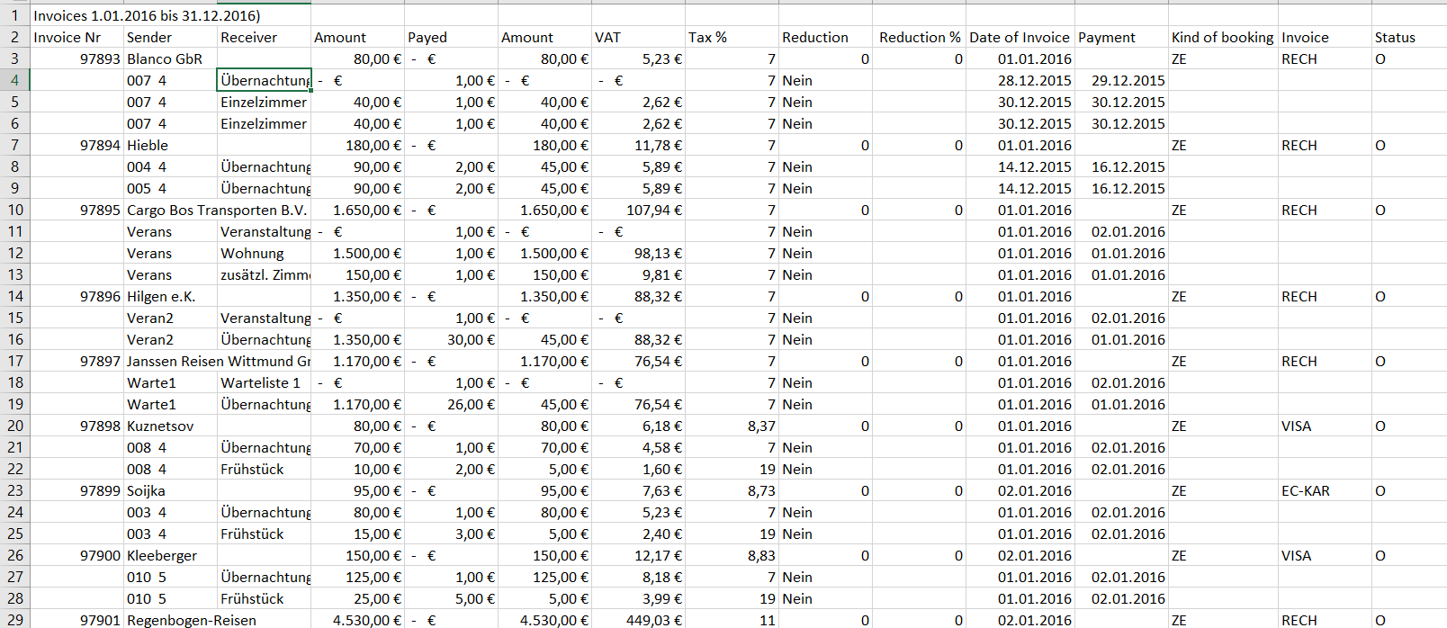
Examples for Other / New Techniques:
SRP Summarized Risk Audit
Invoice database out of hotel software

Slide 30
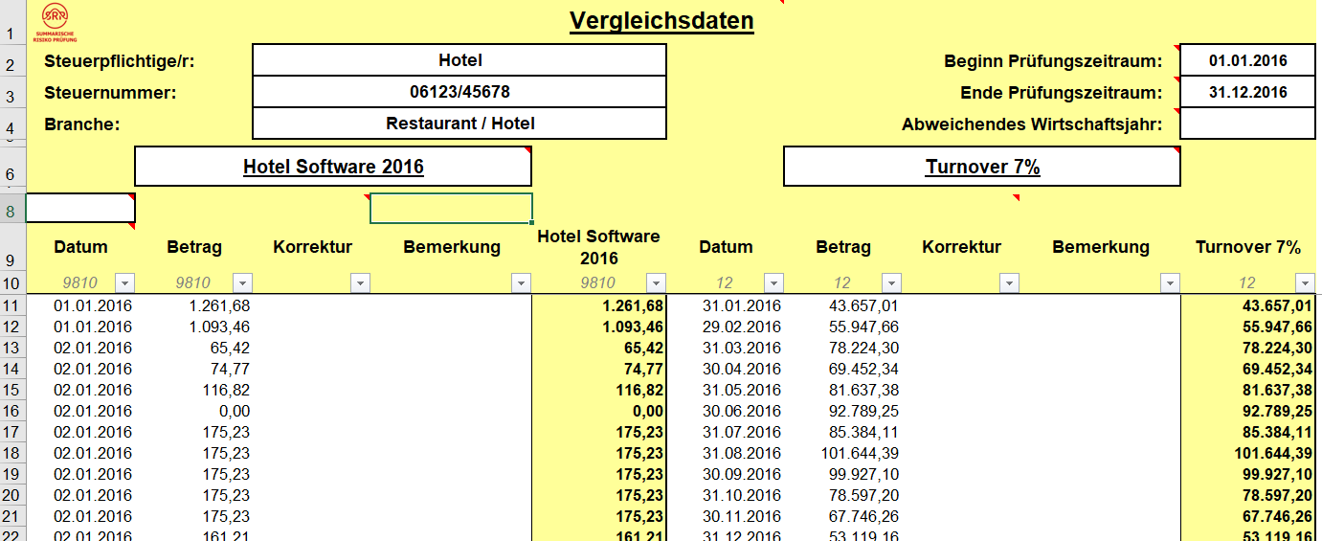
Examples for Other / New Techniques:
SRP Summarized Risk Audit
Invoice database out of hotel software
Import in summarized risk audit tool

Slide 31
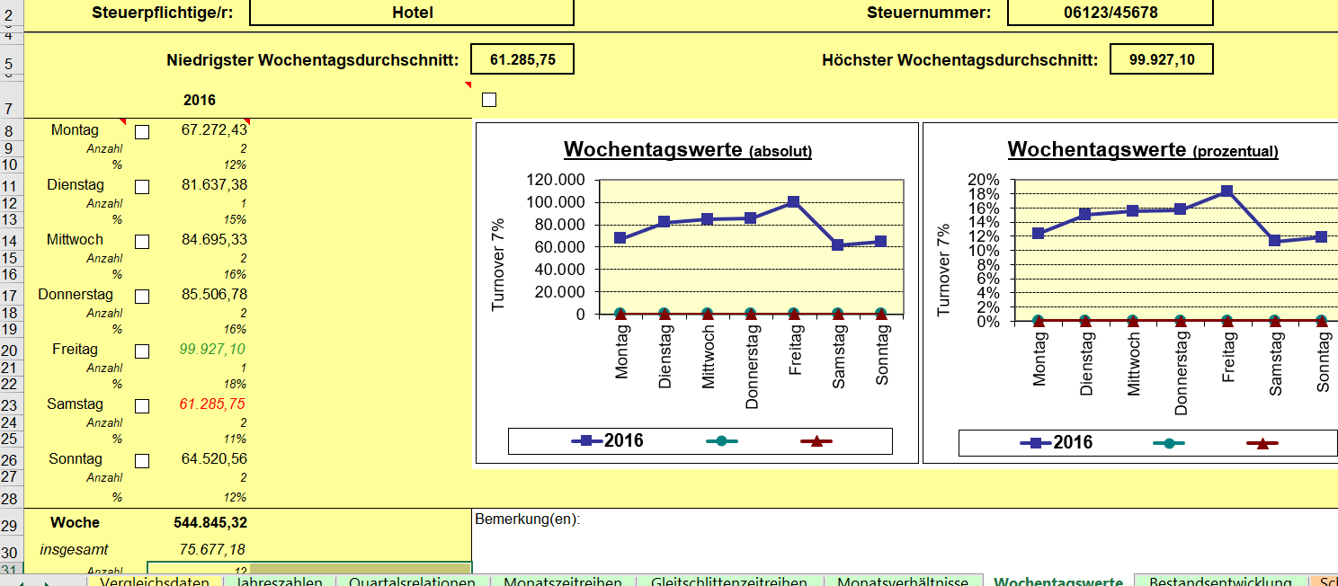
Examples for Other / New Techniques:
SRP Summarized Risk Audit
Invoice database out of hotel software
Import in summarized risk audit tool

Slide 32
Examples for Other / New Techniques:
SRP Summarized Risk Audit
Indicators
Reduced turnover on weekends
Usually busiest time for hotels in tourist areas
Restaurant evaluation:

Slide 33
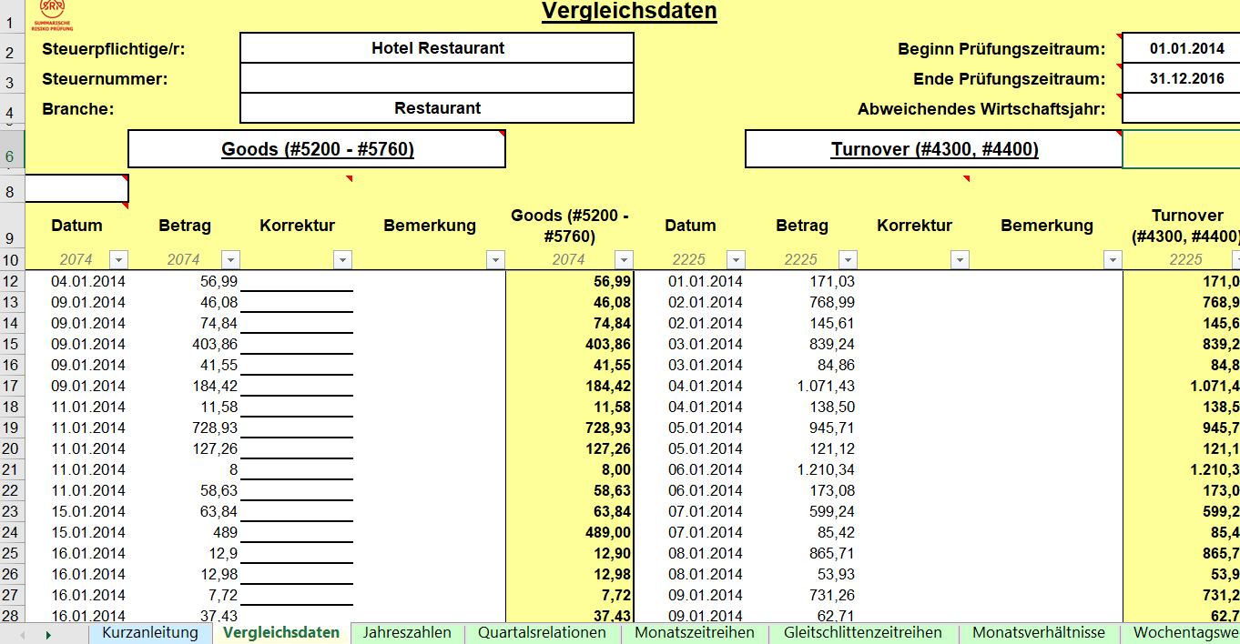
Examples for Other / New techniques:
SRP Summarized Risk Audit
Restaurant Data

Slide 34
Examples for Other / New techniques:
SRP Summarized Risk Audit
Evaluation based on time series analysis
Time series analysis
Average margin comparance
Cutting the pics 16 %
Calculation of available goods
RESULT:
No goods available for turnover ????

Slide 35
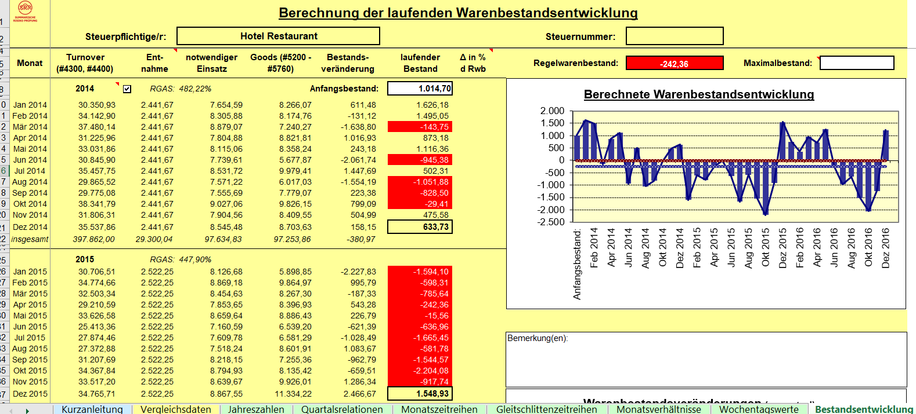
Examples for Other / New techniques:
SRP Summarized Risk Audit
Evaluation based on time series analysis

Slide 36
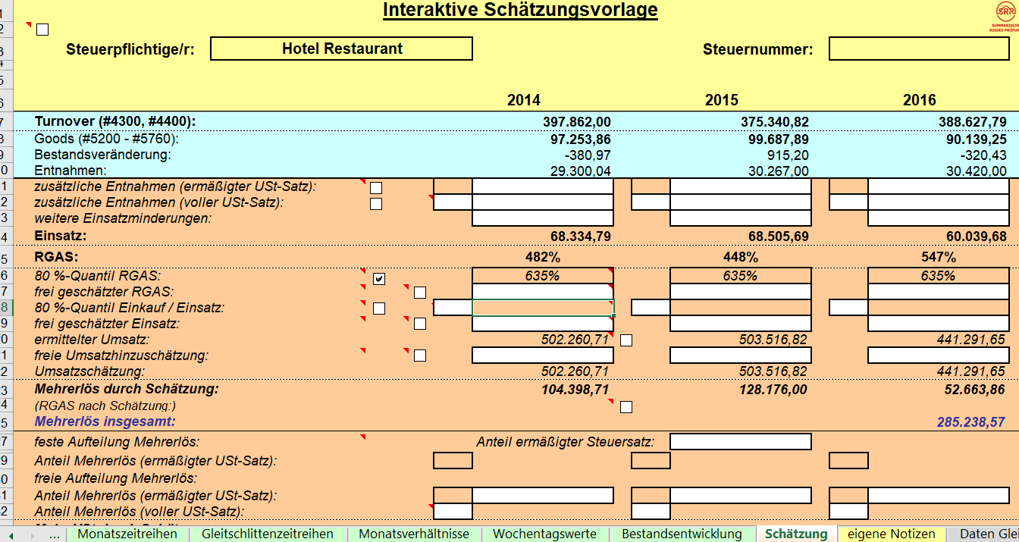
Examples for Other / New Techniques:
SRP Summarized Risk Audit
Estimation of turnover based on time series analysis – more € 285.238,57

Slide 37
Examples for Other / New Techniques :
Visualization of data
Visualization is often excel based or other software / a tool to visualize different figures / data sources in relation to each other in various diagrams

Slide 38
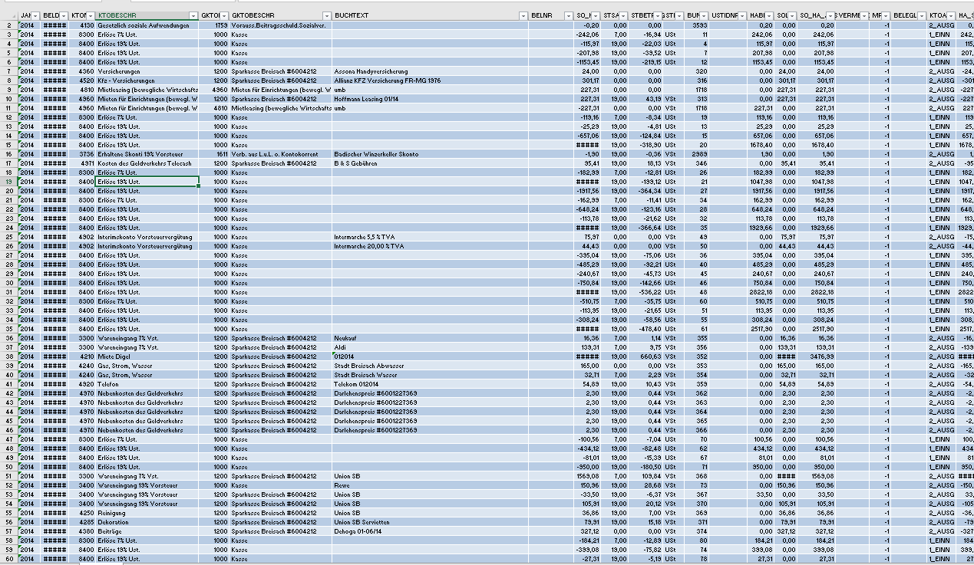
Examples for Other / New Techniques :
Visualization of data – Bookkeeping Data

Slide 39
Examples for Other / New Techniques :
Visualization of data – problems?
420.000 data sets?
How to explore?
Where to start?
Searching?
What kind of parameters?
Where are the indicators?

Slide 40
Examples for Other / New Techniques :
Visualization of data – example
Restaurant
Outside area
Christmas celebration
New year celebrations
Additional participation on different markets
No remarkable changes in business (same size, … employees, … suppliers….)

Slide 41
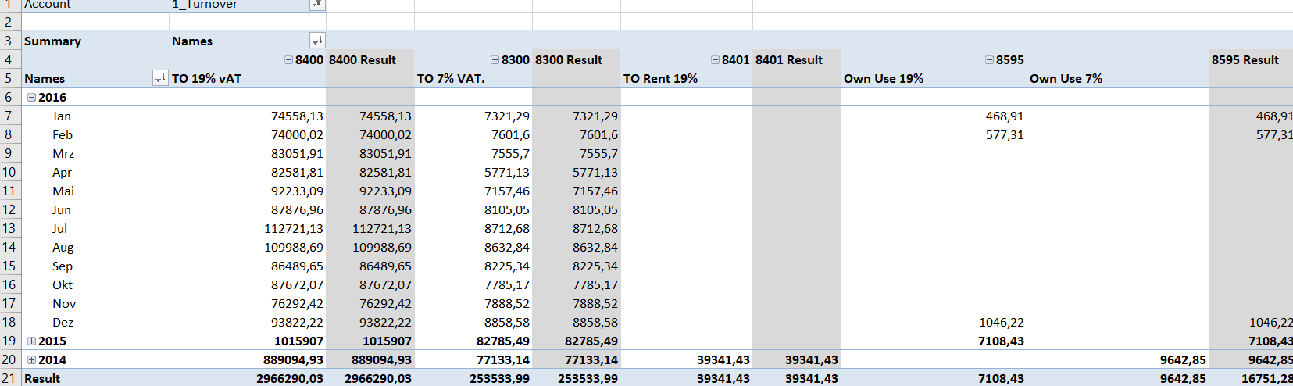
Examples for Other / New techniques :
Visualization of data
Edit data

Slide 42
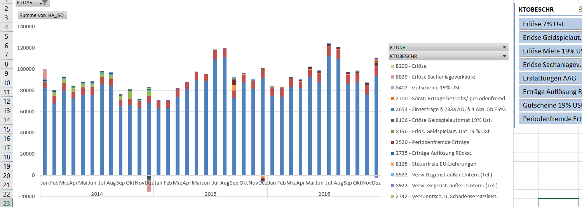
Examples for Other / New Techniques :
Visualization of data
Edited data – visualized

Slide 43
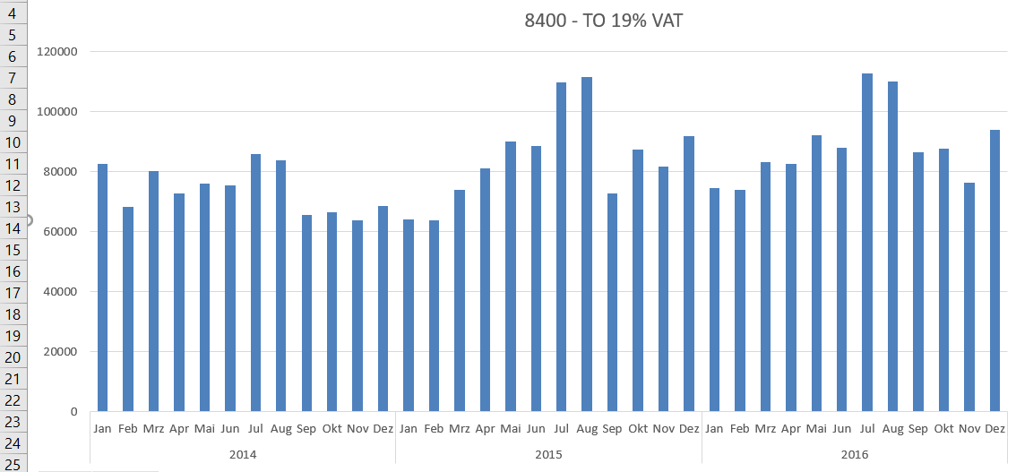
Examples for Other / New Techniques :
Visualization of data – account selection

Slide 44
Examples for Other / New Techniques :
Visualization of data – example
Indicators for problems
Summertime
- reduced turnover compared with other years
Christmastime
- reduced turnover – usually the busiest time of a year for restaurants

Slide 45
Examples for Other / New Techniques :
Visualization
Any expenditures
Turnover
Any other account like input VAT – output VAT
Almost everything could be visualized
…………………..

Slide 46
Methods of proof topics
Direct method of proof
  Specific item method
  Different schemes
Indirect method of proof
  Net worth method
  Projection method
Preparing for trial

Slide 47
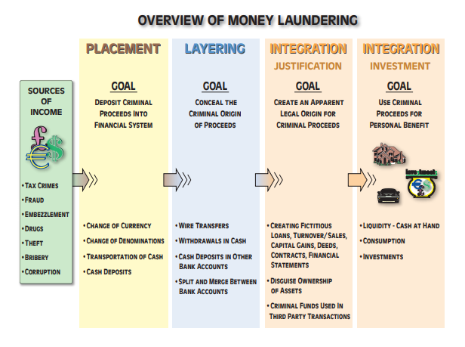
Part 7 - Money Laundring

Slide 48
Focus on detection of money laundring
All methodes mentioned before
  to detect while placement process e.g. criminal or criminal organization owns a legitimate restaurant business. Money obtained from illegal activities is gradually deposited into a bank through the restaurant. The restaurant reports daily cash sales higher than what it actually takes in

Slide 49
Detection of money laundring
All methodes mentioned before
  to detect while layering process e.g. to deal with tax issues – on example of the restaurant - further disguise the criminal source of the extra deposited funds, the restaurant invests the money in another legitimate business, such as real estate - further obscured from the authorities by using shell companies or holding companies that control several business enterprises that the laundered money

Slide 50
Detection of money laundring
All methodes mentioned before
  to detect while integration process e.g. – integration – the money is placed into legitimate business or personal investments (purchase high-end luxury goods, such as jewelry or automobiles. At this stage, the money has, ideally, been sufficiently laundered. The money is typically then either legitimately invested or exchanged for expensive assets such as property.

Slide 51
Indicators of Money Laundring
All indicators as for detection of fraud/tax evasion/............
  Everything unusal / suspicious
  Everything with no economical reason
  Under-valuing or over-valuing of property value
  Rapid successive buying and selling
  Use of third parties or companies that distance the transaction from the criminal source of funds
  ……………..

Slide 52
Indicators of money laundring –
  Real estate area
  Table of indicators of FINTRAC
FINTRAC = Financial Transactions and Reports Analysis Centre of Canada
Table of indicators

Slide 53


