Slide 1

ARGENTINA
THE INVESTIGATION BY THE PUBLIC PROSECUTOR'S OFFICE

Slide 2
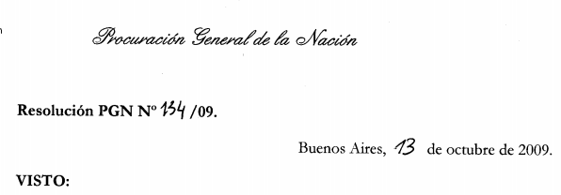
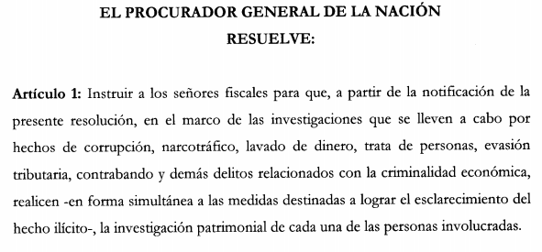

Slide 3
JOINT INVESTIGATION TEAMS
DIFFERENT TYPES OF CRIMES (Corruption, Trafficking in Persons, Evasion, Smuggling, Drug Trafficking, etc.)
ALL DIRECTLY RELATED TO THE PRODUCTION OF PROFITS OF ILLICIT ORIGIN.
NEED FOR "LAUNDERING" - COST/BENEFIT
INTERDISCIPLINARY TEAMS (Lawyers, accountants, IT experts, judicial police, etc.)

Slide 4
SOURCES OF INFORMATION
Often the information is in the possession of bodies (public or private) with which the person under investigation has close relations or with which he or she is directly dependent.

Slide 5
SEARCH FOR FINANCIAL AND ASSET INFORMATION
INVESTIGATION PERIOD
RESPONSE TIME
VERB: "ARE OR WERE".
WELL-PUTTED QUESTION (avoid wasting time)
PRIMARY FAMILY GROUP - FRONT MEN - CORPORATIONS
FORMAL TRUTH vs. MATERIAL TRUTH
INTERNATIONAL EXHORTIONS - DUAL CITIZENSHIP (ID card, national and foreign passport, date of birth, etc.)
ACCOUNTING EXPERTISE (is one more piece of evidence incorporated into the process)

Slide 6
PUBLICLY AVAILABLE SOURCES OF INFORMATION
AFIP: Registration
D.N. Registro Automotor: From the domain number - Surname and Name - Document number and/or CUIT - OBTAINED: Sectional Registry where a vehicle, machinery or motorbike is located
Veraz / Nosis: Financial information
Traffic offences (domain and / or document number)
INPI: Registry of trademarks and patents
Consultation of debtors of the BCRA: data on bounced cheques and general credit situation.
Search engines (Google and others), Facebook, Instagram
VERY BASIC INFORMATION THAT DOES NOT ALLOW TO OBTAIN INFORMATION OF REAL INTEREST FOR ASSET AND FINANCIAL RESEARCH.
Translated with www.DeepL.com/Translator (free version)

Slide 7
KEY-ACCESS INFORMATION SOURCES
DIR. NATIONAL DIRECTORATE OF MIGRATION
DIR. NATIONAL REGISTRY OF MOTOR VEHICLES
REGISTRY OF REAL ESTATE PROPERTY CABA
VERAZ / NOSIS
PROVIDES SLIGHTLY MORE PRECISE INFORMATION, BUT NOT ENOUGH FOR THE PATRIMONIAL AND FINANCIAL INVESTIGATION.

Slide 8
WRITTEN REQUESTS
Provincial and municipal tax agencies
FIU: Intelligence reports
Notaries
Accountants (Affidavits on origin and legality of funds)
Credit cards - Posnet
AFIP-ADUANA: RG AFIP 2704/2009 and its amendments (Declaration over us$ 10,000)
National Register of Ships and Yachts
ANAC (National Adm. of Civil Aviation): aircraft
Caja de Valores: stock exchange
Superintendence of Insurance (circularisation to insurance companies)

Slide 9
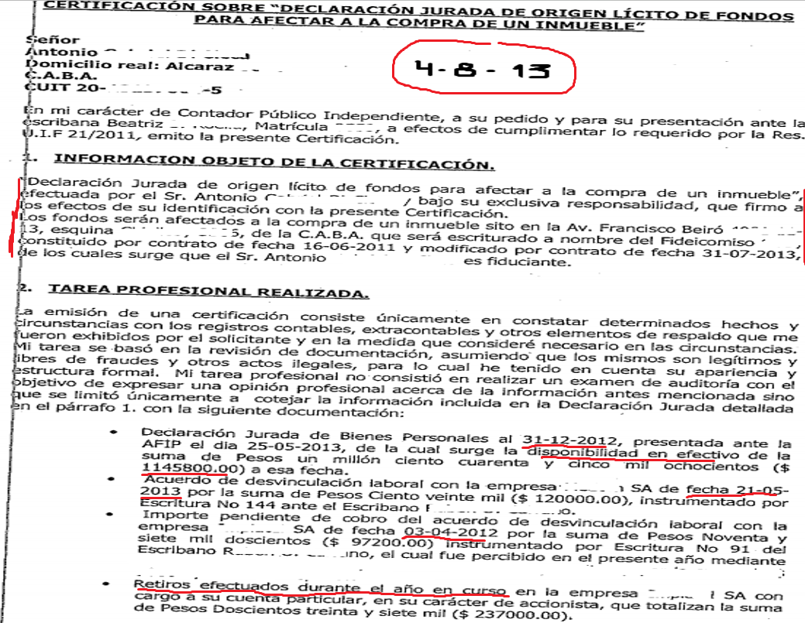

Slide 10
WRITTEN REQUESTS
Public utilities (water, electricity, gas, landline telephony)
Cellular telephone companies
Cable television and internet companies
Labour Risk Administrators (ART)
Motorways - Telepase
Vehicle Technical Verification (VTV)
Auto parts engraving
Western Union (money transfer or receipt of money to or from abroad)

Slide 11
ORGANISED CRIME
VS.
“DISORGANISED" STATE ?

Slide 12
PROBLEMS
TAX SECRECY: PROVISION (AFIP) 98/2009
Secrecy: All information of economic-asset content
Lifting of secrecy:
The Public Prosecutor's Office and specific investigation units that comprise it, by order of the competent judge or request of the intervening prosecutor. In the latter case, when:
It is in charge of the direction of the investigation, in accordance with the provisions of articles 180, second paragraph and 196, first paragraph, of the Code of Criminal Procedure of the Nation or,
b) it is a matter of complaints made by AFIP.
Fiscal secrecy is not opposed to the National Ombudsman's Office, in the framework of the provisions of Article 24 of Law 24284 and its amendment.
SOLUTION: TRANSFER OF THE TAX SECRECY TO THE REQUESTING BODY, UNDER THE SAME PENALTIES AS THOSE FORESEEN FOR THE AFIP.

Slide 13
PROBLEMS
REAL ESTATE REGISTRIES
One for each province
Current, not historical information
National Register of Companies: Law 26.047 of 3/8/2005
REGISTERS OF COMPANIES
One for each province
Company name
D.N. REGISTRO AUTOMOTOR (there is a historical register of ownership)
Sectional Registry
Licences authorised to drive
CENTRAL BANK
Bank secrecy
Circulation to financial institutions

Slide 14
PROBLEMS
Field research: Judicial police
Powers of attorney: Registration
Trusts: Registration
Anti-Corruption Office: Confidential Annexes
Accountants (Affidavits on origin and legality of funds)
Forms 08 transfer of automobiles
Confiscation (preventive seizure)

Slide 15
INTERNATIONAL COOPERATION
AIAMP (Ibero-American Association of Public Prosecutors) - 22 countries
Andorra, Argentina, Bolivia, Brazil, Colombia, Costa Rica, Chile, Cuba, Dominican Republic, Ecuador, El Salvador, Guatemala, Honduras, Nicaragua, Mexico, Panama, Paraguay, Peru, Portugal, Spain, Uruguay and Venezuela.
GAFILAT Asset Recovery Network" (RRAG) - 17 countries
Argentina, Bolivia, Brazil, Chile, Colombia, Costa Rica, Cuba, Dominican Republic, Ecuador, Guatemala, Honduras, Mexico, Nicaragua, Panama, Paraguay, Peru, Portugal, Uruguay and Uruguay.
Facilitating the identification and tracing, aimed at the recovery of assets, proceeds or instruments of illicit activities.
IBERRED (Ibero-American Network for International Legal Cooperation)
It brings together Ministries of Justice, Public Prosecutor's Offices and Attorney General's Offices, and the Judiciary (22 countries of the Ibero-American Community of Nations and the Supreme Court of Puerto Rico).

Slide 16
REPORTS SUBMITTED IN THE JUDICIAL PROCESS
The report with the information gathered and the conclusions of the asset investigation is presented in writing at the trial.
During the course of the investigation, the professional who will write the report (usually a public accountant) must carry out his work with the special consideration that he may be called as a witness during the oral and public trial - probably many years after he has written his report.
At the oral trial, he will be subject to questions from the prosecution, the defence, the complainants and the court itself.
As a witness, the rules of "perjury" apply to him or her.

