Slide 1




VIRTUAL SPECIALIZATION PROGRAM
INVESTIGATIVE TECHNIQUES
FOR THE CASH ECONOMY
March 14 - 23, 2022

Slide 2
CONTENTS
E-WALLETS
DIGITAL CURRENCIES AND CRYPTOASSETS
APOC RISK MATRIX
AUTOMATIC EXCHANGE OF FINANCIAL ACCOUNT INFORMATION - CRS

Slide 3
E-Wallets
Represents a year-on-year increase of 168.3% (compared to the first half of 2020).
170 million
payments with transfers between E-Wallet accounts
Represents an increase of 34.4% (compared to the second half of 2020).
Share of 6.5% of total retail payments.
First Semester 2021

Slide 4
3.0 Transfer Programme – BCRA (Central Bank of the Argentine Republic)
Creation of a unique interoperable QR code
Enable the consolidation of payments from all accounts, through applications with CBU or CVU .
Customers can make purchases or cancel debts with the application that best suits their needs, regardless of the system chosen by the retailer to manage the payments.
Particular Features of the Sector
Persons administering and granting virtual accounts
Obliged to deposit their clients' funds in a bank account
Funds will remain in the BCRA
As from January 2022

Slide 5
Actions in Development
E-Wallets Gathering
  Draw up a list by type of currency, including all the companies operating under this method within the country.
  Since July 2021, by virtue of RG 5029/21, e-wallet administrators must report the transactions carried out by their clients on a monthly basis. A warning was issued for those with irregularities or that did not file a report.
Reporting Regime
  The Directorate of Tax Analysis and Statistics was requested to intervene in order to introduce those who operate as E-Wallets into the nomenclature of activities, who so far can only use generic activity codes.
New Activities in Nomenclature

Slide 6
Digital Currencies and Cryptoassets
"The digital representation of value that can be digitally traded and whose functions are to constitute a medium of exchange, and/or a unit of account, and/or a store of value, without constituting legal tender, and that are not issued, nor guaranteed by any country or jurisdiction.“
Virtual Currencies
Financial Information Unit
"A digital representation of value or rights that are electronically transferred and stored using Distributed Ledger Technology (DLT) or other similar technology. While these technologies could help promote greater financial efficiency and innovation, cryptoassets are not legal tender."
Cryptoassets
CNV - BCRA Joint Communiqué

Slide 7
National legislation does not use a uniform terminology to refer to the same asset, but rather we find different terms such as "virtual currencies", "digital currencies" or "cryptoassets".
In this sense, we could categorize "cryptoassets" into the following sub-types:
Digital Currencies or Cryptocurrencies
  A cryptographically protected digital representation of value, which may be used as an exchange medium, and/or a unit of account, and/or a store of value but which are not legal tender, and are not issued or guaranteed by any country or jurisdiction.
Security tokens
  They represent a right over an underlying asset or a future economic return (similar to a bond or share) of the token issuer. Their distinctive feature is that they are issued for speculative purposes and can be traded in secondary markets.
Utility tokens
  They are designed as an instrument that grants access to a good or service offered by the issuer. They do not grant ownership over the platform offered, but rather guarantee its use.
  They are unique and unrepeatable digital assets (therefore not fungible), whose authenticity is guaranteed through their registration in a blockchain by means of a smart contract. They are often used to authenticate digital art works or to digitalize tangible assets.
Non-fungible tokens (NFT)

Slide 8
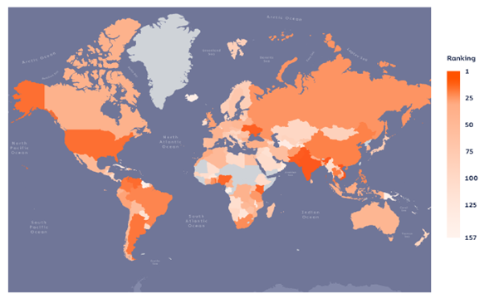
Implementation Level of Cryptocurrencies in Argentina
In October 2021, Chainalysis consulting firm published its annual report entitled "The 2021 Geography of Cryptocurrency Report", in which it was measured the implementation level of cryptocurrencies in 157 jurisdictions around the world.
World map segmented according to the implementation level of cryptocurrencies in period June 2020 to July 2021. Source: Chainalysis, The 2021 Global Crypto Adoption Index, October 2021.

Slide 9
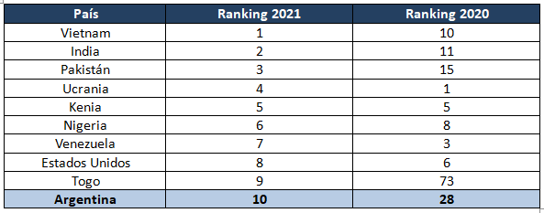
Ranking of countries with the highest implementation of cryptocurrencies 2020 - 2021
Argentina is in the Top 10 for cryptocurrency implementation globally, being one of the countries that experienced higher annual growth.

Slide 10
Ongoing Actions Implemented
  A universe of 30 taxpayers related to cryptocurrency brokerage operations were requested to regularize the filing of the Informative Tax Return of R.G. AFIP 4614/19 (July 2021).
  To date, almost 50% of the circularized taxpayers have regularized the presentation of the informative tax returns related to the above mentioned regime.
1
Cryptoassets Induction Campaign
2
  With respect to taxpayers who failed to comply with the induction issued, 20 infraction notices were issued for the application of the penalties established in the Tax Procedure Law.
Non-compliance Infringement Records
3
Preventive tax audits were carried out to 28 taxpayers related to the activity. These tax audits are currently in progress.
Tax audits with Intervention Orders

Slide 11
4
Taxpayers with tax inconsistencies
  Controls are conducted in order to verify the economic financial capacity of the persons that have carried out operations related to cryptoassets and to detect deviations with respect to those taxpayers that could not justify the origin of the funds operated on digital platforms (Exchanges).
5
Update of Tax Regulations
  A preliminary draft is being elaborated with amendments to the current regimes.
  Design of a new specific information scheme for cryptocurrency transactions.
6
Definition of new activities for the nomenclature of activities
  A proposal is being analyzed to incorporate new codes into the nomenclature of activities reflecting more specificity the activity carried out by the parties involved in transactions with cryptoassets.
7
Tax audits related to cryptocurrency frauds
  This Federal Administration of Public Revenue (AFIP) established the tax examination of parties involved in the maneuver and the monitoring, among other research hypotheses, of possible unsupported capital increases.

Slide 12
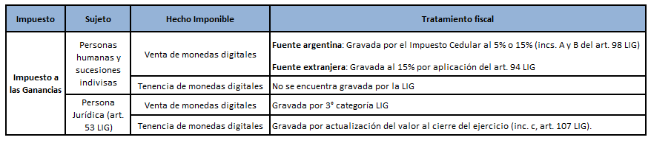
Current Tax Treatment

Slide 13
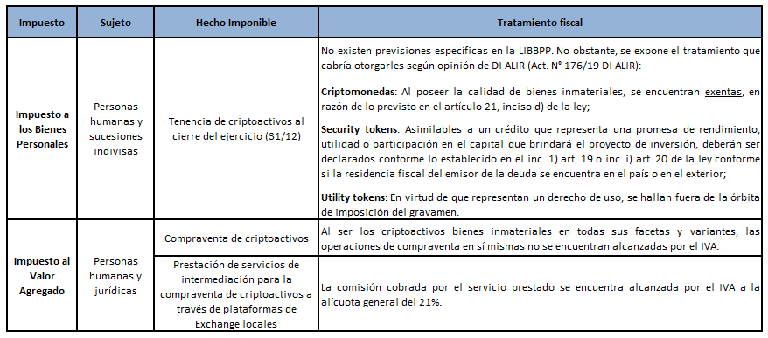

Slide 14
Risk Matrix
Immediate Action
Class "M" authorization
Confirms
Tax Audit / Recursive Proceeding
CUIT Limitation - Inclusion in eApoc Base
Recovers prior authorization
Not Confirmed

Slide 15
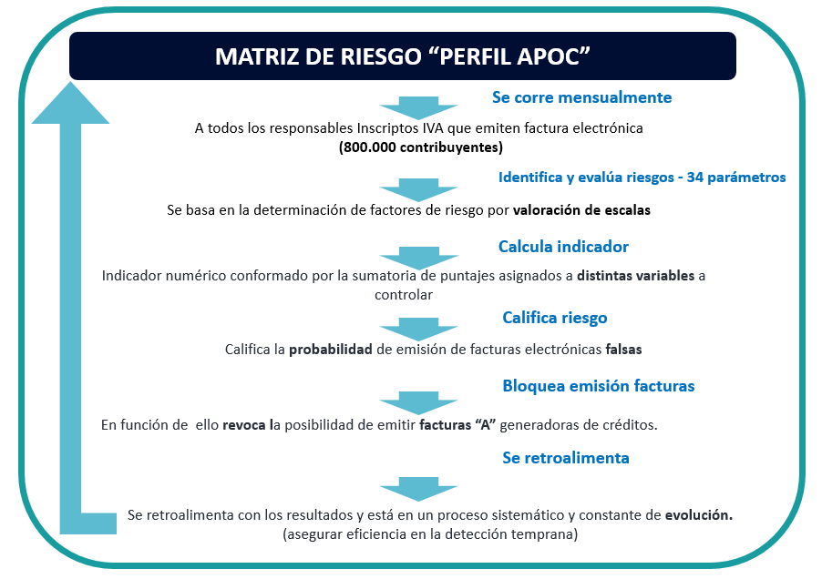
March 14 - 23, 2022

Slide 16
RISK MATRIX - APOC PROFILE
SPECIFIC CRITERIA ADJUSTMENTS AND ADDITIONS
Risk Rating (SIPER)
IP used for fake invoices
Suppliers
Related to already detected issuer of fake invoices (Partner, Accountant, Authorized Person, Accounts, etc.)
Employer seniority
Shared address with partnership already detected as issuing fake invoices, shared employees
Ratio of Billing Amounts / Employed personnel / Declared Activity
APOC MATRIX PROFILE
Repeated changes of address / Inconsistencies of addresses
Ratio of Billing Amounts/
Registrable Assets
Number of paper invoices issued
Sale of fake invoices to users /
“Unreliable” customers
Failure to file tax returns
March 14 - 23, 2022
Number of economic activities registered
Ratio of Billing Amounts/
Payment of tax / Withholdings
Ratio of Billing Amounts/
Bank Accreditations
Large amounts in invoices and VAT debtor
NEW REGISTRANTS
AND SAS
Third party information
E.g. Relevant consumptions
and kw
Inconsistent ratio of VAT debit/credit with activity

Slide 17

APOC RISK MATRIX RUN
Automatic
Impacts
APOC MATRIX
BILLING
APOC BASE
SEFI
APOC cases detected
Authorised APOC "M" INVOICE for domestic market operations.
It is registered and a DIGITAL File is issued.
Issues document for address proof
All case status and tracking is recorded in APOC database.

Slide 18
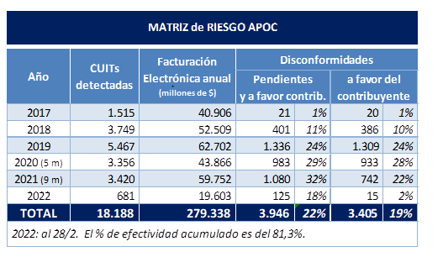
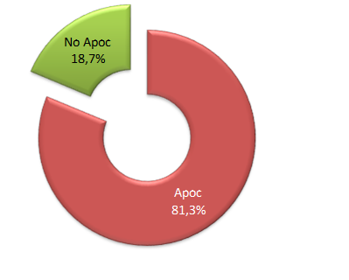
THE MATRIX IN NUMBERS
Matrix efficiency
in the selection of "apoc" cases
Assessed billing reported in millions of $ (Argentine pesos).

Slide 19
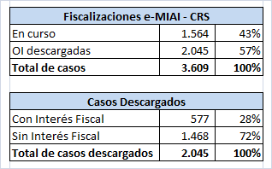
CRS
Cases submitted by International Tax Examination area
As from January 2020
March 14 - 23, 2022

Slide 20
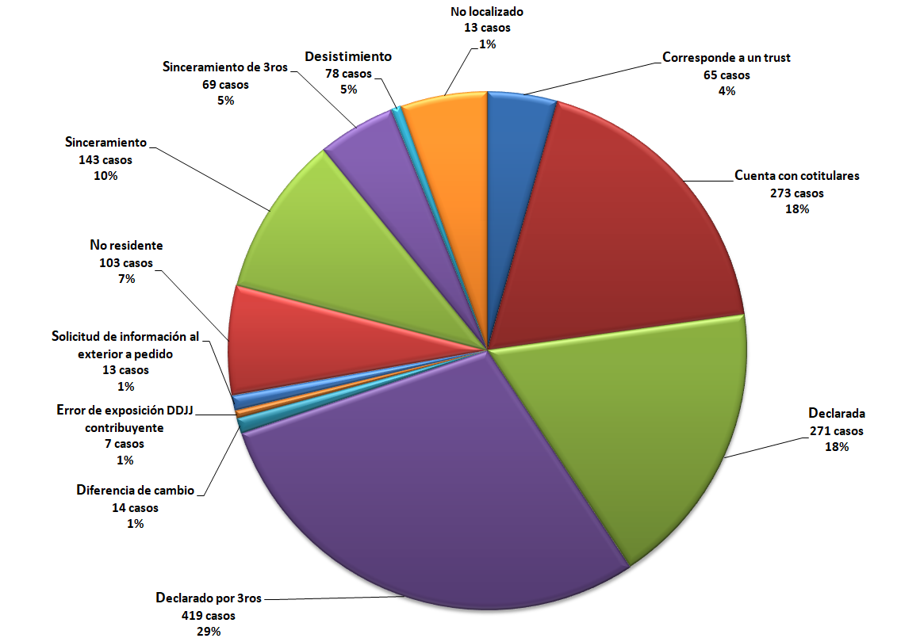
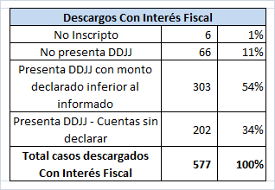
Distribution of Disclosures of NoTax Interest - Reasons
Distribution of Disclosures of Tax Interest

Slide 21
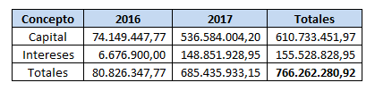
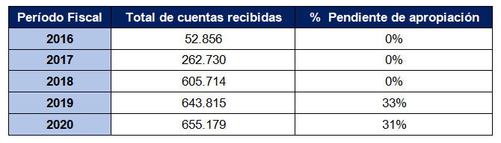
Tax Collection per Fiscal Period
Statistics of the Information Received
March 14 - 23, 2022

Slide 22
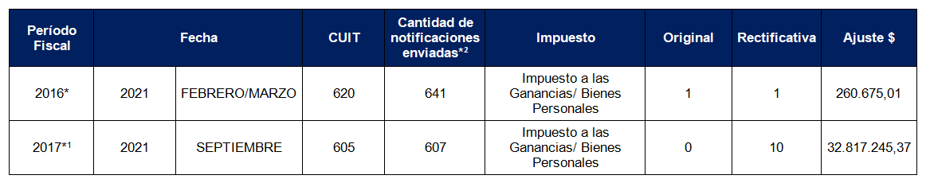
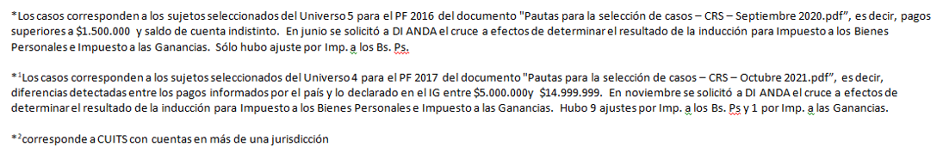
Electronic Notifications
March 14 - 23, 2022

Slide 23
THANK YOU!
March 14 - 23, 2022

