Slide 1
Cash Registers
Types , Risks & Challenges

Slide 2
Different types of cash registers, challenges, problems, fraud types
Practical Exercise
1. When conducting audits or investigations, what different types of cash registers do you encounter?
2. What problems, challenges, types of fraudulent activities do you recognize / experience from the use of the different types of cash registers in your country?
3. Have you or your country experienced electronic sales suppression through the use of certain types of cash registers?

Slide 3
Different types of cash registers
Open cash register / open cash box
Electronic cash register
PC cash register system / proprietary cash register system

Slide 4
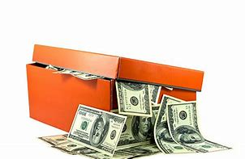
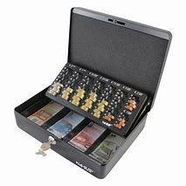
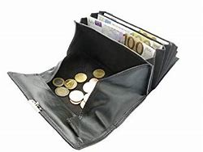
Open cash register

Slide 5
Open cash register
Cash register without technical elements
Cash receipts are stored in a cashbox , drawer or shoe box
Turnovers are determined retroactively on the basis of cash holdings – means by counting the cash money
Even the wallet of the businessman can be an open cash register

Slide 6
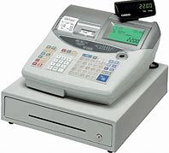
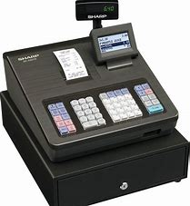
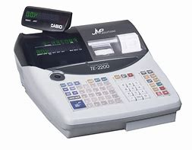
Electronic cash register

Slide 7
Electronic cash register
Cash register system with a mechanical / electronical recording of the business transactions
Data storage on the device – new versions with data export option
Amount of daily turnover on a daily receipt = printout

Slide 8
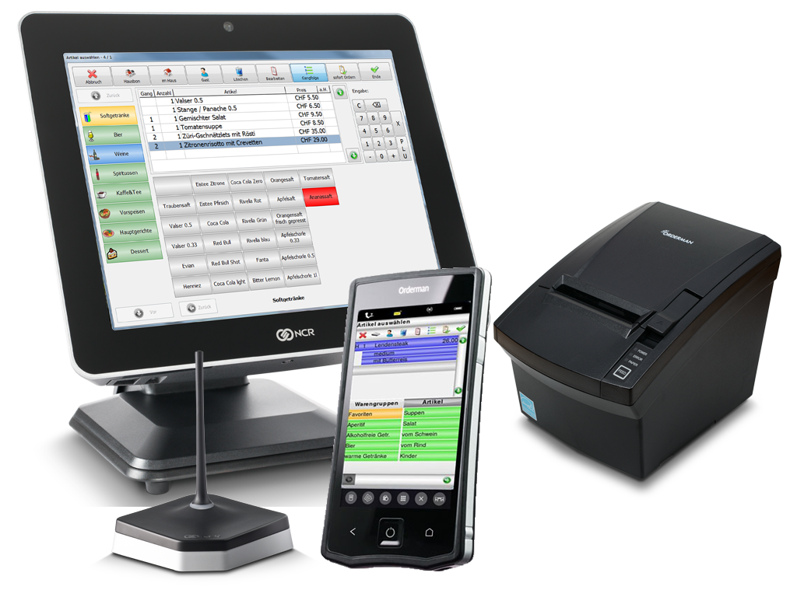
PC cash register system

Slide 9
PC cash register system
Modern cash register systems - store every single transaction in a data collection log - even program changes with date/time/user…information
Based on a standard operating system (e.g. Windows or Linux)
They work much like an normal computer

Slide 10
Electronic Cash Register and PC Cash Register – Data system
Data storage based on idea of multiple database structures
All data stored in various different databases
Journal, Articles, Users, Clients,…anything is possible
challenge is to understand the structure

Slide 11
Electronic Cash Register and PC Cash Register – Data system
Essential for understanding “database description” = explanation of each field and content
Databases initially have to be linked to each other
Finally the result is the complete overview with investigation possibility

Slide 12
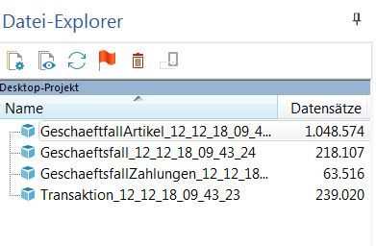
Electronic Cash Register and PC Cash Register – Data system
Example of data base structure – different datasets

Slide 13
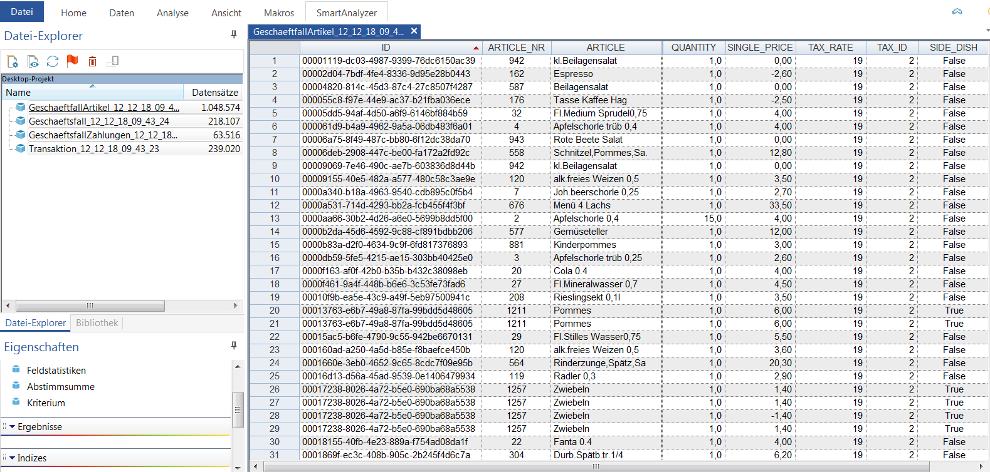
Electronic Cash Register and PC Cash Register – Data system
Example each dataset has a different structure

Slide 14
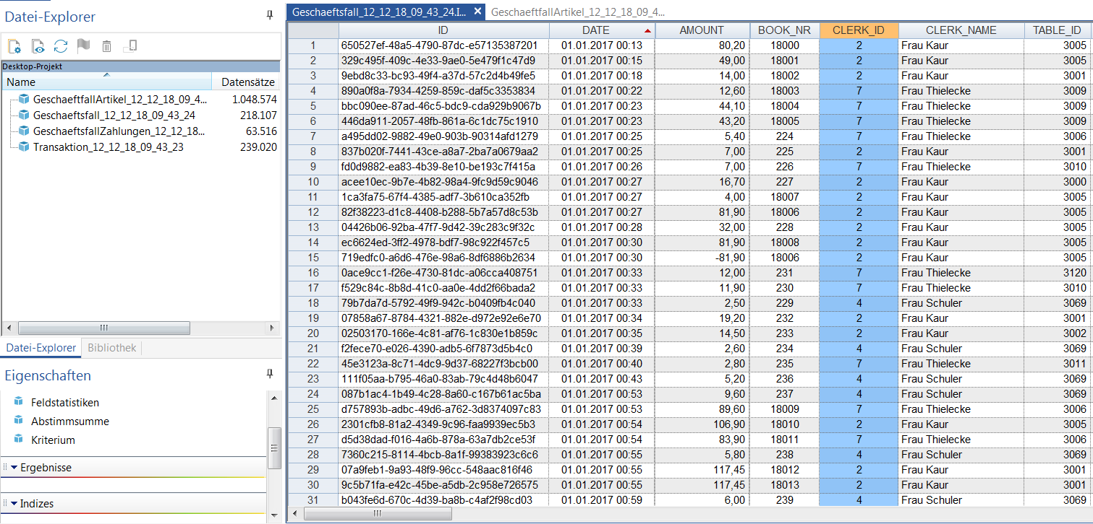
Electronic Cash Register and PC Cash Register – Data system
Example each dataset has a different structure

Slide 15
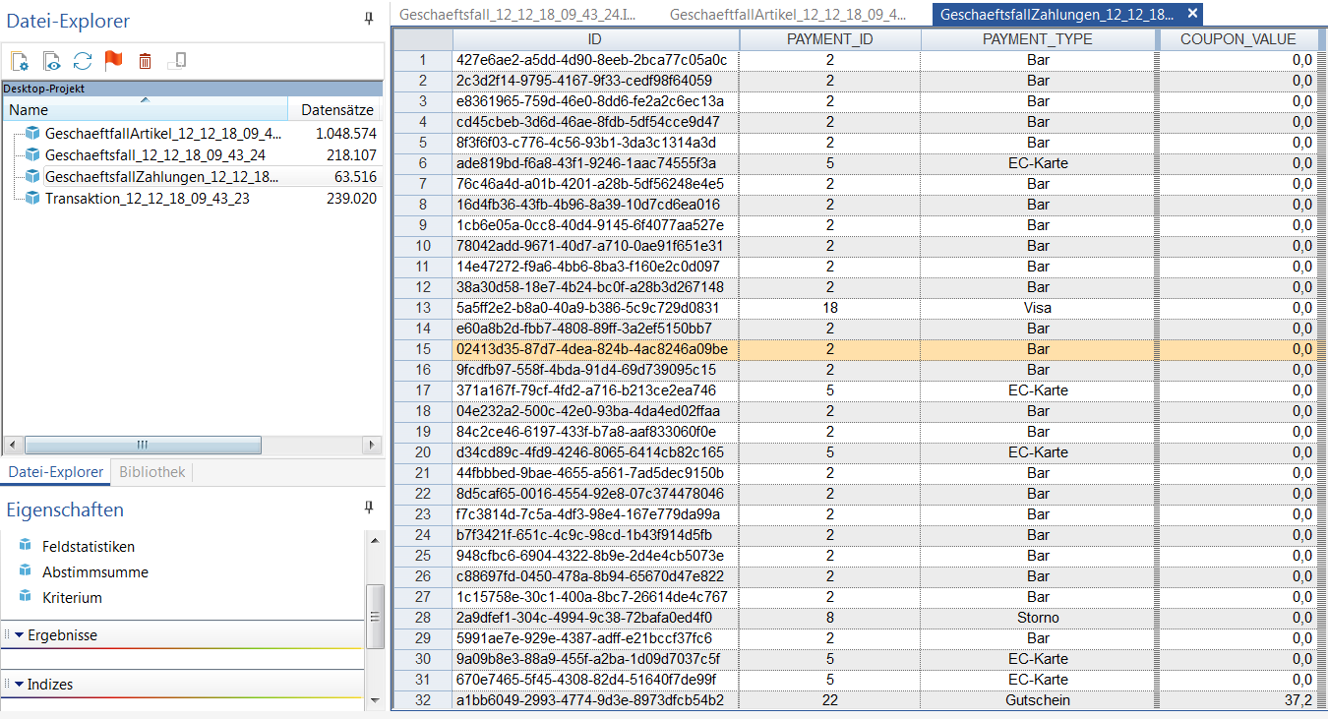
Electronic Cash Register and PC Cash Register – Data system
Example each dataset has a different structure

Slide 16
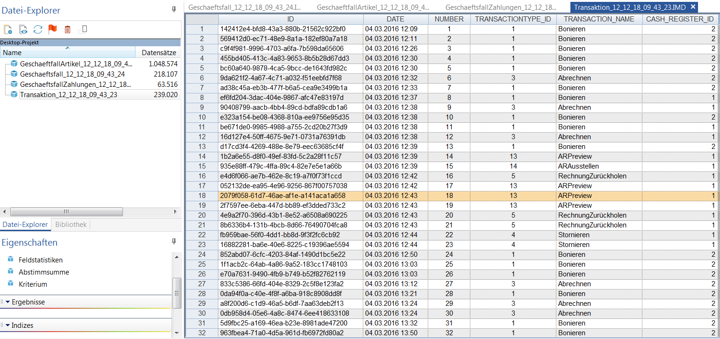
Electronic Cash Register and PC Cash Register – Data system
Example each dataset has a different structure

Slide 17
Electronic Cash Register and PC Cash Register – Data system
Finally it is essentiell to understand the different sets
Prepare them to be able to link
Ability to explore the dataset
Focus on what would you like to check
Unnecessary data should be ignored but not deleted ! – maybe it is helpful in future checks

Slide 18
Other cash registers
Practical Exercise
What other cash registers do you know?
  Coffee machine?
  Car washing machines?
  …………………..
Please explain why they are in your opinion also regarded as cash registers! Inclass Discussion

Slide 19
Examples for manipulation
Manipulations are basically possible within all cash register systems

Slide 20
Examples for manipulation
Reversal / Cancellation functions (single reversal / final reversal / master reversal)
The cancel key cancels incorrect entries
Can be abused to reduce actual turnovers
Can be suppressed - cancellation is not visible on the daily receipt
Especially the master reversal (often only used by the owner after the daily closing of the business)

Slide 21
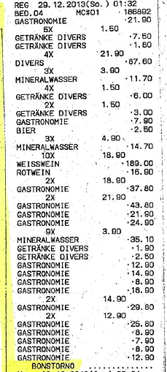
Examples for manipulation
Reversal / Cancellation functions
Extract of journal datas
Extract shows the last sales entry on 29.12.2013 at 01:32 a.m.
Turnover of 1.214,26 € (various meals and drinks)
The sales were reversed at the end of the process
Reversed sales are not included in the daily receipt

Slide 22
Examples for manipulation
Training user generates turnover
Almost every cash register has a training function
Normally used to train new operators
Normal sales/revenues/turnovers can be disguised as training sale
Not visible on a daily receipt

Slide 23
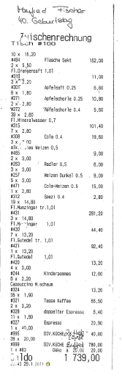
Example for training modus
Invoice of a birthday party on 29.01.2011
Time of bill creation: 11:43 a.m.
Total sales of 1.739,00 €
Operator number 8

Slide 24
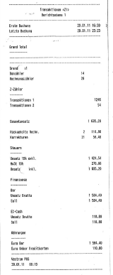
Example for training modus
Daily receipt 29.01.2011
Including sales/turnovers from
4:39 a.m. till 11:23 a.m.
Total sales of 1.695,20 €
!!! Daily turnover is lower than the
turnover of the previous bill !!!

Slide 25
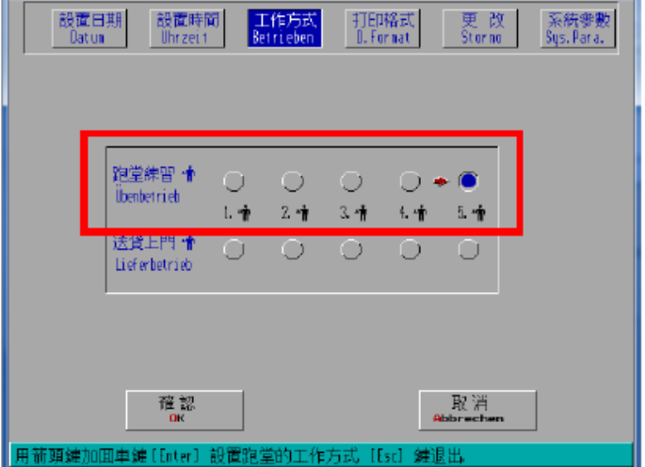
Example for training modus
Selection of Modus (normal or training)
Selection of operator
Operator number 5 works in training mode

Slide 26
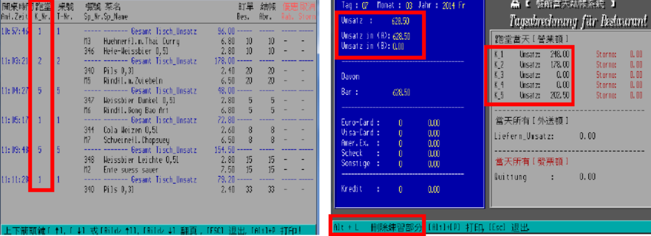
Example for training modus
All operators work on normal mode
Operator Number 1, 2 and 5 generate sales
Total turnover amounts to 628,50 €

Slide 27
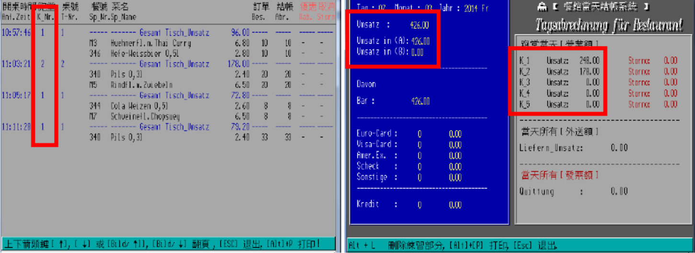
Example for training modus
Operator Number 5 work on training mode
Operator Number 1, 2 and 5 generate sales
Total turnover amounts to 426,00 € - sales of Operator number 5 are declared

Slide 28
Examples for manipulation
Manipulation programs – Manipulation software
‚Zapper‘
External Manipulation software that subsequently changes/zap sales
data of the cash register – e.g. 10/20/30/40% of turnover is zapped
‚Phantomware‘
Already included/embedded manipulation program that replaces
higher-priced items with lower-priced items

Slide 29
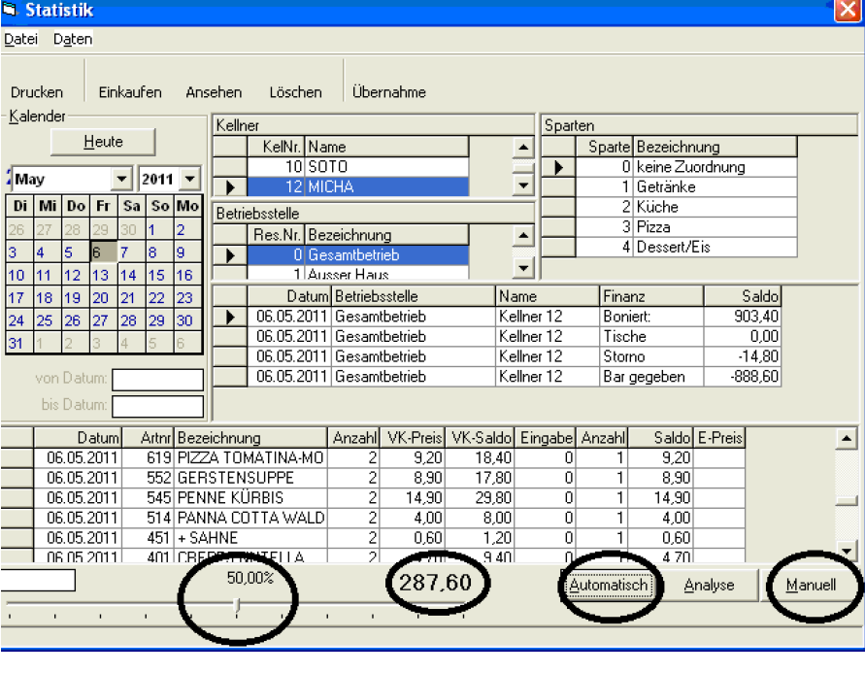
Examples for manipulation
Manipulation programs – Zapper
Turnover of a waiter selected
Amount of sales reduction can be selected individually
Turnover reduced by 287,60 €

Slide 30
Examples for manipulation
….further simple manipulation possibilities..
The entry of the turnover in the cash register is omitted
Use of an equal second cash register its turnover is not declared
Manipulation of the whole data of a electronic cash register by using a computer – deleting/changing/manipulation of data sets

Slide 31
Challenges
Detecting Manipulations
Large amount of data
…
Practical Exercise ML
Discuss within your group (15 min)!
What other challenges related to Money Laundring of the usage of different types of cash registers can you find/imagine/ you are faced with?
How can you use electronic cash registers for ML purposes?
Notes:
A: The usage of an electronic cash registers itself supposes a kind of legality. Usually you would assume that criminals never ever will use an electronic cash register that provides a very detailed documentation for criminal purposes, as detection risk is probably increasing.
Criminals would use them not to raise attention to the business used for ML. They would fullfil all requirements perfectly, what in itself is a kind of indicator for „problems“. Usually it is almost impossible to fullfill all requirements, as it is used by humans, naturally making mistakes.

