Slide 1
Case Study
Operation PIC
Rhonda Blanchard

Slide 2
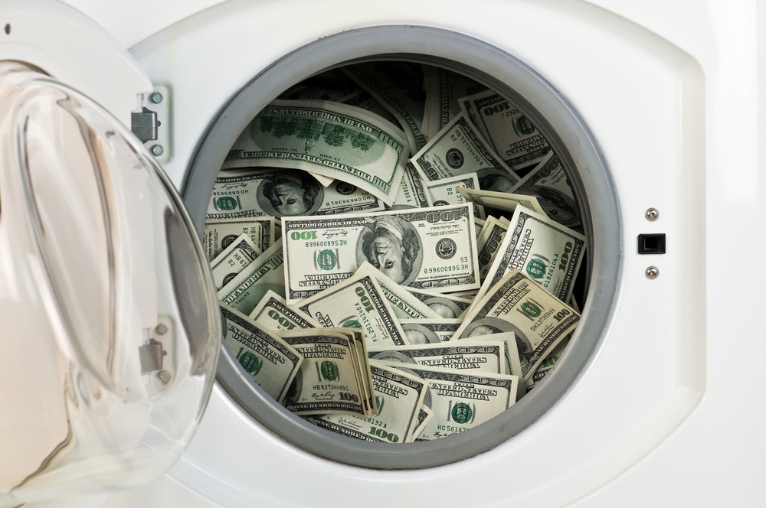
CASE SUMMARY
A Customs Officer noticed an anxious individual and monitored her. She went to the washroom and a female officer went in and caught her flushing money down the toilet. A search was done and she was found with US$78,000 (hidden in various clothes pockets and hand bag).
Further investigations revealed that she had wire transferred US$50,000 a few days before. As a result of this investigation, the FIA was led to believe that there was a case of under reporting and money laundering.
Investigations led to Assessments being generated for five (5)
individuals and seven (7) companies and civil penalties of
wilful default being imposed on two (2) individuals.
Notes:
Joint operation commenced with the monitoring of financial institutions (including credit unions and money transfer agencies), land registry, Companies Registry.
Monitoring and surveillance to determine individuals and locations involved
Joint search
Joint interviews

Slide 3
JOINT SEARCH REPORT
Details of the report:
Summary of the briefing – time, location
Team members
Time of arrival at location and contact made with the commander
Description of the location
Persons contact was made with at the location
Summary of seized documents and items
Difficulties encountered and resolutions to them
Conclusion – the time search ended and details of who signed the seals for the enclosed boxes with the documents.
The search warrant should be attached to the final audit report.
Reports of the raid should be done by the team leader and presented to all institutions before the opening of the boxes with the seized documents.
Notes:
Search warrant for each location – To be obtained by Customs through their Comptroller.
Team Members and command centre
Commander
Team leader for each location (each institution participating must have at least 1 representative from each agency)
Meeting point
Briefing before and after operation
Report formed part of the overall audit report and formed the basis to ensure proper chain of evidence.
Outcome of search :
1 individual charged with an illegal firearm and ammunition
2. The main individuals were all directors and they kept their employees from their country in one house and held their passports and bank accounts.
One company had $411, 000 in an old Treasury safe. And that money was seized.
4. Blank paper with supplier’s stamp.

Slide 4
INTERVIEW
An interview should be well planned and held in a location that is free from noise and distraction and agreed by all parties involved.
1
Questionnaire be prepared as a guide
2
Unsealing of the seized documents. All persons who signed on the documents had to be present at the meeting to ensure that the seals were not broken (chain of evidence)
3
Review the documents and scan or copy what was required and then seal the documents back in the storage boxes.
4
This questionnaire forms part of the audit report as a working paper. While the taxpayer is not legally obligated to sign the questionnaire all persons attending should sign.
Notes:
In some cases the taxpayers signed and other cases they refused to and as such at the end of the documents I indicated that the taxpayer did not wish to sign the questionnaire.
This questionnaire forms part of the audit report as a working paper to which reference can be made to the findings during the audit work. In the audit report we refer the Tp’s statement E.g. TP indicated money seized was being saved from sales to purchase the building they operated from.

Slide 5
ANALYSIS
Issues:
Methods used to corroborate interview and analyze data to make a determination
1
No documents were maintained
2
Taxpayers dealt mainly with cash transactions and indicated during the interview that the money generated was from business sales and wire transfers received from family overseas.
1
Physically observe the daily operations and count the cash at the beginning and end of operations for one (1) week and monitor deposits for the period observed.
2
Indirect methods of analysis :
Bank reconciliation – analyze the bank statement and compare to corporate and VAT returns submitted and the financial Statements.
Analyze incoming and outgoing wire transfers
Review Cost of Sales and compare to customs report from ASYCUDA.
Net worth analysis and living expense analysis
Notes:
To corroborate the money seized – compare the sales and bank deposits and returns submission.
With one of the individuals she indicated that her income was coming from her branch company in Antigua so a request was made to the bank to corroborate the information
Since most transactions are carried out with card you are able to analyze living expense through bank statement.

Slide 6
FINDINGS
1
Sources of income indicated during the interview conducted could not be verified.
2
Significant deposits which did not correlate with sales or incoming wire transfers.
3
Cost of sales was grossly overstated compared to Customs imports.
Notes:
1. One TP indicated during the interview she received income first from brother from China and then from the sale of her branch in Antigua and that was used to pay off her residential mortgage of $1.3 within 3 years. No wire transfers were received or the bank did not have significant deposits from the Antigua branch.

Slide 7
OUTCOME
T.A.N. | Total Additional Income | Total Additional Tax | Total Penalty | Total Taxes Assessed
141610-02 | 2,849,172.63 | 854,751.79 | - | 854,751.79
143130-02 | 2,243,355.98 | 747,710.55 | - | 747,710.55
108051-01 | 1,080,000.00 | 293,880.00 | - | 293,880.00
140907-02 | 1,768,157.08 | 530,447.12 | - | 530,447.12
112255-02 | 2,787,952.00 | 836,385.60 | - | 836,385.60
140909-01 | 707,623.00 | 275,875.35 | - | 275,875.35
145867-01 | 572,076.00 | 149,812.80 | 74,906.40 | 224,719.20
089263 - 01 | 858,506.44 | 208,651.93 |  | 208,651.93
74457-01 | 5,897,355.54 | 1,782,267.57 | 1,302,967.00 | 3,085,234.57
89262-02 | 3,612,598.05 | 1,083,779.42 | - | 1,083,779.42
58696-02 | 3,732,615.60 | 1,119,784.68 | - | 1,119,784.68
068978-02 | 518,486.00 | 86,406.04 | - | 86,406.04
TOTAL | 26,627,898.33 | 7,969,752.85 | 1,377,873.40 | 9,347,626.25
1
Select the Robot picture on the right.
2
Type animation in the Tell Me box, and then choose Add Animation.
3
Choose an animation effect, like Zoom, and wach
what happens.
Notes:
Money seized - the individuals made a claim for the money seized however this was a civil case by the taxpayer’s attorney against the money and the state won as such the money forfeited was applied against outstanding liabilities to the Department.
There was no submission from defense attorneys relating to the guarantee of non-self-incrimination.

