Slide 1
OECD Latin America Academy For Tax And Finantial Crime Investigation
Investigative Techniques For The Cash Economy
Regional Situation

Slide 2
Pre Course Survey
What are the 5 most common areas of investigation in shadow economy cases?
What are the circumstances that favor these behaviors?
What are the main challenges in investigating these cases?
Highlight the strengths or weaknesses of your jurisdiction that help or hinder investigations

Slide 3
First Question
What are the 5 most common areas of investigation in shadow economy cases?

Slide 4
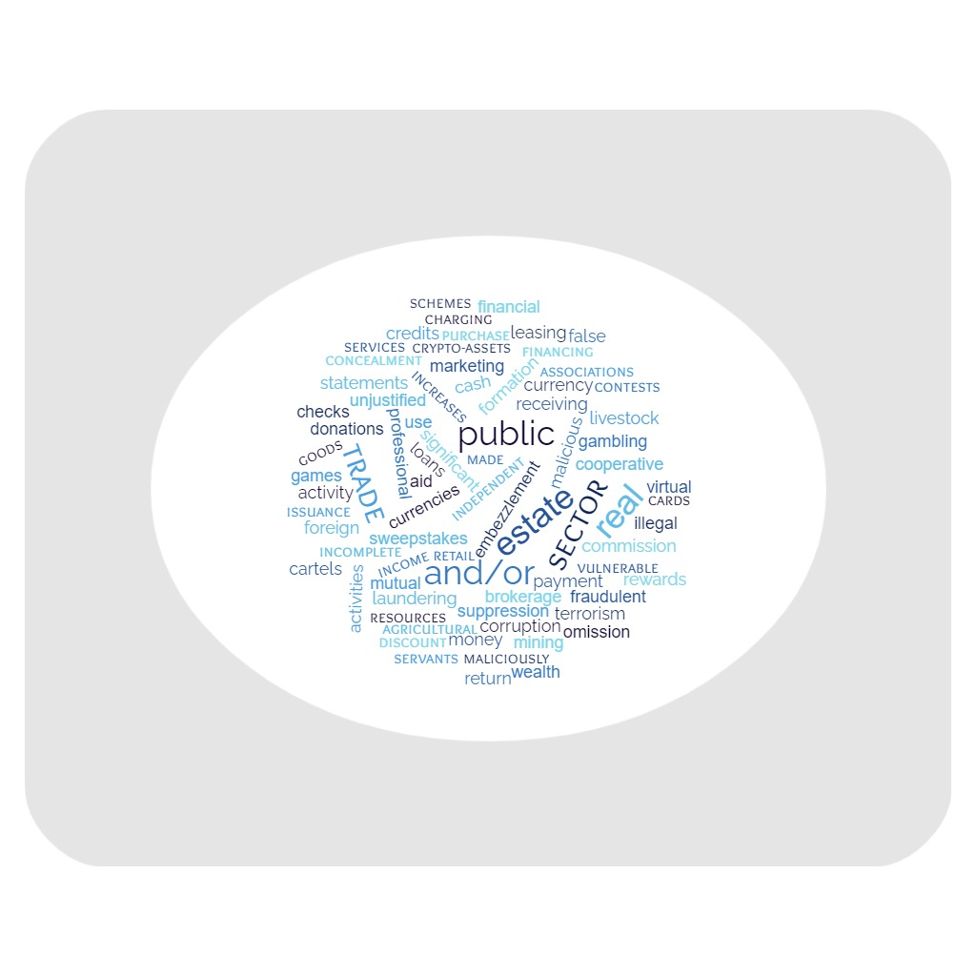
What are the 5 most common areas of investigation in shadow economy cases?

Slide 5
What are the 5 most common areas of investigation in shadow economy cases?
SECTORS AND ACTIVITIES OF THE ECONOMY
Where?
Retail trade
Mutual or cooperative associations
Mining sector
Agricultural and livestock activities
Real estate
Independent professional services
Real estate leasing

Slide 6
What are the 5 most common areas of investigation in shadow economy cases?
Common operations
What do we look at?
Credits and/or loans and/or financial assistance
Discounting of checks by charging a fee for which payment is made in cash
Use of cryptocurrencies
Purchase of currencies
Gambling games, contests and sweepstakes
Issuance of cash back and rewards cards
Receiving donations

Slide 7
What are the 5 most common areas of investigation in shadow economy cases?
Crimes and Misdemeanors
What can we find?
Maliciously incomplete or false statements
Malicious omission
Concealment and suppression of income
Money laundering - Terrorist financing
Trade in illegal goods
Fraud
Corruption of Public Servants
Significant and unjustified increases in wealth
Embezzlement of Public Resources
Cartels

Slide 8
Second Question
What are the circumstances that favor these behaviors?

Slide 9
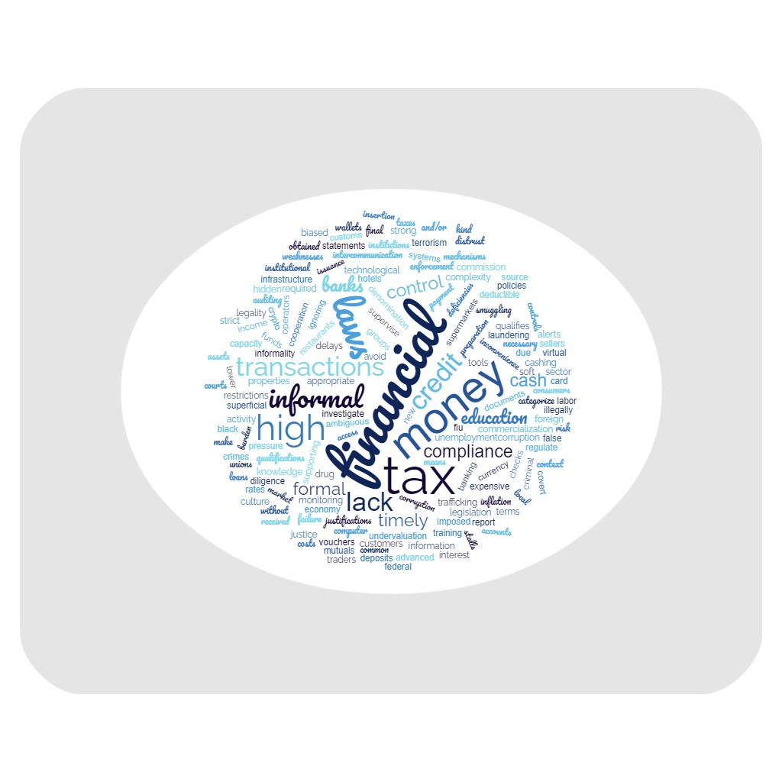
What are the circumstances that favor these behaviors?

Slide 10
What are the circumstances that favor these behaviors?
Regulatory and policy
Soft laws, ambiguous or not strictly enforced.
Crypto-assets, with little regulation
Prebendary policies over the common interest

Slide 11
What are the circumstances that favor these behaviors?
Detection and Control
Weak detection and control
Inadequate customer risk profiles
Insufficient due diligence
Ignored alerts
Lack of advanced and wide-ranging IT systems.
Superficial control by Customs personnel
Poor intercommunication between the local and federal tax administrations.

Slide 12
What are the circumstances that favor these behaviors?
Investigation and sanction
Institutional weakness in investigating crimes
Lack of cooperation to obtain information in a timely manner.
Shortage of detection, enforcement and investigation personnel
Shortage of personnel and training in law enforcement agencies
Lack of preparation and training of judges

Slide 13
What are the circumstances that favor these behaviors?
Incentives
Lack of tax culture
Very low financial education
Complexity of the tax and compliance system
Informal economy without access to the financial system due to lack of qualification.
Need for cash by small traders and/or self-employed workers.
Access to credit for those who do not qualify for the traditional financial sector.
High labor informality / Unemployment
Lack of trust in financial institutions
Cultural tendency to cash transactions

Slide 14
What are the circumstances that favor these behaviors?
Incentives
Lack of banking infrastructure in some regions
High financial costs of credit card operators, banks and virtual wallets.
Delays in payment terms - high inflationary context
High tax rates that make tax evasion attractive
Restrictions on foreign currency transactions
Non-deductible financial transaction taxes

Slide 15
What are the circumstances that favor these behaviors?
Opportunities
New marketing technologies
no presence or intermediaries required no identification of the parties
Issuance of high denomination money
Ease of setting up companies
Easy to obtain "frontmen" to integrate these companies.
Undercover financial institutions (credit unions and/or mutuals) that facilitate the cashing of checks or the granting of false loans.
Supermarkets, hotel services and restaurants that are directed to final consumers do not require receipts.

Slide 16
What are the circumstances that favor these behaviors?
Real Estate
Undervaluation of properties:
obtaining money "black"
acquiring goods for which they do not have the capacity to pay taxes
decrease tax burden
Overvaluation: Externalization and Laundering of illicit resources.

Slide 17
What are the circumstances that favor these behaviors?
Crimes
Corruption
Criminal organizations
Drug trafficking, smuggling and terrorism

Slide 18
Third Question
What are the main challenges in investigating these cases?

Slide 19
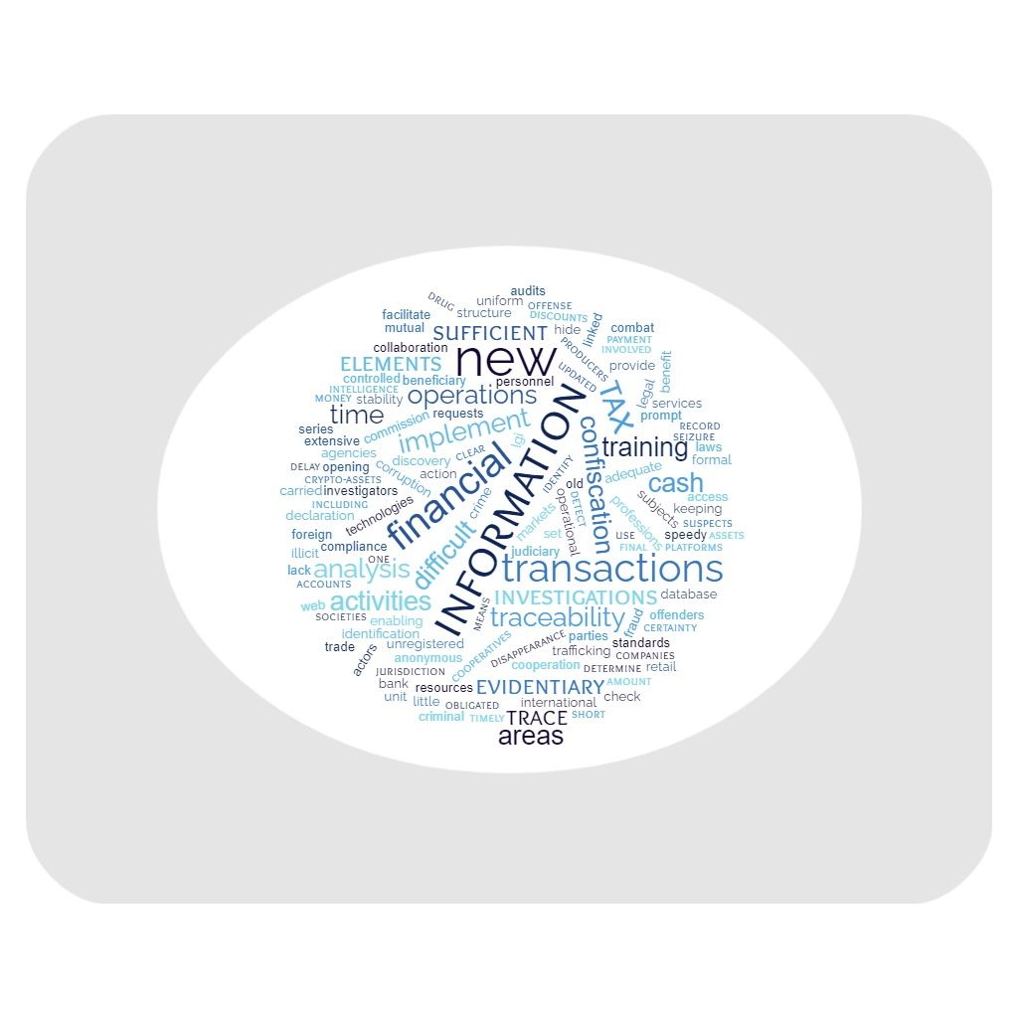
What are the main challenges in investigating these cases?

Slide 20
What are the main challenges in investigating these cases?
Goals
Providing investigators and prosecutors with elements to determine the commission of the crime
Analyze and track information
Necessary amounts for tax crime (condition for proceeding)
Identify operations where cash is being concealed
Origin of funds received in cash
Identify and promote confiscation of assets linked to illicit activities
Proving tax fraud
Obtain as much evidence as possible in a short period of time.

Slide 21
What are the main challenges in investigating these cases?
Challenges
Lack of registration/traceability of activities
Anonymous transactions
Subjects not registered with the tax authorities
One-time transactions
Information through web platforms
Identifying parties in crypto-asset transactions
Origin of new and existing funds in extensive use of check discounts
Access to information and services provided by cooperatives and mutuals.
Limited compliance with ML/FT reporting obligations.
Quickness of criminals to set up new companies and open new bank accounts.
Discovery of the final beneficiary

Slide 22
What are the main challenges in investigating these cases?
Improvements
Adequate training / human talent / qualification level
Inter-agency collaboration
Implement operational intelligence areas
Implement crime analysis areas
Updated database of taxpayers
OSInt
Delays in requests for international cooperation
Laws empowering to conduct audits and other investigations
Use of new technologies and adjustments to the legal framework.
In the area of criminal justice:
Legal certainty and stability of its decisions
Evidentiary standards applicable to these cases

Slide 23
Fourth Question
Highlight the strengths or weaknesses of your jurisdiction that help or hinder investigations

Slide 24
Highlight the strengths or weaknesses of your jurisdiction that help or hinder investigations
Operational weaknesses
Lack of empathy with the control figures.
Lack of resources and tools
Access to financial information of the subjects of study.
Lack of timely and necessary information from financial entities and public agencies.
Bureaucracy
Lack of trained personnel
Excessive turnover of investigative personnel
Intelligence activities are not properly regulated

Slide 25
Highlight the strengths or weaknesses of your jurisdiction that help or hinder investigations
Operational weaknesses
Low operational capacity for tax investigations.
Little coordinated and interdisciplinary work between agencies and specialties.
Lack of preparation of judges and better legislation.
Delays in the processing of criminal cases.
Variability of judicial decisions
Lack of border controls
Bank secrecy

Slide 26
Highlight the strengths or weaknesses of your jurisdiction that help or hinder investigations
Systemic weaknesses
Limitations of the tax code for tax administration to prosecute cases for tax crimes.
Lack of regulation and oversight of crypto-asset activity.
Difficulty to prosecute for tax fraud and not simple evasion.
Lack of preparation of judges and more adequate legislation.
Protection of some professional segments such as lawyers
Legislation that is not in line with new technologies

Slide 27
Highlight the strengths or weaknesses of your jurisdiction that help or hinder investigations
Strengths
Technology and legal attributions of the tax collection agency
Databases in tax agencies with information regimes (financial, patrimonial and economic).
Capacity and professionalism of the officials of the Tax Agency,
Willingness of staff to undergo training
Significant improvements driven by international evaluations (FATF - WGB).
Working groups between different entities / coordinated and collaborative work with other regulatory agencies.
Some useful norms for the punishment of this type of crimes.

Slide 28
Highlight the strengths or weaknesses of your jurisdiction that help or hinder investigations
Strengths
Access by FIU to internal and external information sources.
Activity and reports from regulated entities that identify deviations in their customer profiles.
Development of risk matrices
A new adversarial criminal system (Mexico)
Online transmission of bank statements to law enforcement systems (with judicial authorization).
Agreement with the Central Bank to access account holder information (without judicial authorization).
Progress in the implementation of electronic invoicing
Promotion of electronic transactions and payments
Simplification of the tax structure, improving its monitoring.

Slide 29
Thank you
We look forward to seeing you tomorrow at 9.30 a.m.
Please enter the zoom 15 minutes before.

