Slide 1
KEYS to effective prosecution of ORGANIZED CRIME

Slide 2

Starting point
Organized Crime
Economic crime

Slide 3
Organized Crime
Organized criminal group" shall mean a structured group of three or more persons, existing for a period of time and acting in concert with the aim of committing one or more serious crimes or offences established in accordance with this Convention in order to obtain, directly or indirectly, a financial or other material benefit (art. 2 Palermo Convention).
Characteristics (taken from the Federal Plan to Tackle Organized Crime 2021/2023, Ministry of Security, Argentine Republic)
Cooperation of more than two people.
Distribution of tasks.
Continuous or prolonged action.
Use of methods of discipline and internal control.
Suspicion of the commission of serious crimes.
International operations.
Use of violence or other forms of intimidation.
Use of business or commercial structures.
Money laundering activities.
Exercise of influence (politicians, media, etc.).
Pursuit of profit or power.

Slide 4
Difficulties in investigating and judging
Government agencies. Bureaucracy. Self-interested rationality of agents in conflicting and interdependent interests. Difficulties to innovate (new criminal behaviors/multiple disciplines).
White collar crimes. Difficulties in applying criminal laws to new conducts and establishing harm (Legal interest). Problems related to the prohibition of return: "stereotypically generalized conduct is innocuous" (civil servants, accountants, lawyers, financial advisors). increasing importance of circumstantial evidence.
Procedural restrictions vs. static and dynamic complexity of the offenses.
Risk of nullity proceedings (complex procedures, new techniques,...).
Insufficient knowledge of the general theory of coercive measures.
Complexity of international cooperation and assistance.
Shortage of jurisprudence (e.g. seizures, normative elements of the laundering offense, circumstantial evidence, criminal liability of legal persons, extinction of ownership,...).

Slide 5


How do we achieve our goals?
Criminal Enterprise
Efficiency
Outcomes
Punishment of the crime by the State
…
…

Slide 6

What does a criminal trial consist of?
PROSECUTION
Regulated procedures
Informal level
(Prosecutors and other agencies)
Team meetings
……
Formal level
(Courts)
Formal requests
Minutes
Cooperation with other actors
Telephone exchanges, mail, ...
Drafts

Slide 7


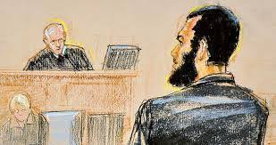
Progressivity of the criminal process
Launching of the investigation ( non-disclosure)
Identification and tracing of assets
Cautionary actions
Entitlement (knowledge of the charge)
Conviction
Restitution/Remediation
Compensation
Forfeiture
Fine

Slide 8


¿How to build a case? Inefficient procedure.
Dispersion
Trial and error
Improvisation
Information Overload
Delays
Low expectation of success

Slide 9


How to build a CASE? Effective procedure.
Search planning for possible conviction
Identification of legal assets
Compensations
Fines
Identification of illicit assets
Restitutions
Forfeiture
Theory of the case (criminal liability)
Factual theory, legal theory, evidentiary theory
Delays
(precautionary measures, administration, modification of teams,...)
Information
Requested authority
I
Information
Requesting Authority

Slide 10
Precautionary measures
(key players in a good preliminary investigation)
Characteristics
temporary
accessory (servant)
In audita parte
Nulla coactio sine lege
Need (ultima ratio)
appropriate
proportional

Slide 11
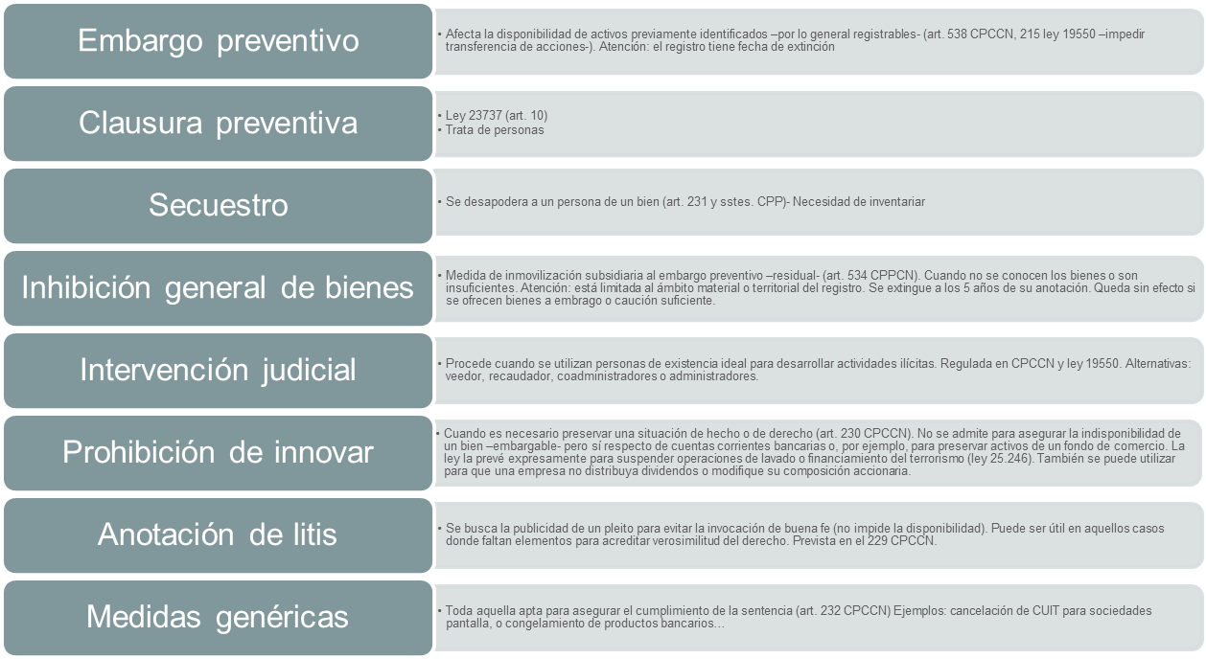
TYPOLOGY
* Examples of Argentine legislation

Slide 12
Division of Labor
Public Prosecutor's Office
(prove and accuse)
Court
(judge)
provides for coercive measures (typicity, necessary, adequate and proportional)
Identification and tracing of assets (MPF Resolutions -129/09,...).
Request precautionary measures (preventive seizure -518 CPP-, general inhibition of assets -518 CPP-, preventive closure -law 23737-, seizure -231 CPP-, judicial administration (222 CPCCN), prohibition to innovate (230 CPCCN), litis record and generic measures -e.g. Freezing of bank accounts).
International cooperation
Collect evidence to offer to the Court
Indict and prosecute
International cooperation
Guarantees proper trial and judges
Acquits/convicts
Provide restitution, repairs, compensation, forfeiture and fines.

Slide 13
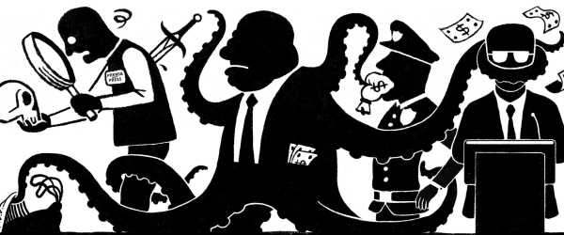
How to obtain evidence on organized crime?
sophistication
Legitimate adjacent activity
dissembling
Challenges in obtaining direct evidence
Indirect evidence

Slide 14
Circumstantial evidence and method
The knowledge, intent or purpose required as elements of any of the offenses set forth in paragraph 1 of this article may be inferred from the objective circumstances of the case.
UN Convention against Illicit Traffic in Narcotic Drugs and Psychotropic Substances
Article 6 Criminalization of laundering of proceeds of crime
(f) The knowledge, intent or purpose required as an element of an offence established in paragraph 1 of this article may be inferred from objective factual circumstances.
UN Convention against Transnational Organized Crime 2004
Article 28 Knowledge, intent and purpose as elements of an offence
Knowledge, intent or purpose required as an element of an offence established in accordance with this Convention may be inferred from objective factual circumstances.
UN Convention against Corruption 2003

Slide 15
Indirect evidence
material object or factual circumstance that makes it possible to formulate a supposition and serves as a starting point for a proof (Couture)
a fact (or circumstance) from which, by a logical operation, the existence of another can be inferred (Cafferata).
Indirect Evidence must be plural
They must be related to each other
They must be concomitant
There must be a precise and direct logical link between the evidence and the fact to be established.

Slide 16
Case law
"In cases, such as the current one, in which the prosecution is charged with the crime of money laundering specifically from drug trafficking, the most decisive indications must consist firstly in the unusual increase in assets or the handling of sums of money which, due to their large amount, the dynamics of the transfers and the fact that they are in cash, reveal ordinary operations; secondly in the inexistence of licit businesses that justify the increase in assets or the monetary transmissions; and, thirdly, in the finding of some link or connection with drug trafficking activities or with persons or groups related to the same that are alien to commercial practices" (Spanish Supreme Court, STS of 23. 5.97)
"both for the importance of the amounts as well as for the dynamics of the transfers and the unusual handling of cash, even with suitcases full of banknotes, it is clear that these operations are completely alien to the commercial practices of legitimate business, which is indeed a first indication of special relevance to appreciate the concurrence of a crime of money laundering and the participation of the appellant in it; as regards the second relevant circumstantial element in this type of crime (non-existence of licit business activities that justify the capital increases or monetary transfers), the lack of reality of the alleged import operations to which the monetary transfers supposedly referred has been sufficiently accredited, even finding certification from the General Directorate of Customs accrediting the non-existence of these operations".
The lack of discrimination -by the a quo- of the "clean" funds from the "dirty" ones invested locally -laundering of assets-, should not be seen as arbitrary, since it would be placing on the prosecution -and then on the court- a truly diabolical test with the exclusive purpose of derogating, in the practice of its application, the provision of art. 278 of the Criminal Code". (CFCP, Orentrajch, 21/03/2006)
"The determination of the basic fact or predicate offense of money laundering is "extraordinarily relevant"; the demonstration -by means of circumstantial evidence- of the predicate offense allows to deduce the execution of the "consequent fact" -money laundering- as long as there is a precise and direct link between the former and the latter. Therefore, it is required to evidence a prior criminal activity in a generic way, which allows the exclusion of other possible origins, not being necessary to go beyond the circumstantial level, since the full demonstration of those links would lead us to the assessment of the conduct of the alleged perpetrator as a form of participation in the predicate offense -a circumstance unrelated to the crime in question-". (CFCP, Orentrajch, 21/03/2006)

Slide 17
Examples
cash deposits in installments
opening accounts for short periods of time
absence of movements based on legitimate business activities
splitting of the income that was paid into the accounts
immediate conversion into nominative bank checks
use of false documents
disproportion between the value of the goods and effects concerned and the convicted person's income of lawful origin
concealment of the ownership or of any power of disposal over the goods or effects through the use of interposed natural or legal persons or entities without legal personality, or tax havens or territories of nil taxation which conceal or make it difficult to determine the true ownership of the assets
transfer of the goods or effects by means of operations that make their location or destination difficult or impossible and that lack valid legal or economic justification

Slide 18
Keys
Fidelity to the Constitution and the laws. To achieve justice through law. Nula coactio sine lege. Legal security.
Change in organizational culture. Efficiency through collective action and cooperation. Deformalization. Distinguishing and taking advantage of informal spaces.
Case planning (investigation/trial). Dealing with delays.
Proof of circumstantial evidence.
Use of new tools and best practice manuals inspired by multilateral agency guidelines. Comparative law.
Investigation of assets "from the beginning of the proceedings" -identification and tracing of assets (confiscation, fines, compensation)-.
Early precautionary measures to recover the money -restitutions and confiscation of illicit gains (direct proceeds - e.g. amount of money stolen- and indirect -e.g. interest-) -and cover attachments (possible fines, civil indemnities, fees) -legitimate assets- (typical, necessary, appropriate and proportional).
International collaboration. Bringing positions closer through joint work. Reciprocity. Need to homogenize procedures (practical guides). Be concrete.
Confiscation. Distinction between absence of criminal liability and good faith. Civil law guidelines (whoever opposes must prove legitimate origin and be an onerous acquirer in good faith -profits, etc-).

Slide 19
THANK YOU

