Slide 1

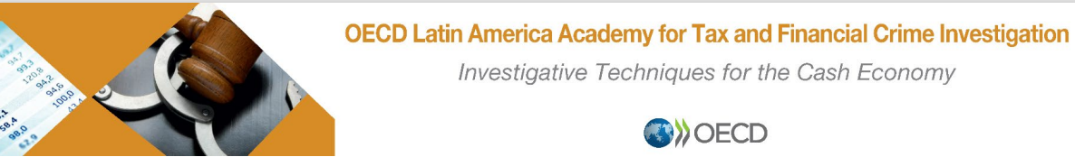
POLÍCIA FEDERAL
Superintendência Regional no Estado do Paraná
Delegacia Regional de Investigação e Combate ao Crime Organizado - DRCOR/SR/PF/PR
Participant Presentation – ERIKA MARENA – Federal Police – Brazil
22.03.2022

Slide 2
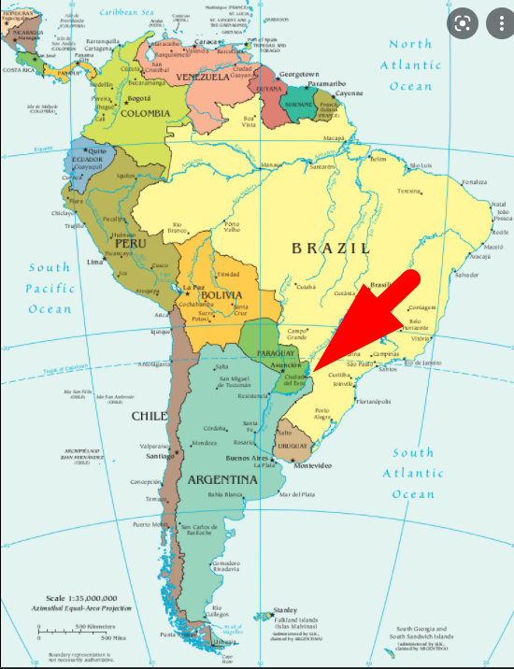
POLÍCIA FEDERAL
Superintendência Regional no Estado do Paraná
Delegacia Regional de Investigação e Combate ao Crime Organizado - DRCOR/SR/PF/PR
HOW DE CASE STARTED – ORIGEN DE LAS INVESTIGACIONES
2007 – US authorities shared information with the Federal Police in Curitiba about an international drug trafficking case under investigation in the State of Georgia/US. The money remmiter used by the drug deallers was a brazilian guy named ERICO DE OLIVEIRA. He lived in Atlanta for many years, and was operating an unlincensed remmitance house and had conecctions to counterparts in Brazil.
Case history : Brazilian Federal Police in Curitiba had investigated previously to 2007 many ilegal money remmitters from all over Brazil that were using the triple border (Brazil/Paraguay/Argentina) operators/remmitance houses to move ilegal funds all over the world. We found in our database from these past cases the name of this money remmiter guy under investigation in US, ERICO DE OLIVEIRA;
Brazilian Federal Police then decided to open a case in parallel to US case, to investigate if this brazilian individual had some point of contact in Brazil to operate his international money laundering scheme;

Slide 3
POLÍCIA FEDERAL
Superintendência Regional no Estado do Paraná
Delegacia Regional de Investigação e Combate ao Crime Organizado - DRCOR/SR/PF/PR
INVESTIGATIVE TECHNIQUES USED
Unvercover agent in US approached the target ERICO DE OLIVEIRA and started to give him periodically amounts up to USD 100.000 and asked him to make this amount available in Brazil;
Undercover banking account in Brazil: Federal Police asked for a Court authorization to open a banking account under a fictitious name as account holder to be used in a joint investigation with US authorities, to receive the money that the US target ERICO DE OLIVEIRA would get from the undercover agent in US;
After the money drop in US, the equivalent in brazilian currency was deposited in our account, but not throught international wire transfer, but several domestic deposits, coming from diferent parts of Brazil, indicating that the US target ERICO DE OLIVEIRA was operating a HAWALA scheme with other ilegal money remmiters/money launderers from Brazil. We started the electronic surveillance in Brazil related to individuals we could identified as the real controllers of those accounts that were transfering money to our undercover account.

Slide 4
POLÍCIA FEDERAL
Superintendência Regional no Estado do Paraná
Delegacia Regional de Investigação e Combate ao Crime Organizado - DRCOR/SR/PF/PR
FINDINGS
Computer/electronic store owners, in Brazil, that had brought products illegally from abroad (smuggling) needed to pay their suppliers, mostly from US. So they periodically gave cash to brazilian operators/money launderers located in their region;
Brazilian immigrants living in US that wanted to send money to their families in Brazil went to remmitance houses, indicating their relatives’ accounts in Brazil that should receive the transfer. Some of these RH in US, as this unlicensed one operating by the US target ERICO DE OLIVEIRA, instead of carrying out an international money transfer, kept the cash to make payments in US, on behalf of his counterparts in Brazil;
The US target ERICO DE OLIVEIRA then provided the payments due to the US computer/electronic products suppliers.
In turn, the operators/money launderers located in Brazil provided the deposit in accounts all over Brazil held by relatives of brazilian immigrants. The deposits were made with the money received from the computer/electronic shop owners.

Slide 5
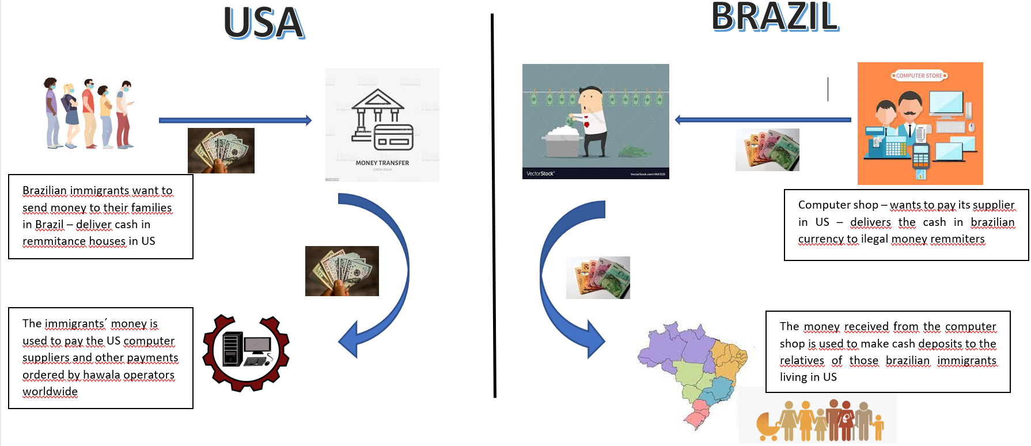
POLÍCIA FEDERAL
Superintendência Regional no Estado do Paraná
Delegacia Regional de Investigação e Combate ao Crime Organizado - DRCOR/SR/PF/PR
*images from internet - google

Slide 6
POLÍCIA FEDERAL
Superintendência Regional no Estado do Paraná
Delegacia Regional de Investigação e Combate ao Crime Organizado - DRCOR/SR/PF/PR
In february 2008 –
Search warrants and Arrests in Brazil and in USA;
Hawala operators identified in many States in Brazil were subject to new investigations;
The ones with more robust evidence were charged with the crimes below:
  (1) Operating an exchange broker without a licence from the Government (cambio de moneda clandestino);
  (2) Money laundering;
  (3) Tax evasion;
information from the case was shared with brazilian Tax Authorities.

Slide 7
POLÍCIA FEDERAL
Superintendência Regional no Estado do Paraná
Delegacia Regional de Investigação e Combate ao Crime Organizado - DRCOR/SR/PF/PR
Thank you

