Slide 1

ARGENTINA
THE MONEY TRAIL
BENEFICIAL OWNERS

Slide 2
INFORMAL ECONOMY - Argentina
In Argentina, 4764 mobile phones (more than three per minute), 160 cars and 3.5 trucks are stolen every day. The sum of these assets exceeds 1.2 billion dollars per year.
Illegal gambling moves more than 50 billion pesos per year in the Province of Buenos Aires.
Informal employment as measured by the Indec gives a figure of 35%; but if we add the self-employed, we could say that the total number of informal employment is close to 50%.

Slide 3
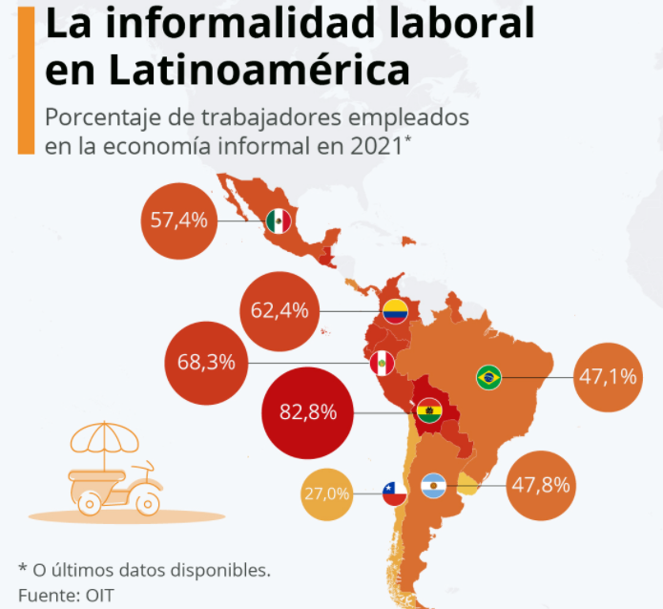

Slide 4
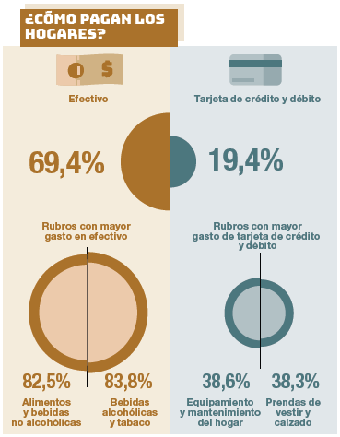
National Household Expenditure Survey
2017-2018 (INDEC)

Slide 5
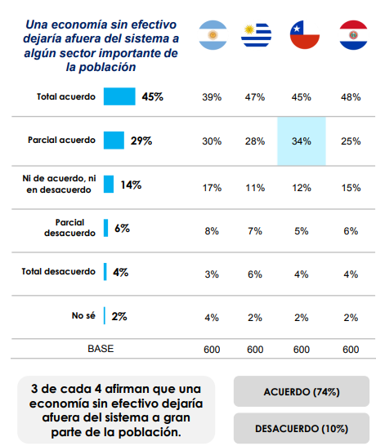
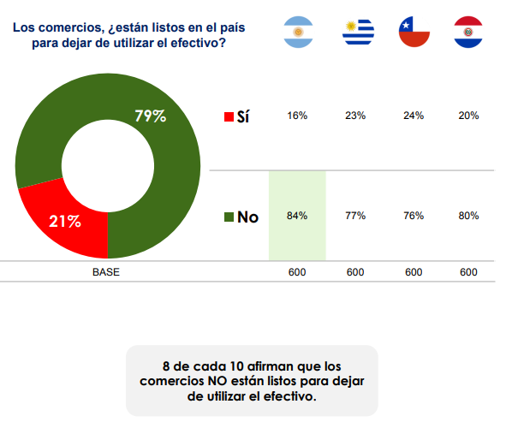

Slide 6
PREVENTION OF TAX EVASION- Law 25.345
Total or partial payments of sums of money in excess of one thousand pesos ($ 1,000), or their equivalent in foreign currency, which are not made by means of the following shall not be effective between parties or with respect to third parties:
1. Deposits in accounts of financial institutions.
2. Money orders or bank transfers.
3. Checks or cancellation checks.
4. Credit, purchase or debit cards.
5. Credit invoice.
Payments that are not made in accordance with the provisions of Article 1 of this law shall not be computable as deductions, tax credits and other tax effects that correspond to the taxpayer or responsible party, even if they prove the veracity of the transactions.
$ 1.000 = us$ 8,70
LAW ON TAX PROCEDURES (11.683)
SECTION 34 - ... taxpayers who do not use such means or forms of verification shall be compelled to prove the authenticity of the transactions in order to be able to compute the aforementioned items in their favour.
The CSJN has declared the unconstitutionality of art. 2 of the 'Anti-evasion Law' 25.345, which prohibits the counting of transactions over $1000 whose payments are made in cash.

Slide 7
PREVENTION OF TAX EVASION- Law 25.345
The payment in cash of sums of money in excess of PESOS TEN THOUSAND ($ 10,000), or its equivalent in foreign currency, made on the occasion of the execution of a public instrument, whereby real rights over real property are constituted, modified, declared or extinguished, shall have the same cancellation effects for the parties and third parties as the procedures provided for in sections 1 to 4 of Article 1 of Law No. 25,345.

Slide 8
Initial research Hypothesis
1) Starting from the existence of an alleged criminal wrongdoing (such as drug smuggling or the payment of overprices in a public work or human trafficking for sexual exploitation), generating an illicit profit, followed by an investigation of the assets of the protagonists of this wrongdoing - and of all those persons linked to them - to detect what commercial or financial operations had to be carried out to give these assets the appearance of legality.
2) It starts from a manifestation of wealth carried out by someone who, in one or several acts of patrimonial content, externalised a power of administration or disposal of assets that is incongruent with their economic capacity.

Slide 9
TRANSACTIONS INVOLVING ASSETS TO BE INVESTIGATED
WRONGDOING
SHOW OF WEALTH

Slide 10
TO CONSIDER
UNLIKE IN OTHER COUNTRIES, HERE THEY OFTEN DO NOT EVEN SEEK TO PAY TAXES IN ORDER TO MAKE THEIR FUNDS AND ASSETS APPEAR MORE ORDERLY OR LEGAL.
They look for regulatory loopholes to escape taxation, generating the evidence with which they try to cover their actions.
EXCESSIVE TAX BURDEN
COST-BENEFIT RATIO

Slide 11
PERSONAL ENRICHMENT
ARE OUTSOURCED THROUGH SELF-DETERMINATIVE INCOME TAX DECLARATIONS.

Slide 12
NON-RECURRING INCOME IS NOT TAXED OR IS EXEMPTED
EXAMPLES: GAINS DERIVED FROM
SALE OF REAL ESTATE
SALE OF BOATS AND CARS
SALE OF PAINTINGS
SALE OF SHARES
DONATIONS / LEGACIES
COLLECTION OF PRIZES
FAILED PURCHASE / SALE TICKETS
IRREVOCABLE REPURCHASE OPTION
LABOR DEBT RECOGNITION AGREEMENTS

Slide 13
MOST COMMON PRACTICES
Use of front companies (concealment of real owners)
Use of front men or nominees (concealment of beneficial ownership)
Use of counter documents (concealment of real titleholders)
Use of broad general authorizations for the administration and disposition of funds (concealment of real owners)
Loans / Back to Back (money transfer)
Apocryphal invoicing of purchases (money outflow)
Over-invoicing of sales (cash inflow)
Over-invoicing of exports (cash inflow)
Import under-invoicing (lower cash outflow and lower tax payment)
Over-invoicing of imports (money outflow)
Use of crypto-assets (opacity)

Slide 14
MOST COMMON PRACTICES
Deposit and withdrawal of cash from bank accounts (opacity)
Use of cooperatives and mutuals for check cashing (opacity/evasion)
Deeded purchase of real estate at a lower price and sale of the same real estate in a short term at a higher price (cash inflow).
Purchase of a property and its deed for less than the price paid. Subsequent sale of the property, in a short period of time, for its market price (cash inflow).
Fractional transfer of funds through a bank account (opacity).
Acquisitions with irrevocable options to buy or sell (cash receipt)
Collection of prizes and/or use of casinos (fund entry)
Donations (fund entry)

Slide 15

USE OF SHELL COMPANIES
INCOME FROM FICTITIOUS LOANS / CONTRIBUTIONS FROM SHAREHOLDERS OR THIRD PARTIES
Person under Investigation
Companies
OVER-INVOICING
Bank Accounts
-Background information (authorized persons, proxies, signatories, etc.)
-Analysis of movements
- Cash withdrawals, check payments, transfers, etc.
FRONTMAN

Slide 16
HOW FRONTMEN OPERATE
- They are the front face of the person or company that uses them.
- Their main function is to hide the real owner or the owner of the company, who does not want his or her name to be known for tax or political reasons or illegitimate money. They merely lend their name and receive payment in return.
- They sign an undated letter of resignation so that the real owners can remove them whenever they want or a broad Power of Attorney in the name of the real owner.
- If you put "Nominee Director" into a search engine you get some 134 million entries for countries all over the world.

Slide 17
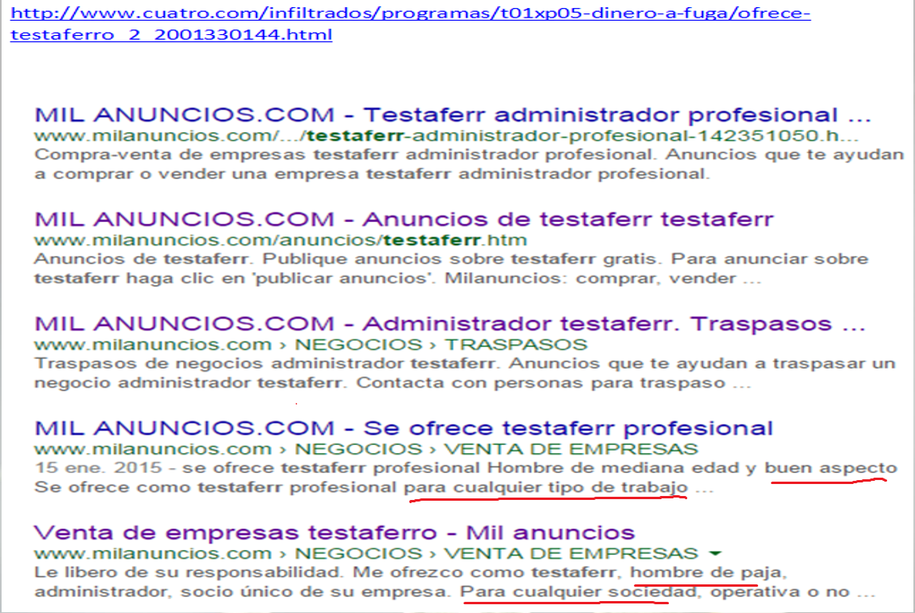

Slide 18
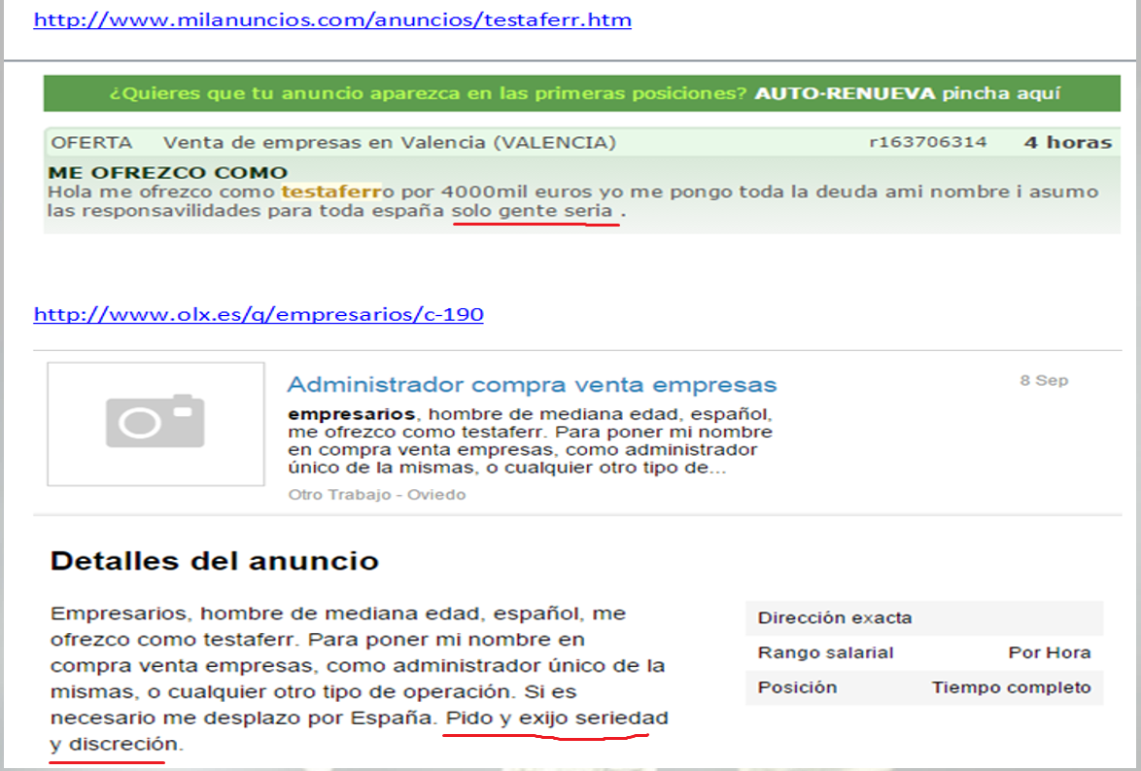

Slide 19
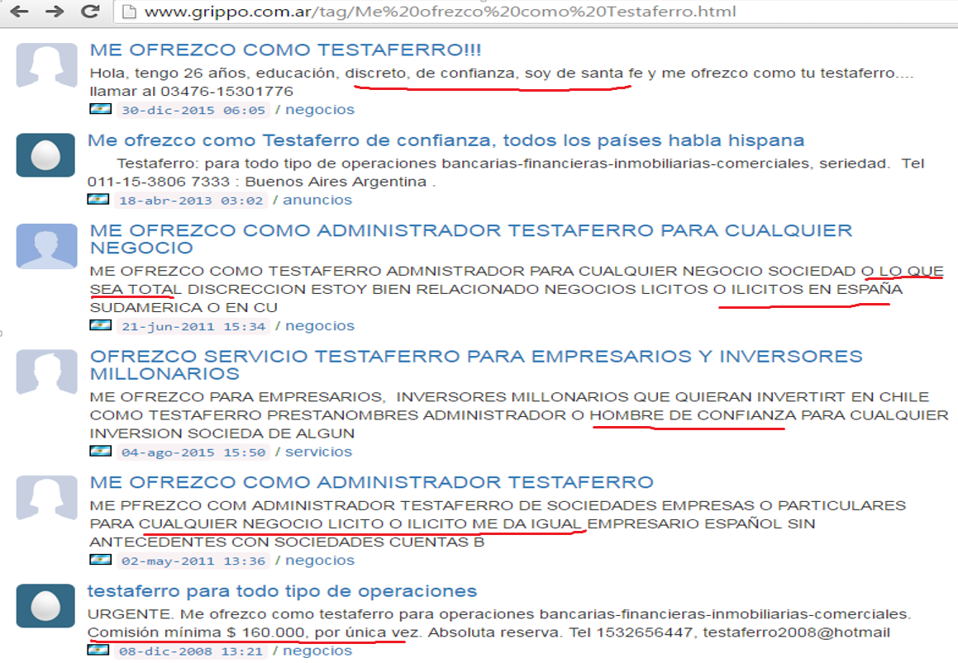

Slide 20
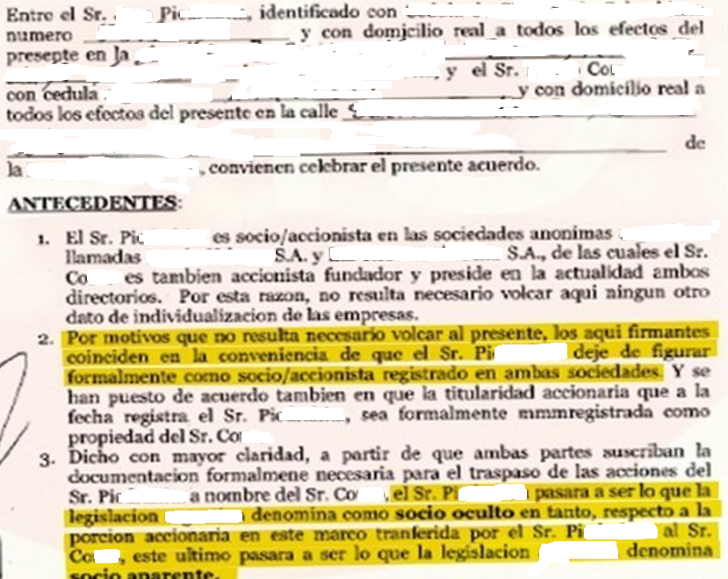

Slide 21
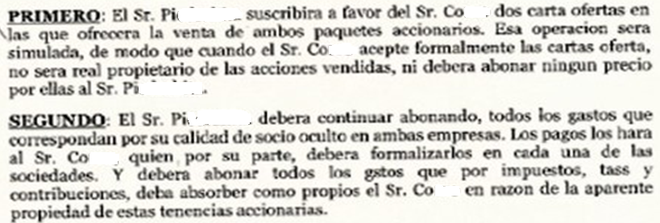
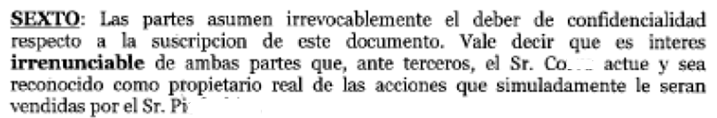

Slide 22
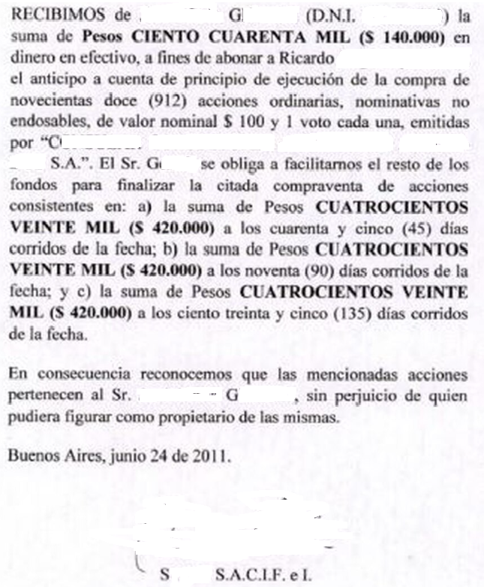
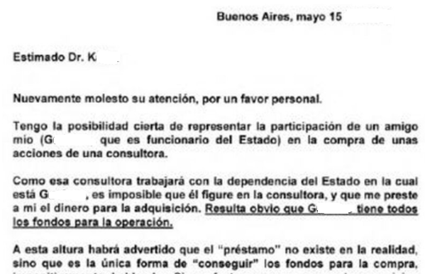

Slide 23
COOPERATIVES AND MUTUALS
They offer the service of collecting securities belonging to their members, through their own bank accounts, which have the benefit of a reduced rate of tax on bank debits and credits (securities collection management).
They also offer loans.
The figure of mutualism and cooperativism is used as a screen to transform themselves into real "money tables", used primarily to exchange checks for cash and thus hinder the traceability of the money.
"Financial assistance" through the exchange of deferred cheques belonging to members or third parties.
Financial intermediation not authorised by the BCRA.

Slide 24
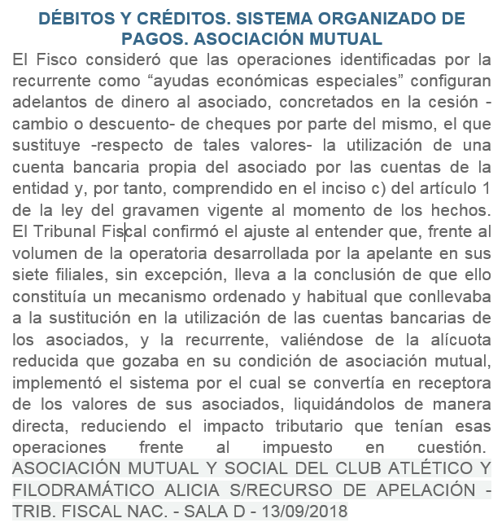

Slide 25
BENEFICIAL OWNERS
Look through the legal person (look-through), in order to identify its "beneficial owners", i.e. the individuals (human persons) who actually have effective control over or benefit from the legal person.
The person who controls the entity, even indirectly through other entities or intermediaries.

Slide 26
ARGENTINA - BENEFICIAL OWNER
General Inspectorate of Justice (IGJ) - Companies - RG 17/2021
Financial Information Unit (UIF) - Resol. 112/2021
The human person who owns at least ten percent (10%) of the shares or voting rights of a legal person, a trust, an investment fund, ... and/or any other legal structure; and/or the human person(s) who by other means exercises ultimate control thereof.
Final control shall be understood to be that exercised, directly or indirectly, by one or more human persons through a chain of ownership and/or through any other means of control and/or when, due to de facto or de jure circumstances, the same person/s have the power to form the corporate will for the taking of decisions by the governing body of the legal person or legal structure and/or for the appointment and/or removal of members of the administrative body.

Slide 27
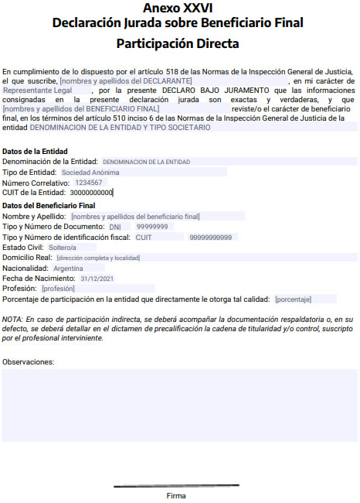
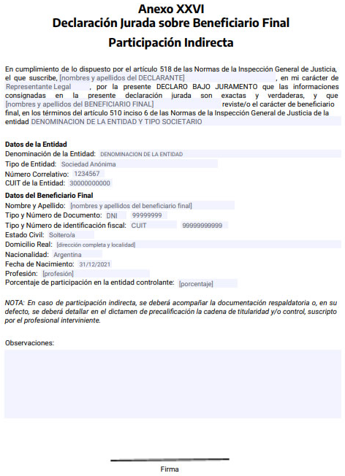
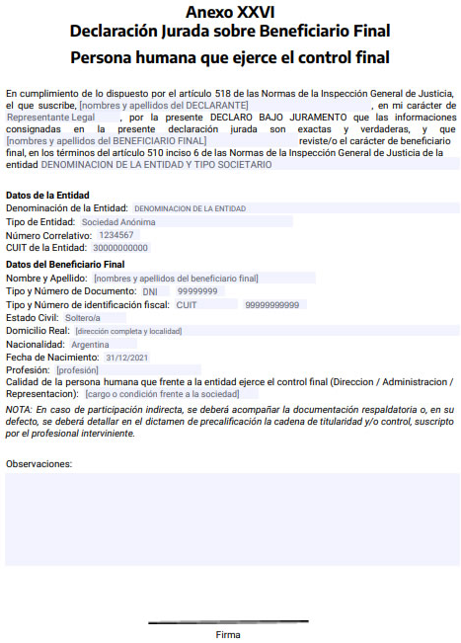

Slide 28
SUPERINTENDENCE OF INSURANCE (Resolution 816/2018)
“"Beneficial owner": Any human person who controls or may control, directly or indirectly, a legal entity or legal structure without legal status, and/or who owns, directly or indirectly, at least TWENTY PERCENT (20%) of the capital or voting rights, or who otherwise exercises ultimate control, directly or indirectly. When it is not possible to identify a human person, the identity of the Chairman or the highest appropriate authority must be identified and verified”

Slide 29
EXAMPLE
If companies A and B are the partners (owners) of company C, the partners, shareholders or direct holders of the shares of company C will be A and B.
The beneficial owners of company C will be the human persons who control or benefit from C through A and B.
If Mr. Peter is the sole partner (shareholder) of A and B, he will in turn be the ultimate beneficial owner of company C.
However, the mere fact of finding a natural person does not mean that he is a beneficial owner.
Peter could be a front man or a nominee shareholder (powers of attorney, mandates, etc.).

Slide 30
ORGANISED CRIME
"DRUG TRAFFICKING” ACCOUNTING

Slide 31
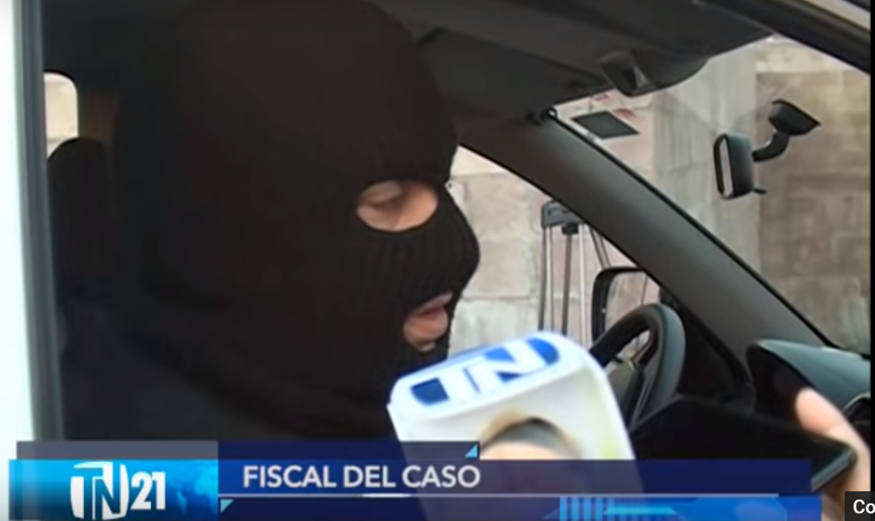

Slide 32
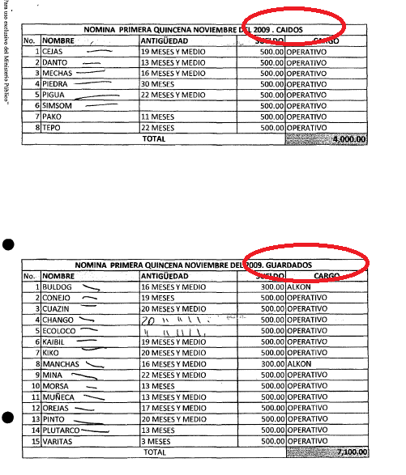

Slide 33
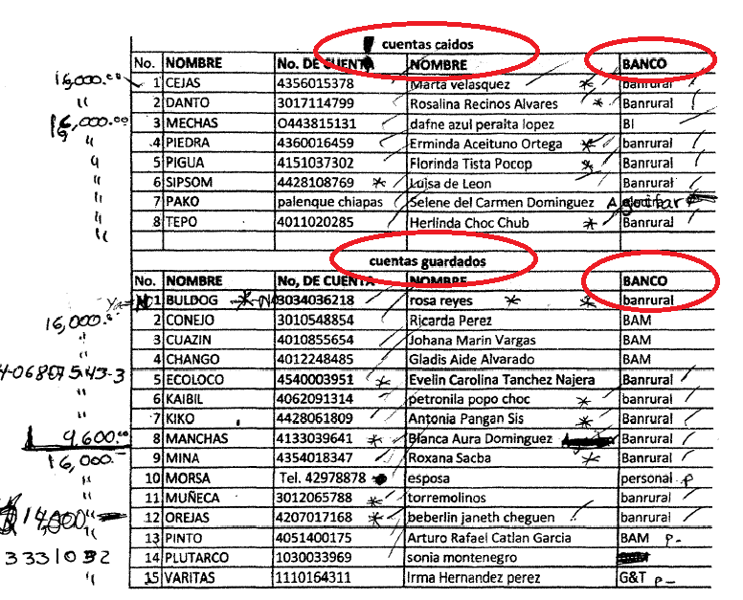

Slide 34
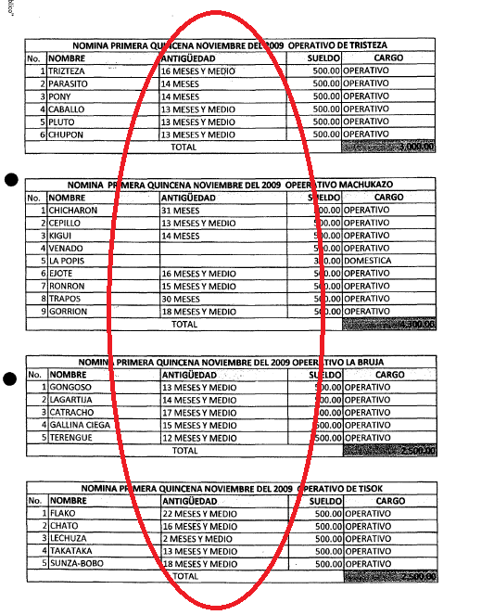

Slide 35
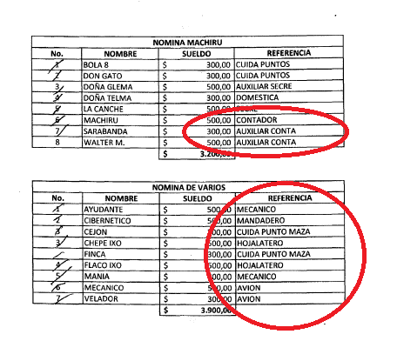

Slide 36
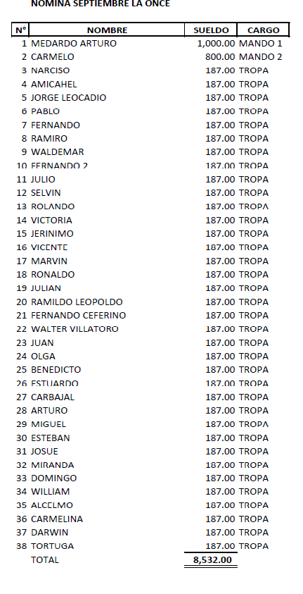

Slide 37
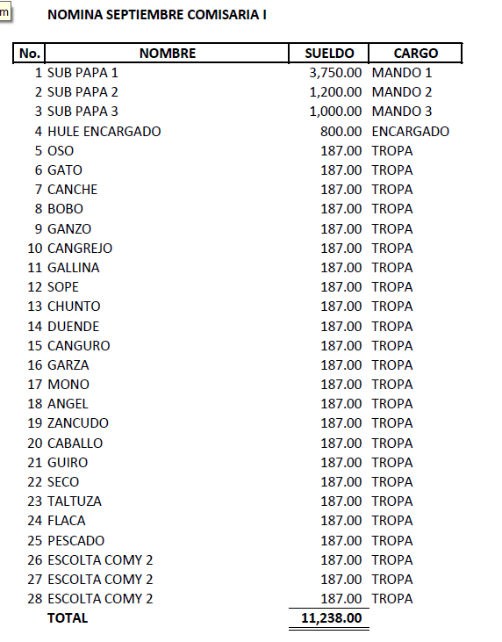

Slide 38
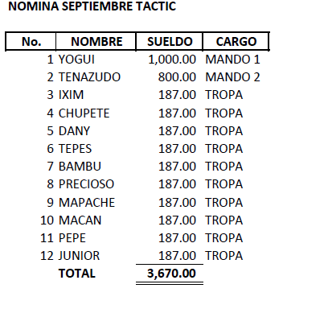

Slide 39
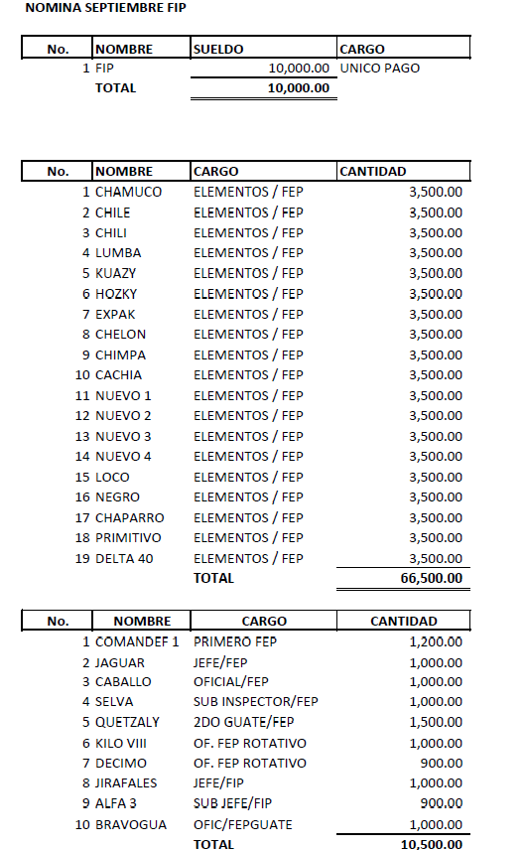

Slide 40
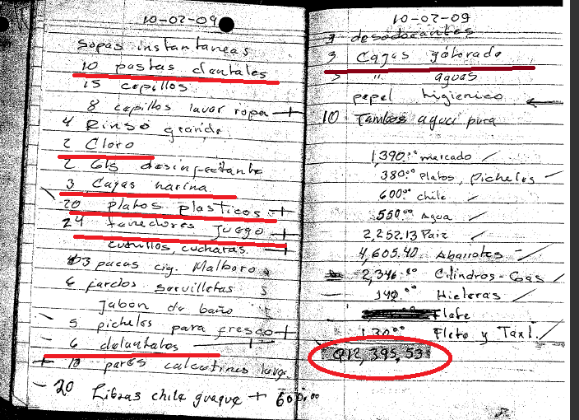

Slide 41
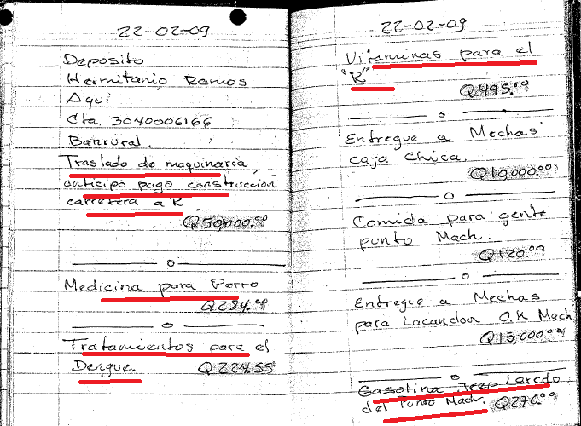

Slide 42
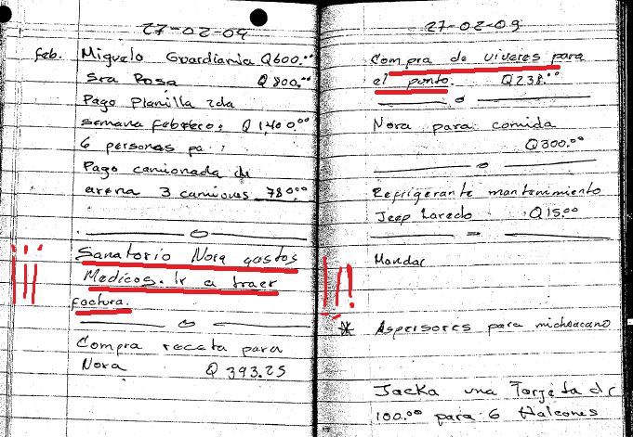

Slide 43
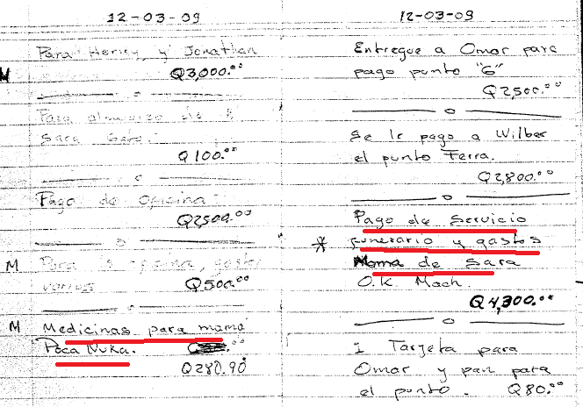

Slide 44
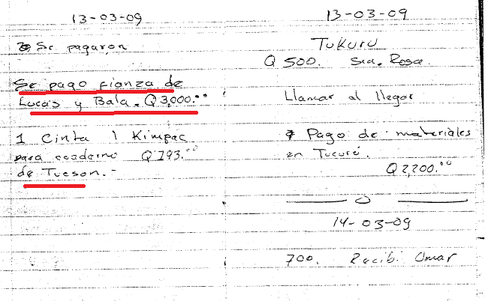

Slide 45
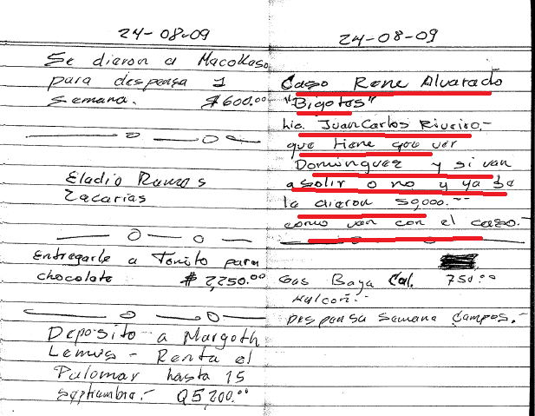

Slide 46
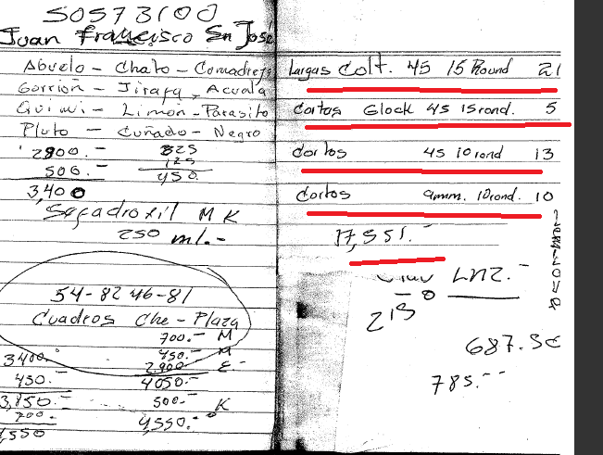

Slide 47
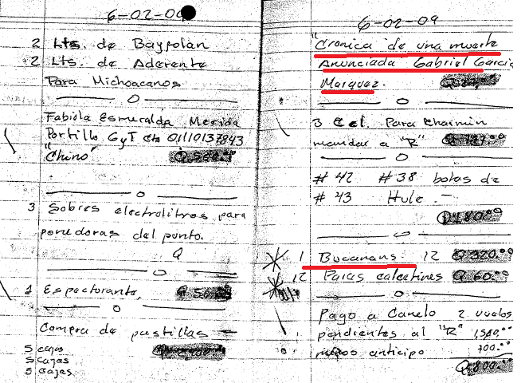

Slide 48
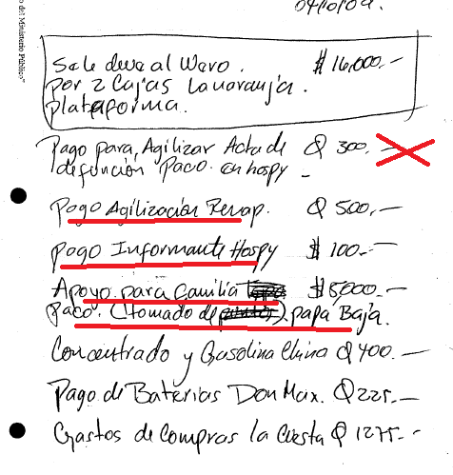

Slide 49
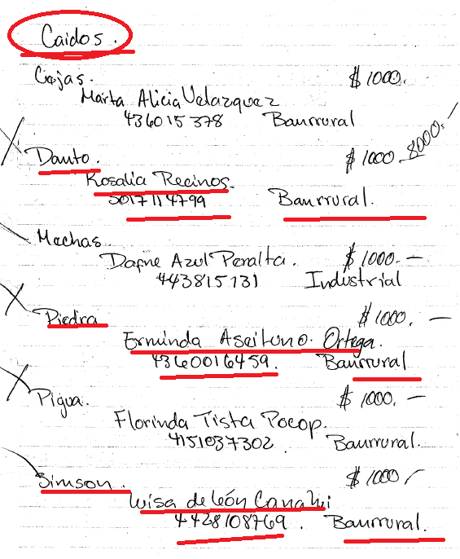

Slide 50
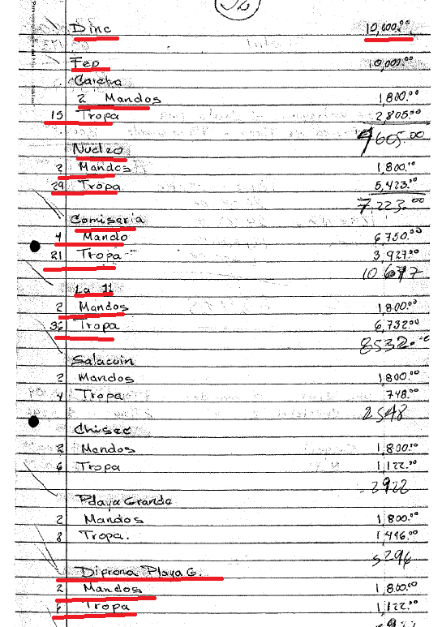

Slide 51
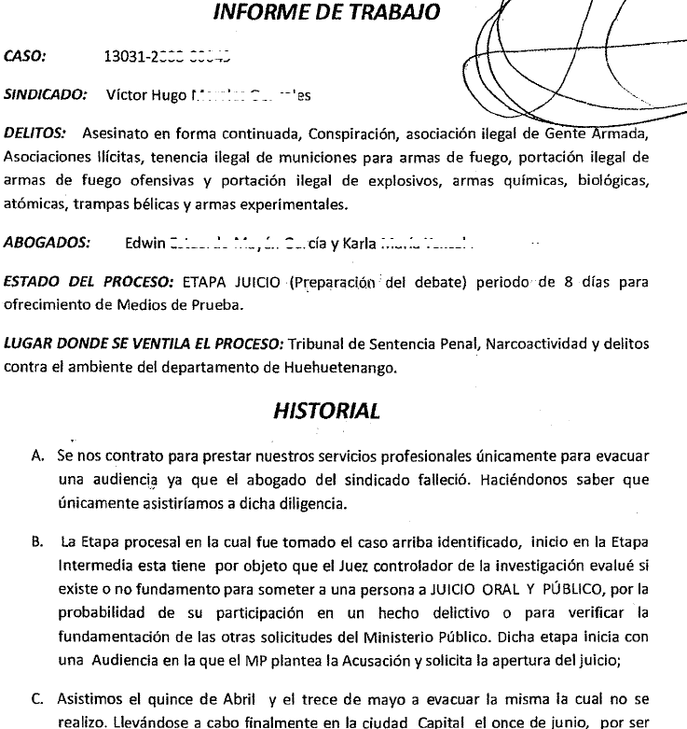

Slide 52
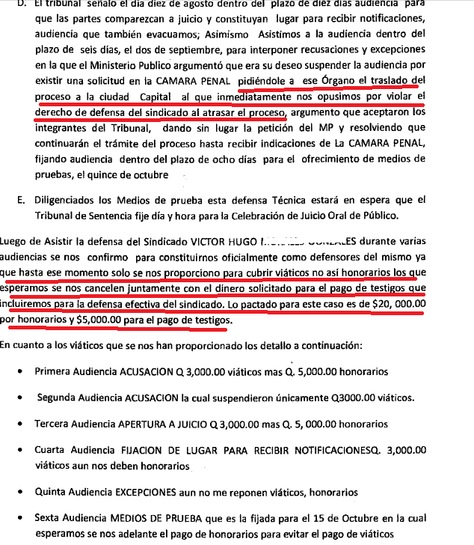

Slide 53
