Slide 1



Office of Economic Crime and Money Laundering
PROCELAC

Slide 2


MONEY LAUNDERING
Buenos Aires · March 2022
MARÍA LAURA ROTETA (LROTETA@MPF.GOV.AR)

Slide 3
Change in international criminal policy (’70s)
Focus of the international community: target the illicit profits generated by organized crime as an efficient strategy for prevention, investigation, prosecution, and punishment of these criminal phenomena.
Legal tools to avoid benefiting from illicit proceeds, and confiscation of property.
Criminal organizations act as (criminal) enterprises.
Perspective of economic rationality: cost-benefit: make the illegal business risky and unprofitable, so that it becomes meaningless.

Slide 4
Criminal-Political Goals:
Deprive criminal organizations of the economic and financial means necessary to continue operating.
Eliminate or reduce the incentive to commit these crimes: profit.
Increase effectiveness in the prevention and investigation of these crimes.
Economically isolating the author.
  Generate negative incentives so that no one wants to receive these goods.
  Deprive of the enjoyment of these goods (anonymity and impunity).
  That illicit goods are left out of the market.

Slide 5
Paradigm shifts at various levels related to criminal law and criminal procedure:
Approach focused on the persecution of people/ approach oriented to the investigation of property and its confiscation.
Logic of investigation of a traditional crime / logic of a modern crime, which uses technologies, complex, globalized and dynamic because it occurs at high speed or in real time.
Approach based on reactive culture/pro-active action.
A state-only approach to prevention/a private sector approach.
Approach focused on natural persons/approach that includes legal persons.
Recovery: criminal confiscation/non-conviction-based (in rem).
International cooperation: from the exception to the rule.
HARMONIZATION: of criminal offences, of procedural systems.

Slide 6
CONCEPT (CRIMINOLOGICAL TYPE/CRIMINAL PHENOMENOLOGY):
ML is a complex and progressive process through which ill-gotten assets are integrated into the legal economic system with the appearance of having been obtained lawfully. In this way:
The existence of ill-gotten goods is hidden
They are disguised to give them the appearance of legality
  Purpose: to hinder their discovery and confiscation, to enjoy them under anonymity and impunity, to generate more wealth and power, to continue financing criminal organizations.
FATF adopted a theoretical or explanatory model of phases or stages:

Slide 7
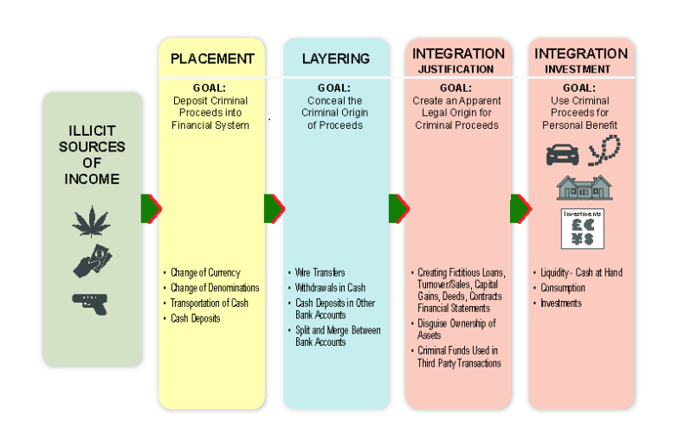

Slide 8
EXAMPLE OF LEGISLATION (ART. 303 Argentine Penal Code) AS A TRIGGER FOR ISSUES TO DISCUSS RELATED TO THE DIFFERENT LEGISLATIVE TECHNIQUES
Crime against the economic and financial order (multi-offensive).
Penalty of 3/10 years in prison and a fine of 2/10 times the amount of the operation.
Convert/Transfer/Manage/Sell/Tax/Disguise/Or otherwise put into circulation on the market.
Assets derived from a criminal offense.
With the possible consequence that the origin of the originating or subrogating goods acquires the appearance of legality.
For this penalty: the value must exceed $300,000 (if it is a lower amount, there is a lesser penalty, from 6 months to 3 years).

Slide 9


RISK INDICATORS AND THEIR IMPORTANCE AS EVIDENCE
https://www.oecd.org/ctp/exchange-of-tax-information/money-laundering-awareness-handbook-for-tax-examiners-and-tax-auditors.pdf
https://www.oecd.org/tax/crime/money-laundering-and-terrorist-financing-awareness-handbook-for-tax-examiners-and-tax-auditors.pdf

Slide 10
Indicators for Cash
Unusual origin of the funds
Cash received from countries with a high level of corruption or political instability.
Cash received from countries with a well-developed financial system.
Cash deposits into personal or business bank accounts from unexplained sources.
Unusual explanations given
Incomplete, unlikely, partly incorrect or no explanation given for the origin of the cash.
No correspondence or supporting documentation in relation to the origin or owner.

Slide 11
Unusual Possession
Amount, denomination, or currency do not fit the bearer’s personal or business background.
Unusual method of transportation
Concealed transportation of cash
Clear safety risk in the method of transportation
High costs of transportation compared to alternative methods of transport
Unusual destination and spending
Countries of risk (e.g. drug producing, ineffective anti-money laundering regulation, strict banking secrecy)
Cash received in countries which do not fit the bearer's background
Cash spent on luxury items
Large cash withdrawals or payments without an economic reason or explanation.

Slide 12
Unusual cash flows
Cash turnover/sales not to be expected in industry
Large increase in cash turnover/sales from non-identifiable customers.
Deposits or drafts in cash in denominations or currency not to be expected in the industry.
Cash deposits which are not registered as turnover/sales.
Foreign loans received in cash and in local currency.
High cash investment by foreign owner of lender.
An occasional high cash transaction (e.g. turnover/sales, cost invoice).
Structuring of bank deposits: smaller transactions in a short period of time, to avoid reporting (smurfing).

Slide 13
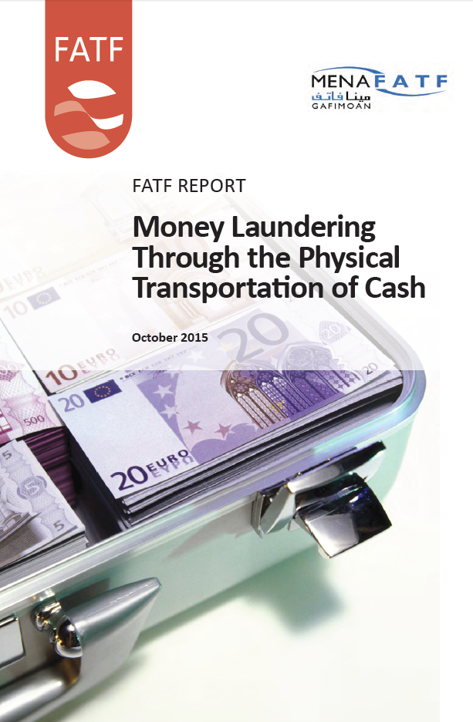
https://www.fatf-gafi.org/media/fatf/documents/reports/money-laundering-through-transportation-cash.pdf

Slide 14
NATURAL PERSONS
Requests to purchase, or possession of, large amounts of foreign currency without a plausible explanation.
Possession of large amounts of money without an adequate explanation.
Possession of money supposedly for business reasons while travelling to countries where cash payments are restricted.
Requests to purchase, or possession of, large volumes of high denomination banknotes. Very few retail businesses in the EU will accept anything higher than EUR 50 note for a routine purchase.
Cash deposits in bank account (possibly indicating previous transportations of cash).

Slide 15
Illogical travel patterns. For example less than 24 hours between inbound and outbound travel bookings, travelling to non-tourist destinations, convoluted routes for no apparent reason; vague or contradictory details of destinations or reasons for travel.
Little or no luggage.
Repeated short notice travel to the same destination.
Tickets bought for cash at very short notice at higher than normal prices.
Tickets purchased by someone other than the traveler.
Multiple individual travellers who appear to be involved in similar unusual movements or show similar travel patterns;
Passenger has a connection (nationality, destination, origin, previous travel, etc.) with a risk area or jurisdiction. E.g. those with specific crime issues; jurisdictions with non-functioning state institutions, etc.

Slide 16
Uneasy movement or unusual body shape due to bulk cash hidden on body.
Passenger has an iron in his luggage. Banknotes are sometimes ironed to make them easier to pack in small spaces.
Passenger is a politically exposed person or otherwise a person of interest.
Passenger leaves luggage at border/(air)port.
Passenger aborts attempt to cross border.
Check-in or last-minute boarding.
Volume of the currency in possession of the traveller exceeds currency/monetary control threshold of country of issuance.
Cash is carried in several currencies.
Possession of large amounts of currency from jurisdictions unrelated to the traveller.

Slide 17
CARGO AND MAIL
Uneconomic cash shipments. Shipment is of a very small amount of cash, why was it not simply banked and wired?
Cash is claimed by someone using fake documents, to identify himself or making fake claims concerning ownership of the money.
No contact from the shipper or beneficial owner after a consignment has been inspected.
Cash is transported in high denomination banknotes.
The nature or volume of the currency does not match the point of origin.
Companies do not exist or appear not to trade.
Goods shipped or posted from high-risk jurisdictions.
Name and address details on parcel are unclear, vague and/or falsified.

Slide 18
VEHICLES
Driver of the vehicle is not the owner.
Nationality of the driver and the nationality of the vehicle do not match.
Demeanour of driver: nervous, sweating, excessive smoking, etc.
Vehicle not insured, or insured in the name of someone who is not the driver.
Recently purchased vehicle.
Vehicle purchased for cash.
Inaccessible parts of the vehicle: parts of the boot/trunk, beneath seats, etc.
New wiring or electrical items (possibly electronically operated access to concealment).
Goods carried by vehicle are uneconomic to ship.
Goods do not match the paperwork.
Driver and passengers give contradictory stories.

Slide 19
OTHER INDICATORS CONTAINED IN THE OECD DOCUMENT

Slide 20
Money laundering indicators for individuals
Unusual income
  No income or low income compared to normal cost of living
  Taxpayer seems to be living beyond their means
Unusual rise in net worth
  Inheritance from a criminal family member
  Fictional inheritance
  Voluntary disclosure by known criminals or their relatives
  Gambling and lottery winnings

Slide 21
Unusual possession or use of assets
A person with low-income owns or uses expensive assets (e.g. car, boat, real estate).
A person owns assets located abroad, usually not declared in their tax return.
Unusual debt
Obtaining a disproportionally high mortgage on a relatively low income.
Obtaining a loan from unidentified parties.

Slide 22
Unusual transactions
Buying assets (e.g. a house) having a relatively low income.
Buy high value assets (e.g. a house) far below market value.
Taking part in a property flipping transaction with no real estate background.
Cash transaction with a unknown person (e.g. fictitious sale).
Information from external sources (e.g. law enforcement, media).

Slide 23
Indicators for Business
Unusual operations and parties
Entrepreneur demonstrates poor knowledge of the business.
Transactions in goods or services do not fit company’s profile.
Transactions without an evident commercial basis.
Transactions or agreements without relevant supporting documents.
Transactions with offshore companies.
Transactions with suspected criminals or their partners.
Non-transparent/non-identifiable customers, creditors or lenders.
Transactions with business associates or customers that share a common address.

Slide 24
Unusual money flows
Payments to or from third parties who are not involved in the transactions.
Payments to or from unrelated offshore companies or accounts.
Company bank account used as a cash flow-through account.
Non-transparent or non-verifiable origin of the money (e.g. cash deposits, loans or cash sales).
Denominations and currency not the norm in the industry.
Bank deposits not declared as turnover/sales.
Money flows without apparent economic reason or supporting documentation.
Unusual use of credit cards or debt instruments.
Profit sharing agreements with no relevant economic basis.
Lack of relevant supporting documentation.
Costs incurred not leading to turnover/sales.

Slide 25
Unusual turnover/sales
Significant increase in (anonymous) cash turnover/sales.
Large cash payments received for luxury goods sold.
Large cash payments received for goods never delivered (fictitious buyer).
Transactions without an evident commercial basis or supporting documentation on file.
Transactions and agreements without related costs or relevant supporting documentation.
Transactions with suspected criminals or their partners.
Transactions in goods or services do not fit company’s profile.

Slide 26
Indicators for Real Estate
Unusual parties
A non-professional party involved is a typical (very large, specialised and/or with high risks).
The party belongs to the social network of a criminal.
There is non-transparency in the ownership of a legal entity.
Unusual possession
Non-transparent ownership (e.g. bearer shares, legal entity not known by the tax administration).
Lack of income in relation to the purchase price.
Persons with criminal records or background.
Social network of a criminal person.
Fast growing portfolio.

Slide 27
Unusual transactions
Unusual transaction prices (e.g. out of line compared to prior transaction price, asking price or market value)
Unusual transaction results (high profits during a short period of ownership)
Unusual financing
Unusual origin of the funds
Unusual lender
Unusual borrower
Unusual loan agreement
Unusual financing result

Slide 28
Unusual occupant or user
Lack of income in relation to fair market level of rent
Persons (or those related to persons) with criminal records or background
Unusual statements given
Highly unlikely, non-verifiable or non-documented statements given

Slide 29
OTHER INDICATORS
Indicators for Charities and Foreign Legal Entities
Indicators for Cryptocurrencies
Indicators for International Trade
Indicators for Loans
Indicators for Professional Service Providers

Slide 30
EVIDENTIARY ASSESSMENT OF INDICATORS
Principles for evidentiary assessment:
Probatory Freedom Principle
Principle of Legal Reasoning
Duty to state reasons
Evidentiary standards:
Suspicion: investigation
Well-founded suspicion: interference, transfer of the accusation
Conviction: certainty beyond reasonable doubt/principle of innocence/in dubio pro reo

Slide 31
Requirements for the assessment of evidence:
Proved by direct evidence
True experience maxims
Make explicit the reasoning/adequacy of the rules of logic and experience
Univocal
Plural
Concordant

Slide 32
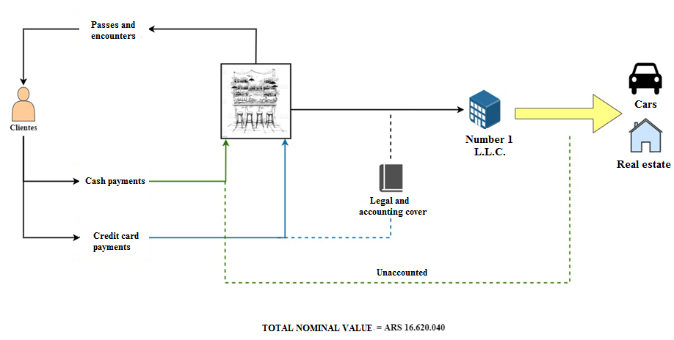
CASE 1

Slide 33
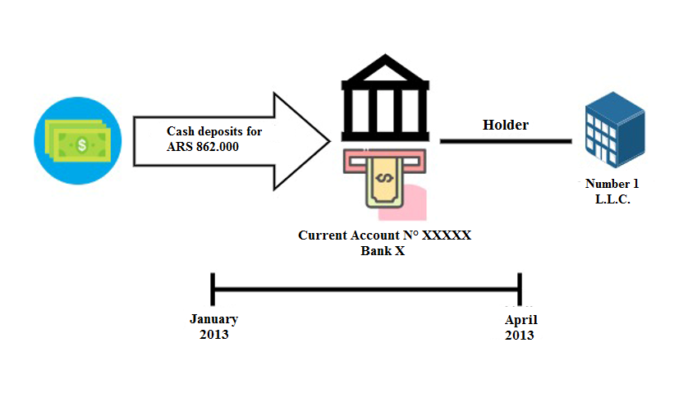

Slide 34
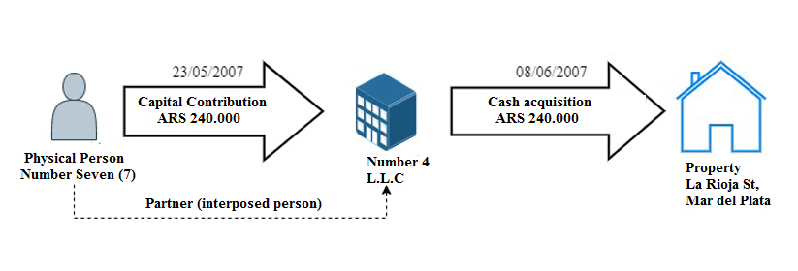

Slide 35
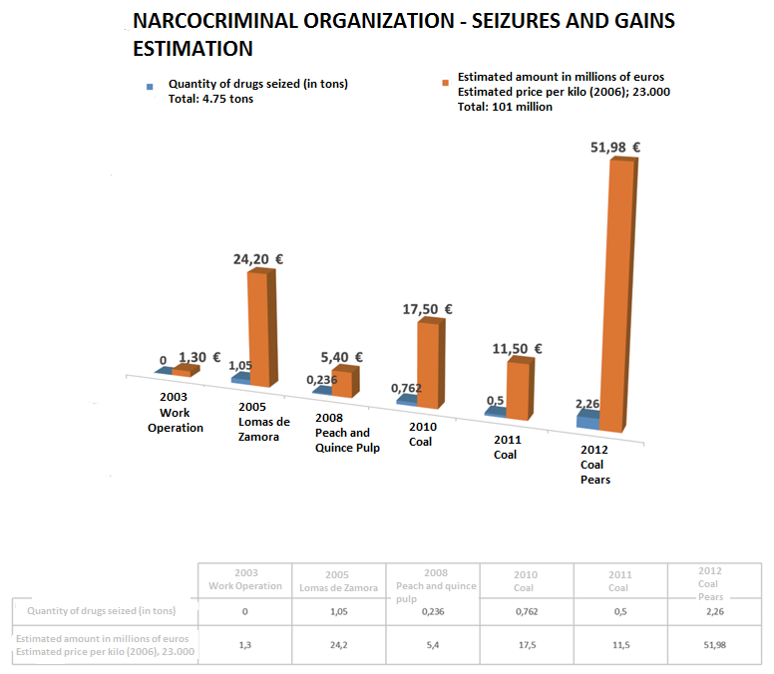

Slide 36
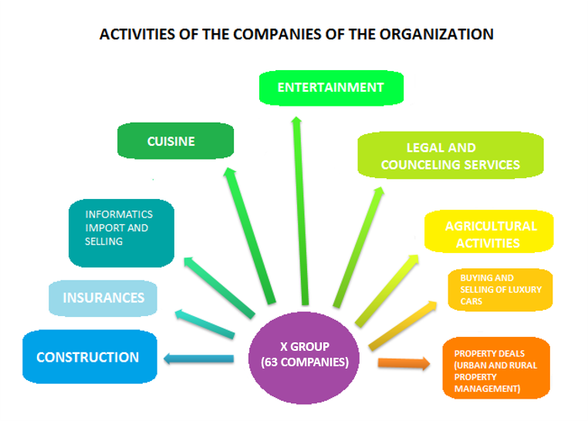

Slide 37
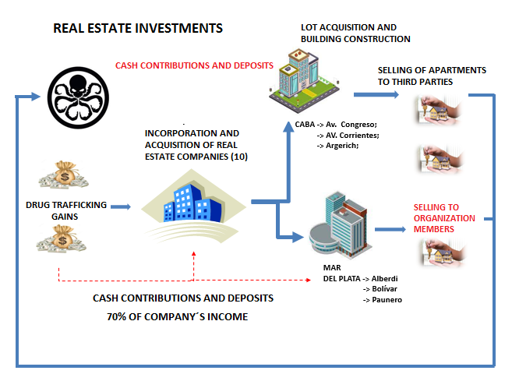

Slide 38
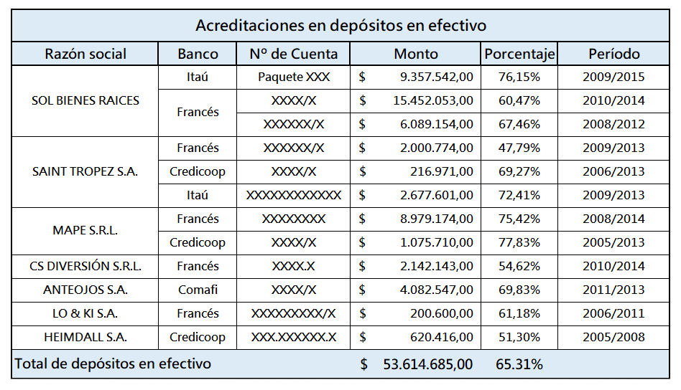

Slide 39
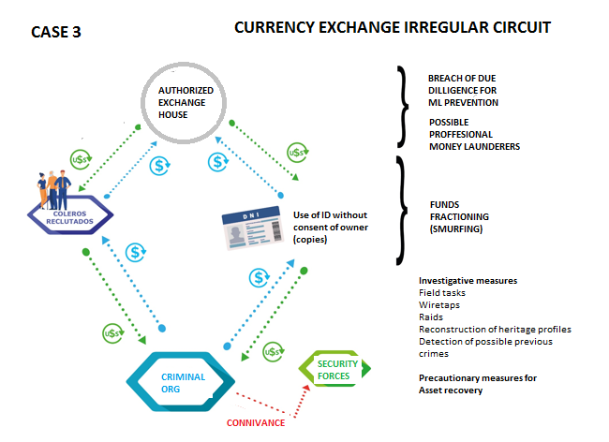

Slide 40
CHALLENGES:
Conduct early, parallel and efficient financial investigations
Undermine the economic power of organized crime
Economize on evidentiary measures
Reach the beneficial owners/Heads of organizations: clarify the organizational structure
The recovery of assets (precautionary, and confiscation of assets)
Identify financial networks and typologies of ML

Slide 41
Increased case detection
From the punitive model to the preventive system
Risk-based approach
Risk indicators or alarms
Training
Have a crime map
Go against professional launderers or facilitators
Need for a strategic approach to the case

Slide 42


Thank you

