Slide 1
Challenges in Obtaining information from Abroad
Richa Gulati
India

Slide 2
Obtaining information from abroad
Any Legal instrument available?
  Article 26 on Exchange of Information in DTAA
  Article 27 Assitance in Collection of Taxes
  TIEA
  Multilateral agreements/convention
  Egmont

Slide 3
Before making the reference
Identify the jurisdiction- Footprints in multiple juisdictions
Identify the legal person
Relevant background
Ground for believing that information is available in foreign jurisdiction
Knowledge regarding public sources to get information
  Singapore and Isle of Man require that that their online Companies Registry should be explored before seeking the information through EOIR
Knowledge regarding how EOI process/system in other jurisdictions to understand what would actually get us information
  Switzerland does not provide information prior to 2011, Similarly, Singapore does not provide information prior to 2008, Lichtenstein does not provide information prior to 01.04.2013 and Luxembourg prior to 01.04.2010
Tax purpose: Assessment, prosecution, recovery of taxes
Certify that domestic sources of investigation are exhausted

Slide 4
Tax Purpose: Illustration
Note: The Long term capital gains on sale of shares on recognized stock exchange is exempt
TX Ltd, Isle of Man
Remittance to bank account
TX Ltd, Bank account in Switzerland
Sale of shares on
Stock Exchange
A Pvt Ltd, India

Slide 5
Tax Purpose: Illustration contd
The company had not filed its return of income in India. Any relief under the domestic law or under the DTAA had to be given only after filing the return
The shares of Indian company were sold to shareholder/director of TX Ltd who was also Chairman of Indian company. Place of effective management of Tx Ltd was questioned
The TX Ltd had been dissolved subsequent to the transfer and refused to file details regarding acquisition of shares.

Slide 6
Specific Information and it’s foreseeable relevancy for investigation
  No fishing expedition
  Beneficial ownership: Mauritius: Form for Category 1 Global Business License and Business plan
  First Minutes of meeting with details regarding bank signatories
  Limited vs General Partner of Limited Partnership in Cayman Islands
  Beneficiares of trust created/administrated/resident of a jurisdiction
  Time period to which information pertains

Slide 7
Relevant Information : Illustration
X Holdings, Mauritius
Indirect transfer of shares of Indian company
X India Pvt Ltd, India
Sale in financial year 2020-21
The shares were acquired in year 2012-13
Notes:
Identify the legal person, country, transaction, time period and relevant information

Slide 8
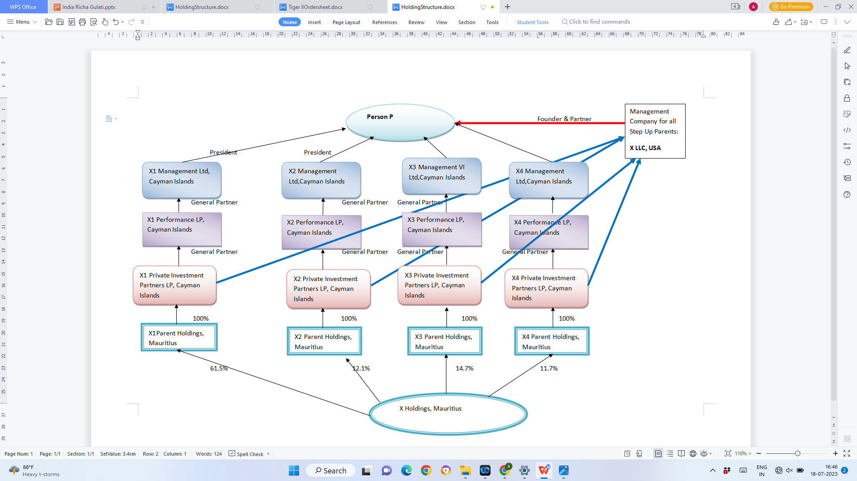

Slide 9
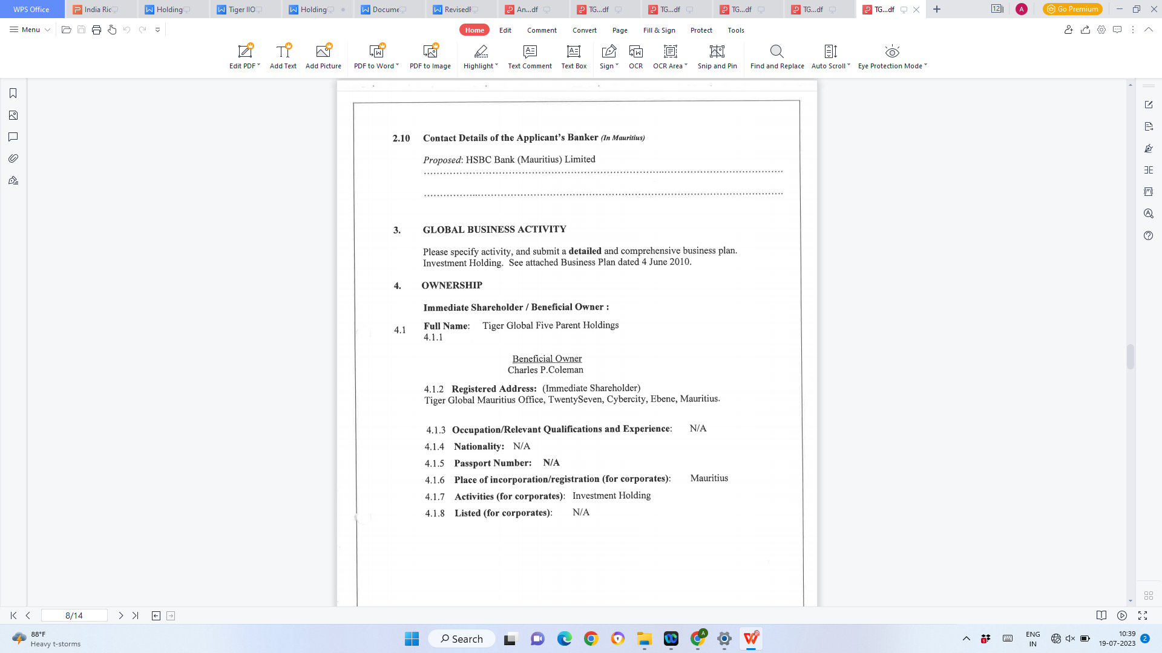
Category 1 Business License: Beneficial Ownership

Slide 10
First Minutes of Meeting: Authorized bank signatories
Control over funds
Illustration: A company was incorporated in Mauritius and in first Minutes of meeting (right after incorporation), the signatories for bank account opened in Mauritius were as under:
Any transactions above USD 250000 required either 2 signatories from Group A or one each from Group A and Group B. Hence it is apparent that the person listed in Group A had the ultimate control over the funds of the Petitioner.
No individual from Group A or B were on Board of Directors of the Mauritius Company neither were they resident in Mauritius. They, however, were key personnel of ultimate parent in USA.
Group A | Group B | Group C
USA Chairman | US Based senior Management | Resident directors in Mauritius

Slide 11
At the time of making the reference
Bureaucractic hurdles: Proformas
Administrative approvals from supervisory authories
Language barriers
Usage of domestic jargons
Lack of knowledge regarding domestic laws and regulations with foreign authorities
Urgency

Slide 12
Challenges: After the reference is made
  Delay in receiving information
    Clarifications
    Multi jurisdiction queries
    Taxpayer may challenge sharing of information by other jurisdiction
    Period of limitation
Part information / Documents not available.
  For example: Partnership agreements, details of limited partners not available with jurisdiction
Relevance of information received
Confidentiality, Prior permission before sharing it with other agencies
Use of information by other law enforcement agencies

Slide 13
Parting thoughts
    Continue to investigate while the information is pending
    Explore publicly available information
    Consider alternate channels for gathering information: Egmont group provides FIUs with a option to share financial Intelligence

