Slide 1
Cryptocurrency Investigation
Sherief Rasheed
Muralikannan V

Slide 2
How we intend to bore you for the next 30 mins
Introduction to VDA & others
Case Study: Investigation into ‘Cryptocurrency’
Crypto : Taxation Scenarios
Online Gaming Investigation
Challenges

Slide 3
VIRTUAL DIGITAL ASSET (VDA)
Any information/code/number/token generated through cryptographic means.
Digital representation of value
With a promise or representation of value
Crypto Currencies, NFTs, Metaverse assets, DiFi
Transactions in VDA undertaken through Crypto Exchanges

Slide 4
Case Study :- Morris Coin- Nishad
Offer interest/dividend returns of 3 to 5% with 300 day lock in period
15000 is minimum amount of investment for which you buy coins
Investments were made into bank accounts of these companies through pin stockists
Investment of minimum 10 lakhs and minimum 5% returns on investment
Aggressive enrolment of new members : ICO
Entered into agreement with Domestic Money Remittance Service Provider Company

Slide 5
Returns paid handsomely in the beginning
Crypto wallet software
Encouragement for converting returns to coins
Cascading effect
Owners and Investors Lifestyles brought in more buyers

Slide 6

The FLOW
Investors
Pinstockists
LR Global , LR technologies, Morris Trading Solutions

Slide 7

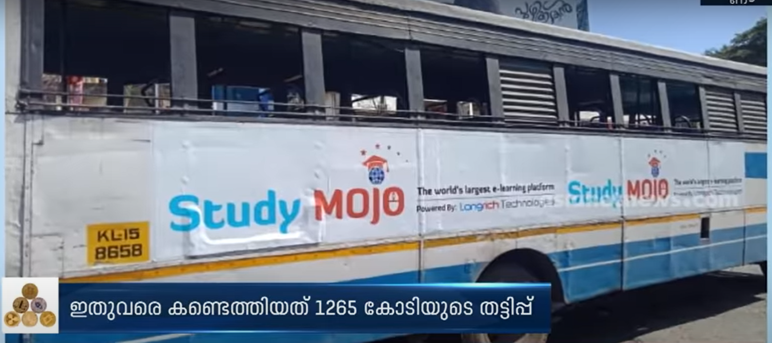

Slide 8
What is the market value of these Crypto?
Absolute Zero because they don’t exist

Slide 9
The BUBBLE BURST
Returns stopped, credibility questioned, rumours
Coins being sold and returns demanded
The promoter , Nishad and his close henchmen flee
Pin stockists gheraoed
Includes investment of even policemen and politicians
Covid times set the perfect platform for flourishing

Slide 10
Cryptotrader
Muhammad Abinaz hailing from Kannur, Kerala
Based on complaint from NRI
30 % returns within 13 days
Even provided agreements on stamp paper to gain credibility
Total of 100 crores embezzlement
Setup office with staff right at the city centre
Owned luxury vehicles,

Slide 11
Making of a Crypto CON Artist
Credibility established through Major influencers(celebrities or youtube)
A high end lifestyle(Flashy cars, bikes, hotels)
Extra ordinary returns promised
Flashy websites and youtube videos/endorsements
No direct contact with investors
Delivering promises over a short period
Fake investors and screenshots over whatsapp

Slide 12
Why investors fall for this?
Absolute Lack of Financial Illiteracy( includes NRIs, Doctors, Actors etc)
Questionable sources of investment : Hawala/Smuggling
Incredible returns and word of mouth
High credibility: Flashy cars, fancy offices
FOMO
No cases registered because of image consciousness

Slide 13
Challenges in Detection of Scams?
Investors not filing cases
Small pockets , not accessible
Often in virtual space
Most of them collapse within 12 to 18 months
High credibility amongst population

Slide 14
Taxation scenarios in CRYPTO
Source of investment is explained but income is not offered to tax
Investment made in websites and exchanges dealing in Digital Currency (Crypto Currency) including Bitcoins registered outside India
Profits generated from conversion of one crypto currency to another crypto currency
Cryptocurrencies are purchased in Initial Coin Offering (ICO) on websites registered abroad and sold in India
Income generated from arbitrage trading on Indian as well as foreign based exchanges
Income generated from peer to peer sale of Bitcoins (either in India or outside)

Slide 15
Other Scenarios
Income generated from sale of Bitcoins on online platforms like LocalBitcoin.com (which enable cash purchase and sale of Bitcoins)
Income generated from Mining of Bitcoins not offered to tax.
Bitcoins received in lieu of services/goods sold outside India
Bitcoins received as gifts from non-residents Indians
Bitcoins purchased abroad while working on site assignments are sold in India

Slide 16
DIFI
Decentralised Finance –emerging financial technology based on secured distributed ledgers similar to Crypto currencies
Removes Third parties, centralised regulators for transactions
  E.g. Uniswap, Sushiswap,

Slide 17
METAVERSE
Single, shared, immersive, persistent 3D Virtual Space where humans live in their digital Avatar
    E.g. Fortnite, Facebook Horizon

Slide 18
METAVERSE :-OPPORTUNITIES
Emerging market which is traded in Crypto exchanges
Though its Virtual world with digital currencies transactions are starting to have underlying financial effect.
E-Gaming market is in early stage of development with enormous scope for growth.
Part of digital marketing/influencing market.
Even musical performances are starting to happen.
    E.g. Fortnite, Facebook Horizon

Slide 19
Investigation into Gaming
A gamer who suddenly became popular Mr. Dilin
Fancy car(BMW – 1.2 crores)
No returns filed
Analysis of bank accounts shows receipts from an intermediary company Analytics Sports(8crores)
Analytics Sports not filing returns
Mumbai based Gaming company : 80 crores loss
Searches carried out on 3 major gamers in Kerala, gaming intermediary and 11 youtube influencers

Slide 20
Major Findings on search on Online Gamers
Presumptive Taxation at 6%
Loco streaming platform remuneration
Platforms digital marketing
Earnings from Youtube was received in Sister’s account
Portion of compensation received outside India
Purchases of high end equipments from abroad, value
Game: Valorent
Ownership of NFT given to platform (agreements found)

Slide 21
VIRTUAL DIGITAL ASSET (VDA) :- Opportunities & Challenges
Emerging area of economy (Cannot be ignored)
Huge potential due to size of population & penetration of technology
Unlocking new areas of employment & revenue
Fast Evolving
No clear regulations
Not tied to a particular standard
Difficult to establish real value
No stability & Prone to upheavals
Speculative in nature
Threat of Money Laundering & Illegal/unregulated Finance Flow

