Slide 1
Correspondent Banking – Follow the Money
How global payments flow, Evidence collection & Bank collaboration
Douglas Sloan
July 2023

Slide 2
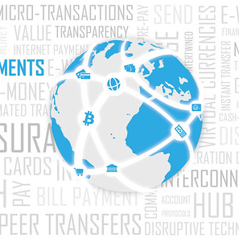
Discussion Topics
Correspondent Banking - - Cross border payments (e.g. SWIFT MT103/MT202cov) explained.
Common Money Laundering Techniques
Law Enforcement & Bank Collaboration

Slide 3



Circuit Diagrams as Wire Transfer Analogy
Simple
Standard
Complex

Slide 4
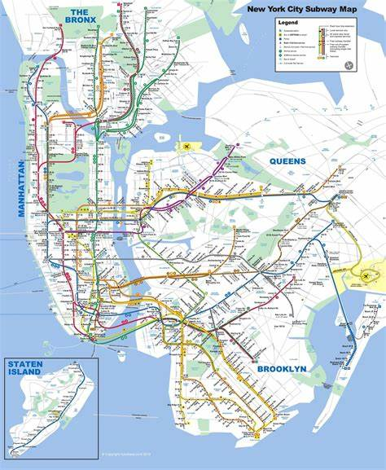
4
4
4
4

Slide 5




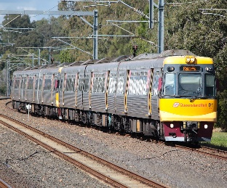
Take the A Train
Second Station. Transfer Option
Your Departure Address
Your Arrival Address
Station Departure
Station Arrival
5
5
5
5
5

Slide 6
Standard Mediums of Exchange
Cash
Doesn’t even cover some foreign mediums
Money Orders
SWIFT
ACH
EFT
Credit & Debit Cards
Virtual Currency
Wires
Checks
FedWire
CHiPs
Travellers Checks
ICH

Slide 7
Major Money Center & Correspondent Banks
The major money center banks are also the major correspondent banking providers. Along with other large banks, they act as the primary processors of US and global US$ payments.
Chief Characteristics of Money Center & Correspondent Banks
No two banks are the same
Depends on Bank
Depends on the Currency
Depends on the Market

Slide 8
Primary Processors of Global US$ Payments
The Clearing House (“TCH”)
Wells Fargo
BNY Mellon
Deutsche Bank
Incoming $
Outgoing $
MUFG
Bank of America
Citibank
Usually SWIFT
HSBC
JPMorgan
Usually SWIFT
Standard Chartered

Slide 9
Basic Wire Transfer
Originator
Originating Bank
Intermediary Bank
Beneficiary Bank
Beneficiary

Slide 10
Basic Wire Transfer
Multiple Intermediaries

Slide 11
Basic Wire Transfer
Multiple Institutions

Slide 12

Complex Wire Transfer

Slide 13
The Basic SWIFT Payment Message types Explained

Slide 14
Basic Wire Transfer
Serial MT103
Serial MT103
Serial MT103: All the Details, All the Value, Lower Risks, Slower

Slide 15
Basic Wire Transfer
MT103 & MT202 (one payment in two messages)
MT103
MT202
MT103: All the Details and Very Fast Communication b/w Org Bank and Bene Bank; But no value.
MT202: Very few details; slow; but has the real value.

Slide 16
Basic Wire Transfer
MT103 & MT202Cov
MT103
MT202cov
MT103: All the Details and Very Fast Communication b/w Org Bank and Bene Bank; But no value.
MT202Cov: All the Details; slow; but has the real value; less risks.

Slide 17
Examining the Wire

Slide 18
Train Ticket
HAPPY RAILS TRANSPORTATION
Reservation Number: XN45BT39283
Reservation Date: August 31, 2020
Fare: $237.89
Class: Economy
Date: September 16, 2020
Passenger: Douglas Sloan
Passenger Number: A12345
Departure: B&O Station. Akron, Ohio
Train: 3478 Midnight Express
Destination: Union Station. Harpers Ferry, WV
Transfers: Penn Station, Newark, NJ
Train: 2648 Regional InterCity
18
18
18
18

Slide 19
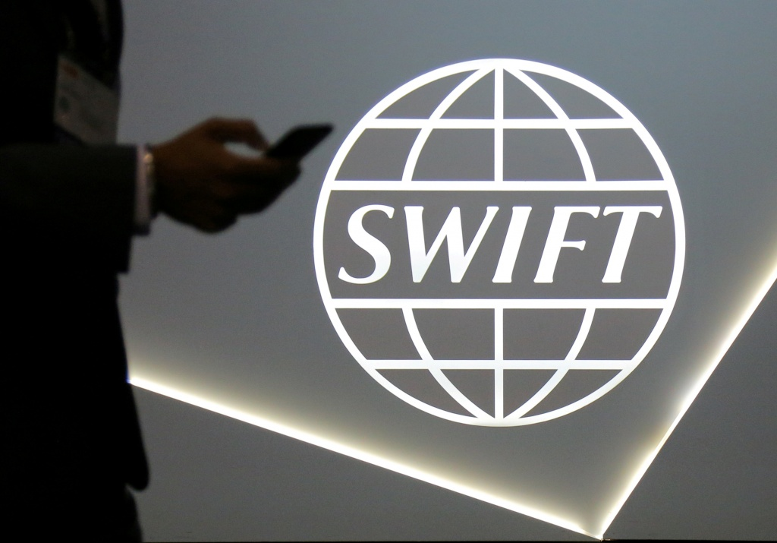
Contents of a SWIFT MT103/202Cov
Date
Amount
Originator
Originator Address
Originator Bank and BIC
Beneficiary Bank and BIC
Beneficiary
Beneficiary Address (Optional)
References/Memo Field (Optional)

Slide 20
Standard SWIFT MT103/MT202Cov [appearances may vary]
TXN #: 564794047494
Transaction Date : August 31, 2020
Transaction Amount: $12,237.89
ORG: Bob’s Boats
ORG Account #: 009-87-68574
ORG Address: 123 Sesame Street, Paris, France
ORG Bank: HSBC Paris
ORG Bank SWIFT #CCFRFRPP
Intermediate Bank: Bank of America
Bene Bank: Deutsche Bank Hamburg
Bene Bank SWIFT #: DEUTDEHH
Beneficiary: Al Capone
Bene Account #: RT783674842
Bene Address: 64-16 Talbot Street, Seoul, Korea
Memo: Payment for contract number 34453
The SWIFT Code or BIC Code is 8-11 characters including: 4 letters for the bank; 2 letters for the country; two letters or numbers for location. An additional 3 digits is optional for the primary office.
20
20
20
20

Slide 21
Analyzing a series of payments over a given time period is crucial for understanding the activities of your target/suspect and building on the cope of your investigation.

Slide 22
Software Assistance Please…
MS Excel and MS Access are good but basic tools to use in analyzing payment data for criminal activity. However, they can be limited. There are a variety of free and expenses software solutions, some more user-friendly than others. Common examples include:
Python (and Python notebook: Anaconda)
Knime
Neo4J
ACL and Arbutus
Many others…
If working in the cloud or software is through provider, make sure you have complied with proper security and confidentiality protocols.

Slide 23
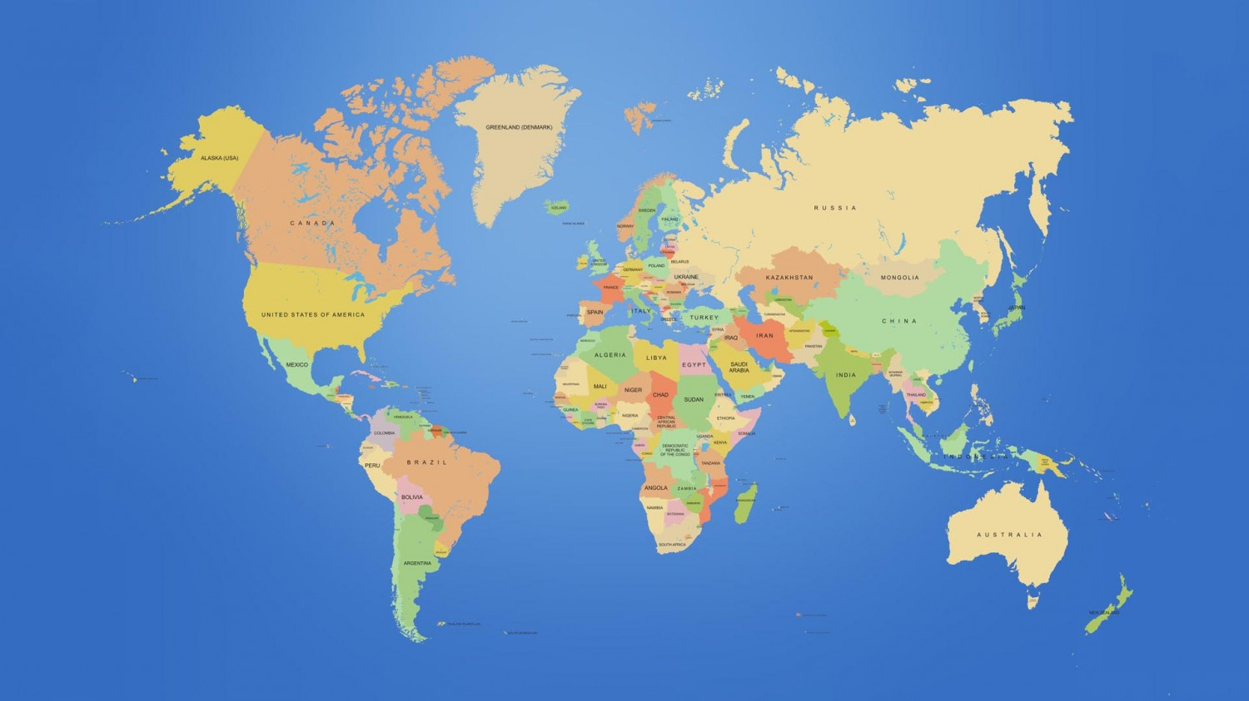
Criminal Funds Flow Case 1. Origination step
23
23

Slide 24
Criminal Funds Flow
Criminal Funds Flow Case 1. Intermediate step
24

Slide 25
Criminal Funds Flow
Criminal Funds Flow Case 1. Settlement step

Slide 26
Criminal Funds Flow
Criminal Funds Flow Case 2. Origination step
26
26
26

Slide 27
Criminal Funds Flow
Criminal Funds Flow Case 2. Intermediate step
27
27
27
27

Slide 28
Criminal Funds Flow
Criminal Funds Flow Case 2. Settlement step
28
28
28
28

Slide 29
Common Money Laundering Techniques– Games People (Bad guys) Play
  Spoke and Wheel
  PSPs & MSBs
  Facilitators and Anonymity (Lawyers, accountants, back office service providers)
  Let me do you a favor (one entity sends for another)
  Switch Entities
  Multiple firms with accounts at same bank
  Switch currencies on the wire
  Mexican Diversion
  Virtual currencies
  Hawala
  Loans & Taxes
  Other Schemes/Cases

Slide 30

  Spoke and Wheel
Originating Bank
Intermediary Bank
Sourcer A
Send Wire
Sourcer B
Collector
Sourcer C

Slide 31
Payment Service Providers & Money Service Businesses
Originator
PSP/MSB
Originating Bank
Intermediary Bank
Beneficiary Bank
Beneficiary
True Originator
Instructs PSP/MSB
Note: True Originator could also be true beneficiary or both!

Slide 32
  Facilitators and Anonymity (Lawyers, accountants, back office service providers)
Originator
Facilitator
Originating Bank
Intermediary Bank
Beneficiary Bank
Beneficiary
True Originator
Instructs Facilitator
Note: True Originator could also be true beneficiary or both!

Slide 33
Let me Do you A Favor (one Entity Sends for another)
Originator
On behalf of Another
Originating Bank
Intermediary Bank
Beneficiary Bank
Beneficiary
True Originator
Asks friendly entity to send pymt on its behalf. They exchange value between themselves locally.

Slide 34
  Switch Entities…. Overlap the lifespan of a shell entity, transfer the assets, and continue the movement of funds.
Shell A. Pass the funds and kill the firm
Shell B. Pass the funds and kill the firm
Shell C

Slide 35
  Multiple firms with accounts at same bank – Separate the illegal flow using two payments switched inside a bank with a book-to-book transfer.
Incoming Wire
Book to Book Transfer in Bank
Outgoing Wire

Slide 36
Switch Currencies on the wire
Originating Bank
Swiss Franc Pymt
Intermediary Bank
USD Pymt
Beneficiary Bank
USD Pymt
Beneficiary
USD Pymt
Originator
Swiss Franc Pymt
First Intermed Bank
From original instructions, converts Swiss Franc Pymt to USD Pymt

Slide 37
  Mexican Diversion
Originator
Originating Bank
Intermediary Bank
Beneficiary Bank (MX)
Bene Bank
Redirects based on customer advice
Beneficiary
Third Party

Slide 38
Virtual Currency
Criminal in country A purchases Bitcoin in local currency. Anonymously sends or “Sells” Bitcoin to criminal counterpart on other part of world.
Criminal counterpart in country B receives Bitcoin. Can hold or “sell” in currency of choice, and use or wire out as desired.
NOTE: Any wires can be conducted locally with complete break in transaction activity from one party to another; from one location to another. Many ways to structure the virtual currency exchange of value.

Slide 39
Hawala
Criminal in country A transact with Hawala Broker. Hawala broker receives or directs placement of funds/cash, and “communicates” with counterparty or with another Hawala broker.
Hawala Broker receives (coded) instructions from first Hawala Broker, and provides funds to the criminal beneficiary.
Both Hawala Brokers “settle” their own “ledgers.”

Slide 40
Loans, Taxes & Transfer Pricing
Loans:
In lieu of dividends, loans upstream to parent can reduce tax liabilities.
Loans from parent to subsidiary (or vice versa) or from affiliate to affiliate can (but might not) violate transfer pricing laws and regulations; capital controls; and tax evasion; not counting other criminal laws and violations.
Many offshore “shell jurisdictions” as well as jurisdictions with favorable intercompany transaction laws, permit certain favorable treatment allowing the use of loans (and other transactions) at non-arm’s length.
Parent Holding Company
Affiliate A
Affiliate B

Slide 41
Other Schemes/Cases
  The inside job
  Strawmen
  Mirror Trading
  Flips
  Pump & Dump
  L/C Invoicing and Amendments

Slide 42
If you are interested in exploring the possibilities for collaboration and strengthening your abilities…
    Douglas A. Sloan
    President
    Catamount Huntsman
    DASloan@outlook.com
    +1-917-565-7695

