Slide 1
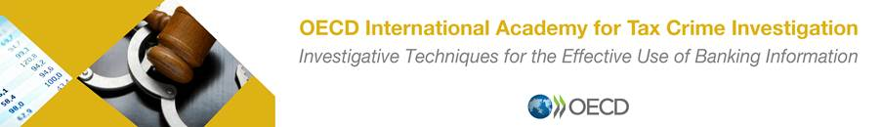
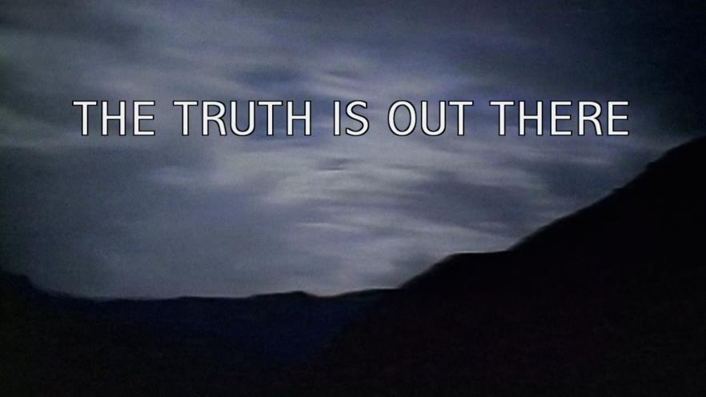

Slide 2
IRS – CRIMINAL INVESTIGATION
International Operations
Anthony Cook
Regional Attaché
U.S. Consulate – Dubai Post

Slide 3
Interviewing Techniques
AGENDA
The Importance of Interviewing
Legal Information
Planning for Interviews
Types of Interviews
Deception during Interviews
Practical Exercise

Slide 4
The Importance of Interviewing
The interview can be the single most important aspect of an investigation
Human intelligence and information
Face to Face, Telephone, Skype
Can “make or break” an investigation
Direct evidence or a statement
The interviewer can be more important than the interviewee
Interviewing or interrogating

Slide 5
Legal Information
European Convention of Human Rights
  Article 6 paragraph 2:
    Everyone charged with a criminal offence shall be presumed innocent until proved guilty according to law
  Article 3 no torture
    no inhuman or degrading treatment or punishment
    no (police) violence
    no poor conditions in detention
  Article 6 right to a fair trial
    public hearing
    presumption of innocence
    lawyer

Slide 6
Planning for Interviews
Do you create questions in advance?
How may people do you interview at one time? Exceptions?
How many investigators do you bring? Be aware of surroundings and safety.
Is there a primary and a secondary? Can you switch halfway through?
Public or private location?
Who asks the questions? What about language barriers?
Who takes the notes?
Do you offer business cards?
What is a co-conspirator wants to participate? What about a spouse?
Can we show empathy?
What are verbal and non-verbal indicators?

Slide 7
Planning for Interviews
Our reactions need to remain neutral and objective
No judging
Typically avoid politics, religion, or other sensitive matters if relevant
Remain professional and keep eye contact
White House Correspondents Dinner 2011
May 1, 2011 Seth Myers Video
May 2, 2011 at 11:36 PM White House Video

Slide 8
Planning for Interviews
How we carry ourselves (don’t be offended by comments)
Representatives of the government (no personal attacks)
Professional (yelling vs. a very intense line of questioning)
Importance of the memorandum (accuracy)
Attire
Eye contact
How we enter the room
Where we position ourselves

Slide 9
Planning for Interviews
Introduction
Rapport (every interview?)
Will the interview be recorded?
Questions: interview outline, open vs closed ended, fact based, opinion based, does witness sign statement, is it evidence, follow-up questions
Lance Armstrong Video
Summary
Follow-Up
Conclusion: memorandum of interview

Slide 10
Types of Interviews
For the type of interview below, the demeanor, attitude, tone, rapport, urgency can change based on the person and the type of interview you are conducting.
Witness
Victim
Informant
Subject
National Security or Counterterrorism
Is a diplomatic channel more appropriate instead of requesting an interview via the MLAT if there is an allegation of public corruption

Slide 11
Types of Interviews
Testifying - Walk with confidence, sit straight, hand high if there is a swearing in
  Tell the truth and be prepared (your memory can be refreshed)
  What are the main points to mention about your background?
  Be comfortable speaking in public and presenting evidence to civilians
  Understand the differences between questions from the prosecutor and defense (be prepared for a tough cross examination and anticipate your credibility being attacked, it is not personal)
  It is not unreasonable to ask a few times to repeat question (not a lot)
  Address the attorneys, defendant (though not aggressively), the judge, and jury (yes, your honor…yes sir…)
  Tell a story (familiarize yourself with introducing evidence)
  It is OK to be nervous (preparation avoids lack of certainty and confidence)
  Tell the truth

Slide 12
Types of Interviews
Interviews during Undercover Operations
  Safety is paramount.
  Creative use of technology to avoid ‘wires’.
  The UCA should understand the criminal violations and what needs to be proved during a trial (all elements of the crime).
  The UCA is the specialist for covert activities, but the case agent needs to steer the conversation and direct the UCA to advance the investigation.
  Try to avoid noisy places or other distractions.
  Encourage the UCA to specify times, locations, space to assist with a search warrant in the future (for example, on the recording, “is the upstairs office where you keep your business records?”
  Be prepared and think trial.
  Safety is paramount.

Slide 13
Types of Interviews
Strategies during Interviews (more advanced)
  Increasing and decreasing the speed of questions
  Pausing in between questions
  Increasing and decreasing the volume of voice
  Not giving the person the opportunity to answer
  Repeating a question
  Confirming an answer
  Telling someone you already know the answer to the question
  The interviewee tries to ask the interviewer questions
  Leading questions
  State a fact not publicly known to show the person you know information

Slide 14
Deception during Interviews
What if you detect a lie during an interview
Why do people lie
Is it illegal for a person to lie to law enforcement
Is it legal for law enforcement to lie to a person during an interview
Is it ethical for law enforcement to lie to a person during an interview
Huston Pools Story
What if someone asks for an attorney before, during, or after an interview

Slide 15
Deception during Interviews
What is the goal of the interview?
Reliability and validity of the witness
Is the confession accurate
  Examples – Hueston, Shaffer, Koger discussion
False confessions
  Covering for a loved one
  Concerned about safety
  No lawyer present
  No sleep, food, or drink
  Deceit by law enforcement
  Felt pressured by law enforcement
  Did they state something specific to the crime
  Is the information publicly available

Slide 16
Panama Papers (but Interview related)
  11.5 million leaked document that provided information about financial and attorney-client information involving over 200,000 entities. The entities were created under Panamanian law by the law firm Mossack Fonseca
  Leaked by an anonymous source
  Documents contained personal financial information about wealthy individuals and public officials
  While offshore business entities are legal, the allegation involves the law firm created shell corporations that were utilized to further schemes involving fraud, tax evasion, and evading international sanctions including regulatory controls and legal requirements.
  The person who leaked the documents cited “income equality” for their actions and the documents were published on the website for the International Consortium of Journalists – which includes 107 media organizations in 80 countries.
  Panama Papers

Slide 17
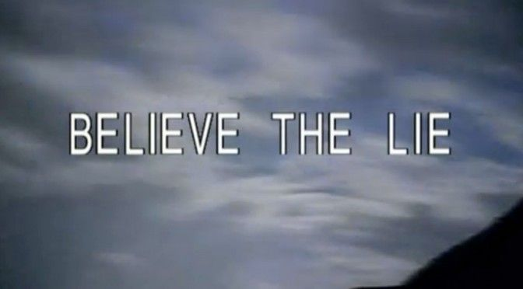
Deception during Interviews

Slide 18
SUMMARY
The Importance of Interviewing
Legal Information
Planning for Interviews
Types of Interviews
Deception during Interviews
Practical Exercise

Slide 19

IRS-Criminal Investigation
International Operations
U.S. Consulate – Dubai Post
Attaché
Anthony Cook
Anthony.Cook@ci.irs.gov
WhatsApp +1 202.494.3248

