Slide 1

Case study asset recovery: freezing and seizing assets
Presented by
Esther Muchiri, Kenya

Slide 2
Presentation outline
Introduction
Background of the asset recovery case
Crimes Committed
Investigative techniques
Inter-agency cooperation
Assets recovered.

Slide 3
Introduction
Assets recovery is a powerful tool to combat crimes, by taking away the expected rewards ,benefits or proceeds of crime.
The principal law governing assets recovery in Kenya is the Proceeds of Crime and Anti-Money Laundering Act (POCAMLA).
The POCAMLA established the Assets Recovery Agency whose mandate is to identify, trace, freeze, seize and recovery of proceeds of crime.
The wo modes of assets recovery provided under POCAMLA;
1) Criminal forfeiture(conviction based)
2) Civil forfeiture(non conviction based)

Slide 4
Criminal Forfeiture
Investigations
restraint orders of proceeds of crime
Confiscation of assets
Trial and Conviction of the criminal

Slide 5
Civil Forfeiture
Investigations
preservation orders of proceeds of crime
Forfeiture of assets
Gazette the preservation orders within 21days

Slide 6
Background of the assets recovery case
NRB MISC APP NO 4 OF 2017
ASSETS RECOVERY AGENCY –VS- QUORANDUM LTD & EZEKIEL OWUOR
This case involved theft of funds amounting to Kshs.180, 894,946M unlawfully transferred from the Youth Enterprise Development Fund (YEDF) Bank account to the 1st Respondent (Quorandum Ltd) bank account.
The theft of Kshs.180, 894,946M was facilitated by the former acting Chief Executive Officer of YEDF, who unlawfully contracted the 1st Respondent to provide consultancies services which was never rendered.

Slide 7
Cont’
The 1st respondent used part of the Kshs. 180,364,789M to purchase property known as Duplex Apartment at a cost of Kshs 48,500,000M from the 1st interested party (Duchess park development Company Ltd) who was the developer.
The 1st Respondent also transferred Kshs 8,800,000M to the 2nd Respondent (Ezekiel Owuor) purportedly as a loan repayable later.

Slide 8

Crimes committed
Unlawful acquisition of public property contrary to section 45(1) as read with section 48 of the Anti-corruption and Economic Crimes Act.
Abuse of office contrary to section 46 of the Anti-corruption and Economic Crimes Act.
Fraudulent payment contrary to section 45 (2) Anti-corruption and Economic Crimes Act.
Making of false documents contrary to sections 347(a) as read together with sections 349 of the Penal Code

Slide 9

Investigative techniques
Search warrants from the Court to investigate respondents and other suspects accounts.
Financial analysis of the respondents and others suspects financial records
Interrogation and recording statements of the suspects and witnesses.
Conducting searches at land registry to identify the apartment.

Slide 10

Inter-agency Cooperation
Directorate of Criminal Investigation
Conducted investigations into the fraud of Kshs.180, 894,946 Million.
Cooperated with the Assets Recovery Agency to trace the Duplex Apartment procured at a cost of Kshs 48,500,000million and the transfer of the 8.8 million.
Financial Institutions
The banks provided the account opening forms, bank statements and records of the Respondents and other parties.
Office of the Director of Public Prosecution
Instituted criminal proceedings against the respondents and other parties and charged them with the offences; unlawful acquisition of public property ,abuse of office.
Assets Recovery Agency
The Agency filed preservation proceedings in Court to secure the assets.
The Agency filed forfeiture proceeding and prosecuted the matter.

Slide 11
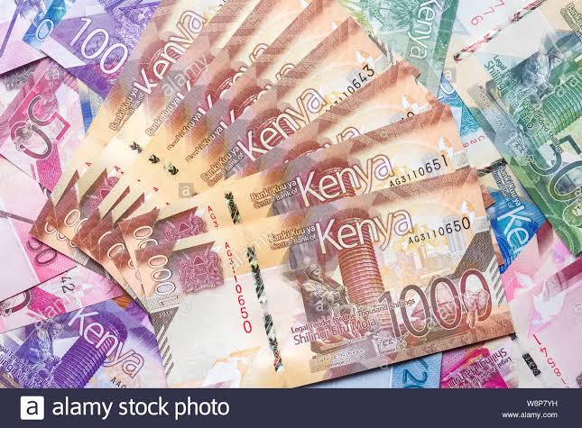
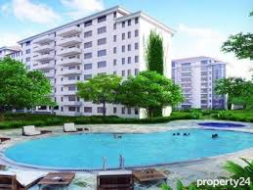
Assets recovered
The assets forfeited to the Government;
Duplex apartment worth Ksh 48,500,000million.
Kshs 8,800,000million.
The Anti-corruption Court fined the director of Quorandum Ltd Ksh720 million for theft of public money from the Youth Development Fund.
If unable to raise the fine, the director of Quorandum Ltd, will serve 27 years in prison in default.
The case can be accessed at www.kenyalaw.org

Slide 12


