Slide 1
Challenges of Conducting
Tax Investgations in Japan
MAO KITAOKA
Large Enterprise and Criminal
Investigation Department
Takamatsu Regional Taxation bureau

Slide 2
Contents
The flow of Criminal investigation in Japan
4 focus evasion cases in Japan
Case study

Slide 3



The flow of criminal investigation in Japan
① Collevting information
② Examining
③ Requesting a search warrant and seizure warrant
④ Compulsory investigation

Slide 4



⑤ Seize articles of evidence or articles
⑥ Examining
⑦ Questionarie survey
⑧ Putting together
⑨ Accusation to Prosecutor

Slide 5
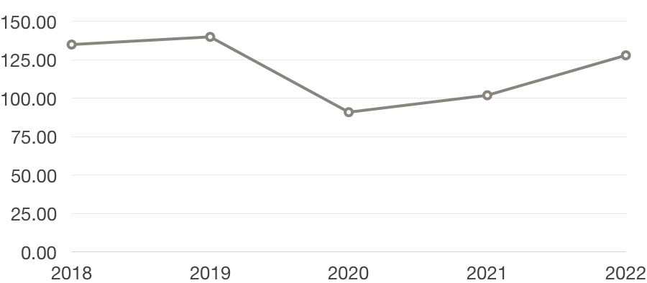
The amount of Tax Evasion
Million yen
135
140
128
102
91

Slide 6
4 focus evasion cases in Japan
Filing dishonest return for refund
Evasion by failure to file
Evasion by taking advantage of international trade
Others with the tide

Slide 7






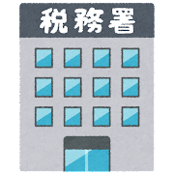
Case study
Fictinal
taxable purchases
Fictinal
Tax-free sales
B co.
(Co-conspirator's
company)
A co.
Dishonest claim
for a refund
Foreign tourrists
Refund
Tax office

Slide 8
THANK YOU!

