Slide 1

Challenges with asset recovery

Slide 2

The importance of the recovery axis
‏The global cost of corruption, according to estimates by the World Economic Forum, is $2.6 trillion annually, which constitutes 5% of the size of the global economy.
The amount of bribes paid annually is estimated at (1) trillion dollar.
Recovering stolen funds resulting from acts of corruption is considered one of the best means of preventing and reducing crime, as it deprives corrupt people of benefiting from the proceeds of corruption crimes.
The recovered funds are considered part of the compensation for the damages of the crimes committed.
Asset recovery prevents money laundering crimes arising from predicate corruption crimes or any other crimes.

Slide 3
Regional and international agreements:
United Nations Convention against Corruption 2003.
United Nations Convention against Transnational Organized Crime of 2000.
International Convention for the Suppression of the Financing of Terrorism of 1999.
United Nations Convention against Illicit Traffic in Narcotic Drugs and Psychotropic Substances of 1988.
The Arab Anti-Corruption Convention, under the management and supervision of the General Secretariat of the League of Arab States, 2010.
International Anti-Corruption Academy (IACA) 2007 - The Kingdom joined the Asset Recovery Initiative (STAR), which was launched in 2007 in cooperation between the United Nations Office on Drugs and Crime and the World Bank in order to activate and raise the efficiency of law enforcement personnel to recover stolen assets.
…etc.

Slide 4
Legal provisions related to asset recovery in the United Nations Convention against Corruption, Chapter Five
With regard to preventing and detecting the transfer of proceeds derived from crimes:
Verify the identity of customers by taking reasonable steps to determine the identity of the beneficial owners of funds deposited in high value accounts.
Issuing guidance on the types of natural or legal persons to which financial institutions are expected to apply careful examination to their accounts, and the types of accounts and transactions to which they are expected to pay special attention.
Maintaining customer/customer identity records as part of databases for reference.
Preventing the establishment of banks that do not have a physical presence and are not affiliated with a regulated financial group.
Establish effective financial disclosure systems for relevant public officials and provide appropriate penalties for non-compliance.
Take measures to oblige people to report external accounts.

Slide 5
Regarding direct asset recovery measures
Taking measures that allow recourse to the civil judiciary to prove ownership of the assets that are the subject of the corruption crime.
Taking measures that allow recourse to civil justice to obtain fair compensation as a result of corruption.
Recognizing foreign court rulings issued to confirm asset subject to the crime of corruption.

Slide 6
Mechanisms for recovering property through international cooperation in the field of confiscation
International cooperation in the field of mutual legal assistance through the implementation of foreign judgments establishing the right to ownership of assets/funds acquired through corrupt acts, including the implementation of forfeiture judgments issued by a foreign court or a foreign court confiscation order.
Applying the principle of sources not based on a conviction in cases of death, escape, or absence.
Implementing seizure or freezing orders issued by a competent court.

Slide 7
International cooperation for the purposes of confiscation
Accepting requests for assistance related to confiscation rulings and referring them to the competent local authorities.
Taking measures to detect, trace, freeze or seize criminal proceeds, property, equipment or other tools for the purpose of confiscating them by order issued either by the requesting State Party or by the requested State Party.
Taking into account the rights of others (third party) in good faith.
Providing information from one State Party - without prior request - to the other State Party that may lead to the disclosure of criminal proceeds or contribute to the recovery of assets.

Slide 8
Legal provisions related to recovery in the Jordanian Integrity and Anti-Corruption Law and its amendments No. (13) of 2016
Article (8) of the same law stipulates that the following powers are granted to the board members of the Authority:
‏ B. Requesting the competent judicial authority to issue an urgent decision to seize movable and immovable funds and banning the travel of anyone who commits any acts of corruption, or requesting that these decisions be amended or canceled in accordance with the legislation in force. ‏
C. If the Council finds evidence of abnormal growth in the wealth of any of those covered by the provisions of the Illicit Gains Law, it may request the Financial Disclosure Department to provide it with an exact copy of the declarations and any data or information related to that person.
‎ D. The Council has the right to contribute to recovering money obtained from acts of corruption, whether the money is inside the Kingdom or not outside and deliver it to its beneficiaries in accordance with the relevant legislation. ‏

Slide 9
Methods of contributing to recovery through the Authority
Direct recovery: The Authority contributes directly to the collection of funds arising from corruption and deposited in a trust account with the Central Bank of Jordan.
Indirect recovery: Here, the Authority follows up on corruption cases that have a financial impact in cooperation with relevant authorities such as: the Income Tax and Customs Department and the Public Funds Collection Directorate.
In 2022, the Commission contributed with the relevant departments to recovering a total of (159,483,902) / one hundred and fifty nine million, four hundred and eighty-three thousand, nine hundred and two dinars, of which (10,900,000) / ten million and nine hundred thousand dinars are a direct recovery through the Commission.

Slide 10
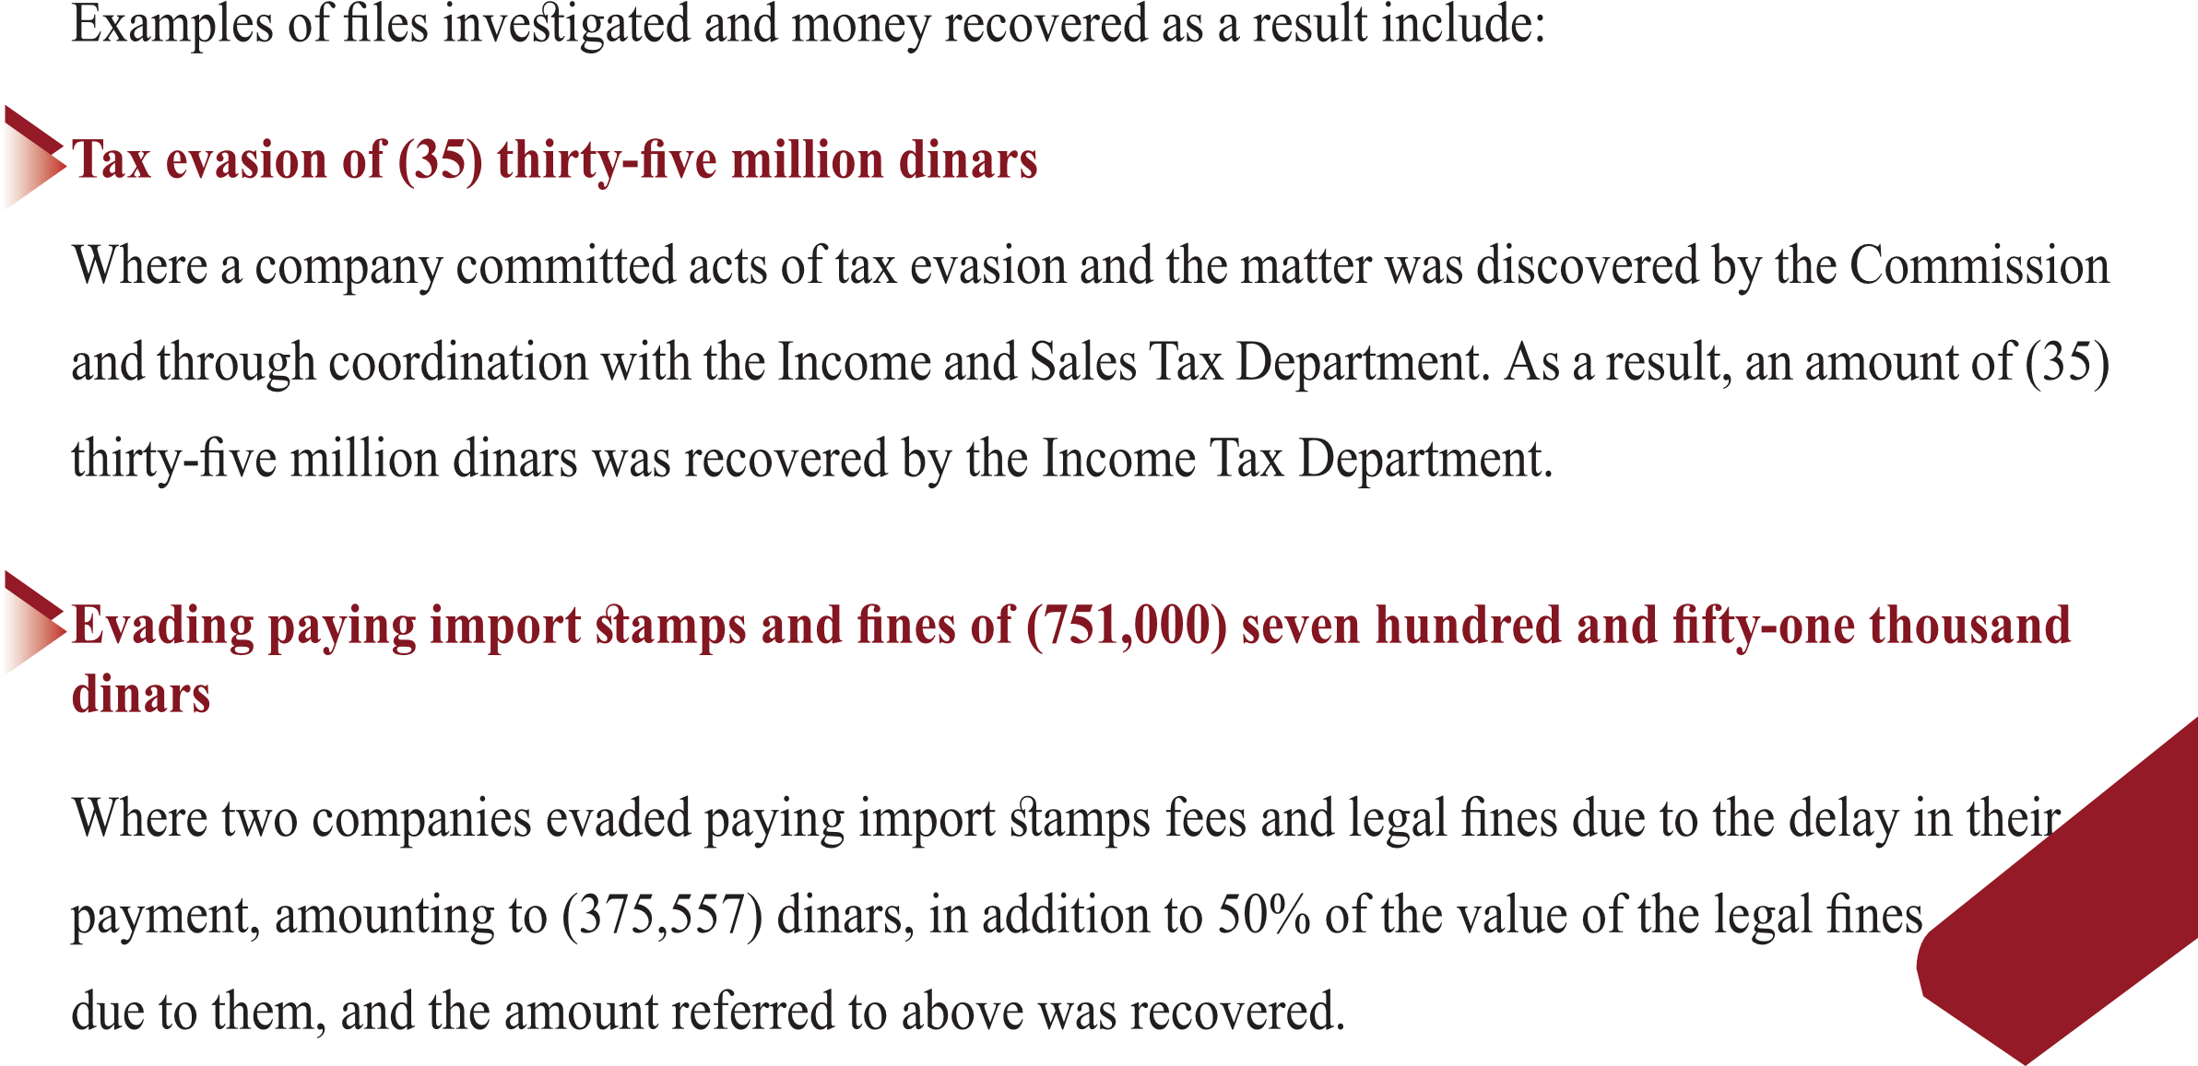
Practical case on direct and indirect recovery

Slide 11
Exemption from punishment or reduction in accordance with Article 7 of the Jordanian Economic Crimes Law
For reasons related to the recovery of funds arising from crimes:
Anyone who accomplices to the crime, other than the instigators of its commission, notifies the competent authorities of the crime before it is discovered and this notification leads to the return of the money subject of the crime shall be exempted from the penalty prescribed for crimes involving public funds that are punishable in accordance with the provisions of this law.
If the notification occurred after the discovery of the crime and before the final ruling was issued, and this notification led to the return of the money, the court must impose the minimum penalty and may take mitigating reasons.

Slide 12
The powers granted to the Public Prosecution in accordance with the Economic Crimes Law
Article (9) of the Economic Crimes Law grants the Public Prosecution the following powers:
Precautionary seizure of the funds of those who commit an economic crime.
Prohibiting the disposal of this money
A travel ban until the investigation procedures are completed and the case is decided.
Precautionary seizure of assets, the family parts of those who commit an economic crime.
Suspending the perpetrator of an economic crime from work if necessary and for the period that the Public Prosecution or the court deems appropriate.

Slide 13

Asset recovery enhancements according to Jordanian law
Recovering the funds and re-registering them in the name of the public treasury.
Travel ban.
Provisional seizure.
Retroactive implementation of the law.
Sale by public auction.

Slide 14
The most prominent challenges in asset recovery
Some countries did not respond by seizing funds or allowing their recovery, except by a final ruling from a regular court.
People with multiple nationalities are perpetrators of crimes.
Safe havens for money smuggling, making it difficult to trace money.
Managing recovered assets.
Lack of adequate understanding and training for some countries in asset recovery procedures.

Slide 15
To view and communicate
https://www.youtube.com/watch?v=L7a7Lp6G8YM
https://www.jiacc.gov.jo/Default/En

Slide 16
Thank you for listening,,,

