Slide 1
Compliance Division
Misuse of Technology in Financial Crimes
TOPIC: VAT FRAUD IN FIJI
Presenter:
Shivneet Chand
[Fraud & Evasion]
May - 2025

Slide 2
Fiji's Digital Transformation & Tax System
Fiji introduced an online tax system, where taxpayers could use the online platform for wide range of tax services such as:
Registration for tax services;
Access to tax statements;
Filing of tax returns and tax payments;
Tax returns are self assessed.
With the online platforms it was expected to provide:
Streamline processes;
Reduce traditional fraud.
Notes:
This investment was designed to enable the tax office to simplify tax administration in Fiji and to create better customer service

Slide 3
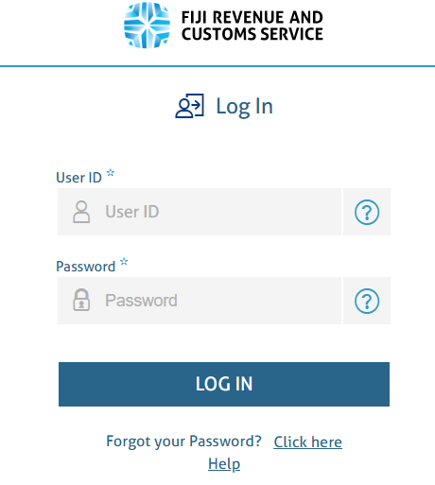
Misuse of Tax Online System
The accountant misused online tax system for VAT evasion schemes.
The accountant obtained login credentials of his clients and accessed taxpayer's online portal to lodge tax returns.
The accountant manipulated VAT inputs with significantly inflated refund claims were submitted.

Slide 4
Investigation Process
Initial investigation revealed the creation of fake invoices by the accountant to support the bogus VAT refund claims.
A key finding was the accountant's unauthorized access to taxpayer accounts.
Taxpayers may had provided their login details;
  Knowingly to collude and obtain financial advantage.
  Unknowingly by placing faith in the accountant.
  The accountant exploited the taxpayers' limited understanding of accounting principles and tax obligations.
Notes:
Accountant maintains a copy of VAT return with signature of taxpayers indicating taxpayer has authorised the lodgement of tax return.

Slide 5
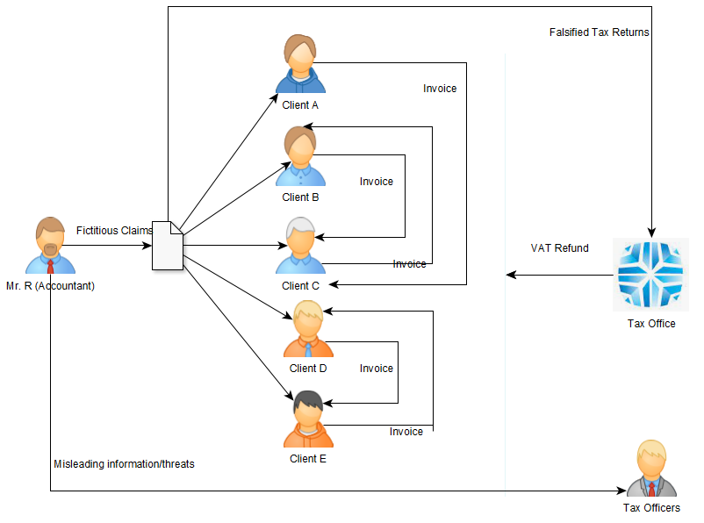

Slide 7
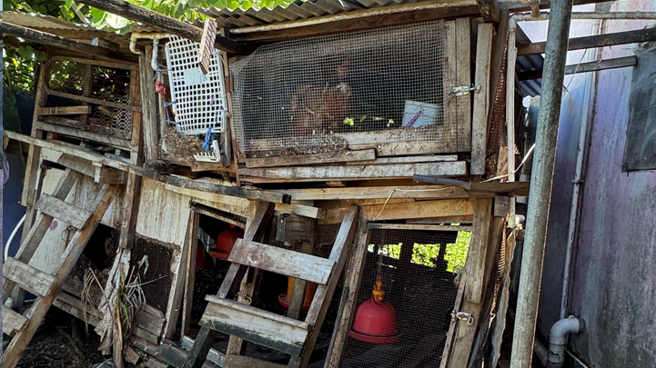

Slide 8
Individual Audits Expose the Scale of the Crime
The individual audits of the accountant's clients clearly confirmed the fraudulent VAT refund scheme.
The audits detailed the specific manipulations of financial figures within each affected account.
The accountant's consistent pattern of generating inflated refund claims was established.

Slide 9
Outcome: Consequences and Lessons Learned
The taxpayers faced penalties for their involvement due to the irregularities in their tax filings.
They were advised to engage registered tax agents to ensure compliance in the future.
The case highlighted the critical need for taxpayer education regarding their tax obligations and the importance of secure online practices.

Slide 10
Conclusion
The accountant has been referred to Fiji Independent Commission Against Corruption (FICAC)
This case, and similar instances of technology misuse, emphasize the evolving nature of financial crime.

Slide 11
Thank You

