Slide 1



OVERVIEW ONLINE SCAMS
brunei darussalam
OECD ASIA-PACIFIC ACADEMY FOR TAX AND FINANCIAL CRIME INVESTIGATION
MISUSE OF TECHNOLOGY IN FINANCIAL CRIMES (SPECIALTY) PILOT PROGRAMME
ROYAL BRUNEI POLICE FORCE
CCD/CID/RBPF – MAY 2025

Slide 2



SCOPE OF PRESENTATION
Overview
Case Example
ROYAL BRUNEI POLICE FORCE
CCD/CID/RBPF – MAY 2025
Notes:
TREN

Slide 3

PAGE 8
OVERVIEW ONLINE SCAM
~USD$3.7 million
861
~USD$1.9 million
848
~USD$3.9 million
748
5 TOP ONLINE SCAM (2024)
198
426
76
70
289
46
11
83
2022
2023
2024
CCD/CID/RBPF – MAY 2025

Slide 4

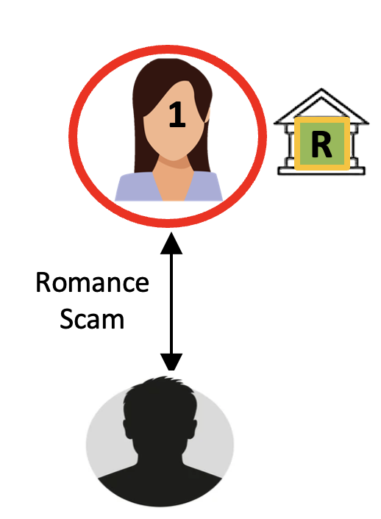
Case example
USD$389

Slide 5

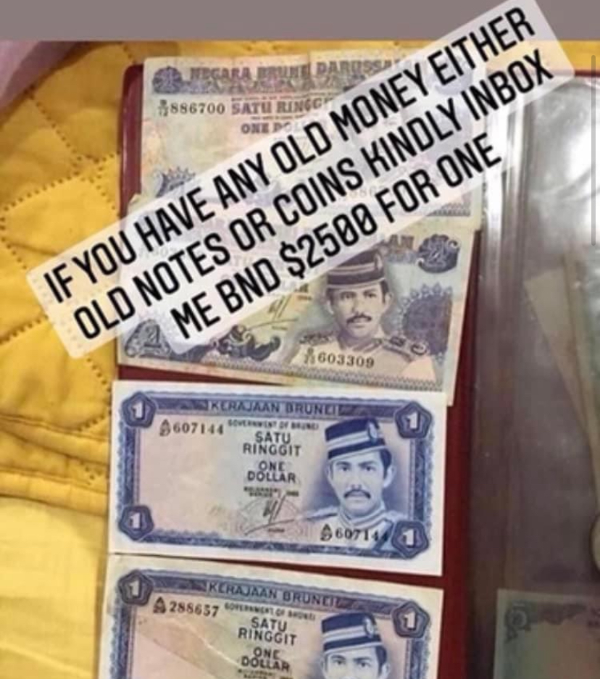
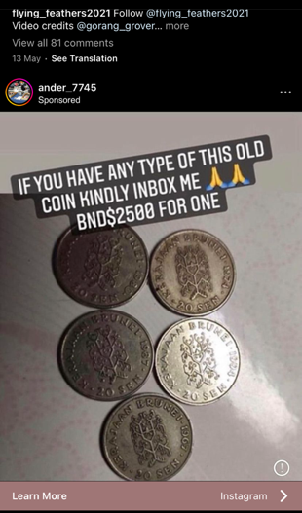
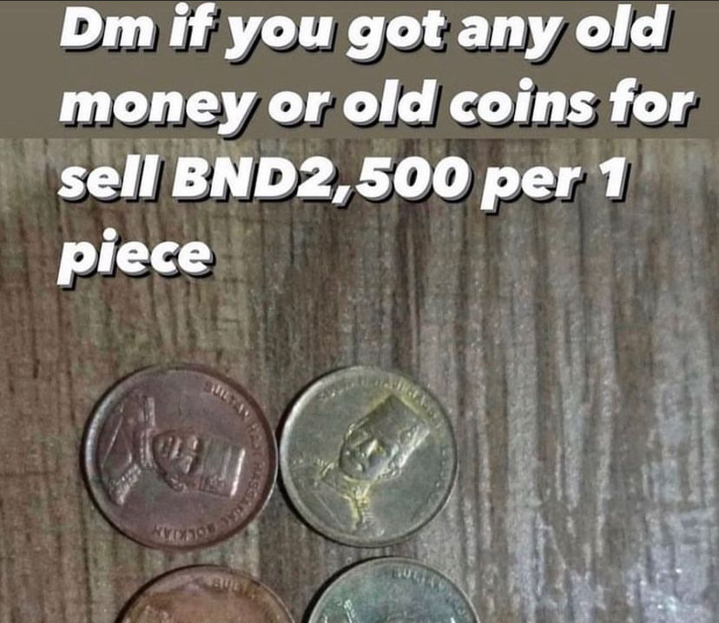
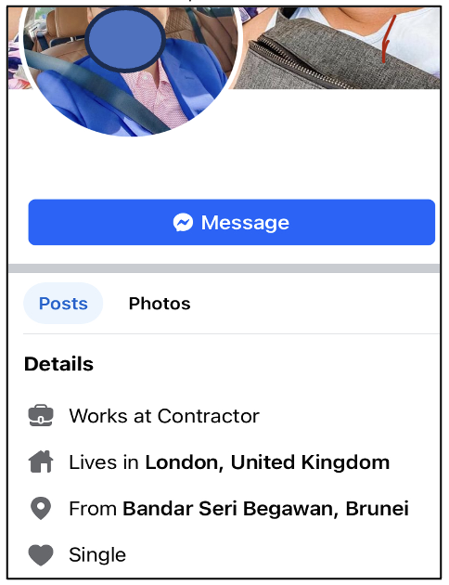







Case example
Finding:
7 Mule Account (3 Binance)
Only 3 Reported Case
11 Victims
Total Lost USD$79,492
Offence:
Sec 109 Abetment, Penal Code Chap 22
Sec 120B Criminal Conspiracy, Penal Code Chap 22
Sec 414 Assisting in concealment or disposal of stolen property, knowing it to be stolen, Penal Code Chap 22
Sec 419 / 420 Cheating, Penal Code Chap 22
Sec 3 Money Laundering, Criminal Asset Recovery Order (CARO), 2012
Old Coin Scam
Old Coin Scam
Romance Scam / Job Scam
Access by Scammer
Romance Scam / Job Scam
4
5
6
7
8
9
10
11
M
C
C
C
C
C
C
2
1
389
311
662
3,230
739
4,705
2,553
467
233
67,040
R
M
20,897
389
10,896
17,512
2,958
156
8
157
778
Access by Scammer
43,754
Romance
Scam
I
I
R
R
R
12
13
14
15
16
17
18
19
3,783
M
2
Investment
Scam
Access by Scammer
16,267
Romance
Scam
Romance
Scam
M
1,,167
389
3
M
M
10,896
M
Romance Scam / Job Scam

Slide 6
THANK YOU
ROYAL BRUNEI POLICE FORCE

