Slide 1

COLOMBIA. DIRECCIÓN DE IMPUESTOS Y ADUANAS NACIONALES - DIRECCIÓN DE GESTIÓN DE ADUANAS.
Subject:
Free trade zone regime and others: risks, alarms, available information, investigation techniques.
H. Miguel Másmela D. hmasmelad@dian.gov.co October 2023

Slide 2
In the Colombian case, money laundering is classified as a criminal activity, as described in the following paragraphs. Article 323 of the Penal Code as follows:
"ARTICLE 323. ASSET LAUNDERING: whoever acquires, safeguards, invests, transports, transforms, stores, conserves, guards or administers assets that have their mediate or immediate origin in activities of migrant smuggling, human trafficking, extortion, illicit enrichment, extortive kidnapping, rebellion, arms trafficking, trafficking of minors, financing of terrorism and administration of resources related to terrorist activities, trafficking of toxic drugs, narcotics or psychotropic substances, crimes against the financial system, crimes against the public administration, or linked to the proceeds of crimes executed under conspiracy to commit a crime, or gives the assets derived from such activities the appearance of legality or legalizes, conceals or covers up the true nature, origin, location, destination, movement or right over such assets or performs any other act to conceal or cover up their illicit origin, shall incur for that conduct alone, imprisonment of 10 to 30 years and a fine of 650 to 50,000 legal monthly minimum wages in force.50,000 legal monthly minimum wages in force. The same penalty shall be applied when the conducts described in the preceding paragraph are carried out on assets whose extinction of ownership has been declared. The laundering of assets shall be punishable even when the activities from which the assets originate, or the acts punished in the preceding paragraphs, have been carried out, totally or partially, abroad (...)".

Slide 3
With Law 1762 of July 6, 2015, the Anti-Smuggling Law, smuggling is a conduct constituting money laundering and increased penalties. This means that smuggling is established as form of money laundering, so that whoever incurs in money laundering through smuggling will be penalized for both crimes and not only for smuggling.
For smuggling of goods the penalties are increasing by up to 4 years. The Penal Code currently provides for a prison sentence of 3 to 5 years when the amount of the merchandise is greater than 50 smmlv, equivalent to $32 million 217 thousand pesos, and 5 to 8 years when the amount is greater than 200 smmlv, which corresponds to $128 million 870 thousand pesos. With this law, the penalties are increased to 8 and 12 years, respectively.
The law also recognizes the magnitude of fossil fuels smuggling, which occurs in alarming quantities, and consequently doubles the penalties for smuggling more than 80 gallons. The Penal Code currently establishes a maximum penalty of 8 years. The Anti-Smuggling Law increases this penalty to 14 years and provides for a penalty of up to 16 years when the volume exceeds 1,000 gallons.

Slide 4
For the Colombian case, Article 345 of the Criminal Code deals with the financing of terrorism, as follows: "ARTICLE 345. FINANCING OF TERRORISM: whoever directly or indirectly provides, collects, delivers, gives, receives, administers, contributes, safeguards or keeps funds, goods or resources, or performs any other act that promotes, organizes, supports, maintains, finances or economically sustains organized crime groups, armed groups outside the law or their members, or national or foreign terrorist groups, or national or foreign terrorists, or terrorist activities, shall incur a prison term of thirteen (13) to twenty-two (22) years and a fine of one thousand three hundred (1,300) to fifteen thousand (15,300) years and a fine of one thousand three hundred (1,300) to fifteen thousand (15,300) years.300) to fifteen thousand (15,000) legal monthly minimum wages in force."
The criminal offense of illicit enrichment is enshrined in Article 412 of the Criminal Code in the following terms: "The public servant, or whoever has performed public functions, who during his relationship with the administration or within five (5) years after his dismissal, obtains, for himself or for another, unjustified patrimonial increase, shall incur, provided that the conduct does not constitute another crime, imprisonment from nine (9) to fifteen (15) years, a fine equivalent to twice the value of the enrichment without exceeding the equivalent of fifty thousand (50.000) legal monthly minimum wages in force, and disqualification from the exercise of public rights and functions for ninety-six
(96) to one hundred and eighty (180) months "54.

Slide 5
In the Colombian case, Article 434A of the Penal Code, on omission of assets and inclusion of non-existent liabilities, establishes that those who omit assets or declare a lower value or declare non-existent liabilities, by 5,000 minimum monthly salaries or more, is subject to a penalty of 48 to 108 months of imprisonment. In addition, if the amount exceeds 7,250 minimum wages, but is less than 8,500, the penalty will be increased by one third, and if the amount exceeds 8,500, the penalty will be increased by one half.
However, the paragraph clarifies that "the criminal action will be extinguished when the taxpayer files or corrects the corresponding return or returns, as long as it is within the term to correct provided in the Tax Statute and, in any case, makes the respective payments of taxes, tax penalties and interest". In other words, when the offender is brought up to date, the risk of imprisonment is eliminated.
In turn, Article 434B of the same code, on tax evasion, stipulates that whoever, being obliged to file a tax return, fails to do so, omits income or includes non-existent costs or expenses, for more than 250 minimum salaries and less than 2,500 salaries, he will receive a penalty between 36 and 60 months in prison. If the amount is higher, but remains below 8,500 salaries, the penalty increases by one third and, if it exceeds that ceiling, it goes up to one half.
This offense, as with the previous one, is also extinguished when the debtor catches up with its obligations, assuming the corresponding penalties.

Slide 6
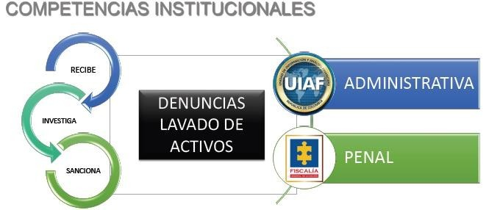
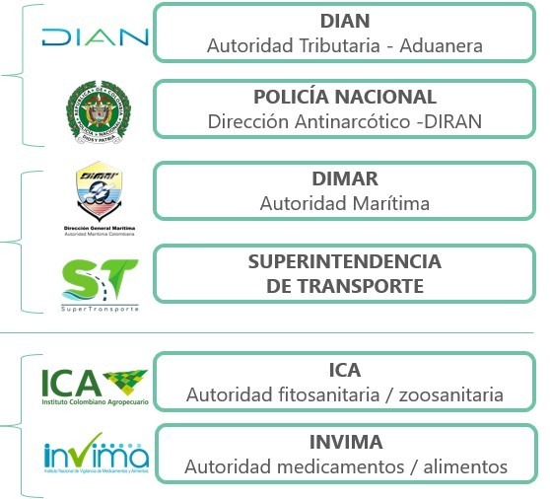
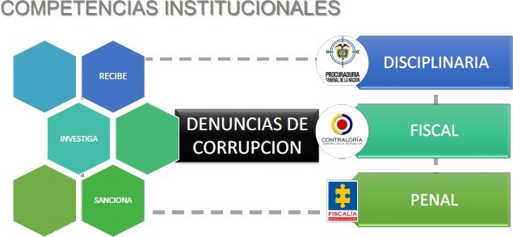
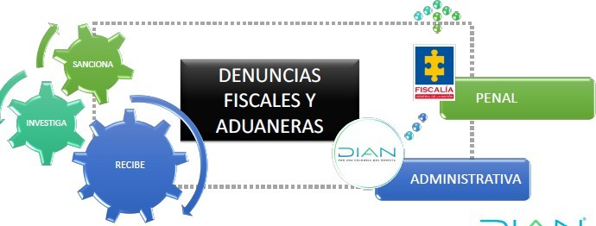
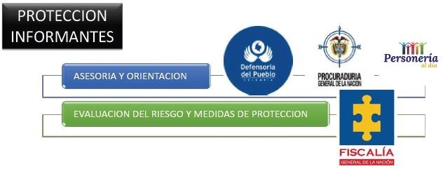
Interinstitutional Approach

Slide 7
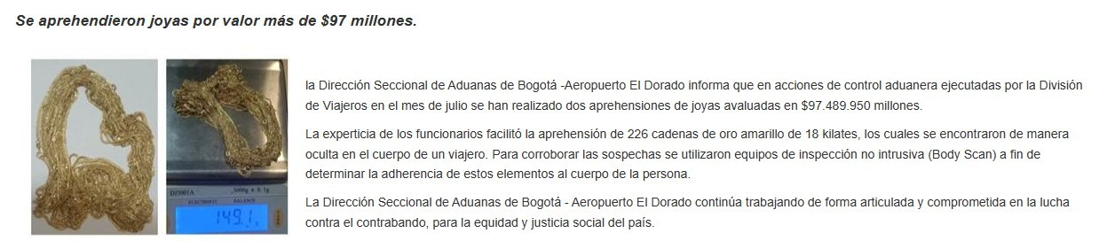
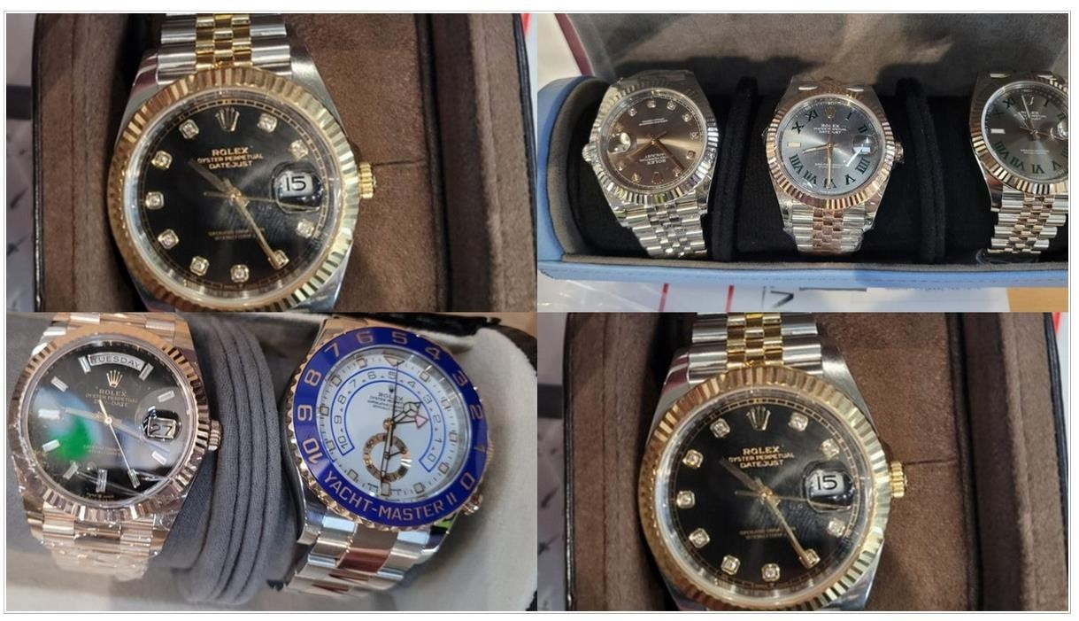
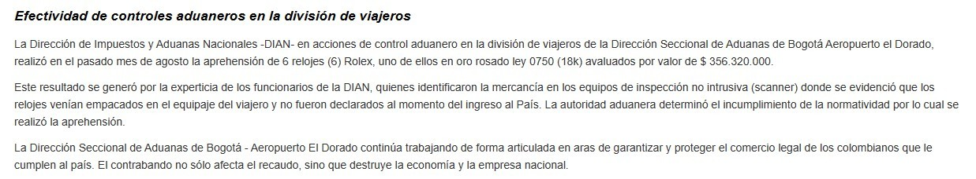

Slide 8
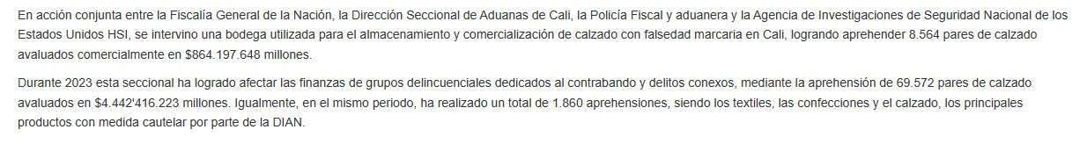
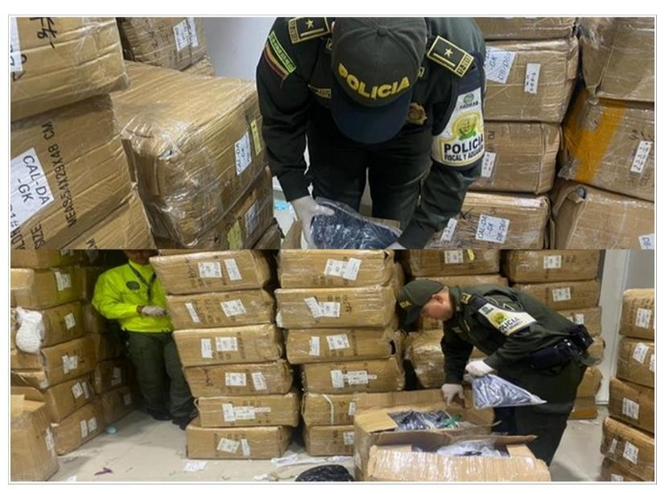
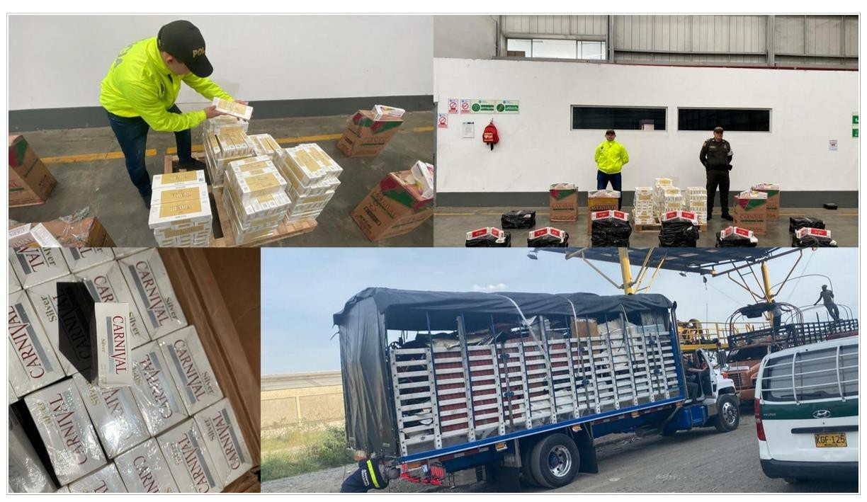
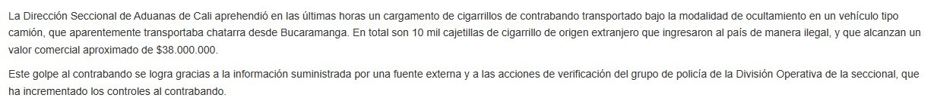

Slide 9
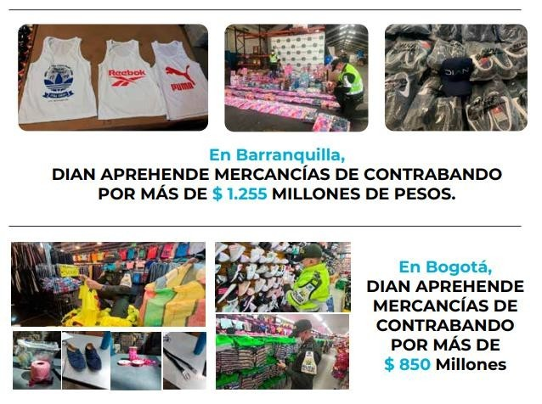
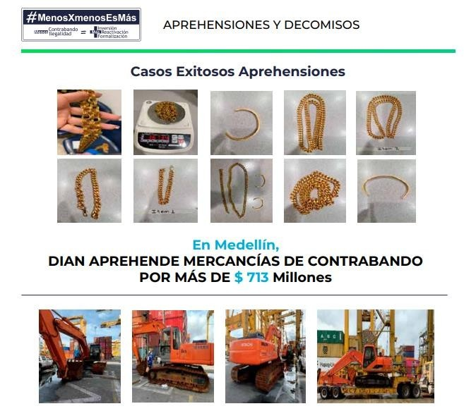
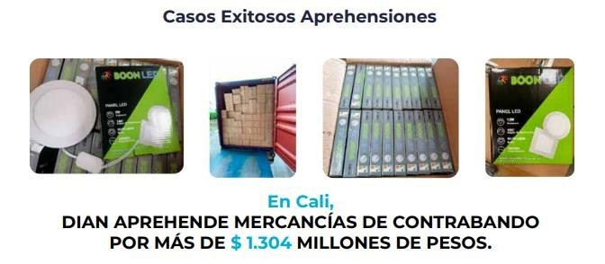

Slide 10
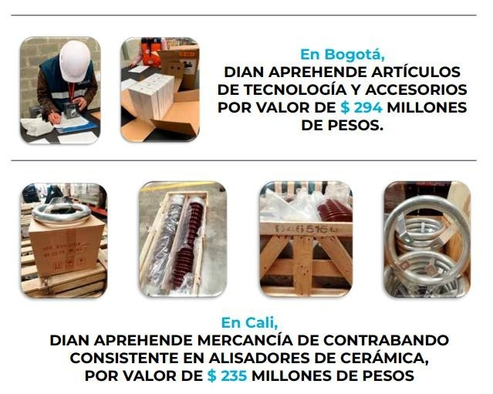
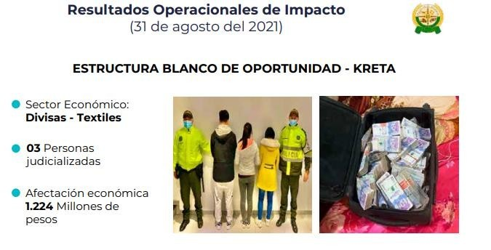
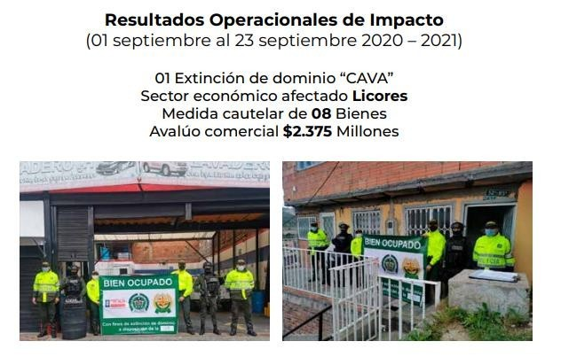

Slide 11
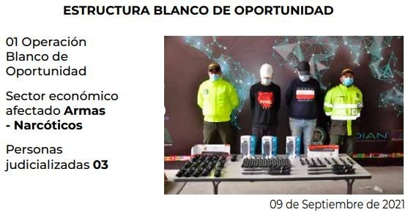
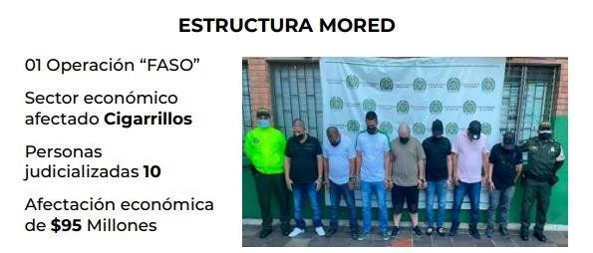
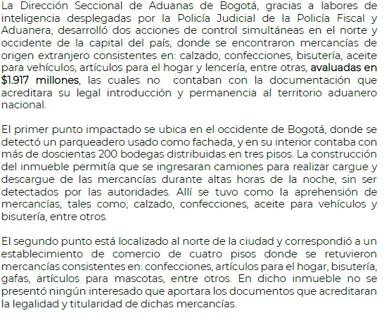
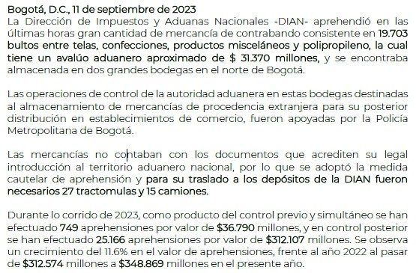

Slide 12
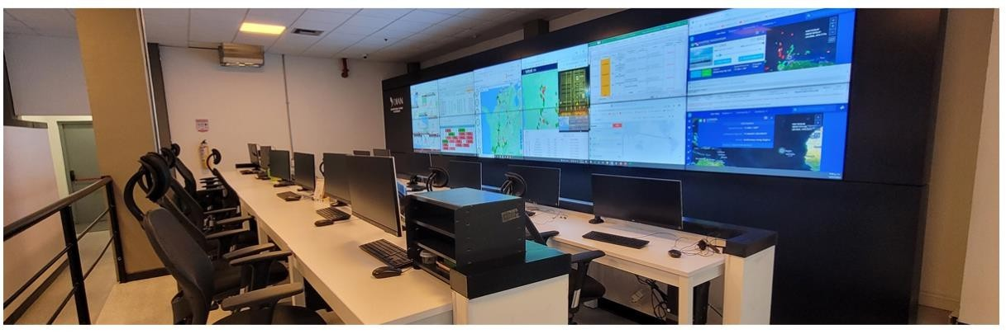
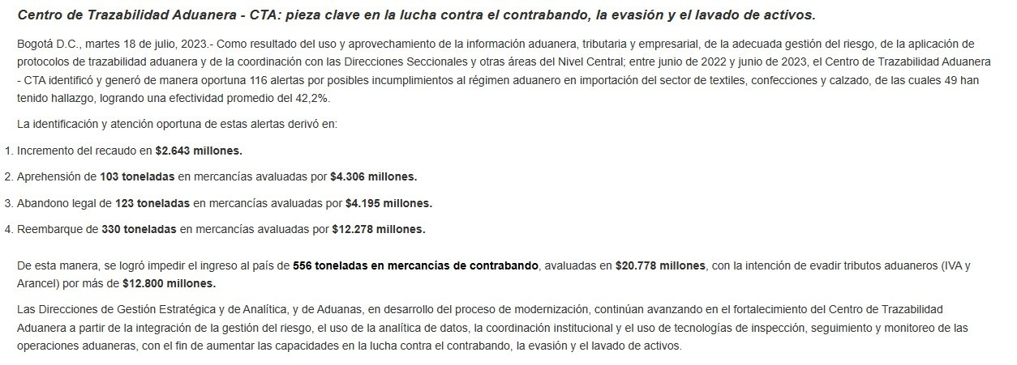

Slide 13
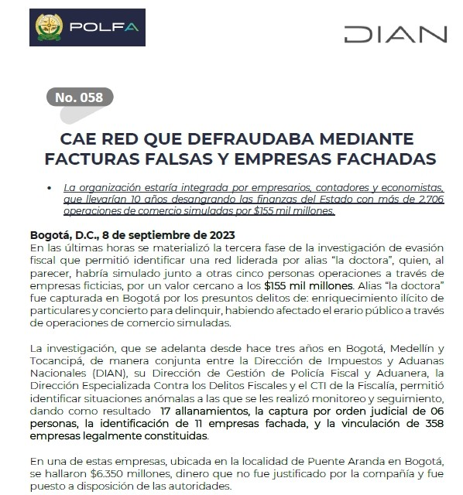
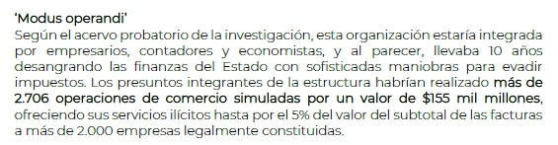
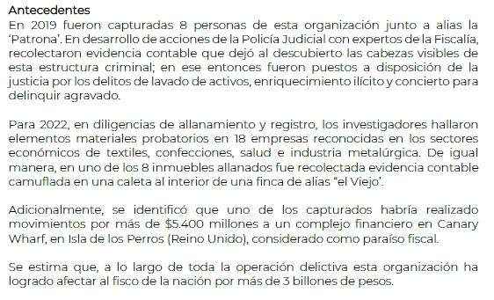

Slide 14
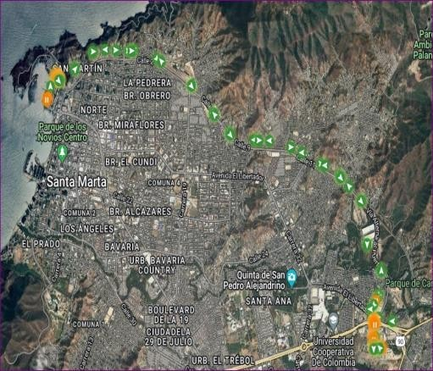
The HLXU container was shipped to the Port of Santa Marta on July xxxx, 202x at 08:50 hours, with security seal 031xxx, door tag No. 47, and side door tag No. 470, in the vehicle with license plates UYxx, property of the company xxxx, driven by Mr. xxxx, who identifies himself with
C.C.xxxxx. Said tractor-trailer arrived at the traffic circle at the entrance to the Port of Santa Marta, nineteen minutes later (09:09 hours) according to the GPS report of said vehicle. Such report indicated that during the mentioned route no suspicious activity or action against the security of the fruit was evidenced. It should be noted that the vehicle took 7 minutes to enter the port due to the high vehicular flow at the point.
The aforementioned container was selected in the selectivity of the National Antinarcotics Police on July xxx, 202xx, and was taken to Zone 03 of the Port of xxxx at xxx hours of the same day.

Slide 15
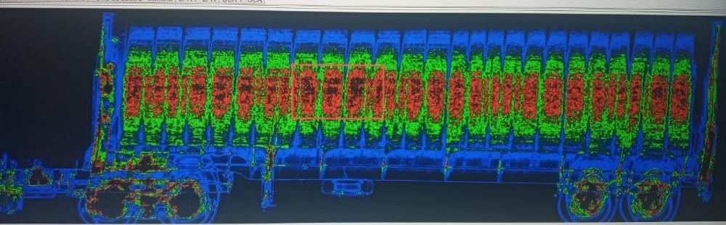

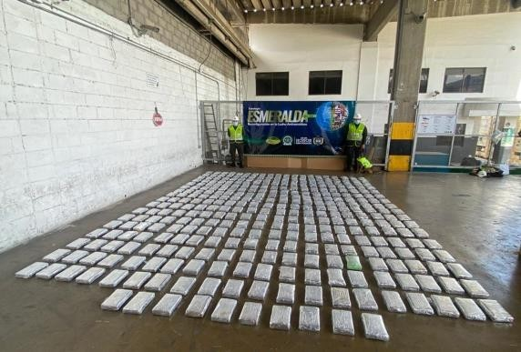
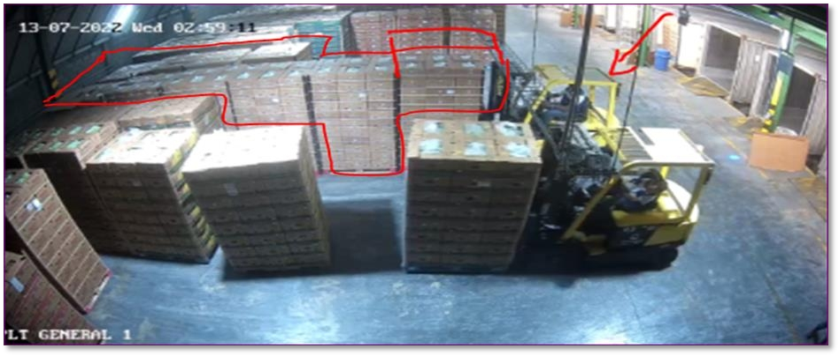

Slide 16
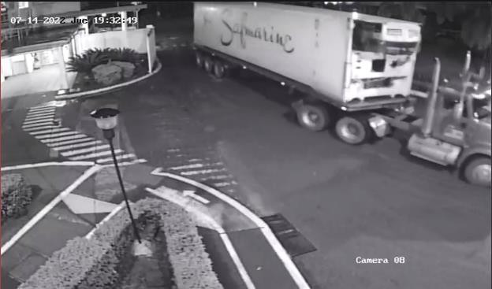
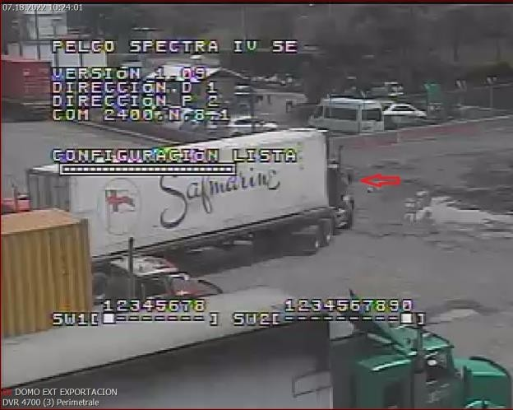
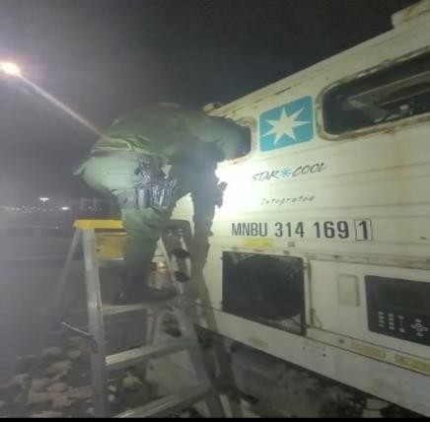
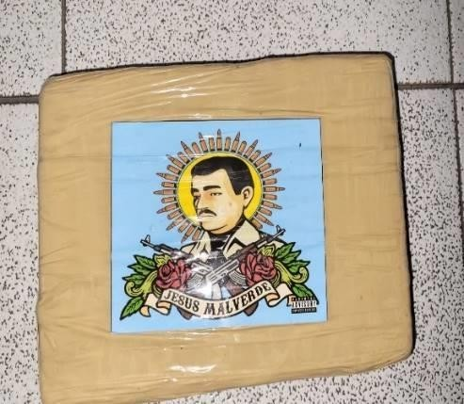
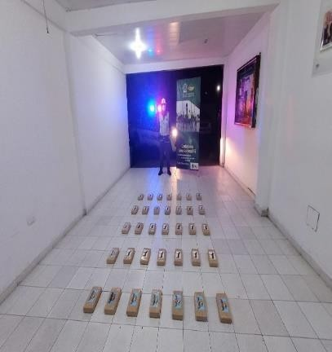
The contamination was on the front wall, where they apparently use the windows to embed the power generation unit, removing the foam that internally protects the walls of the container (a task that takes time), which was the place where the 51 packages apparently containing narcotics were detected, which indicates that it is almost impossible that this contamination has been made inside the plant facilities, because the container was always installed with the power generation unit and access to the windows is impossible.
The container leaves the paila plant on July XX, 202 and enters the port on July XX, 202X, passing through the scanner without any news, which enters without the power generator which is removed before entering the port and XX days later on July XXX, the anti-narcotics police ordered a pre-stowage inspection and it was there where through a new passage through the scanner the novelty was detected in the place indicated above.

Slide 17
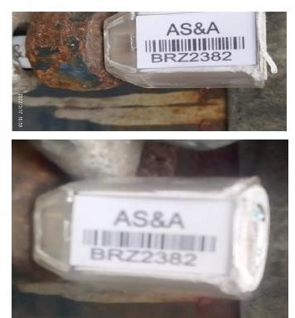
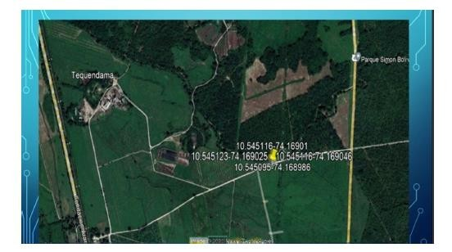
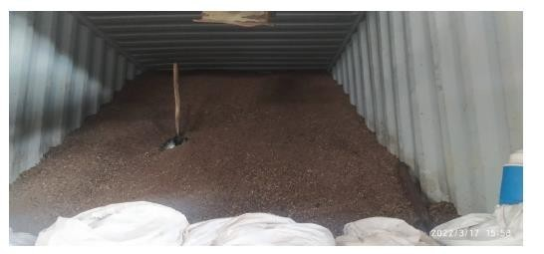
In the process of this investigation, an employee was identified as allegedly involved in the incident, who in the respective proceedings carried out by the company confessed his criminal actions in the exchange of the security seals, which led to the contamination of the cargo, for which reason he was immediately dismissed from the Company.
Cargo Transport Unit Traceability Service by means of Cargo Traceability Devices - DTC "Satellite Seals".

Slide 18

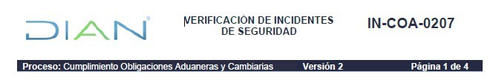
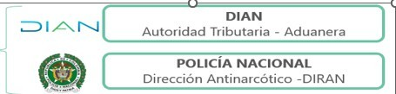

Slide 19
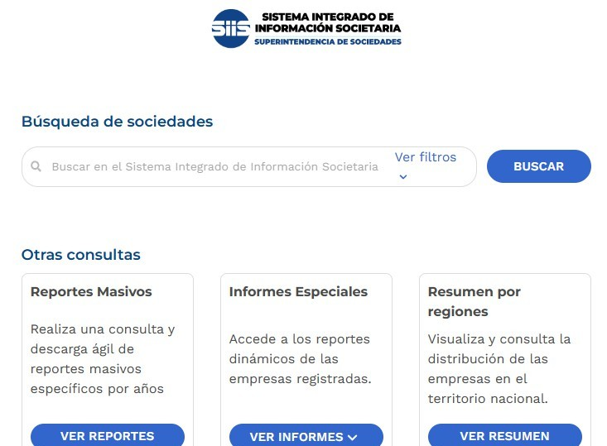
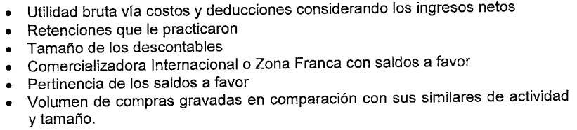
PENALTY FOR INACCURACY. <amended by Article 288 of Law 1819 of 2016> The penalty for inaccuracy shall be equivalent to one hundred percent (100%) of the difference between the balance payable or credit balance, as the case may be, determined in the official determination and that declared by the taxpayer, withholding agent or responsible party, or fifteen percent (15%) of the inaccurate values in the case of income and net worth returns.
This penalty shall not be applied on the greater value of the advance payment generated when modifying the tax declared by the taxpayer. In the following cases, the amount of the penalty referred to in this article shall be: Of two hundred percent (200%) of the greater value of the tax payable determined when assets are omitted or non-existent liabilities are included. 2 One hundred and sixty percent (160%) of the difference referred to in paragraph 1 of this article when the inaccuracy originates from the conducts contemplated in numeral 5 of article 647 of the Tax Statute or from the commission of an abuse in tax matters, in accordance with the provisions of article 869 of the Tax Statute.
SIIS - / / (supersociedades.gov.co)

Slide 20
OBLIGATION TO INFORM. The customs authority may request from any person, directly or indirectly related to foreign trade operations or actions concerning, the information required to carry out studies, verifications, checks or investigations in general and for customs control. Likewise, public entities involved in the promotion, regulation, control, coordination or provision of any type of service in foreign trade operations must report the information requested.
OBLIGATION TO REPORT.
Natural or legal persons to whom the Special Administrative Unit of the National Tax and Customs Directorate (DIAN), through the competent agencies, has requested information under the terms provided in this article, and who do not provide it, provide it late, or provide it incompletely or inaccurately, shall be subject to a fine equivalent to two hundred (200) Tax Value Units (UVT) for each unfulfilled requirement. The official who makes the requirement may not demand information held by the entity.

Slide 21


Behavioral Warning Signs Related to Supplier, Company and Company Behavior
Companies whose financial statements reflect very different results compared with other companies in the same sector with similar economic activities.
Company with non-operating income higher than operating income.
Company with managers who do not fit the profiles of the positions they hold.
Foreign company (with different currency rate to the US $) that has branches in our country, which sends payments or deposits (in Dollars) by ACH, to foreign employees based in our country working for the supposed company (shell) based in our country.
Incorporation of companies with capital or partners from territories or countries considered non-cooperative by the Financial Action Task Force (FATF), or tax havens or harmful preferential tax regimes by the Organization for Economic Cooperation and Development (OECD).
Companies that refrain from providing complete information, such as main activity, references, name of directors, financial statements."
Subdirectorate of Customs Control

Slide 22
Companies developing large investment projects in unusual rural areas.
Companies that invest in local companies with unrelated economic activity.
Companies that reflect an exaggerated increase in sales volume or experience an important economic recovery after a crisis.
Distribution companies located in areas with illegal groups or places with low demand, which suddenly register a level of orders due to an increase in the level of their sales, with no apparent justification.
Incorporation of companies with names similar to those of companies with a recognized track record.
Purchase and sale of bankrupt companies or companies in economic difficulties by individuals with no track record in the sector.
Newly created companies that soon have a dominant position in the sector.
Companies in economic difficulties that present new owners, change their nature and soon after The company's sales growth has been out off line with the market and the sector.
Indications that the customer is not acting on his own or is attempting to conceal the identity of the real buyer.

Slide 23
That the foreign company, corporation and/or branch is not under precautionary measure with depositary appointment and in process of extinction of domain, in which the suspension of the dispositive power over the assets of the company, corporation and/or branch is ordered.
The capital of the company is not seized and is represented by Sociedad de Activos Especiales S.A.S., as administrator of FRISCO -Administrador del Fondo para la Rehabilitación, Inversión Social y Lucha contra el Crimen Organizado (Frisco). Decree 2136 of 2015.
Companies that have been incorporated with low capital and carrying out operations that do not match the economic capacity of the company.
When an importer constantly changes Customs Agency and Warehouses.
Loss or theft of goods on the way from the place of arrival to the warehouse.
Overvaluation or undervaluation of imports or exports, adjusting prices, quantities or qualities or a combination thereof.
Companies show non-operating income higher than operating income.
Economic sectors susceptible to being used as a mechanism to carry out money laundering or terrorist financing operations.
Increase in the turnover of a company's business, for no justifiable reason.
Entry of large sums of money in containers, suitcases, secret compartments in vehicles, postal or express shipments, etc.

Slide 24
RISK MANAGEMENT. Dec 1165-2019
ARTICLE 582. RISK. Risk is the probability of non-compliance with current customs regulations and, in general, with the obligations administered by the Special Administrative Unit of the National Tax and Customs Directorate (DIAN).
ARTICLE 583. RISK MANAGEMENT SYSTEM. The Special Administrative Unit of the National Tax and Customs Directorate (DIAN) may use risk management practices and procedures in order to prevent or combat the use or destination of trade for purposes that threaten national security or customs provisions.
For this purpose, and with due observance of the rules on habeas data and handling of personal data information, the Special Administrative Unit of the National Tax and Customs Directorate (DIAN) will use databases that allow it to have information, among other aspects, on the operations and on the persons who act before the Entity, to evaluate the security of the logistics chain in foreign trade.
In the development of the risk management system, the Special Administrative Unit of the National Tax and Customs Directorate (DIAN), in order to guarantee compliance with the customs obligation, will direct its control activities with emphasis on the operations that represent the greatest risk, with the purpose of ensuring and facilitating international trade. Consequently, risk monitoring mechanisms may be implemented, control measures may be established in places of entry and exit of goods and other duly recognized international mechanisms may be used.

Slide 25

RISK MANAGEMENT
PARAGRAPH: The risk management system of the Special Administrative Unit of the National Tax and Customs Directorate (DIAN) may be coordinated with the risk management systems of other control bodies related to customs and foreign trade operations, such as: Migration Colombia, ICA, Invima and National Police.
Elements of risk management. Coordination of Tax, Customs and Exchange Compliance Risks of the Subdirectorate of Risk Analysis and Programs, qualifies among others according to: (Decree 1165 of 2019 - Article 584).
TAC payment obligations and penalties.
Failure to comply with TAC obligations.
Evasion of customs duties by:
  Customs value of imported goods,
  Preferential treatment resulting from the application of the rules of origin
  Aspects related to tariff nomenclature.
Source of funds.
Economic Solvency
Among others.
The risk profile is the input to issue a favorable or unfavorable concept for customs users. For the
Medium and Low profiles, a favorable rating is issued.
In no case may a favorable concept be issued with a High risk profile.

Slide 26
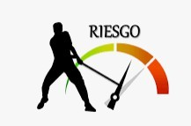
Obtain a favorable rating by the DIAN, in accordance with the verifications carried out in the implementation of the Risk Management System referred to in Decree 1165 of 2019.
The DIAN's Risk Management system has the character of a special confidentiality, in accordance with the provisions of Article 130 of Law 2010 of 2019, which states:
"(...) Information of the Risk Management System of the Special Administrative Unit of the National Tax and Customs Directorate. The information and procedures administered by the Risk Management System of the National Tax and Customs Directorate (DIAN) are reserved. This special reserve shall be enforceable against individuals and all public entities, and may only be lifted by order of a competent judicial authority".

Slide 27
https://www.dian.gov.co/Paginas/Control_Cambiario.aspx
https://www.dian.gov.co/fizcalizacioncontrol/Paginas/Sistema-de-Informacion-Denuncias-de-Fiscalizacion.aspx
https://www.dian.gov.co/Proveedores_Ficticios/Proveedores-Ficticios-05-12-2022.pdf
https://www.dian.gov.co/Contadores_Sancionados_DIAN/Contadores_Sancionados_por_la_DIAN_y_UAE_JCC_21 102022.pdf
https://www.dian.gov.co/aduanas/opecomeexterior/Paginas/Usuarios-Aduaneros.aspx
https://www.dian.gov.co/Paginas/SitiosInteres.aspx
https://www.rues.org.co/
https://siis.ia.supersociedades.gov.co/#/
https://www.bvc.com.co/indices/msci%20colcap
https://www.unodc.org/documents/colombia/2015/Julio/Modelo_de_Administracion_del_Riesgo_de_LAFT_y_Co ntrabando_web.pdf
https://www.dian.gov.co/impuestos/RUB/Documents/Manual-beneficiarios-finales.pdf

Slide 28

THANK YOU

