Slide 1
Verde Austral Case:
Embezzlement of public funds, fraud, illicit association and money laundering by a police agency.

Slide 2

Verde Austral Case:
More than 100 people participated, including active and retired civil servants and civilians.
It allowed the misappropriation of public funds for more than 10 years, for an amount equivalent to USD 33,341,874.
Those implicated provided their accounts and banking products to different members and leaders.
General background of the case
The bank accounts and products were used for the theft of millions in public funds.
It includes a criminal organization within a police agency.

Slide 3

How did Chile's National AML/CFT System work?
1
Banking institution (regulated entity) sent a STR to the Financial Analysis Unit (UAF) regarding suspicious transactions of a police officer.
The UAF's financial intelligence processes enabled the detection of indications of money laundering. Therefore, a Financial Intelligence Report was sent to the Public Prosecutor's Office (MP), the only institution responsible for investigating and prosecuting crimes in the country.
2
In 2016, the MP initiates a secret investigation, detecting complex irregularities, so it forms an inter-institutional "task force" (21 people from 3 public institutions), in charge of investigating the case.
3
4
Based on the investigative work for this fraud case, dozens of related cases have been initiated: DIPRECA case (2017), Cuentacorrentistas (2018), Inapillaima (2018), Frontera (2019), etc.
Throughout the process there was full coordination between the FAU and the MP, reflected in an exchange of financial intelligence information, with the FAU sending 41 communications (complete reports) to the MP, where it has reported more than 81 persons related to the case.
5

Slide 4
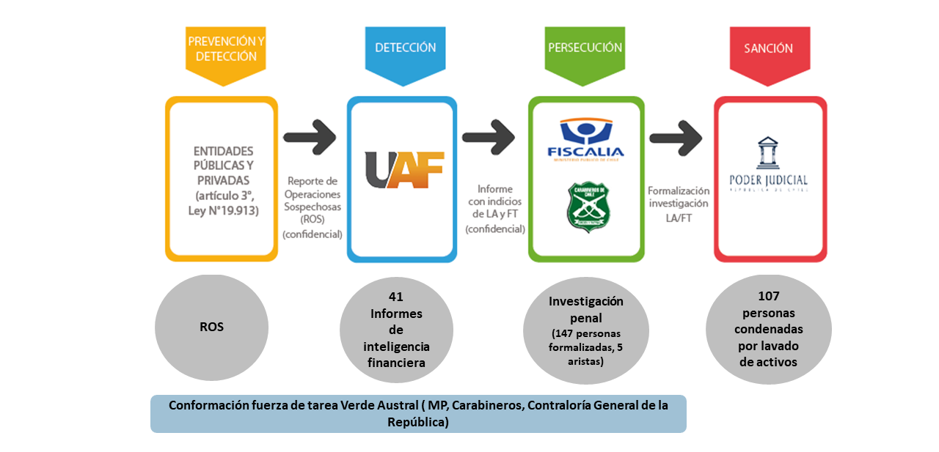
National AML/CFT System of Chile:

Slide 5

Typologies detected:
Prepayment of loans and credit cards
Modification of the marital property regime
Frontmen
Fractionation
Dummy
companies

Slide 6
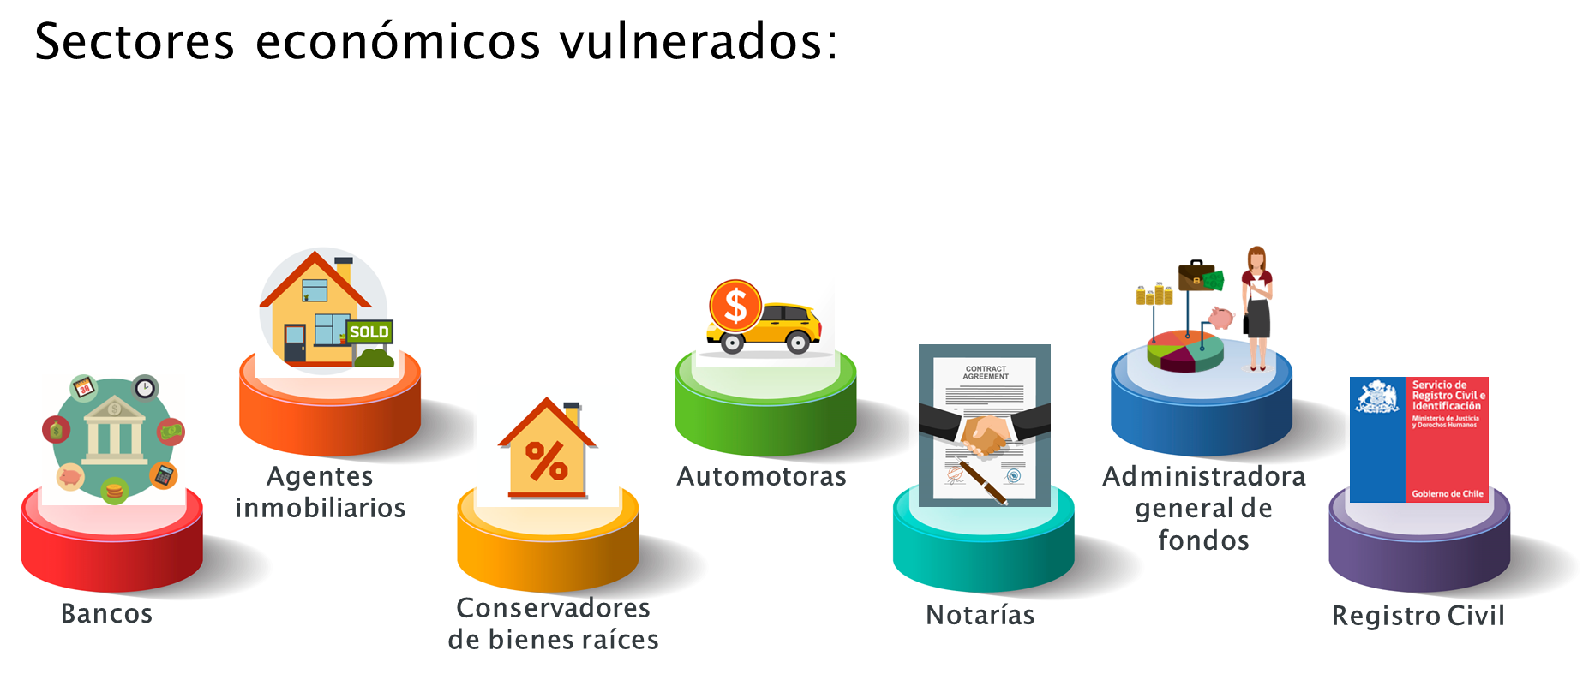
Economic sectors impacted
Car Dealers
Real Estate Agents
Fund Management Companies
Banks
Notaries
Civil Registry
Real Estate
Curators

Slide 7
Results achieved:
115 persons convicted in the main case and its aspects:
Money laundering and predicate offense convictions | 98 people
Money laundering convictions | 9 people
Base offense convictions | 8 people
Total convicted of money laundering | 107 people
Seized or forfeited assets | 268 real estate and personal property.
Money claimed for recovery | USD 2.193.990
Freeze on bank accounts | USD 147.207 in bank accounts and deposits.
Seizure in other accounts | USD 595.912 (Cash, vouchers and 7 caballeres)
Judicial seizure | USD 1.411.350 for evictions compensation, bonus and payments to Welfare Department funds.

Slide 8
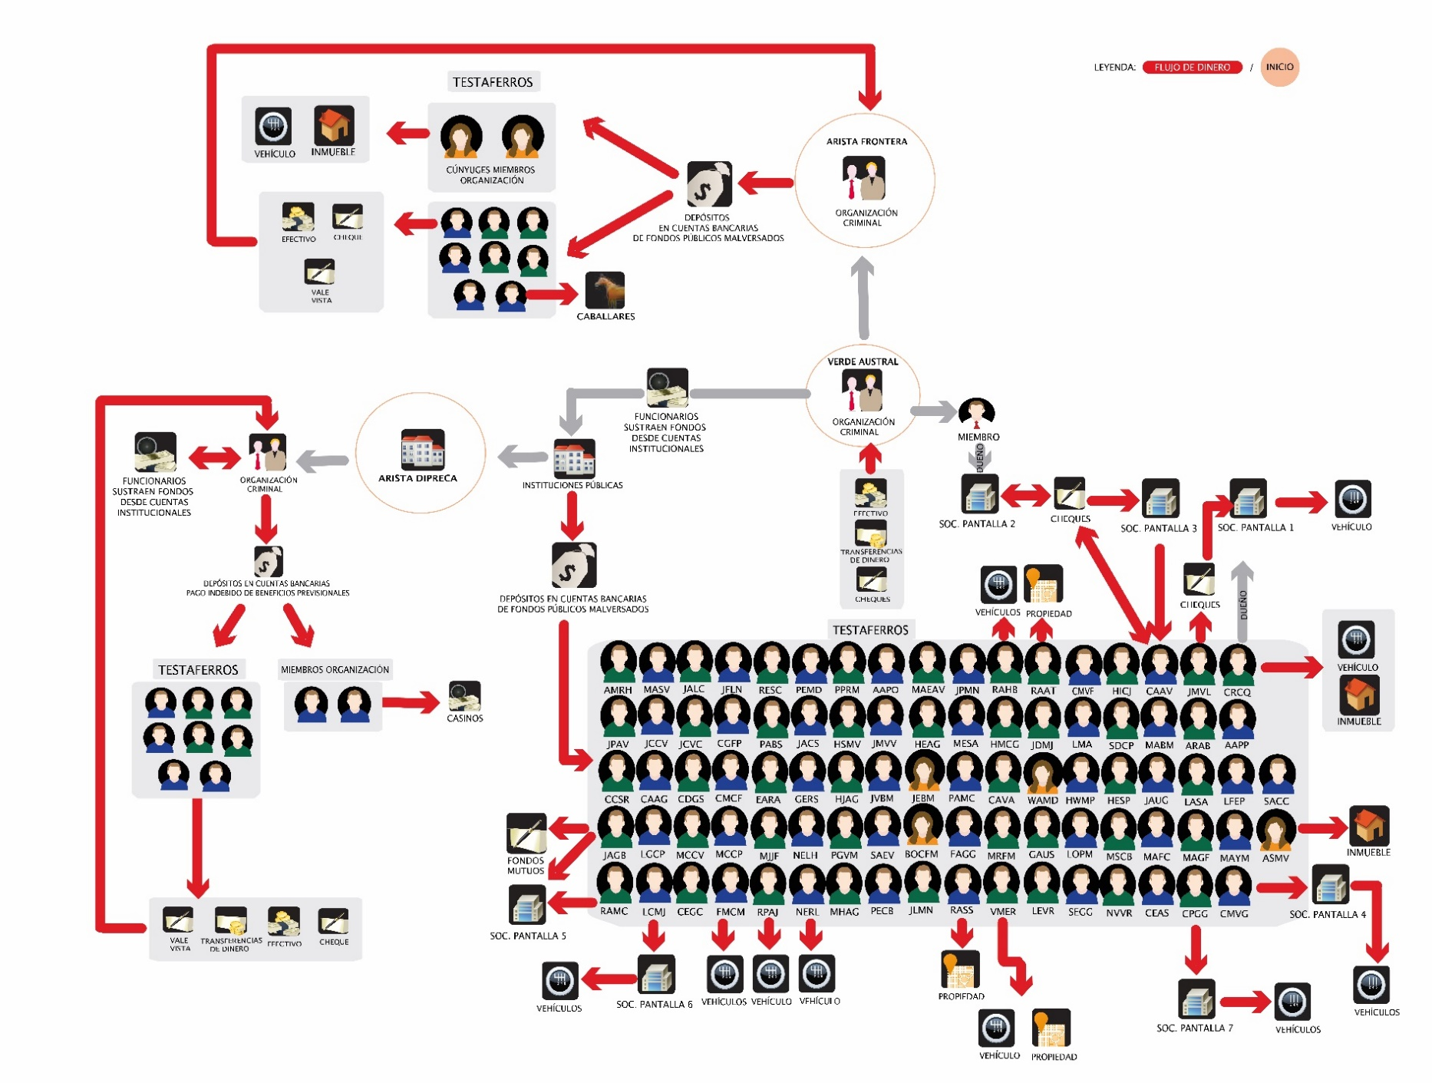
Diagram of the case

Slide 9
Conclusions:
For Chile, the Verde Austral case is a success example of the National AML/CFT System that shows the importance of public-private collaboration, which reflects the following:
Bank
(regulated entity)
The implementation of preventive measures enabled the detection of a suspicious operation by a bank and the sending of a STR to the FAU..
UAF
Through financial intelligence processes, the FAU detected indications of ML and sent an Intelligence Report to the Public Prosecutor's Office.
Public Prosecutor's Office
The Public Prosecutor's Office opened a criminal investigation, making it one of the largest cases of corruption and money laundering in Chile.

Slide 10
Conclusions:
The implementation of a multidisciplinary task force made it possible to dismantle the criminal organization from the asset side, with 115 people convicted in an abbreviated trial and 31 people belonging to the organization's leadership, who faced an oral trial.
The Office of the Comptroller General of the Republic of Chile implemented an organizational reform and created a department to permanently audit the Armed Forces and the Police and Security Forces.
The police agency implemented a structural reform and created an Internal Audit Directorate, composed of approximately 50 police officers, with the objective of auditing all internal processes of this institution on a permanent basis, advised by the General Internal Audit Council of the Chilean Government (CAIGG).

Slide 11
THANK YOU

