Slide 1


Investigative Interviewing to the Criminal Investigation Standard
October 2023
Douglas Sloan

Slide 2
Benefits of interviewing training
  more complete, accurate, and reliable information
  less duplication of effort (e.g. re-interviewing)
  greater consistency in performance
  better deployment of staff (use of experts)
  better decision-making re prosecutions/disciplinary etc
  enhanced credibility of investigators
  improved public trust and confidence

Slide 3
Who are we Interviewing or Interrogating?
Suspect
Witness
Victim
Bystander
Expert
Interviewing
Outcome
Interrogating
(When Appropriate)

Slide 4
An introduction to the PEACE Model
Plan and Prepare
Engage and explain
Account, clarification, compare and contrast
Closure
Evaluate

Slide 5
The PEACE Model
The PEACE model
P E A C E
Interview
Preparation
&
Planning
Engage & Explain
Account Clarification & Challenge
Evaluation
Closure
Notes:
Who has seen or carried out interviews?
This is the PEACE model of interviewing which was introduced as a result of the Police & Criminal Evidence Act 1984, this introduced audio recorded interviewing for policing, this then resulted in the acknowledgement that police interviewing was very poor and generally without structure. Dr Eric Shepherd was then tasked to introduce a structured phased model of interviewing which resulted in the PEACE model. This has developed in application over the years but the general principles remain the same.
Movement between phases in the interview is fluid and can go full circle, an applicant may think they are finished with an account but the telling of their account triggers further memories and you have to move back through the process.
The material facts may need separate interviews and more sensitive areas may need further Engage & Explain in order to ease the applicant into the process
The ‘P.E.A.C.E Model’ diagram shows lines linking the three active phases of the interview. Planning & Prep and Evaluation are generally factors to be conducted outside of the interview itself.
We will explain each of these stages in further detail as we go through this week.
It is important to remember that there are no rigid boundaries between the phases and flexibility is required throughout.

Slide 6
7 Principles of Investigative Interviewing
Investigators should…
  Obtain accurate and reliable accounts
  Must act fairly
  Approached with an investigators mindset
  Be free to ask a wide range of questions
  Recognise the positive impact of an early admission
  Not bound to accept the first answer given
  If right of silence is exercised by suspect, put questions to them
Notes:
6
Give out handout 3 ‘7 Principles of Investigative Interviewing and discuss

Slide 7
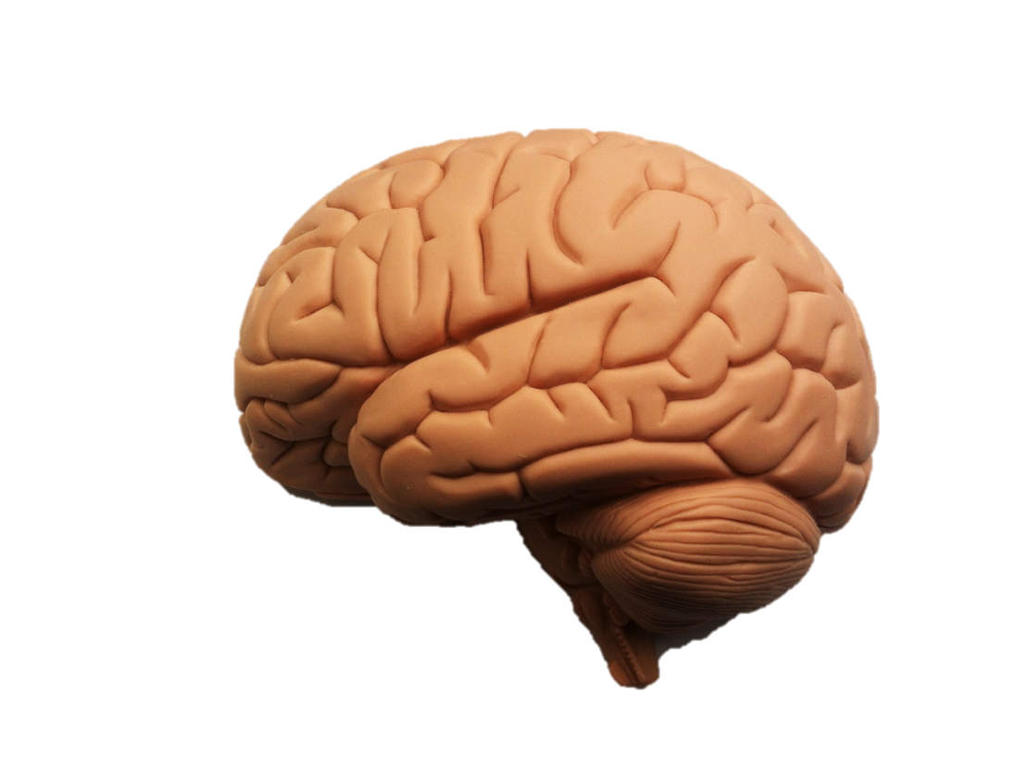
Learning Outcome
Understand how the memory works

Slide 8

Why do interviewers need to know about memory?
To understand memory is fragile
Memory can be influenced by the interviewer
Interviewees’ can be assisted to remember
Notes:
Pose the question, Why do investigative interviewers need to know about memory.
Interviewers are generally obtaining information about peoples past experiences.
The models of interview to be taught have been constructed specifically to work with peoples memory and cognitive processes.
Having even just a basic insight into memory allows us to;
Place more realistic expectations on our witnesses
Overcome many of our previous frustrations with witnesses i.e. “why can’t they remember that particular piece of information? They were stood right there watching?”
Better assist them to recall information
Avoid influencing their account
Obtain the maximum quantity and quality of information we can in a way which will withstand scrutiny

Slide 9
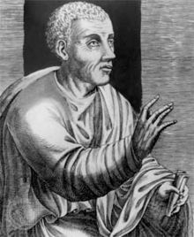
Lying (Deception)
‘A liar should have a good memory’
Quintilian

Slide 10
“HURDLES TO EFFECTIVE LYING”
HURDLE ONE
Anticipate being questioned
HURDLE TWO
Create a storyline (a script, account or version of events)
HURDLE THREE
Cope with being questioned (link with “fine grain detail” questioning)
HURDLE FOUR
Remember what you’ve said!

Slide 11
Factors affecting memory & recall
Drugs and alcohol
Prejudice
Stereotypes
Violence
Time
Notes:
Drugs and alcohol – Surprisingly there has been little research in this area. What research has been done tends to suggest that persons who ingested amounts of alcohol compared to sober controls remembered fewer details. It seems to be quantity, rather than quality of information that is effected.
Partisanship - Has been found to effect accuracy. Boon and Davies (1996) showed a controversial football match between England and Scotland separately to opposing fans. When asked to comment on who was responsible for the majority of the infringements the Scottish fans adjudged the English to be responsible for 57% of them and the Scottish just 10%. Finding in reverse i.e. when the English fans were posed the same question were very similar.
Stereotypes – Studies have shown that witnesses often used stereotypes to fill in the gaps of information to be remembered. For example stereotypes in relation to hair and eye colour and complexion. Blonde hair – must have blue eyes etc.
Violence – recall has been found in some studies to be greater in none violent events than violent ones. The same studies tend to suggest that less information was recalled about the assailant themselves but there was more peripheral detail available for recall.
Time – Memory can be subject to decay over long periods of time. It is worth noting however that whilst the loss of a small amount of recall was evident between recall straight after the event to that a few days later. From that point on the amount of detail seemed to remain largely consistent. i.e. you are not going to lose much by interviewing someone a few days after the event as opposed to immediately after. Interviewing someone immediately after a traumatic event may be detrimental as other factors such as fear, trauma, emotions and anxiety may all be influencing recall attempts.

Slide 12
Memory: Retrieval
A first attempt at recall reveals broad outlines, but little detail
People may add or miss detail in their first attempt at recall
Retrieval is aided by setting the scene
Allow the person to give an uninterrupted account
The way people remember varies
Confidence does not guarantee the accuracy of what the witness says

Slide 13
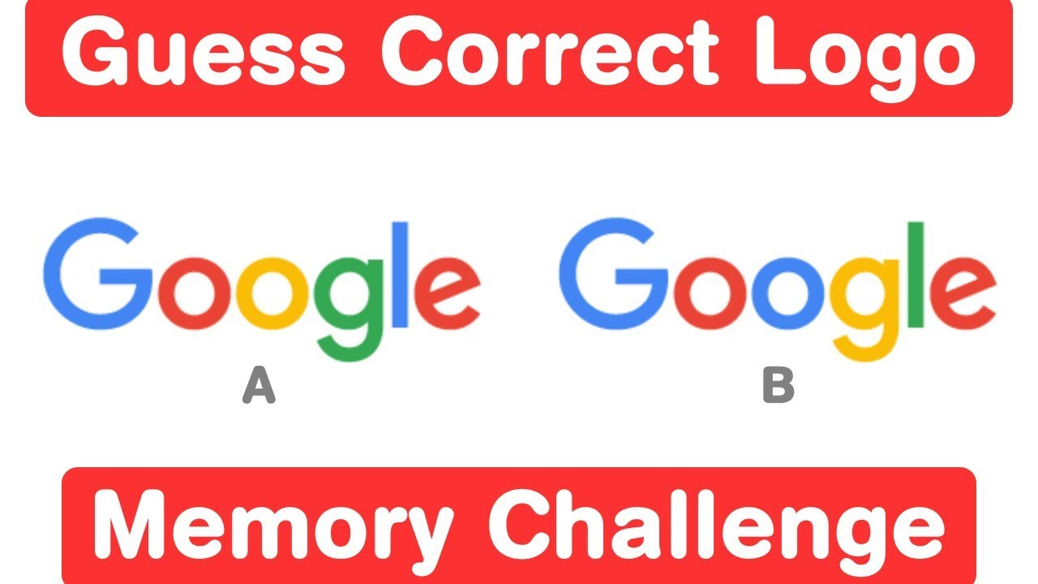
MEMORY TEST

Slide 14


Slide 15
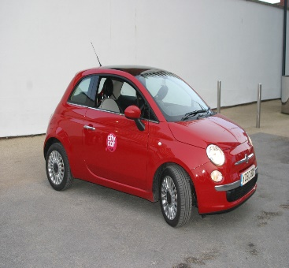

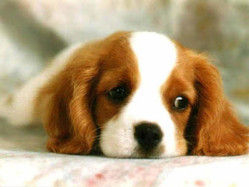
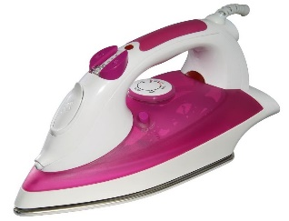



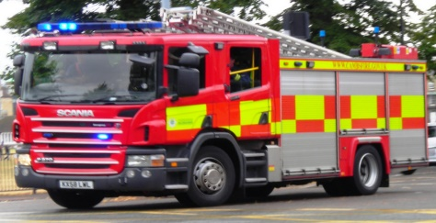

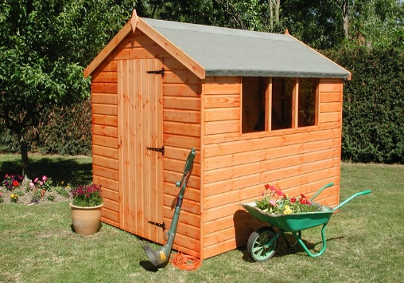

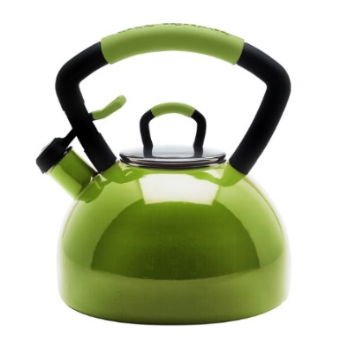
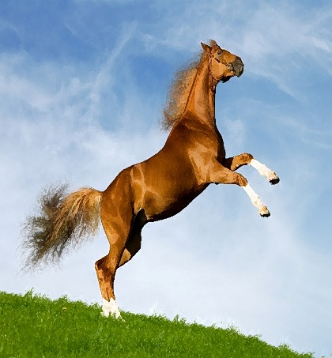


The number 17
Notes:
Memory Test. Get the students to view the slide for 60 seconds and then write down as many as they can remember. Debrief with how they remembered any techniques to help them etc.

Slide 16

What can you remember???

Slide 17
“The biggest communication problem is that we don’t listen to understand.
We listen to reply”

Slide 18
The six ways a communication transaction may take place
Verbal communication
Words
Non-verbal communication
Voice tone
Dress and ornaments
Distance
Position and gestures
Word spacers

Slide 19
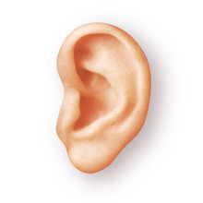
Active Listening
Active listening is a communication technique that requires the listener to feed back what they hear to the speaker
Re-stating
Paraphrasing

Slide 20
Active Listening
To confirm what they have heard and moreover, to confirm the understanding of both parties
The ability to listen actively demonstrates nothing is being assumed or taken for granted
Active listening can be used to improve personal relationships, reduce misunderstanding and conflicts, strengthen cooperation, and foster understanding

Slide 21
Finding out the truth – Open Questions
TED
Tell
Explain
Describe
5WH
When
Where
Why
What
Who
How
Notes:
These are important commands to be used in questioning. The TED questions are to be used in the opening questioning of a witness e.g. tell me everything you can. The 5WH are commands to gather further detail. See next slide re funnel.

Slide 22
Questioning Funnel
Topic
Tell
Explain
Describe
5WH
Link

Slide 23
Questioning sequence
Use open TEDS style questions until these are no longer productive. It is possible to obtain all information by asking open questions.
Use probing 5WH questions when and where necessary.
Use appropriately closed questions sparingly, aimed at checking and confirming points raised.
Information Funnel

Slide 24

QUESTIONING TIPS

Slide 25
THE BASIC RULES OF CONVERSATION
Conversation requires co-operation.
Co-operation grows from:
R Respect for the person
E Empathy
S Supportiveness
P Positiveness (Unconditional Positive Regard)
O Openness
N Non-judgemental attitude
S Straightforward talk
E Equals talking ‘across’ to each other

Slide 26
ECHO PROBE
“ the forms were duplicated”
“Duplicated?”
MIRROR PROBE
“she blamed you?”
“Blamed you?”

Slide 27

EFFECTIVE NON VERBAL COMMUNICATION
S Signs of sincerity
O Open posture
F Forward lean
T Touch
E Eye contact
N Nods
S Supportive sounds and silence

Slide 28
INAPPROPRIATE QUESTIONS
AND
BLAME

Slide 29
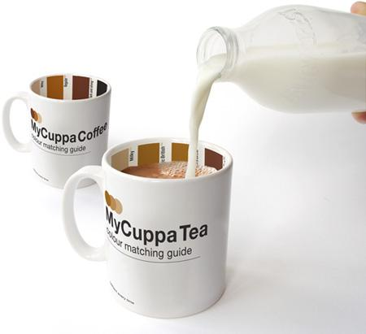
FORCED CHOICE QUESTIONS
“Do you prefer Tea or Coffee?”

Slide 30
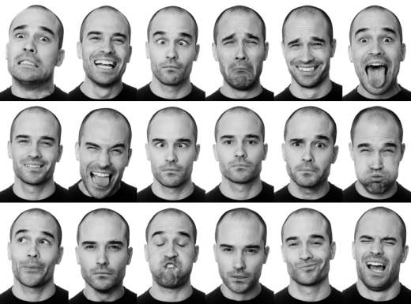
MULTIPLE QUESTIONS
“Did you see the car? Was there another vehicle ? Which way did it go?”

Slide 31
LEADING AND MISLEADING QUESTIONS
Leading questions and misleading questions
introduce information to the interviewee and imply it is the correct or incorrect response
- Was his jacket black?
- And was the car, a Ford?
- Did you go straight home?

Slide 32
COMPLEX QUESTIONS
Complex questions occur when the question is not well thought out by the interviewer:
  ‘You said that you’ve never been there before but I think that you did go there, and that you said you’ve never been there because you know you would get into trouble for being there because you know that place was unsafe. Isn’t that so?’

Slide 33
Questions to avoid
Statement / Opinion type questions are those that attempt to impose the interviewers thoughts and ideas on the interviewee.
  We’ve spoken to the girlfriend and she’s telling the truth.
  (No evidence.)
  You’re lying, I know you are!
  Are you sure you don’t know what happened…..

Slide 34
Negative phrasing occurs when a question begins with a negative statement and seeks the interviewee’s agreement
  You’re not employed are you?
  You didn’t see it did you?
  You don’t work there do you?

Slide 35
Hypothetical questions are suggestive questions about things that may not have actually happened. I.e. The ‘what if’ factor.
  You say you didn’t hit them, but if you did hit them would you have injuried them?
  If you were the driver where do you think you would have gone?

Slide 36
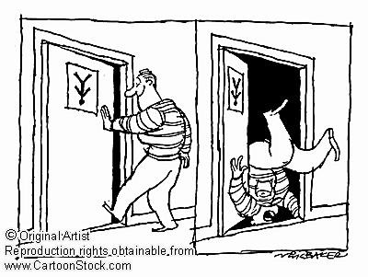
ASSUMPTIONS
Do not assume anything. Seek clarification from the interviewee. If they don’t know, tell them that its is okay to say so.

Slide 37
REMEMBER!
The way in which interviewers structure questions can have a marked influence on the responses given by the witness or suspects.
Thus, it is imperative to understand the nature of questioning in order to conduct the most effective and non-biased conversation in order to obtain quality evidence.

Slide 38

Douglas Sloan: +1 917 565 7695

