Slide 1



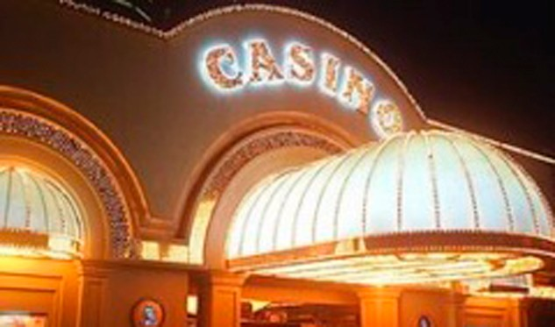
FINANCIAL CRIMES AND THEIR POSSIBLE IMPACT ON THE CASINO SECTOR
PARTICIPANT: GEOVANNI VARGAS
October 2023.

Slide 2
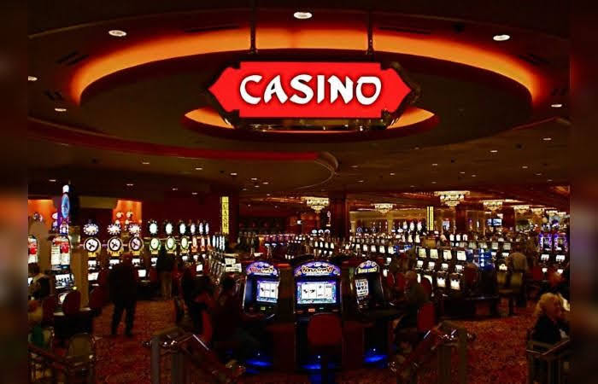
FINANCIAL CRIMES AND THE CASINO SECTOR
ILLEGAL CASINOS
CASINOS AS VICTIMS
CASINO-OWNING CRIMINALS
USE OF CASINO OPERATIONS FOR THE ML/FT/FPADM
OTHER CRIMES

Slide 3
RELEVANT CHARACTERISTICS OF THE SECTOR THAT MAKE IT VULNERABLE
USE OF CASH
CURRENCY EXCHANGE OPERATIONS
RECEIVING AND SENDING BANK TRANSFERS
DIFFICULTY IDENTIFYING THE CUSTOMER

Slide 4
MODALITIES OF MONEY LAUNDERING.
PURCHASE OF CHIPS WITH ILLICIT RESOURCES FOR THEIR SUBSEQUENT REDEMPTION
PURCHASE OF PRIZES WITH ILLICIT RESOURCES
PURCHASE OF CHIPS FROM OTHER PLAYERS IN CASH TO LATER REQUEST TRANSFERS
TRANSFER OF ILLICIT FUNDS TO CASINO ACCOUNTS TO LATER EXCHANGE THEM FOR LICIT ASSETS.

Slide 5
ALARMS AND WARNING INDICATORS
CUSTOMERS WHO GO OUTSIDE THE PARAMETERS OF THE USUAL CLIENTELE; CUSTOMERS WHO TIP EXAGGERATEDLY.
CUSTOMERS WHO APPROACH OTHER CUSTOMERS TO BUY CHIPS OR RECEIPTS.
PLAYERS WHO BUY CHIPS OR CARDS FOR HIGH AMOUNTS, PLAY LITTLE AND THEN CASH THEM IN.
PLAYERS WITH LARGE AMOUNTS OF CASH.
PLAYERS WHO REQUEST PAYMENT OF PRIZES WITH TRANSFERS OR CHECKS MADE OUT TO THIRD PARTIES.

Slide 6
INVESTIGATION TECHNIQUES.
CONTROL SYSTEM
SPECIALIZED CONTROL ENTITY FOR THE SECTOR.
PREVENTION AND DETECTION PROCEDURES
TRAINING
INVESTIGATIVE BODIES
SPECIALIZED BODIES UNIF, CICPC AND PUBLIC PROSECUTOR'S OFFICE.
SPECIFIC STRUCTURES IN THE CASINOS FOR THE FIGHT AGAINST CRIME.
APPLICATION OF PROCESSES FOR CUSTOMER KNOWLEDGE.
ALERT SYSTEMS
PROCEDURES FOR ANALYZING UNUSUAL TRANSACTIONS
REPORTING OBLIGATIONS.
NATIONAL COORDINATION
INTERNATIONAL COORDINATION.

Slide 7

IMPORTANCE OF SECTORAL RISK ASSESSMENT
STATUTORY OFFENCE | RISK LEVEL
Money Laundering | 3
Terrorism | 3
Terrorism Financing | 3
Drug trafficking | 3
Illicit enrichment | 3
Corruption | 3
Illicit trafficking of strategic resources or materials | 2
Criminal organization | 2
Illicit drug production | 2
Drug trafficking | 2

Slide 8
ANALYSIS OF VULNERABILITIES
No Factor | No. Variable | FACTOR | Description | Inherent risk level | Residual risk
1 | LEGAL FRAMEWORK RESULTS |  |  | 3,7 | 2,7
2 | SUPERVISION EFFECTIVENESS RESULTS |  |  | 4,3 | 1,43
3 | COOPERATION AND COORDINATION RESULTS |  |  | 3 | 1
4 | RESULTS OF RISK ASSESSMENT |  |  | 4,1 | 2,2
5 | RESULTS OF COMPLIANCE BY REGULATED ENTITIES |  |  | 4,4 | 2,4
6 | RESULTS OF TECHNOLOGICAL TOOLS |  |  | 5 | 4
7 | RESULTS OF ALERT INDICATORS AND SARS |  |  | 4,3 | 2,7
8 | RESULTS OF TERRORIST FINANCING |  |  | 4 | 2,5
9 | RESULTS OF FINANCING FOR THE SPREAD OF WEAPONS OF MASS DESTRUCTION |  |  | 3,7 | 3
 |  |  | OVERALL INHERENT RISK OF THE SECTOR | 4,1 | 2,3
 |  |  | HIGH |  | MODERATE AVERAGE

Slide 9

QUESTIONS?

Slide 10
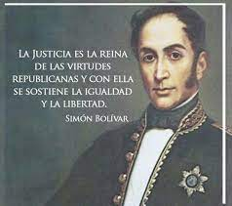
"Justice is the queen of republican virtues and it supports equality and liberty“
Simón Bolivar.
Discurso en Bogotá, 13 ene. 1815
ON THE OCCASION OF THE INSTALLATION OF THE GENERAL GOVERNMENT OF THE NEW GRENADA IN THE AFOREMENTIONED CITY

