Slide 1

The Role of a State Attorney in Asset Recovery and Money Laundering Cases
Understanding the Relationship between Investigation and Litigation

Slide 2
Introduction
Introduction on the Law Governing Civil Asset Recovery (Dominica)
State Attorney’s Role In Investigation
Relationship between investigation and litigation
Investigators participation and responsibility at trial
Evidence in Asset Recovery Cases and Money Laundering

Slide 3
Asset Recovery- cash forfeiture Application
Application for forfeiture of the seized cash filed at the Magistrate Court pursuant to:
Section 68A. of the Proceeds of Crime Act Chap 12:29, which states:
A law enforcement officer may apply to the Magistrates’ Court for a forfeiture of the whole or any part of the cash detained under section 66.
Where a law enforcement officer applies to the Magistrates’ Court for a forfeiture order and the Magistrates’ Court is satisfied that the cash or part of it-
is recoverable cash; or
is intended by any person for use in unlawful conduct,
the Magistrates’ Court may order the forfeiture of the cash or any part of it.

Slide 4
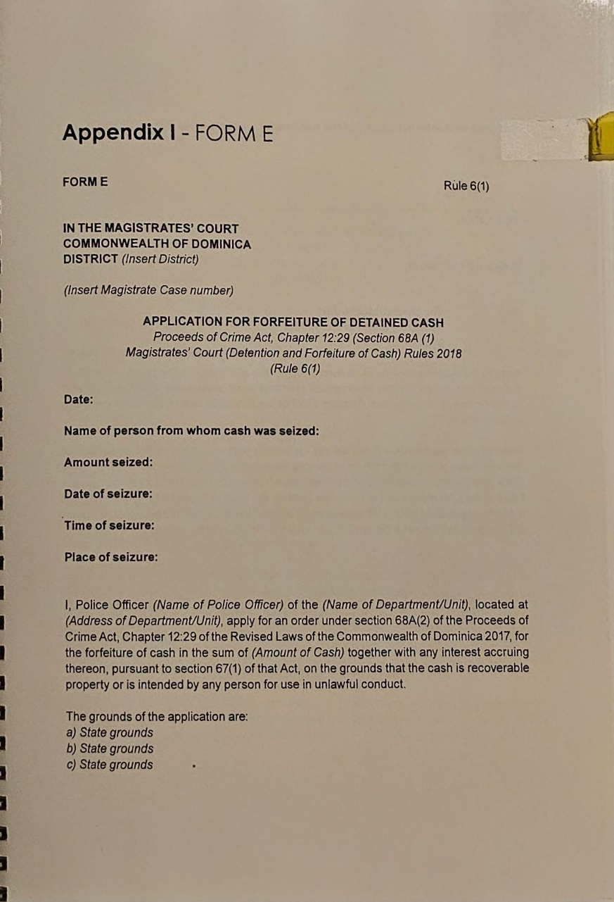
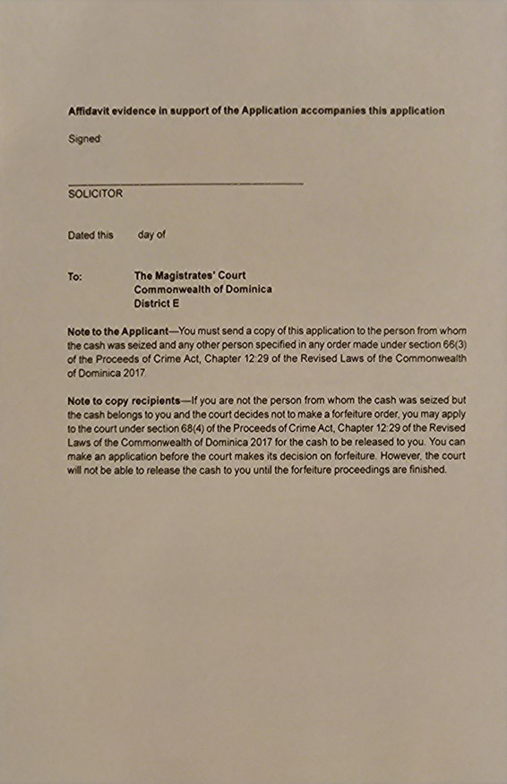
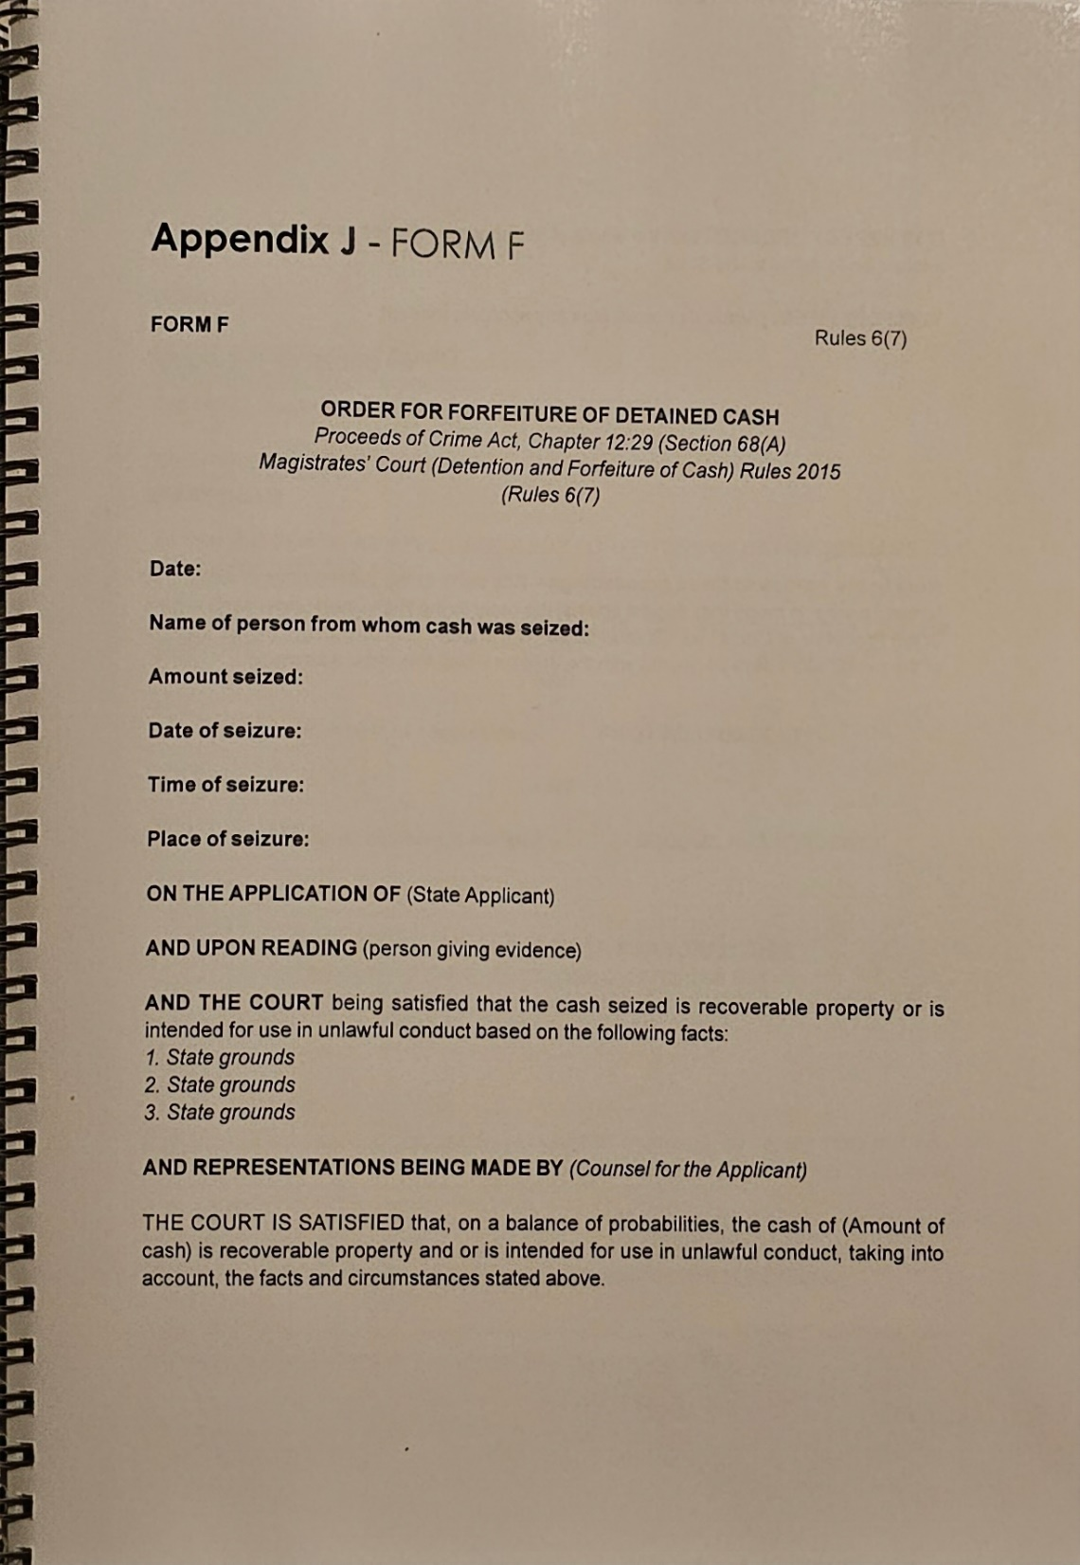
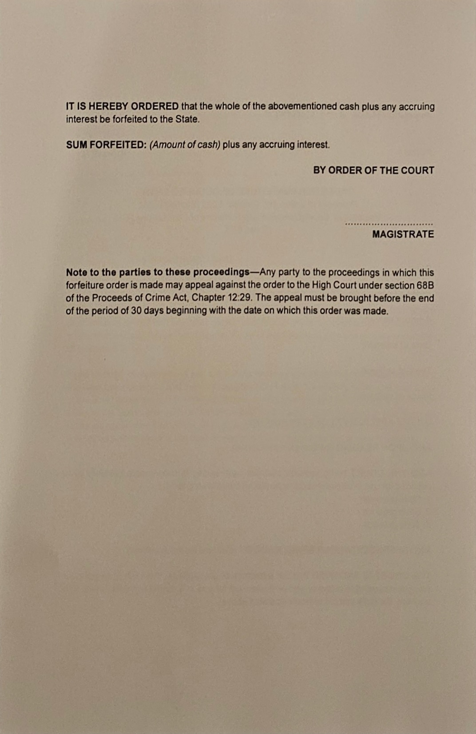

Slide 5
Production Order
1. An application is made at the High Court for a production order under Section 41(1)(b) of POCA (Chap 12:29) pertaining to documents relevant for identifying, locating, and quantifying the property of the accused, or documents necessary for the transfer of property of the aforementioned individuals.
2. Section 17 of the MLA.
3. An affidavit supporting the application, executed by the Financial Investigator, accompanied by eight exhibits, and a draft of the order.
4. The grounds for this application must be specified in the notice of application and the supporting affidavit.
5. The production order is submitted subsequent to the initiation of a forfeiture case in the magistrate court. This is done when there is a high likelihood that the accused will attempt to dispose of the assets.
6. The production order empowers the investigator to access information that is constitutionally protected, including the personal information of the accused, held by banking institutions and other financial entities.

Slide 6
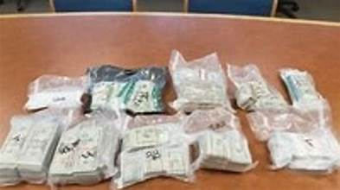
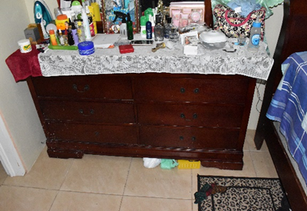
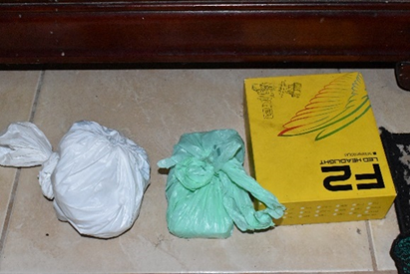
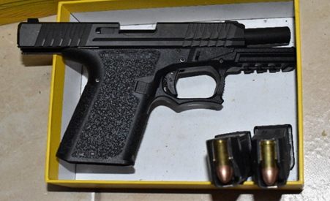
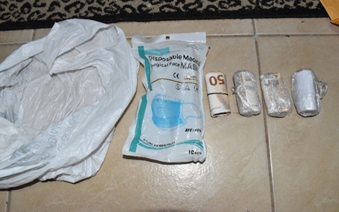
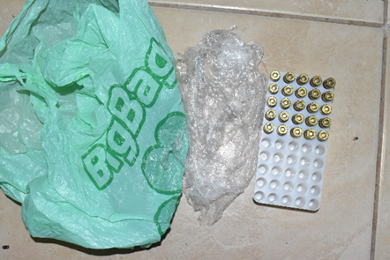
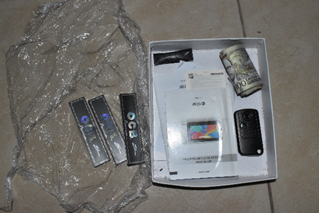
evidence

Slide 7
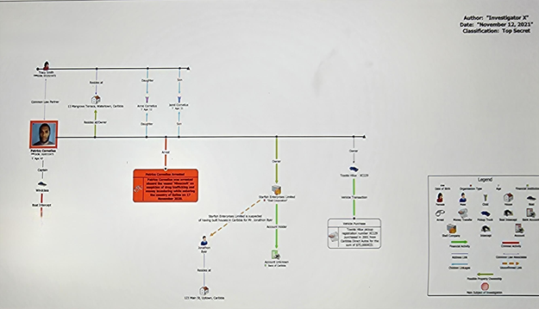
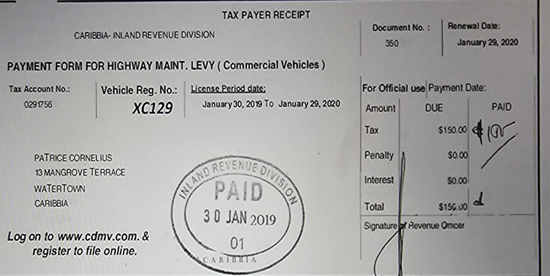
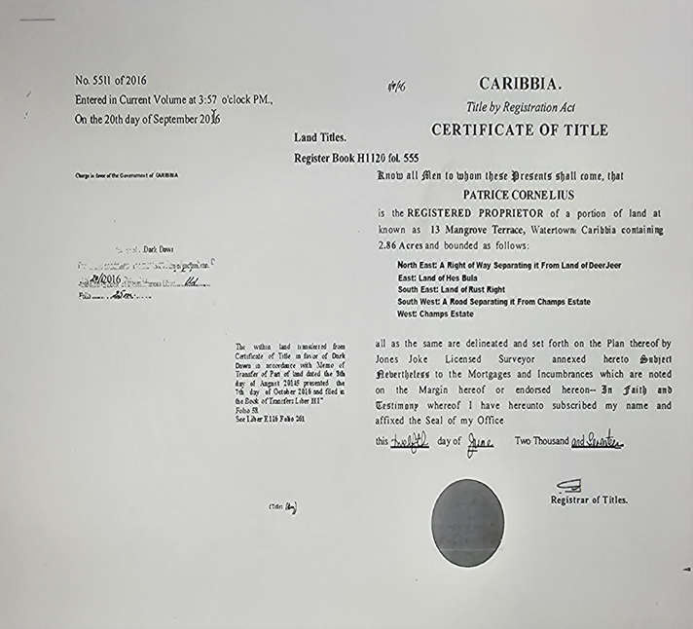

Slide 8
Case study – operation Runner
Intelligence received indicated that €4775.00 was obtained from illicit activity.
The cash was found concealed under a chest of drawers amongst one unlicensed firearm and fifty-one rounds of 9mm Ammunition.
Subject 1 at the scene, was questioned about the firearm, cash, and ammunition, under caution, and claimed the properties.
The cash was wrapped in a manner associated with drug dealers’ packaging of their cash while traveling via sea on “Go Fast” open keel vessels.
The quantity of cash found totaled €4775.00. This is not a currency predominantly used in Dominica since the Euro currency is not in common circulation or used for direct commerce.
A vacuum sealer machine was found at the apartment occupied by the subjects in a blue bag which also consisted of Marijuana residue.
Subject 1 is unemployed.
Subject 1 has no record of receipt of returns and employment history at the Inland Revenue Division
Subject 1 last Social Security contribution was in July 2009
Subject 2 has no record of receipt of returns at the Inland Revenue Division
The subjects have no monetary declarations declared at the Customs and Excise Division
The subjects do not receive cash consistently at the MSB or the Financial Institutions (MOBANKING, Wire Transfers) often enough to fund their livelihood.
Financial records indicated Subject 2 earns a salary of $1,100 xcd before deductions. Investigation revealed the rent (including utility payments but excluding electricity) paid by Subject 2 amounted to 700xcd. It is highly unlikely that Subject 2 salary alone can sustain the lifestyle of herself and her family. (Subject 1 and son).
The subjects have no registered company to explain a legitimate alternative source of income to support their lifestyle.

Slide 9
Challenges
1. Limited resources for investigating matters.
2. Restrictions and extended response times for Mutual Legal Assistance Treaty (MLAT) requests.
3. Unauthorized disclosure of information to the accused.
4. Delays within the legal system.
5. Accused individuals evading state authorities.

Slide 10
Thank you

