Slide 1
OECD LATIN AMERICA ACADEMY FOR TAX CRIME AND FINANCIAL INVESTIGATION
Managing Financial Investigations (Intermediate)
LAVADO DE ACTIVOS
Patricia Laburu
Uruguay
Octubre de 2023

Slide 2
What is Money Laundering?
It is the process through which assets of criminal origin are integrated into the economic system pretending to have been obtained in a licit manner.

Slide 3
It is a process of HIDING income from criminal activities to make it appear legitimate.
Hiding/dissimilar/hiding
Reverse process: investigation and identification

Slide 4

¿Porque es importante trabajar en una efectiva confiscación de los ACTIVOS?

Slide 5
- Criminals need to hide resources to ensure the permanence and continuity of the organizations.
- One of the main priorities for States is to combat the increase in organized crime by depriving them of "the proceeds of crime".

Slide 6

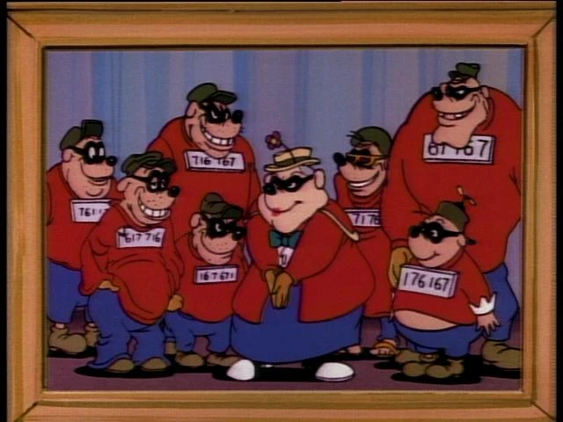


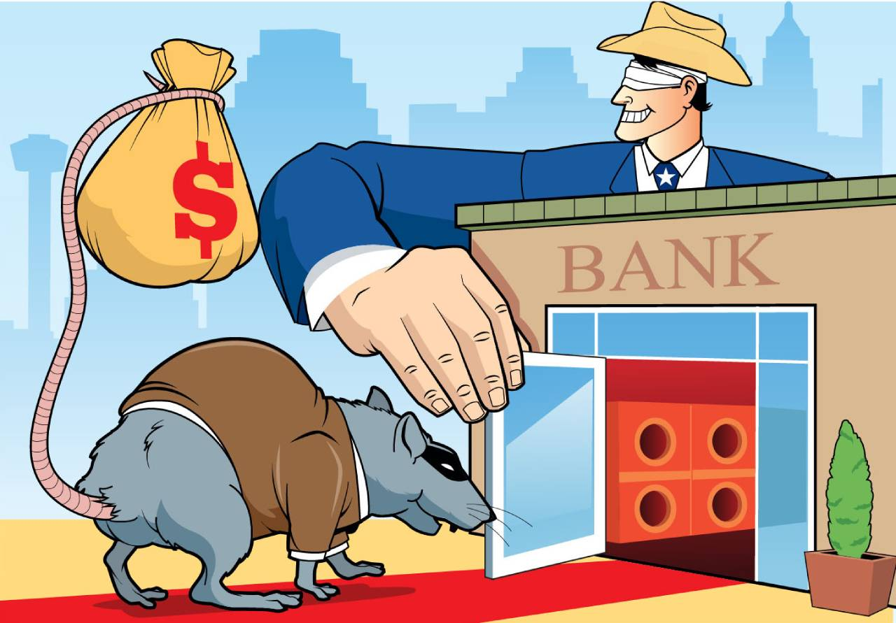
THE FIGHT AGAINST MONEY LAUNDERING
"Main Problems".

Slide 7





THE FIGHT AGAINST MONEY LAUNDERING
"Main Actions".

Slide 8
THE FIGHT AGAINST MONEY LAUNDERING
The States have:
1. Repressive or penal system: detection and enforcement.
2. Preventive or administrative system

Slide 9
THE FIGHT AGAINST MONEY LAUNDERING
Interaction of the three essential components of the system
Criminal Enforcement
Detection
Prevention

Slide 10
PREVENTION SYSTEM
What is it?
It is the system used to prevent the entry of goods and assets of criminal origin into the economic and financial system.
How does it work?
Imposing certain obligations on financial and non-financial entities so that they can detect and report "suspicious transactions", thus enabling the authorities to take action.
What are we looking for?
The correct application of these procedures leads to a reduction in money laundering and terrorist financing activity within these entities.

Slide 11
PREVENTION SYSTEM
EFFECTIVENESS OF THE PREVENTION SYSTEM
Financial institutions, Designated Non-Financial Businesses and Professions (DNFBPs) and Virtual Asset Service Providers (VASPs):
- understand the nature and level of money laundering risks.
- develop and implement AML/CFT policies, internal controls and programs to adequately mitigate those risks
- apply appropriate customer due diligence (CDD) measures
- detect and adequately report suspicious transactions; and comply with other AML/CFT requirements.

Slide 12
WHAT DOES THE PREVENTION SYSTEM REQUIRE?
WHAT SHOULD COUNTRIES ESTABLISH?

Slide 13
REPORTING ENTITIES
designate certain entities and activities in order to improve the prevention and detection of unusual or suspicious transactions in areas that may present ML/FT risks.
subjects that, due to the activities they carry out, are in a position to become partners of the State in the fight against these scourges.

Slide 14
REPORTING ENTITIES
are suitable for detecting and reporting those businesses suspected of maneuvering with assets of illicit origin, or which, being licit, are suspected of being destined to the financing of terrorism
designating obligated parties is vital to ensure that the reporting mechanism, and therefore the system for preventing money laundering and terrorist financing, functions satisfactorily

Slide 15
REPORTING ENTITIES
FINANCIAL
NON-FINANCIAL – DESIGNATED NON-FINANCIAL ACTIVITIES AND PROFESSIONS
VIRTUAL ASSET SERVICE PROVIDERS – VASP’s

Slide 16
OBLIGATIONS OF THE REPORTING ENTITIES
Main obligations:
Suspicious Transaction Report (STR)
Customer Due Diligence and Risk Analysis
Record Keeping

Slide 17
EFFECTIVENESS OF THE PREVENTIVE SYSTEM/PROPORTION OF THE STR
CHILE - 78 % FINANCIAL SYSTEM
- 15% CASINOS
- 7 % OTHER DNFBP
MEXICO - 99,55% FINANCIAL SYSTEM
- 0, 45 % DNFBP
PANAMA - 95% FINANCIAL SYSTEM
- 5 % DNFBP
PARAGUAY - 98 % FINANCIAL SYSTEM
- 2 % DNFBP
URUGUAY - 95,23 % FINANCIAL SYSTEM
- 4,77% DNFBP

Slide 18
EFFECTIVENESS OF THE PREVENTIVE SYSTEM/PROPORTION OF THE STR
GERMANY- 98% FINANCIAL SYSTEM
- 2% DNFBP
FRANCE- 94% FINANCIAL SYSTEM
- 6% DNFBP
UNITED KINGDOM- 96,54% FINANCIAL SYSTEM
- 3,45 % DNFBP
FINLAND - 68% FINANCIAL SYSTEM
- 31% CASINOS
- 0,3% DNFBP

Slide 19
EFFECTIVENESS OF THE PREVENTIVE SYSTEM/PROPORTION OF THE STR
CHINA -99,99 % FINANCIAL SYSTEM
- 0,01% DNFBP
U.S. -- 100% FINANCIAL SYSTEM
- DNFBPs only report transactions above a certain threshold.

Slide 20
BREAKOUT GROUP EXERCISE
HOW DOES THE PREVENTIVE SYSTEM WORK?
WHAT ARE THE MAIN MANDATORY ACTIVITIES?

Slide 21
FROM INTELLIGENCE TO EVIDENCE
HOW TO TURN FINANCIAL INTELLIGENCE INTO PROOF?

Slide 22
FINANCIAL INTELLIGENCE CYCLE
Reporting Entities-
Detection
FIU - Analysis
Prosecutor's Office/Judge - Investigation
Financial intelligence process
Transforms data into useful information
Seeks to confirm whether elements of unusualness or suspicion are present
Financial and non-financial data
Financial intelligence report
Decision
(Judiciary)
Other sources of information
Financial and non-financial data

Slide 23
FINANCIAL INTELLIGENCE CONTENTS
Tax Information - Taxpayer Information
Tax returns
Informative declarations (payments, cash transactions, customers and suppliers, wages and salaries, bank accounts, etc.).
Customs information
Cross-border transportation of cash and valuables statements.
Foreign trade operations (information on import and export operations, persons or companies with whom it operates abroad, type of goods, amounts traded, etc.).

Slide 24
FINANCIAL INTELLIGENCE CONTENTS
Asset Information
Real Estate
Personal property
Financial information (accounts, investments)
Business and Corporate Information
Public Registry of Commerce Information
Beneficial Ownership Registry Information

Slide 25
FINANCIAL INTELLIGENCE CONTENTS
Migratory Information
Record of entries and exits to and from the country, as well as their origin and destination (entry route, frequency of travel).
Passport information
Police and Judicial Information
Criminal Records
Investigation reports
Police proceedings
Convictions

Slide 26
FINANCIAL INTELLIGENCE CONTENTS
Information from Supervisory Bodies
Supervisory reports, sanctions
Other Sources of Information
Social Security, Electoral Registry, Public Officials, Telecommunications and Internet, Air and maritime transportation, Driver's licenses.

Slide 27
FINANCIAL INTELLIGENCE CONTENTS
Sharing of information:
With foreign FIUs through: -EGMONT Group
- Memorandum of Understanding
- Information sharing agreements
- Asset Recovery Networks (e.g. RRAG - Gafilat)
Other sources of information:
- Private providers (e.g. World Check, World compliance, Lexis Nexis, etc.)
- Open sources (specialized search engines, press, social networks, web sites, chambers of commerce, etc.)
- Others: Central Bank information, credit information, etc.)
- UN, OFAC, DEA, FBI, etc. lists.

Slide 28
The financial intelligence report
Result of the analysis
How should it be presented?
Logical sequence of the facts
Simple but formal language
Standardized figures
Avoid use of acronyms
Avoid superlative adjectives

Slide 29
The financial intelligence report
Result of the analysis
How should it be presented?
EXECUTIVE SUMMARY: Brief description of the analysis, identifying the main elements, financial/non-financial behaviors and amounts transacted.
RELATIONSHIP DIAGRAM
ANALYSIS: Detailed description of the case including the comparative analysis of the financial information compared with information from other databases. Documentary analysis and support.
ANNEXES: Information and documentation supporting the analysis of the persons involved.

Slide 30
The financial intelligence report
FIU - Complainant - Inconveniences and Challenges

Slide 31
Use Of Intelligence Information
KEY POINTS
• The independence and autonomy of the FIU in the coordination and sharing of information between the FIU and investigative authorities.
- The use of financial intelligence reports in criminal proceedings.
- The use of financial intelligence as evidence
- Coordination between FIUs and investigative law enforcement authorities in national and international cooperation and in asset recovery and confiscation.
Documento Gafilat “INTELIGENCIA FINANCIERA: RETOS, EXPERIENCIAS Y LECCIONES APRENDIDAS” en:
https://www.gafilat.org/index.php/es/biblioteca-virtual/gafilat/documentos-de-interes-17/otros-17/2921-informe-uso-inteligencia-financiera-giz-gafilat/file

Slide 32
Use Of Intelligence Information In The Investigation
Engage the prosecutor/judge at an early stage to determine which pieces of intelligence are useful.
Direct the investigation so that intelligence is supplemented or substituted by admissible evidence (e.g. court-ordered account statements or communications records, tax/financial information after lifting of secrecy, asset registry information, etc.).
Use administrative powers to freeze or seize assets on the basis of intelligence (if enabled by law).
The FIU can always provide additional financial intelligence upon request or by integrating Muldisciplinary Teams.

Slide 33
Investigation Planning
Prosecutor/Judge
Plan, lead and control the investigation in an effective and efficient manner.
Search for and obtain evidence useful to the investigation.
Legality of the evidence.
Gathering indications and collecting evidence to support the prosecution and, consequently, the compensation of the damage.
Speed and economy.
Use of resources in an optimized manner.

Slide 34
ASSET INVESTIGATION
CASE THEORY
INVESTIGATION GOALS
IDENTIFICATION OF THE ASSETS
HISTORICAL ASSETS EVOLUTION
SOCIO-FINANCIAL GROUP PATRIMONIAL REPORT

Slide 35
MULTIDISCIPLINARY TEAMS
Members
Roles
Coordination
Final report

Slide 36
Multidisciplinary Teams
Required for large or complex financial investigations.
Collaboration/information requests and performance/advice requests
Strategic approach to cooperation of each body/agency
May consist of:
Specialized financial investigators - FIU
Financial analysis experts
Expert Accountants/IT experts
Tax/Customs/Registrar/Registrar/LA experts

Slide 37
Relevance of the establishment of Multidisciplinary Teams
In the investigations that:
- The economic-financial order is presumed to be affected due to the amount of assets involved in the alleged criminal maneuver.
- with a great complexity in economic-financial matters.
- in which there are indications of the transnational scope of the operation.
- where there is indication of a criminal organization.

Slide 38
Relevance of the establishment of Multidisciplinary Teams
Each Body/Agency will share such useful and relevant information as it may be able to, to the other members for the purposes of research and analysis.
Each Body/Agency is responsible for selecting and analyzing the information it is to provide.
The Financial Intelligence Reports will expressly include suggestions on how to proceed to acquire or reconstruct the evidence in the process (what to ask, how to ask and who to ask).

Slide 39
Guidelines for requests for collaboration (information) and/or performance (advice)
Indicate:
the facts under investigation
persons under investigation: natural and/or legal persons involved in the facts under investigation.
information to be requested
applicable legal provisions: indicate possible illicit acts, money laundering, predicate offenses, etc.

Slide 40
Instances of interaction between the Team and the Prosecutor/Judge
Create spaces for exchange
Reducing response times
Focus on information that is truly relevant to the purpose of the investigation.
Intermediate deadlines for reports on certain topics

Slide 41
Lifting of secrecy
Any request for collaboration (request for information) and/or action (request for advice) requested to bodies/agencies under secrecy/reservation must be accompanied by the release of the secrecy by the Judge.

Slide 42
Instrumentation and filing in court
Protection for interagency team members
Statement by the authors of the report under appropriate security conditions.
Analysts' witnesses' testimonies

Slide 43
Instrumentation and filing in court
Evidence at trial - challenges
How to include intelligence? FIU Sources
Assistant to Justice
Expert report
Testimonial and/or documentary evidence
Interrogations - Role of the defense

Slide 44
CHALLENGES OF EVIDENCE IN MONEY LAUNDERING TRIALS
CIRCUMSTANTIAL EVIDENCE
DYNAMIC EVIDENTIARY BURDENS

Slide 45
CONVICTION
CONFISCATION - FORFEITURE

Slide 46
Forfeiture
Confiscation
Extinction of dominion

Slide 47
"... The deprivation on a definitive basis of any property, proceeds or instrumentality by decision of a Court or other competent authority."

Slide 48
Confiscation Process
Investigation Phase: Training - Appropriate Tool- Resources
Provisional Measures: Powers to freeze or seize temporarily
Disposal Phase: Mechanisms to manage or dispose of the assets.

Slide 49
Confiscation
Assets of the predicate offense
"Laundered" assets
Other assets
Proceeds/instrumentalities of crime

Slide 50
Provisional measures
What to do with the assets?
How to manage them?

Slide 51
Examples
Building
Automobile
Crop
Livestock
Company

Slide 52
Effective system
Confiscate criminals' money and assets
Confiscate instruments of crime
Manage them
Sharing or returning them

Slide 53
CONCLUSION
DEPRIVING CRIMINALS OF THEIR ILLICIT PROCEEDS

Slide 54
BREACK GROUP EXERCISE
HOW TO DEAL WITH THE CHALLENGES OF MONEY LAUNDERING INVESTIGATIONS?

Slide 55
LA/FTE combat system
Graphic scheme of operation
PREVENTION &
DETECTION
Analysis
Finantial Intelligence Unit
INVESTIGATION AND
PROSECUTION
OF CRIME
Database
JUDICIARY
Reporting Entities
Informe de Inteligencia Financiera
PROSECUTOR
Customs– Cash transportation
STR
Finantial Sectos
Public Bodies
MULTIDISCIPLINARY TEAMS
Non – Finantial S
FIU from abroad
RST
Public information sources
SENTENCIA/
DECOMISO

Slide 56
THANK YOU
plaburu@presidencia.gub.uy

