Slide 1
Salaries via Cryptocurrency – A Case in Malta
Kurt Callus
Intelligence Analyst, FIAU Malta
OECD International Academy for Tax and Financial Crime Investigation
kurt.callus@fiaumalta.org

Slide 2
Information (SAR) from Whistle-blower
Company X is paying wages in Cryptocurrency.
Manager earns USD 3,000 + USDT 2,000.
Employees earn USD 2,000 + USDT 1,000.
Both manager and 16 employees involved in this payment scheme are from the same nationality.

Slide 3
Intelligence from FIU A (1)
Provided information on 4 employees:
  Full name
  Date of Birth
  Maltese Residency Card number
  IBAN funding the Binance.com wallet
  Email address
  Report on the 4 employees

Slide 4
Intelligence from FIU A (2)

Slide 5
Summary of 4 Binance.com Reports
Employees
Source Addresses

Slide 6
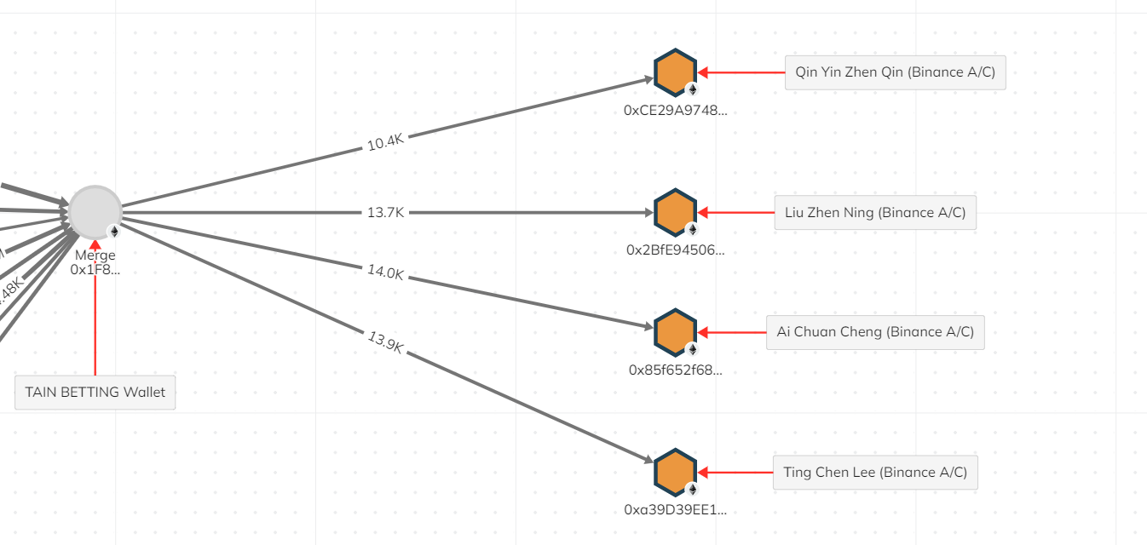
Chainalysis

Slide 7
Merged Cluster Transfers

Slide 8



Additional Potential Employee Addresses
27 additional Binance.com addresses.
1 additional Bybit.com address.
9 additional MaiCoin.com addresses.

Slide 9
What does the FIAU want to achieve?
Determine the taxes evaded through this payment scheme.
Discover the Source of Funds of the merged cluster.

Slide 10
Thank you for your attention!

