Slide 1
Obtaining information from oveseas
Marek Kaplita, FIU Poland
10.7.2024, Conducting Financial Investigations
(Foundation Programme) - online

Slide 2
FIU to FIU exchange of information
framework
Administrative FIUs analyse financial intelligence data and do not conduct investigations. They ground, not verify suspicions of ML/TF.
FIUs obtain foreign information through other FIUs.
Information shared cannot be used as evidence in court proceedings, but FIU’s request can be followed by MLA request.
Usually FIUs exchange information through dedicated safe Internet connections: Egmont Secure Web (worldwide) and FIU.net (European Union)

Slide 3
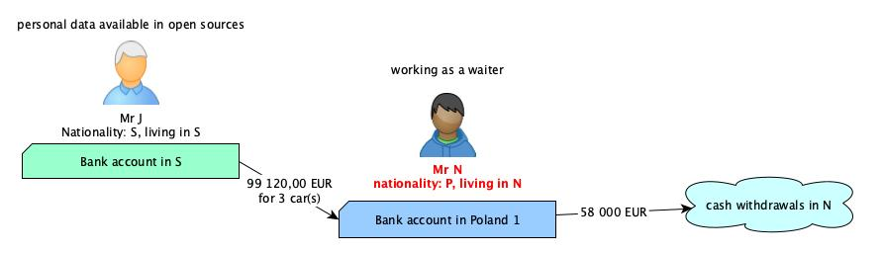

Slide 4
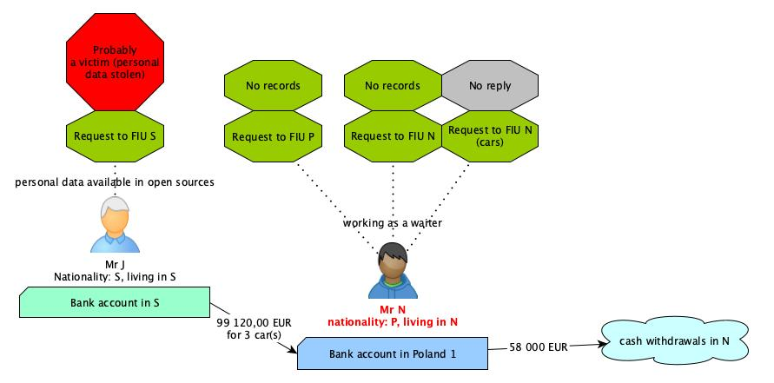

Slide 5
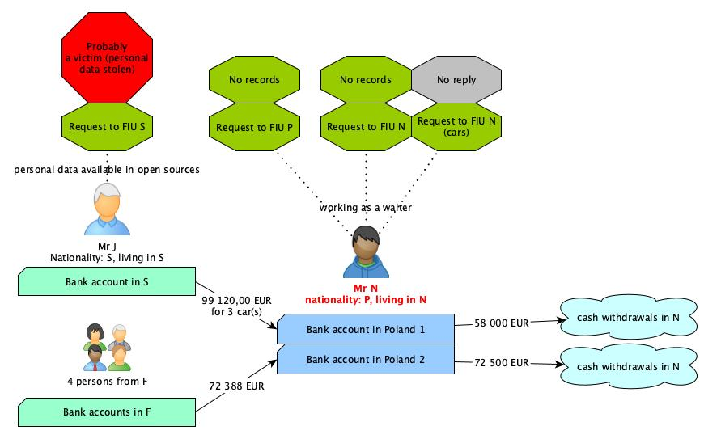

Slide 6
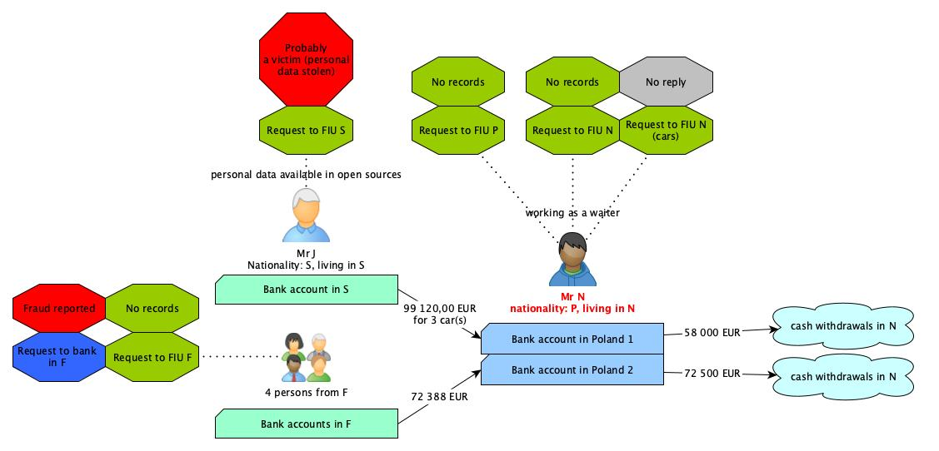

Slide 7
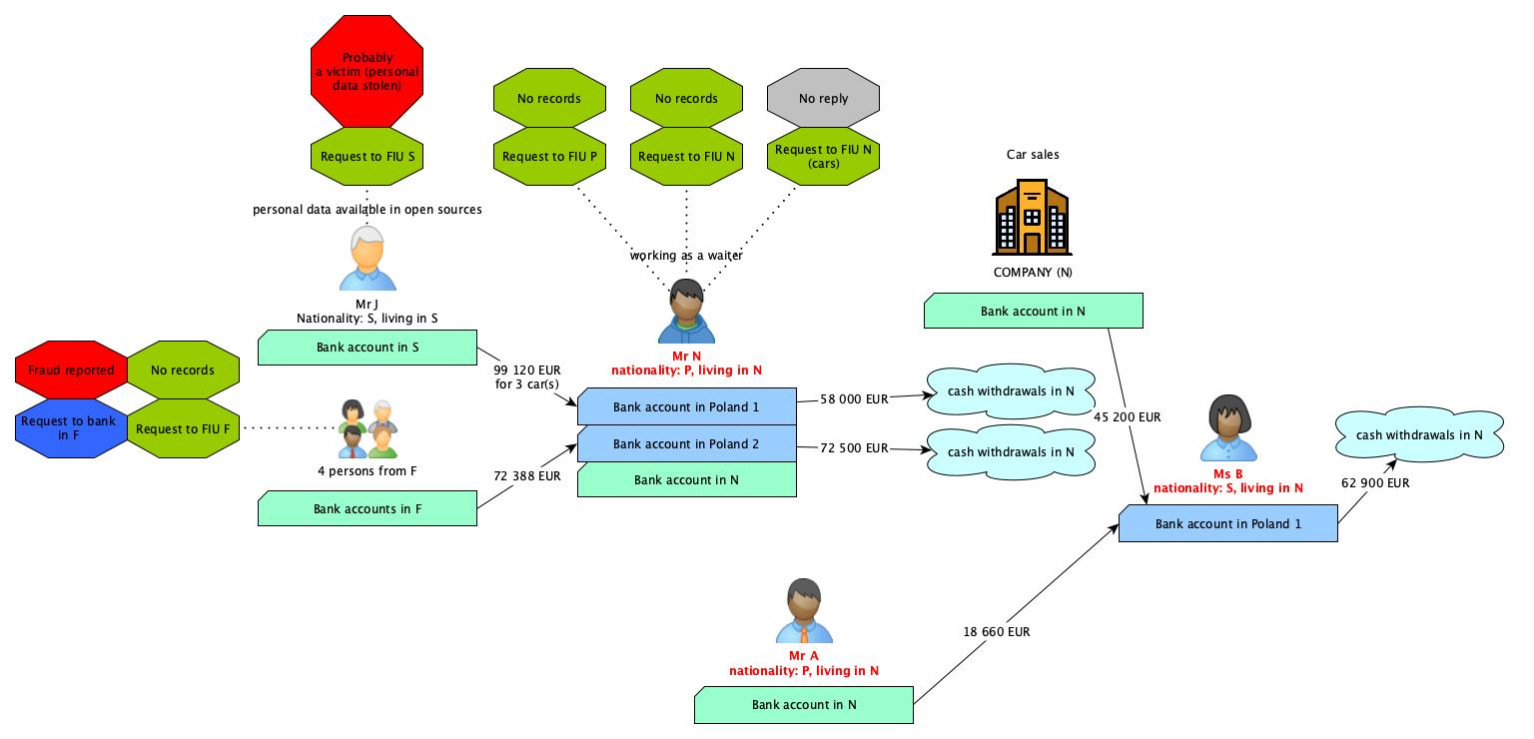

Slide 8
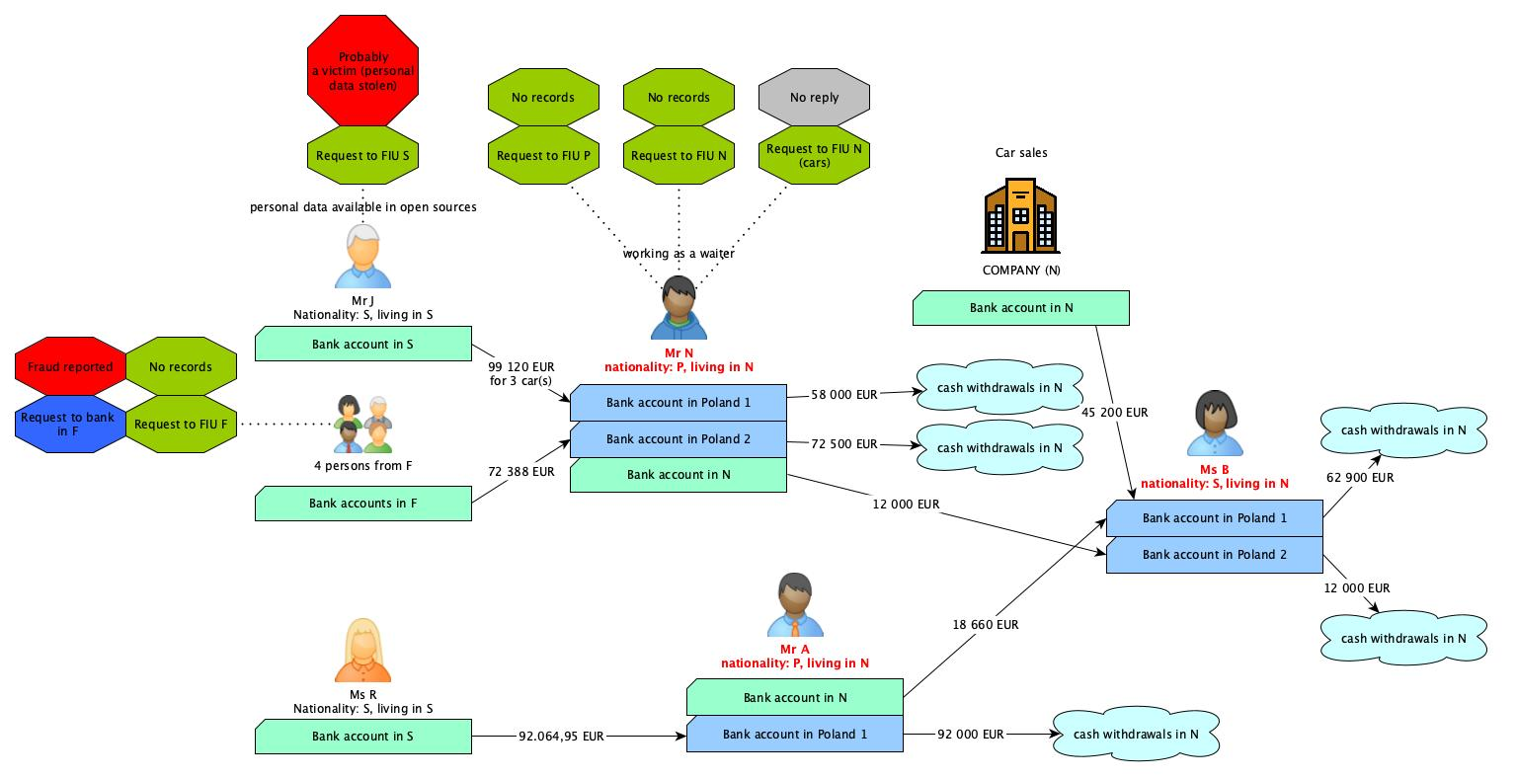

Slide 9
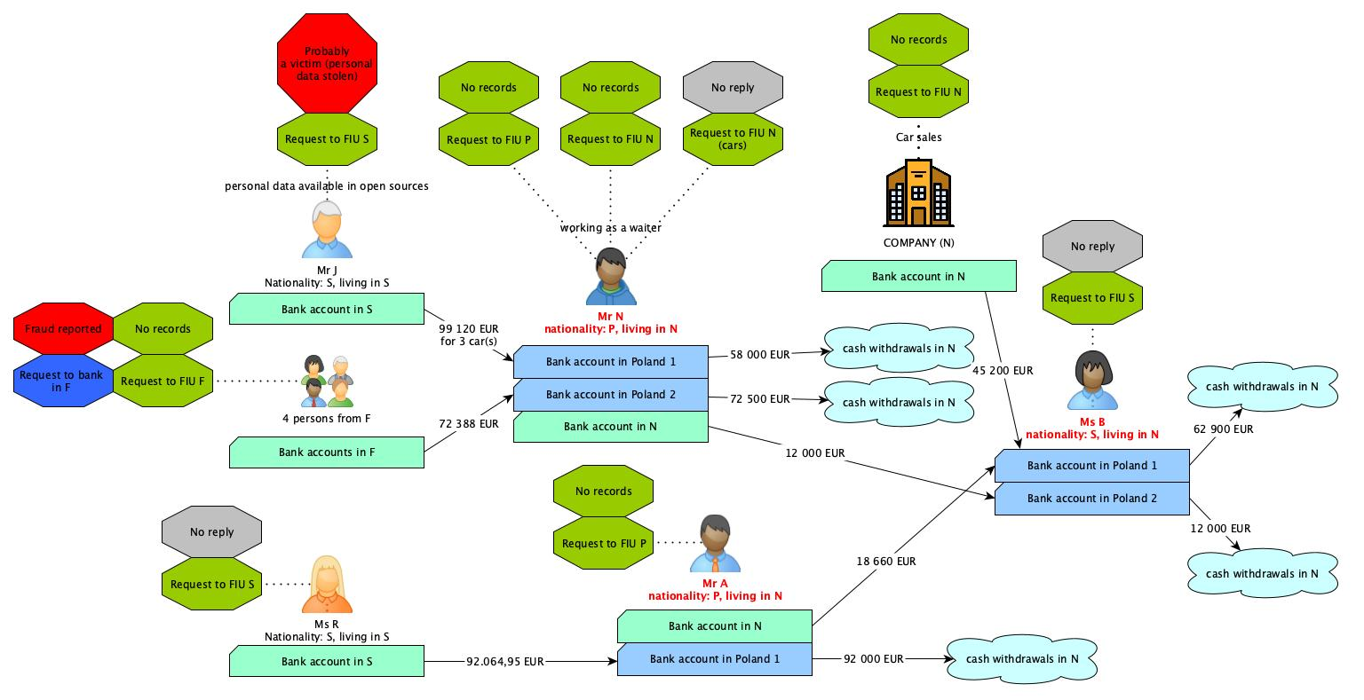

Slide 10
Conclusions
Information from foreign sources are often crucial. Response time is decisive for successful freezing of assets.
Good practices:
  documents translated into widely-known language,
  editable versions of documents,
  giving consent to disseminate the information without beeing asked for,
  asking obliged entities for obtaining information from their foreign partners.
Wanted future developments:
  structured electronic forms,
  joint analysis teams – to analyse crossborder cases,
  FIUs’ wider access to important domestic databases,
  open and transnationally interconnected databases (corporate registries, bank account registries etc.).

Slide 11
Thank you for your attention

