Slide 1


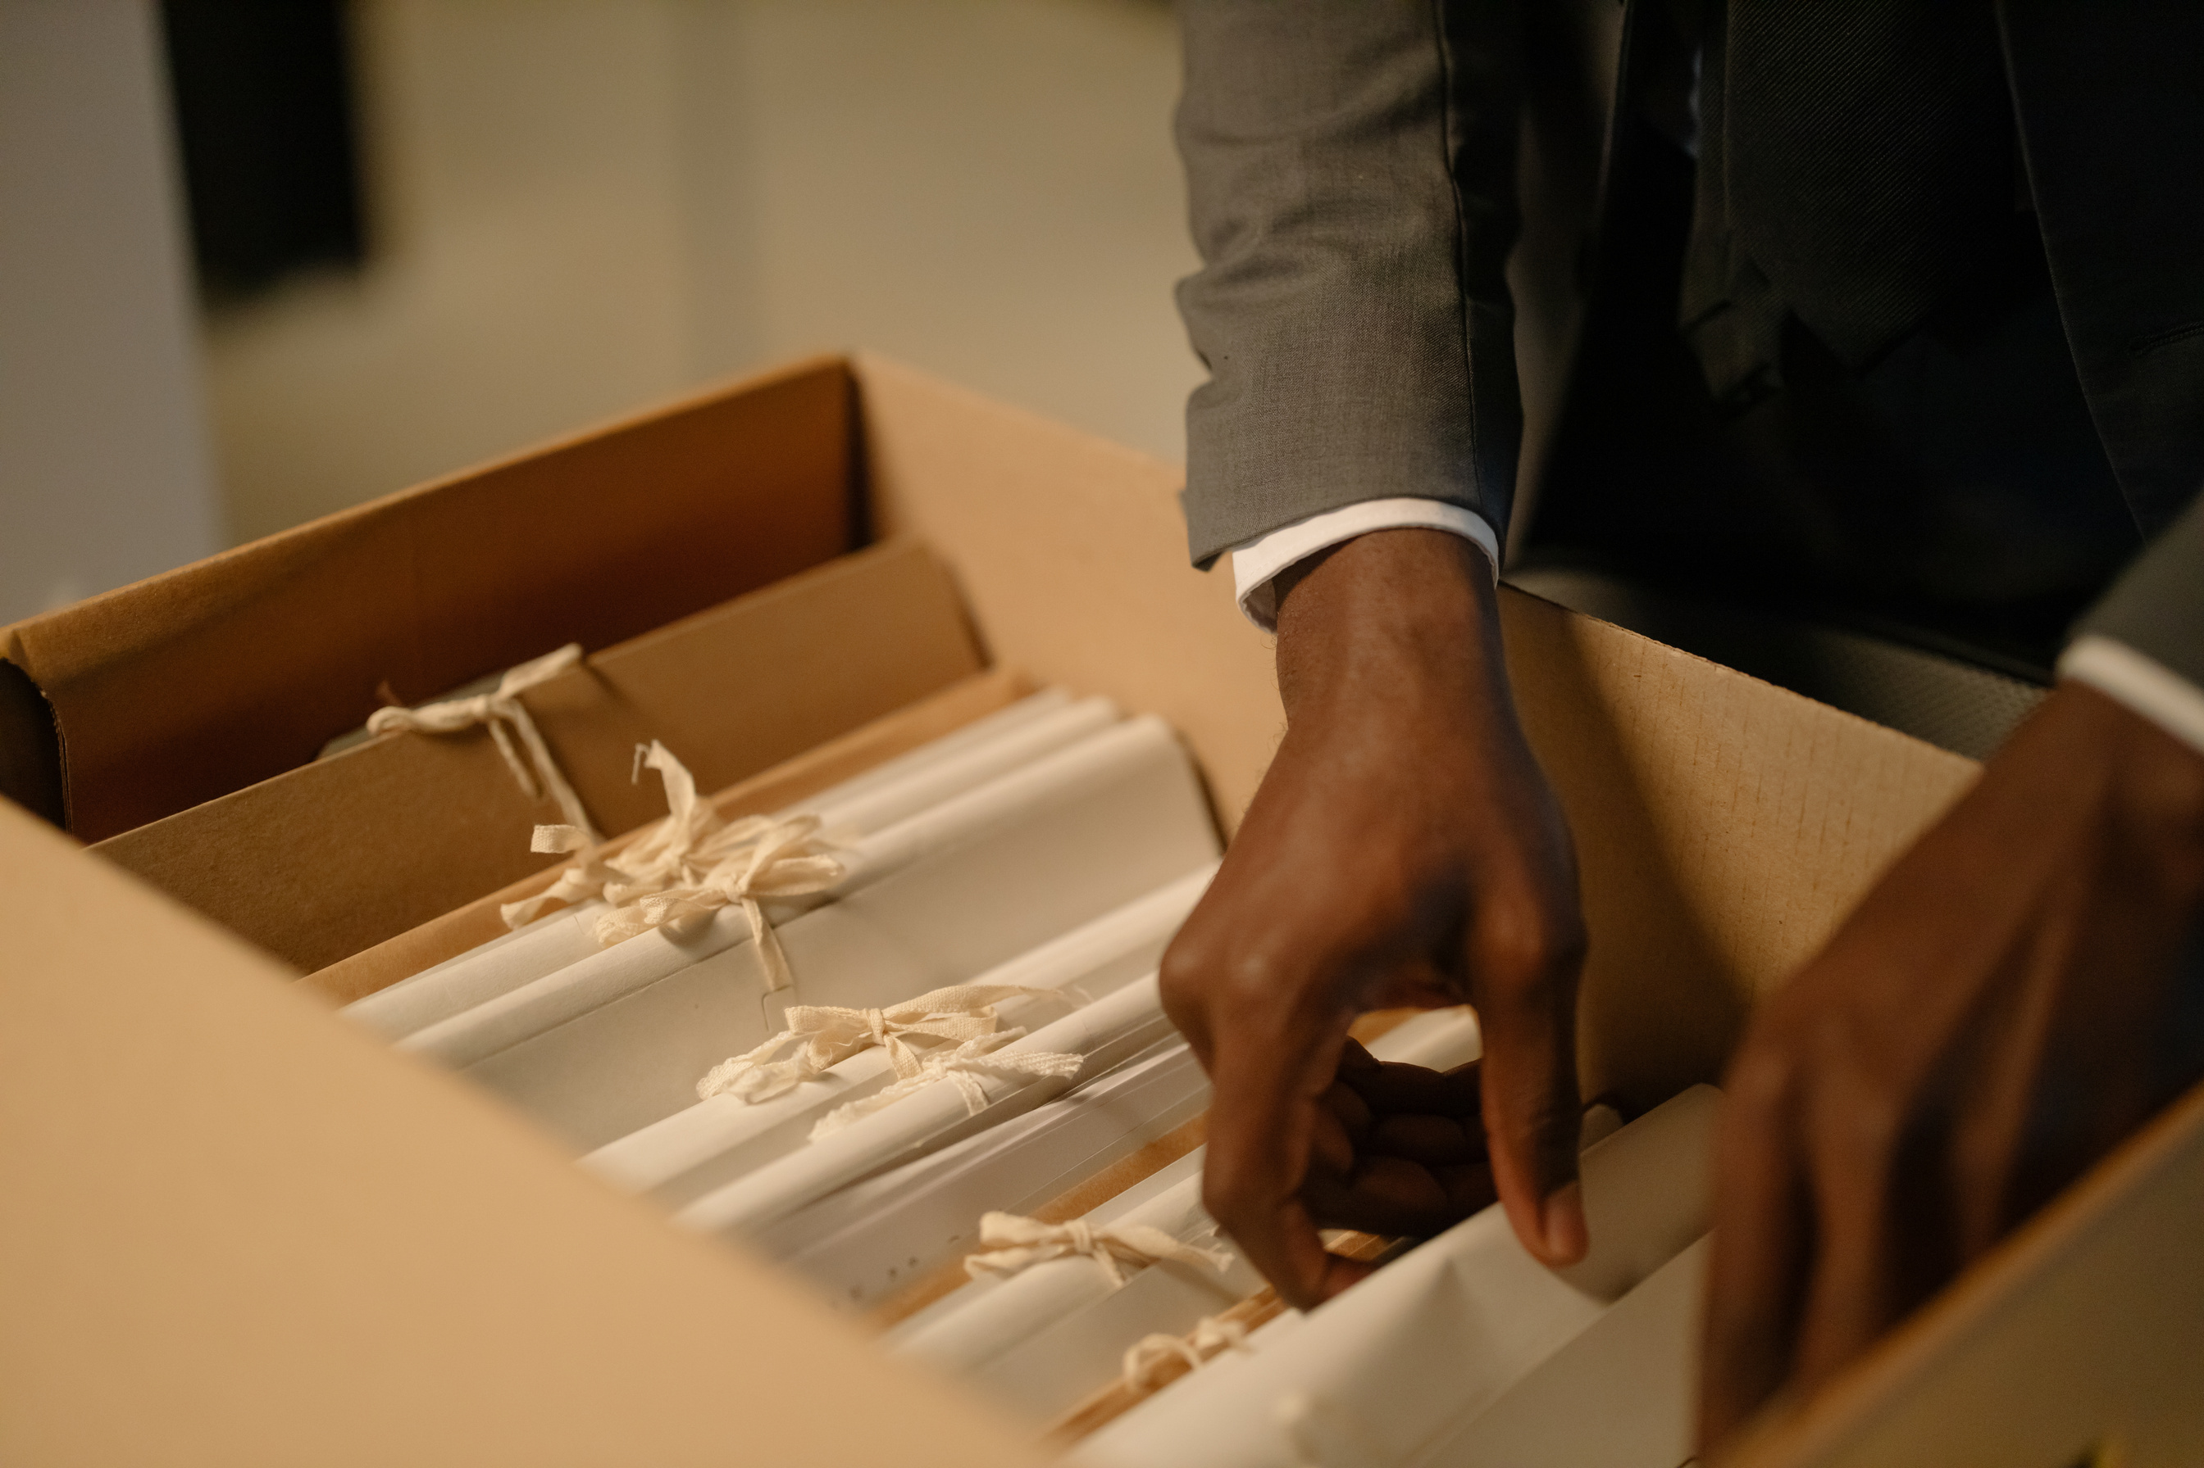
From a judicial perspective, what are the primary challenges in obtaining evidence from overseas ?

Slide 2
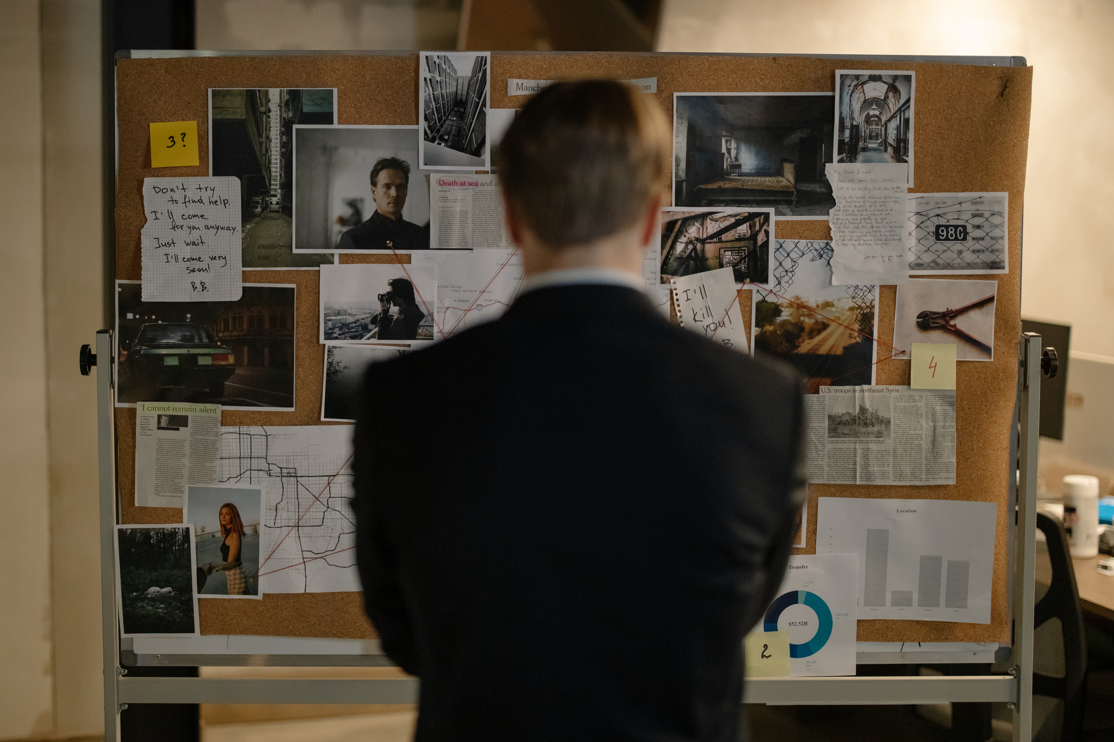

MISSIONS OF INVESTIGATING MAGISTRATE
  The investigating magistrate is typically responsible for handling complex cases
  These cases often involve suspects who are fugitives, unidentified individuals, or organized transnational crimes.
  The investigating magistrate is tasked with finding and gathering evidence, as well as determining both charges and dismissals..

Slide 3


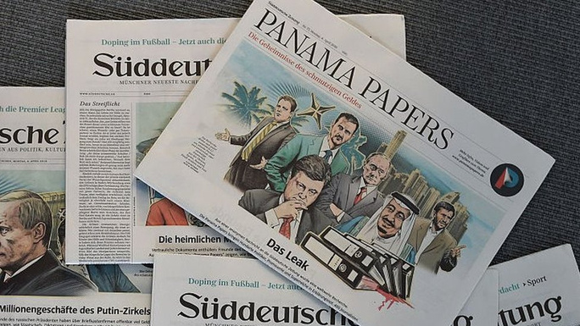
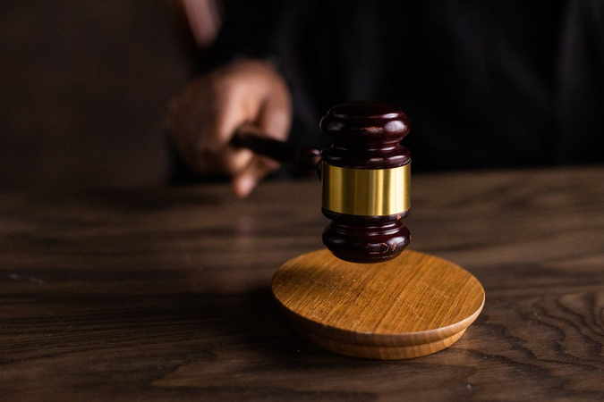
CHALLENGES AND RISKS
When dealing with organized transnational crimes (OTC), the investigating magistrate must collect substantial and legally admissible evidence.
The risk is analogous to the Panama Papers case.
Despite significant public attention, 28 defendants were acquitted due to issues with the traceability of evidence, which prevented establishing its authenticity and integrity with certainty.

Slide 4



FIRST CHALLENGE
PROBLEMS WITH THE FORMAL MUTUAL LEGAL ASSISTANCE REQUEST OR MLA PROCESSES
Mutual Legal Assistance (MLA) is the most formal method for obtaining admissible evidence from foreign jurisdictions.
The magistrate and the Competent National Authorities (CNA) must utilize the MLA Request Writer Tool developed by UNODOC.

Slide 5



LIMITS AND CHALLENGES
ABOUT MLA
Magistrates often express concerns that the MLA processes are excessively time-consuming.
However, ensuring a fair trial requires closing the case within the legal deadlines.

Slide 6


LIMIT OF INTERNATIONAL
ROGATORY LETTER
An international rogatory letter necessitates obtaining evidence from witnesses and third parties, as well as the examination or arrest of the individual who committed the crime.
However, once issued, the letter of request may encounter additional obstacles such as evolving confidentiality laws, including banking secrecy, confidential medical information, state secrets, as well as the immunity and diplomatic privileges of the individuals involved.

Slide 7
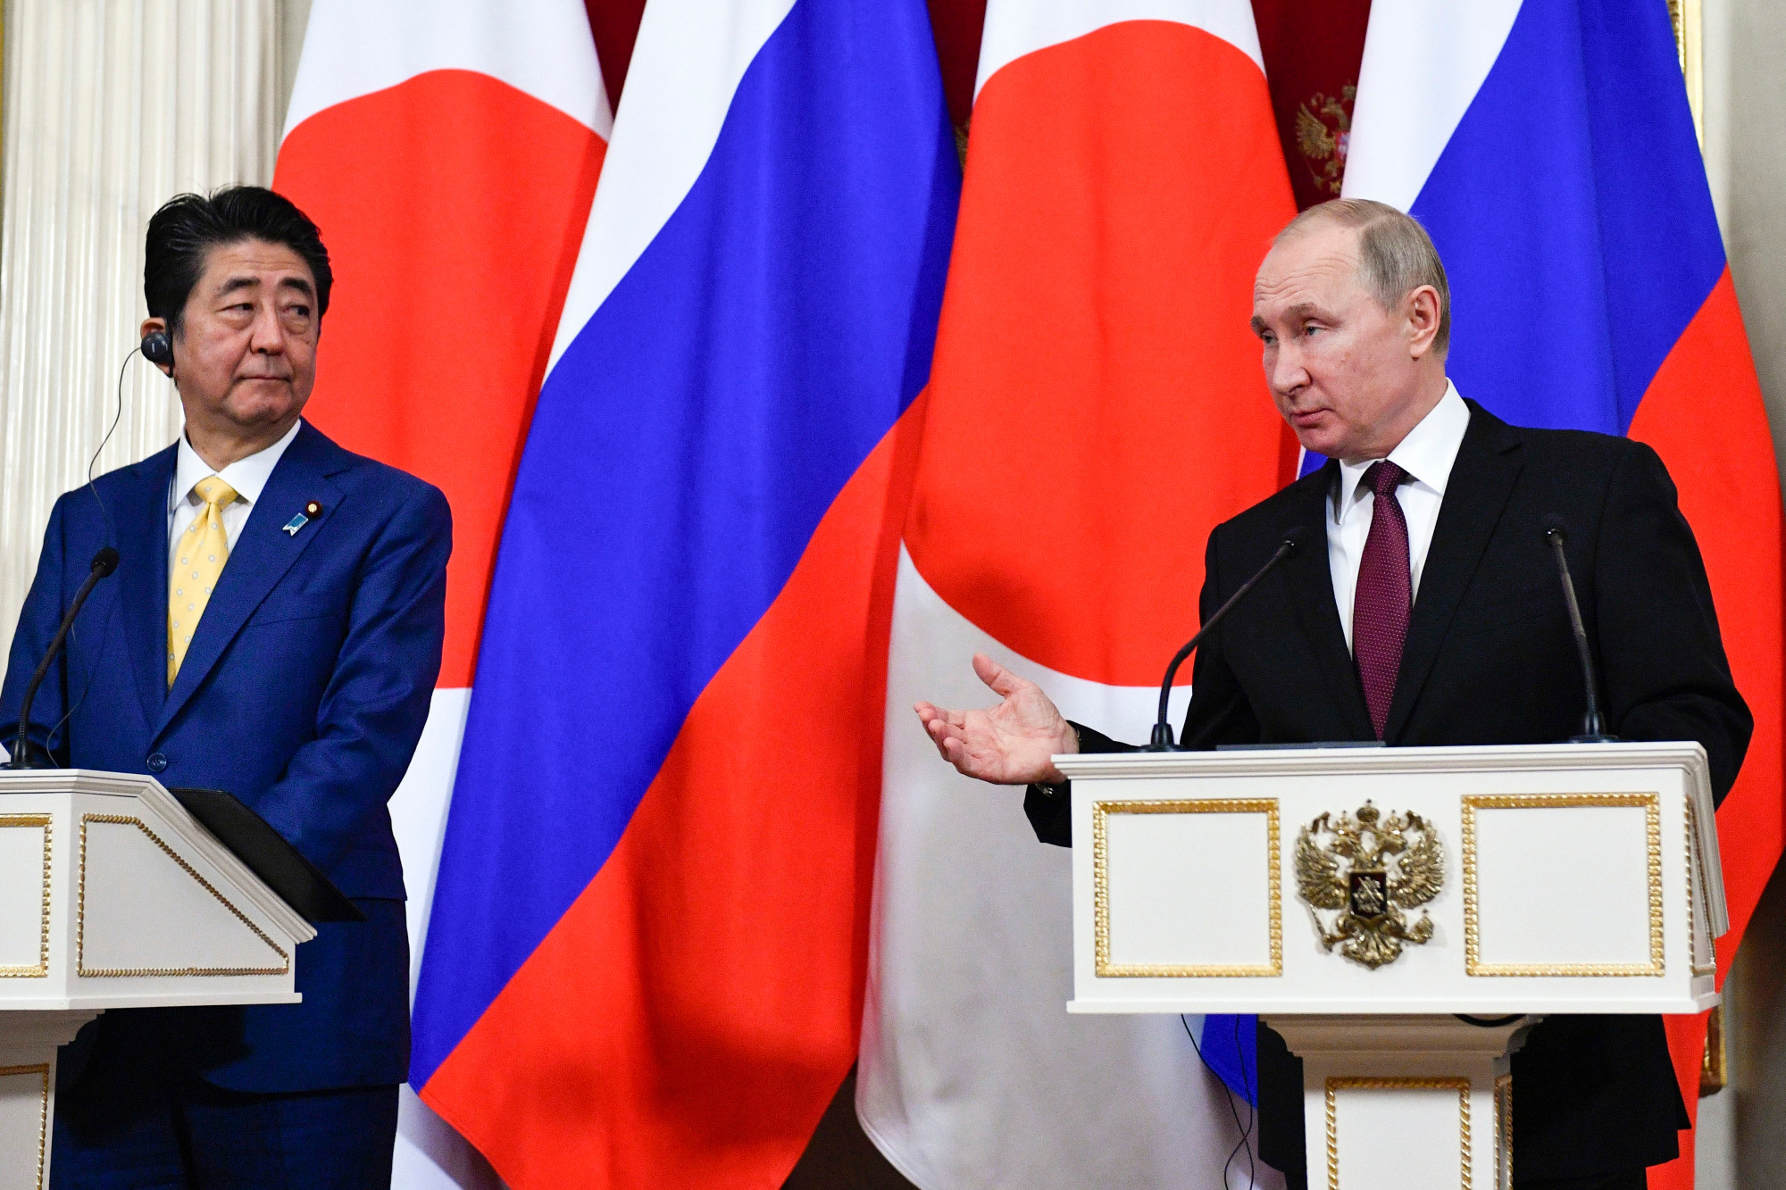
OTHER CHALLENGE
There are also challenges with non-cooperative states that have not signed any bilateral or multilateral treaties with the requesting state, resulting in a lack of response to the letter of request.

Slide 8

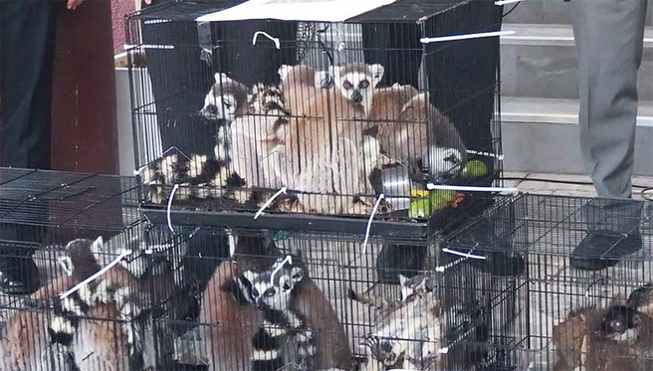
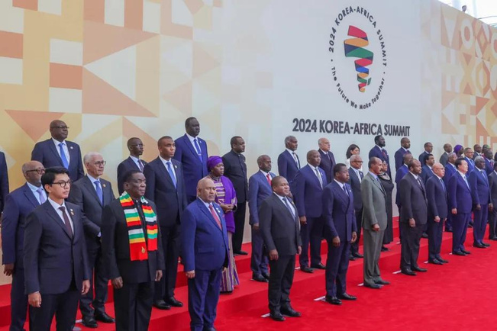
OTHER BARRIERS
Language barriers are a significant concern. The investigating magistrate must specify requests using judicial English or other languages such as Chinese or Arabic.
Current ongoing trafficking case: 48 lemurs and 1076 radiated turtles from Madagascar entered Thailand in May 2024. An MLA request has been sent, but no response has been received yet.
However, during the 2024 Korea-Africa Summit, the Malagasy Ministry of Environment personally visited Thailand to foster cooperation, highlighting a promising diplomatic channel.

Slide 9



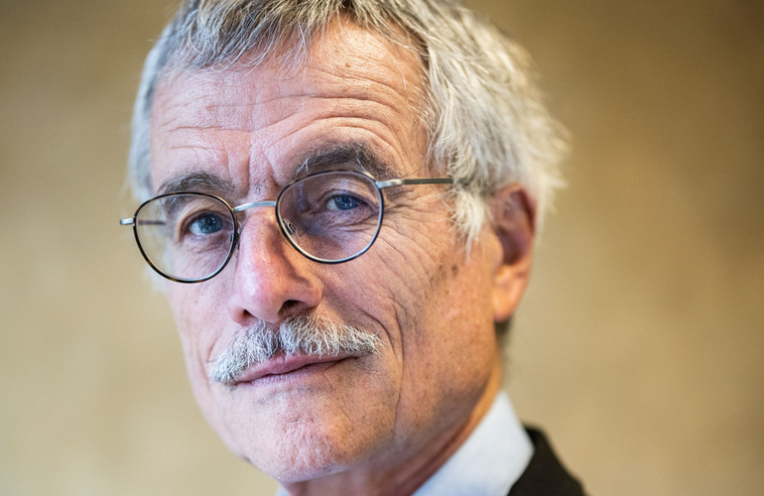
Use of non formal
evidences encouraged
Certain organizations can aid and support the magistrate in their mission, such as INTERPOL, alert Launcher, and investigative journalists. These entities contribute to gathering extensive evidence, which must be corroborated with formal evidence or confessions.
In the case of Sir Jérôme Cahuzac, a French scandal exposed by Mediapart regarding tax fraud laundering, audio recordings were examined by Judge Renaud van Ruymbeke. Initially denying the accusations and accusing Mediapart of falsehoods, the defendant ultimately confessed to owning a Swiss account transferred to Singapore, holding €600,000.

Slide 10

THANKS FOR WATCHING !

