Slide 1
Investigative Techniques OECD 2024
Investigative Techniques
Ralf Oberle

Slide 2
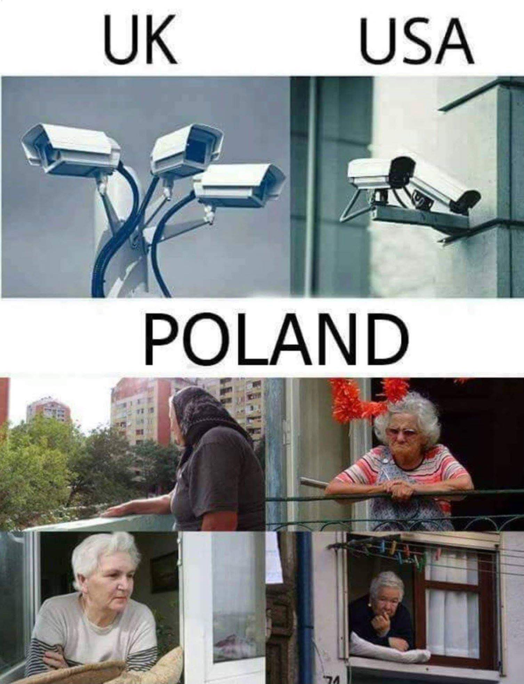
Investigative Techniques
Kinds of investigative techniques?
…….?
…….?
…….?
…….?
…….?
…….?

Slide 3
Investigative Techniques
Definition:
measure/action/handling to gather information / evidence
measure/action/handling to avoid that investigation is endangered
measure/action/handling to recover assets

Slide 4
Investigative Techniques
Kinds of investigative techniques?
…….?
…….?
…….?
…….?
…….?
…….?

Slide 5
Investigative Techniques
Group discussion:
What kind of investigative techniques, to gather information that are essential to investigations, do you know?

Slide 6
Investigative Techniques
Techniques used covered or open!
Important facts to think about in advance!
- When / in which way we use techniques!
- Why we don`t use a single technique?
- Who to inform about the use?
- Who has to approve it?

Slide 7
Investigative Techniques
  General to keep in mind before!
  Time
  Costs
  Human resources
  Material needed
  Location
  Support necessary
  Prediction of success – versa facts above

Slide 8
Example for a Investigative Techniques structure:
Audit – to get knowledge about the business
Surveillance, observation after getting notice of real business
Information exchange national/internat.
Inter-agency co-operation police / customs / industry or business areas
Special techniques - traditional

Slide 9
Investigative Techniques
Practical Exercise in Groups 20 min:
  Arrests - Group 1
  Searches - Group 2
  Wiretapping – Group 3
  Surveillance Group 4
  focus on aspects as
  pro s and con s
  Expected benefits
  Expected challenges
  Resources
  Requirements legal or practical
  ………..

Slide 10
Investigative Techniques
  Techniques highlighted!
  think about in advance, who, when, how, adv. – disadvantages
  Arrests
  Searches
  Wiretapping,
  Surveillance,
  Digital techniques?????

Slide 11
Digital Investigative Techniques
Ralf Oberle

Slide 12
What kind of digital data sets are you faced with in your investigation?
Group discussion
Ralf Oberle

Slide 13
Digital Data Sets
Book keeping data
Electronic cash register data
Electronic invoices
Inventory
Banking data
IP addresses
GPS data
etc
Ralf Oberle

Slide 14
Investigative Techniques
Practical Exercise in Groups:
What kind of digital investigative techniques do you know or/and use within your investigations (20 min) ?
Highlight what kind of you use, its benefits, linked problems and all other related aspects!

Slide 15
Digital Techniques:
Margin comparison
Gains comparison
Business figures at all
Cost structures compared – eg employees visa turnover
Special different business database- crosschecks of databases

Slide 16
Other / New Digital Techniques:
Visualization of business figures
Technical check tools / for failure detection out of high volume data bases – Monetary Unit Sampling
Summarised Risk Audit (SRP) based on the principle of a
„Time Series Analyses“

Slide 17
Examples for Other / New Techniques :
Definition MUS – Monetary Unit Sampling:
MUS
Monetary Unit Sampling, also known as probability proportional-to-size (PPS) or dollar unit sampling (DUS), is a statistical sampling method used to determine if the account balances or monetary amounts in a population contain any misstatements. Each individual dollar (i.e. monetary unit) in the population is considered a sampling unit, thus account balances or amounts in the population with a higher value have a proportionately higher chance of being selected.

Slide 18
Examples for Other / New Techniques:
Definition SRP Summarized Risk Audit
SRP = Time Series Analysis
Any metric that is measured over regular time intervals forms a time series. Analysis of time series is commercially importance because of industrial need and relevance especially w.r.t forecasting (demand, sales, supply etc).

Slide 19
Examples for Other / New Techniques:
SRP Summarized Risk Audit
Case example
Hotel with restaurant
Outside area
Christmas celebrations
New year celebrations
Additional participation on different markets

Slide 20
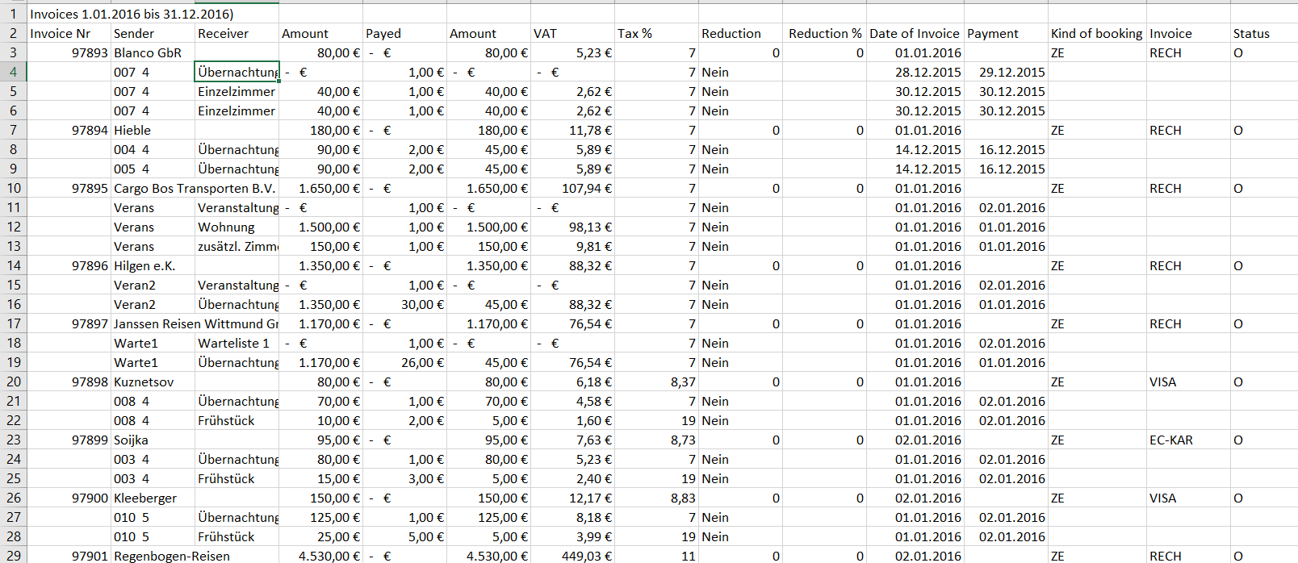
Examples for Other / New Techniques:
SRP Summarized Risk Audit
Invoice database out of hotel software

Slide 21
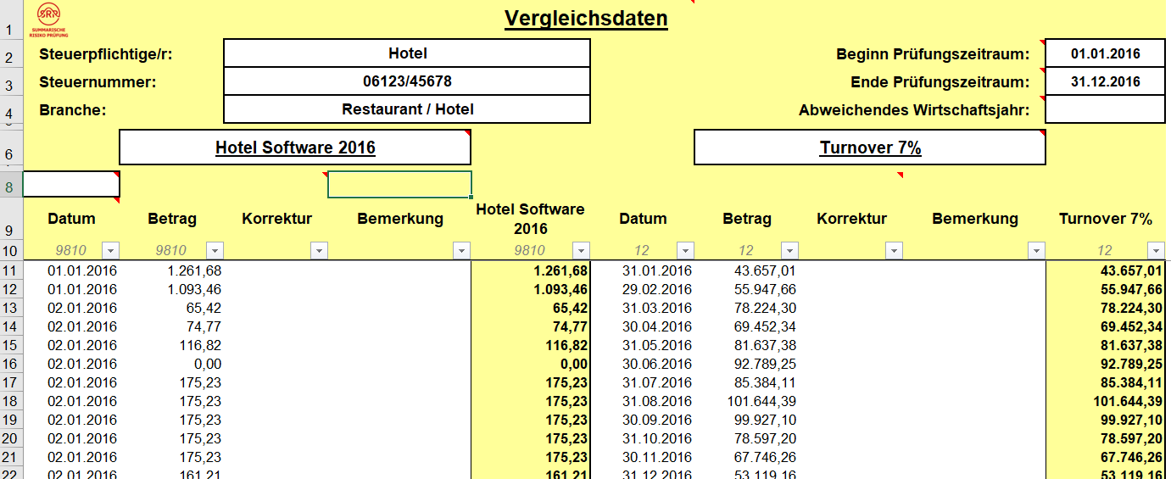
Examples for Other / New Techniques:
SRP Summarized Risk Audit
Invoice database out of hotel software
Import in summarized risk audit tool

Slide 22
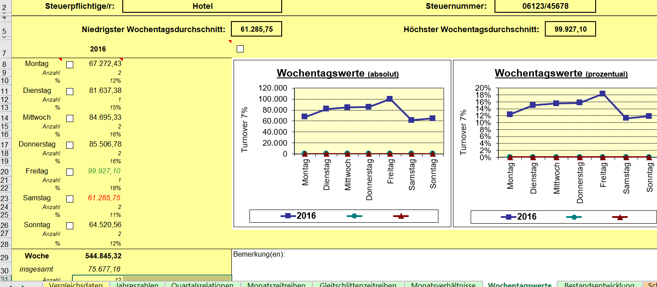
Examples for Other / New Techniques:
SRP Summarized Risk Audit
Invoice database out of hotel software
Import in summarized risk audit tool

Slide 23
Examples for Other / New Techniques:
SRP Summarized Risk Audit
Indicators
Reduced turnover on weekends
Usually busiest time for hotels in tourist areas
Restaurant evaluation:

Slide 24
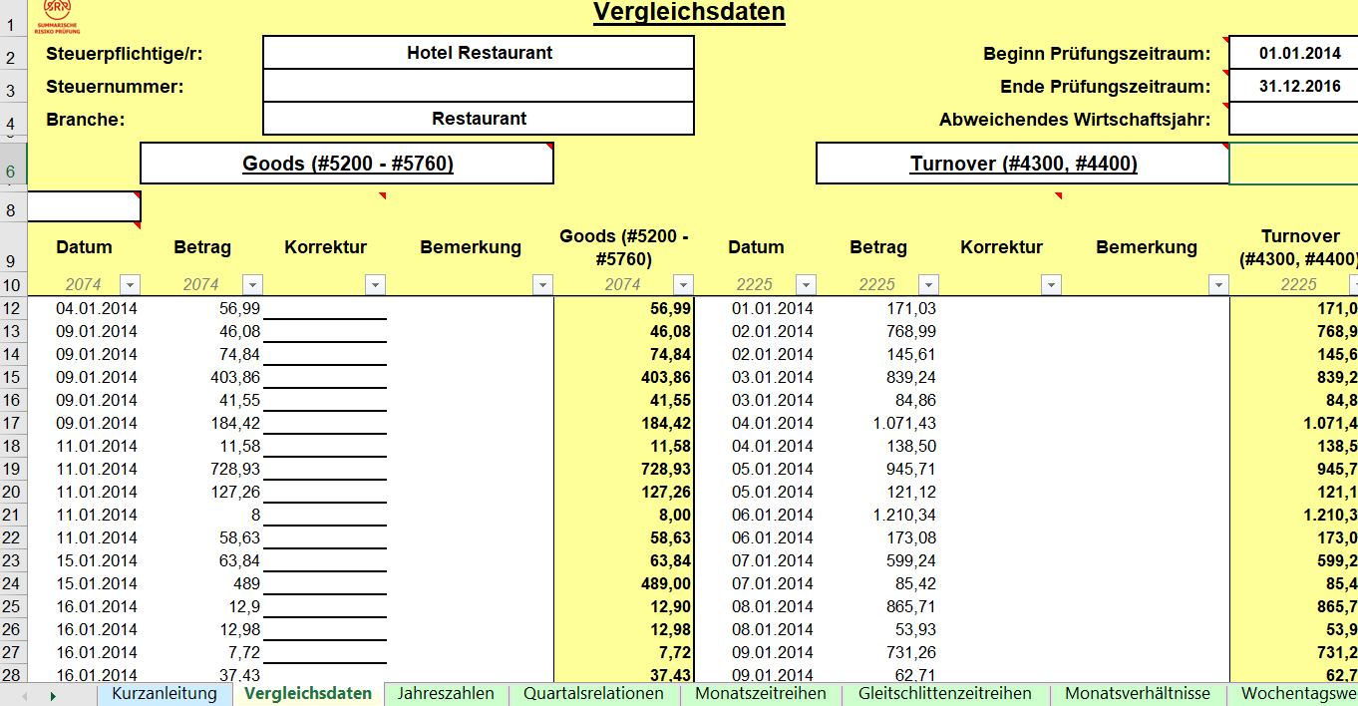
Examples for Other / New techniques:
SRP Summarized Risk Audit
Restaurant Data

Slide 25
Examples for Other / New techniques:
SRP Summarized Risk Audit
Evaluation based on time series analysis
Time series analysis
Average margin comparance
Cutting the pics 16 %
Calculation of available goods
RESULT:
No goods available for turnover ????

Slide 26
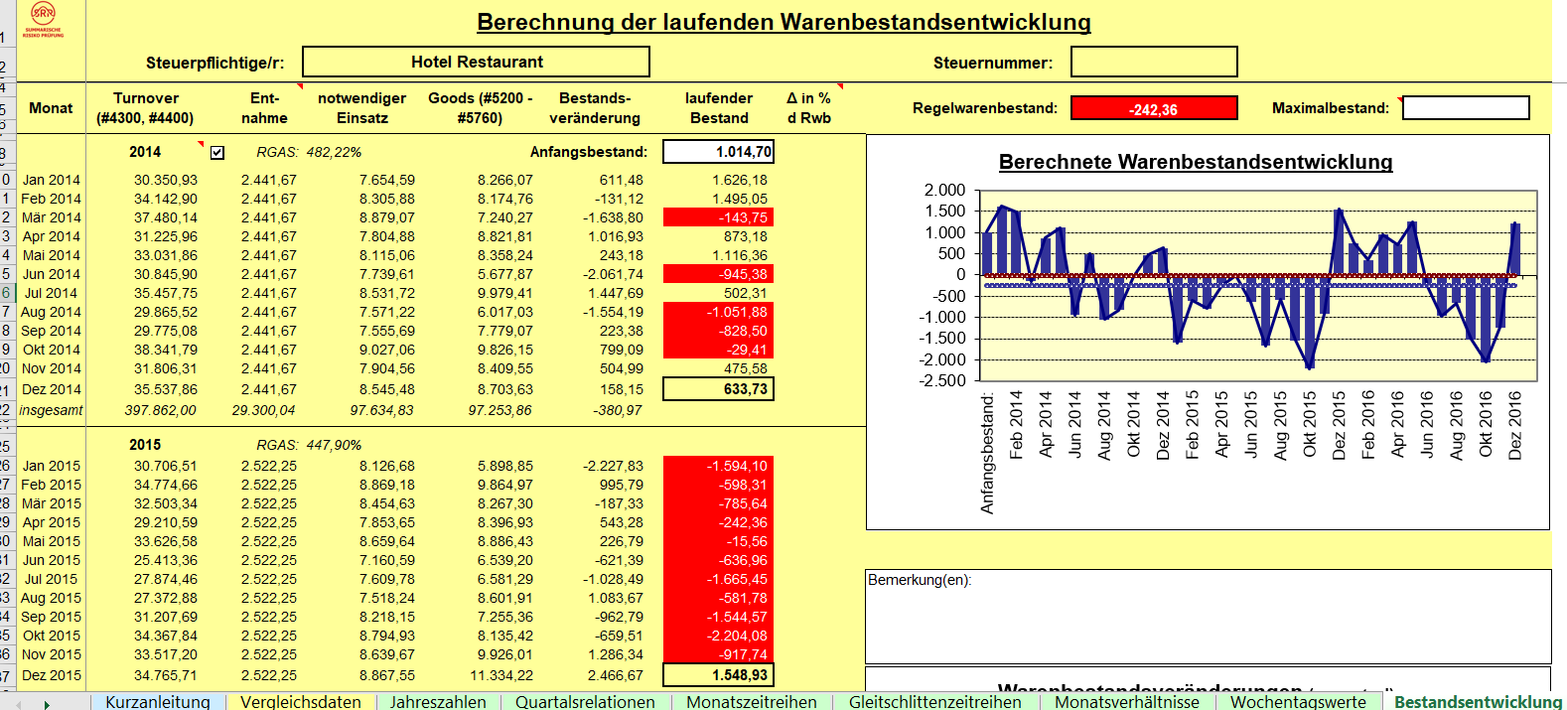
Examples for Other / New techniques:
SRP Summarized Risk Audit
Evaluation based on time series analysis

Slide 27
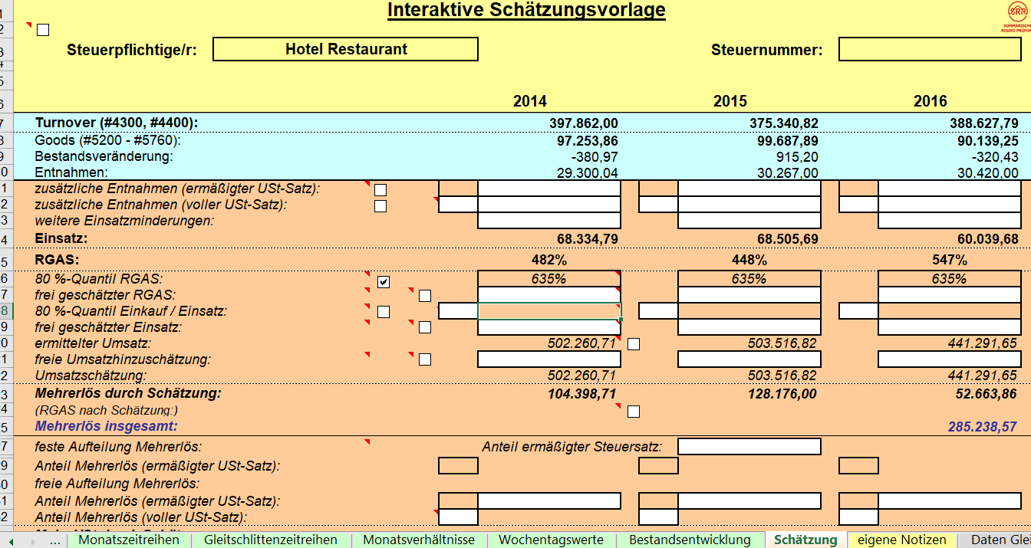
Examples for Other / New Techniques:
SRP Summarized Risk Audit
Estimation of turnover based on time series analysis – more € 285.238,57

Slide 28
Examples for Other / New Techniques :
Visualization of data
Visualization is often excel based or other software / a tool to visualize different figures / data sources in relation to each other in various diagrams

Slide 29
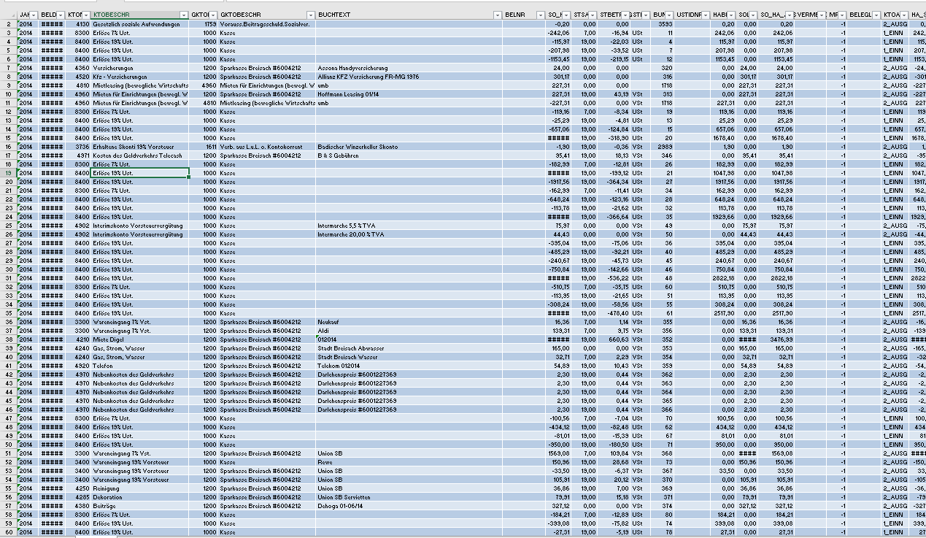
Examples for Other / New Techniques :
Visualization of data – Bookkeeping Data

Slide 30
Examples for Other / New Techniques :
Visualization of data – problems?
420.000 data sets?
How to explore?
Where to start?
Searching?
What kind of parameters?
Where are the indicators?

Slide 31
Examples for Other / New Techniques :
Visualization of data – example
Restaurant
Outside area
Christmas celebration
New year celebrations
Additional participation on different markets
No remarkable changes in business (same size, … employees, … suppliers….)

Slide 32
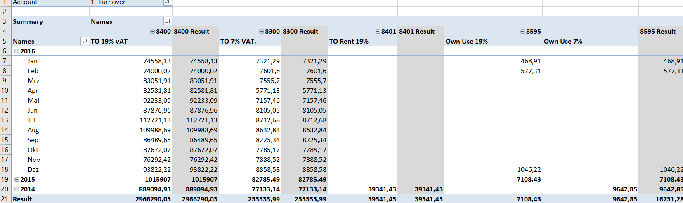
Examples for Other / New techniques :
Visualization of data
Edit data

Slide 33
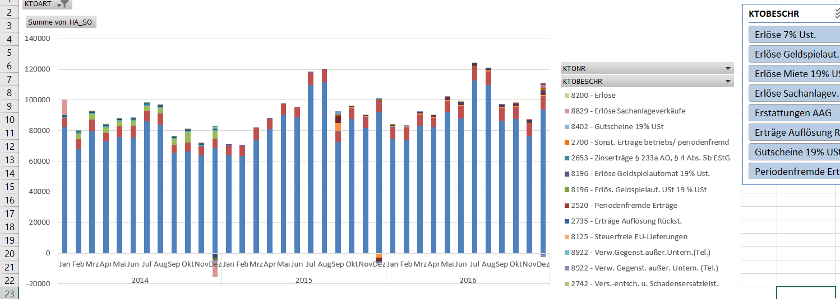
Examples for Other / New Techniques :
Visualization of data
Edited data – visualized

Slide 34
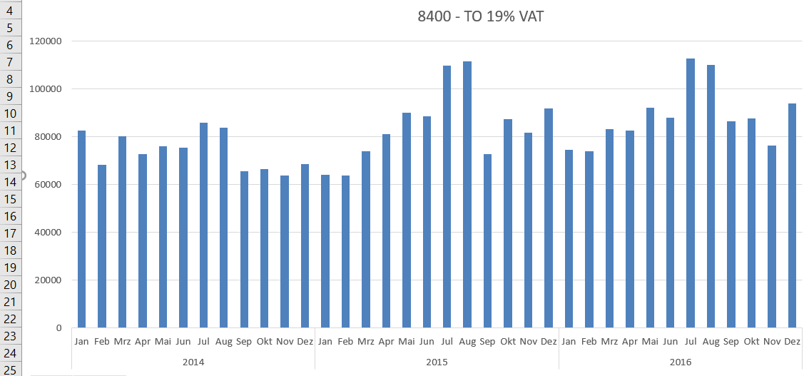
Examples for Other / New Techniques :
Visualization of data – account selection

Slide 35
Examples for Other / New Techniques :
Visualization of data – example
Indicators for problems
Summertime
- reduced turnover compared with other years
Christmastime
- reduced turnover – usually the busiest time of a year for restaurants

Slide 36
Examples for Other / New Techniques :
Visualization
Any expenditures
Turnover
Any other account like input VAT – output VAT
Almost everything could be visualized
…………………..

Slide 37
Benford`s Law
Benford`s Law
This “Law” is focused on the “relative rate” of figures at the beginning of numbers
Ralf Oberle

Slide 38
Benford`s Law
Naturally there are more small things than big things !!
In the whole world there exist
more sand as pebbles
more pebbles as stones
more stones as rocks
more rocks as mountains
more mountains as mountain-ranges
Ralf Oberle

Slide 39
Benford`s Law
Frank Benford
Physiker, USA
Benford`s Hypothese:
1920
There exist more numbers with a small figure than with a high figure (at the beginning)
Ralf Oberle

Slide 40
Benford`s Law
Benford did more than 20.000 single checks to proof his thesis!:
- Results of the American Baseballleagues
- air pressure figures
- weight of atoms
- Invoices of energy on Solomon Islands
- articles of Reader`s Digest
- numbers of inhabitants of countries, cities …
- bookkeeping of enterprises
....
Result:
The „1“ was always the leading figure
the „9“ always the last one
Ralf Oberle

Slide 41
Benford`s Law
The spread-rates for the “first figure” were
Figure
Rate
1
30,10 %
2
17,60 %
3
12,49 %
4
9,69 %
5
7,91 %
6
6,69 %
7
5,79 %
8
5,11 %
9
4,57 %
Ralf Oberle

Slide 42
Benford`s Law
Benford`s Law:
every 3. number starts with a „1“
Ralf Oberle

Slide 43
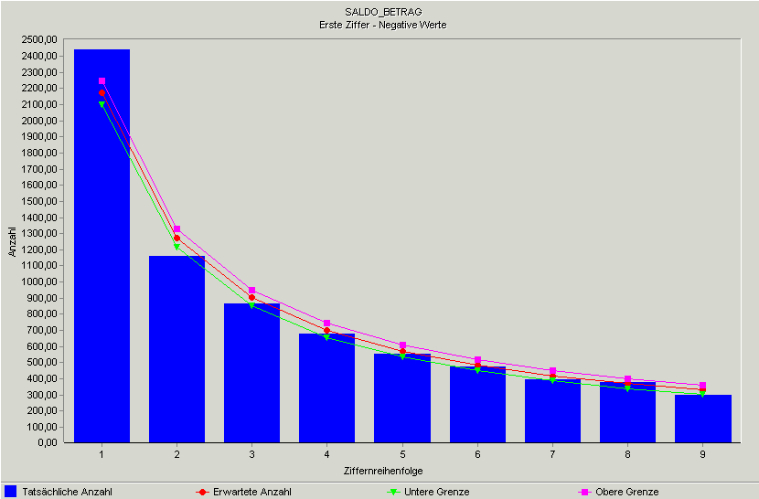
Benford`s Law
Grafik: 1. Rate-Test
Ralf Oberle

Slide 44
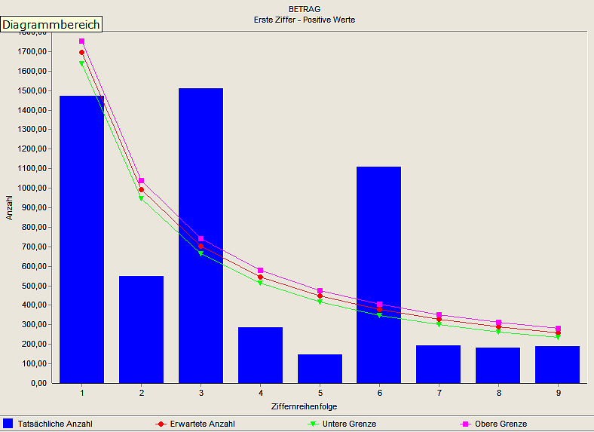
Benford`s Law
Grafik: 1. Rate-Test
normal
noticeable
Ralf Oberle

Slide 45
Benford`s Law
Is Benford`s law always right ?
law of maths
or
freak of nature
Example Cars
Ralf Oberle

Slide 46
Benford`s Law
Benford`s Law is always right for naturally formed figures / databases
Figures, following the nature-laws as:
Numbers of inhabitants
Length of all rivers of the world
Size / amount of water in all seas/lakes/oceans
Stock-courses
Booking numbers
Turnover
Trading prices
Ralf Oberle

Slide 47
Benford`s Law
Relevanz of Units
Benford`s Law is universal
Change of Units doesn’t influence the rate!
Km – Miles– Morgen – Zoll – Inch – Acr
EUR - BAT- $ - Yen
Ralf Oberle

Slide 48
Benford`s Law
The Benford check is an own automatic tool within the analyse-programs IDEA/ACL (and others)
After import of databases you can run the check automatic by allocating the source – “a thing of seconds”
BUT BENFORD-CHECK IS NOT THE PROOF OF THE FRAUD IT’S THE ENTRY FOR FURTHER CHECKS
Ralf Oberle

Slide 49
Benford`s Law
Benford`s Law
Examples
Ralf Oberle

Slide 50
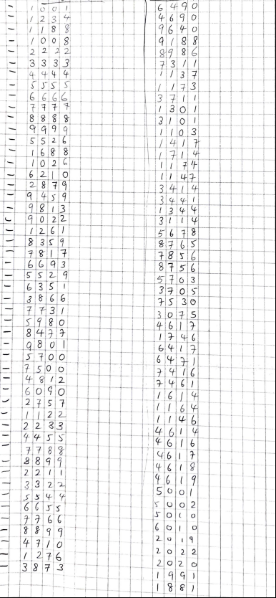
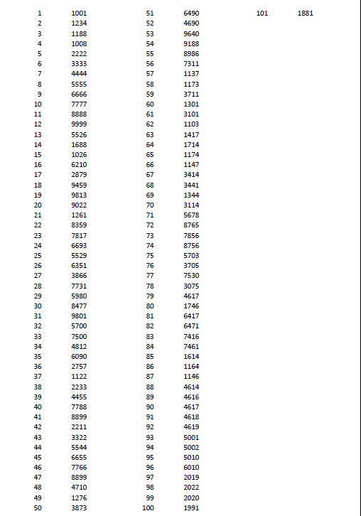
Wai San Loh
Ralf Oberle

Slide 51
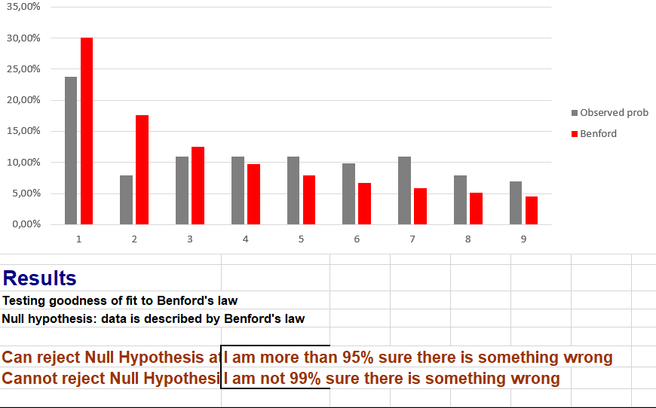
Benford`s Law
Ralf Oberle

Slide 52
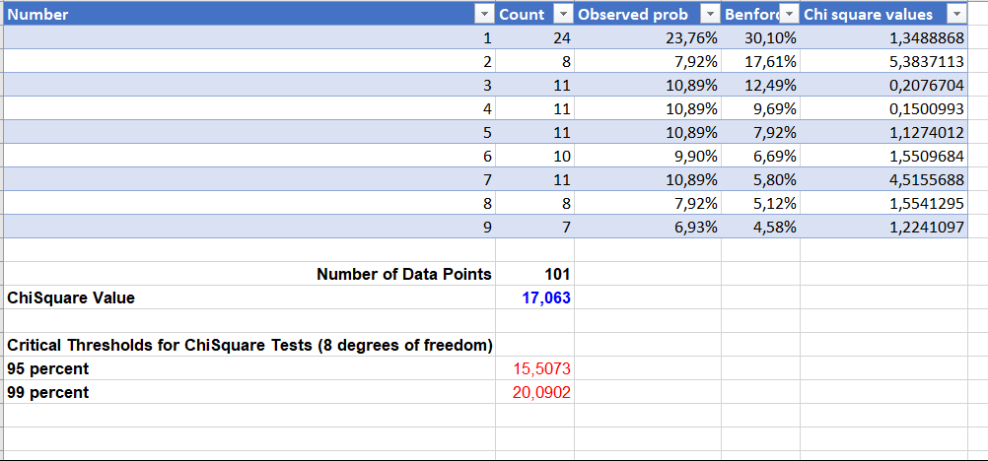
Benford`s Law
Benford`s Law
Ralf Oberle

Slide 53
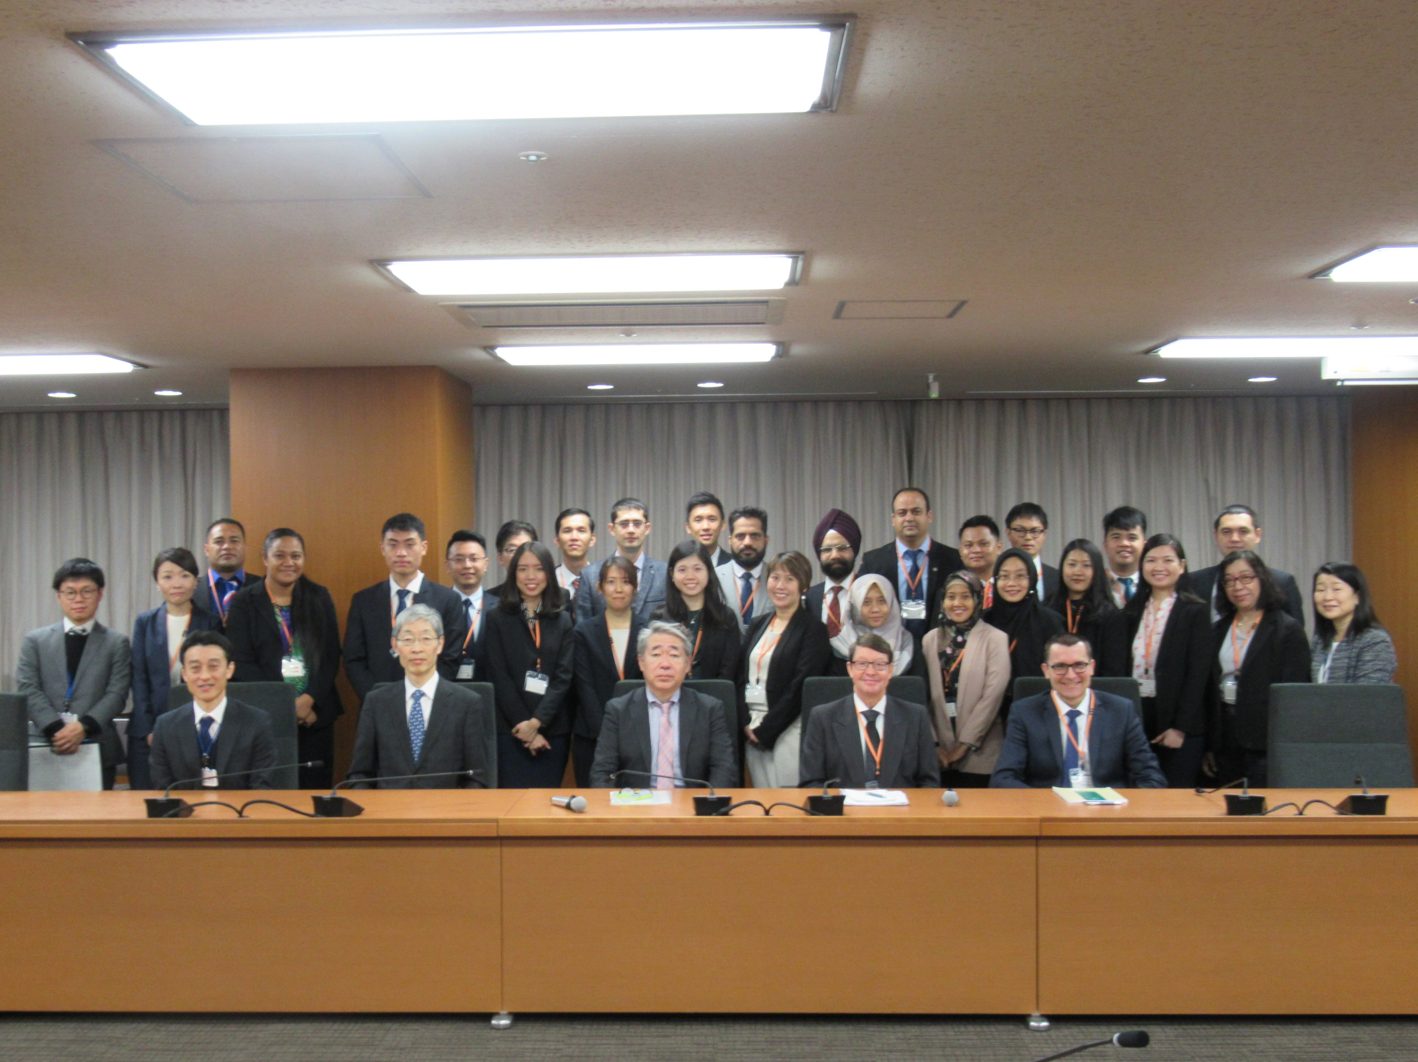
Group
Ralf Oberle

Slide 54
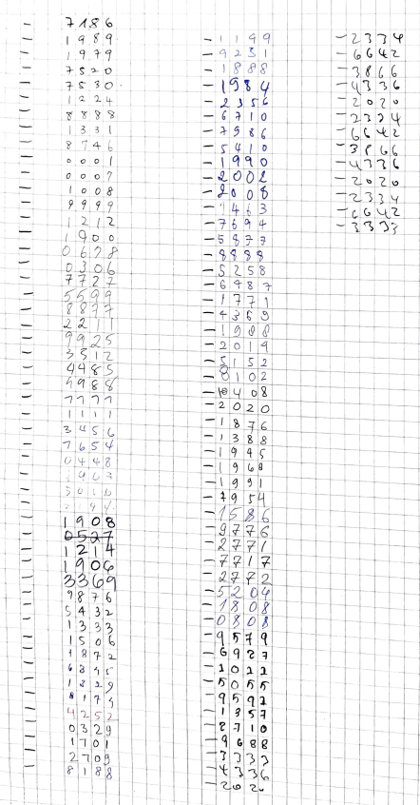
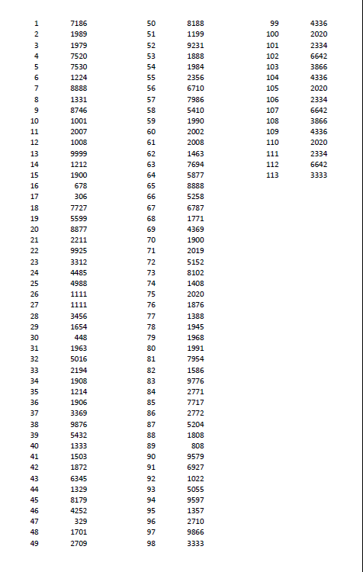
Benford`s Law
Ralf Oberle

Slide 55
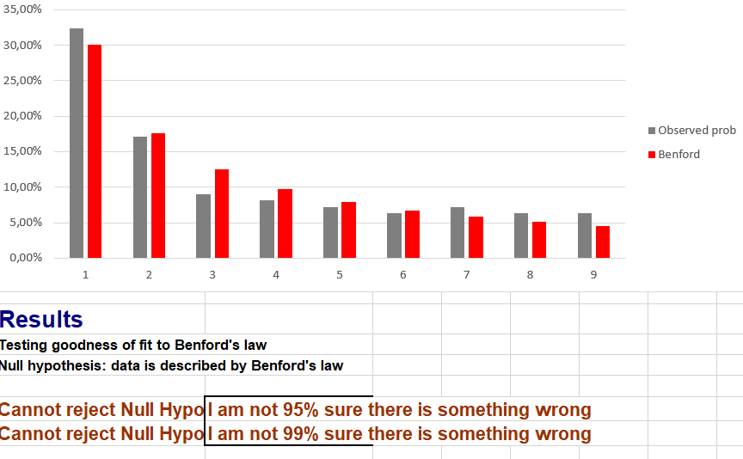
Benford`s Law
Ralf Oberle

Slide 56
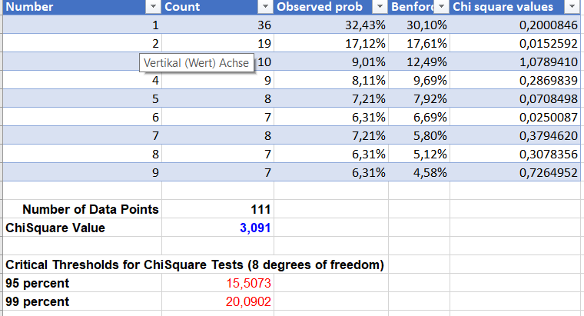
Benford`s Law
Ralf Oberle

