Slide 1

Asset Recovery Case: Namibia
The Case of Mr. L M and Indulgence Accommodations CC
Date: 18 July 2024
Prepared by: D/W/O Hertha AN Salomo: Namibian Police: AML-CFT

Slide 2
Case Background
Incident Date: April 2020
Individual Involved: Mr. L. M
Entity: Indulgence Accommodations CC
Nature of Fraud: Overpayment of tax returns, defrauding NAMRA
Suspect was arrested on the predicate offence and criminal ML offences.
Parallel investigation

Slide 3
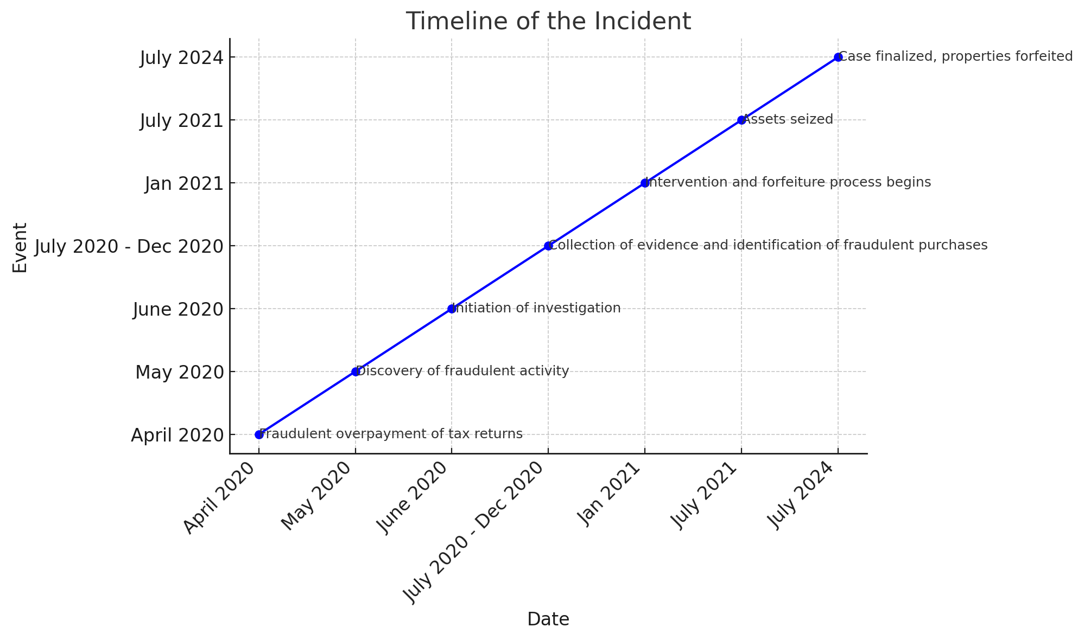
Timeline of Incident

Slide 4
Assets Involved
Fraudulent Assets Description: Higher tax returns
Estimated Value: N$ 8,000,000 (USD 440,000)
Purchases Made with Fraudulent Funds:
House valued at N$ 1,000,000 (USD 55, 570)
4 vehicles valued at N$ 3 million ( USD 166 700)
Cash N$ 2,5millions (USD 138 000)
Cash withdrawals, daily purchases.

Slide 5
Legal Framework
Namibian Laws and Regulations: POCA 29 of 2004 as amended.
Section 83 authorisation.
Section 4, 5, 6 and 6A ML offences
Chapter 6 of POCA: Preservation, seizure, forfeiture.

Slide 6
Recovery Process
Steps Taken: Intervention, seizure, forfeiture.
Involved Agencies/Entities: Namibian police, NAMRA, FIU, Office of the PG, Banking institutions, Deeds Registry, NATIS
Challenges Faced: Delay in obtaining info.

Slide 7
Current Status
- Recovery Efforts Status: case finalised
Properties forfeited

Slide 8
Questions ????
                D/W/O Hertha A.N Salomo
                AML-CFT Division
                Namibian Police
                HASalomo@nampol.na
                +264813761168

