Slide 1
crypto assets
An overview
Priyanka Ahuja
(india)

Slide 2
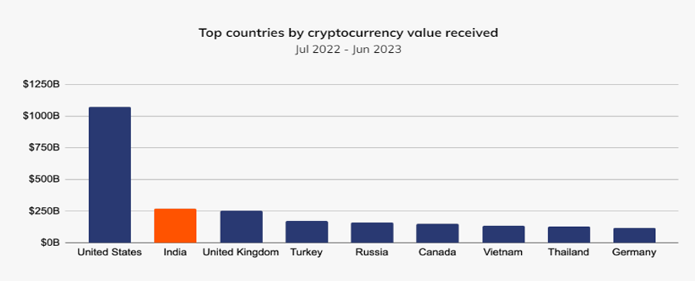
India remains a top crypto market despite regulatory challenges - Global Crypto Adoption Index

Slide 3

India ranks in the top ten in usage for cryptocurrency services in a varied set of categories
A top cryptocurrency market in spite of a challenging regulatory and tax environment for the industry to navigate
uneven implementation of TDS may be making it more difficult for homegrown Indian exchanges to compete.

Slide 4
What Is a Cryptoasset?
Cryptoassets leverage cryptography, consensus algorithms, distributed ledgers, peer-to-peer technology and/or smart contracts to function as a store of value, medium of exchange, unit of account, or decentralized application (DApp).
There are four most common types of cryptoassets:
  cryptocurrencies, utility tokens, security tokens and stablecoins.
Cryptocurrencies are the most widespread of these: the two largest assets by market capitalization on the crypto market, Bitcoin (BTC) and Ethereum (ETH), belong to this class.
Cryptocurrencies are coins, i.e. fully independent assets, that can be transacted between the participants of their networks and use the blockchain technology to function
A blockchain is a decentralized ledger of all transactions that have ever been made with a particular cryptocurrency, which is maintained and updated via the use of a consensus mechanism, such as proof-of-work or proof-of-stake.

Slide 5

What is Blockchain?
Blockchain is an immutable digital ledger that enables secure transactions across a peer-to-peer network.
It records, stores and verifies data using decentralized techniques to eliminate the need for third parties, like banks or governments. Every transaction is recorded, then stored in a block on the blockchain.
Each block is encrypted for protection and chained to the preceding block — hence, “blockchain

Slide 6
  Blockchains are made up of a series of individual blocks.
  Each block contains information about transactions conducted within a given time period.
  They also contain a unique identifier to differentiate them from every other block in the chain.
  Blocks are created by solving cryptographic problems.
  The process of solving these problems is known as mining.
  Mining a block on the blockchain attracts a reward.
  the blockchain is stored on the computers of every user of that given blockchain. That’s why called as Distributed Ledger
  the unique block identifier — known as the hash — is derived from the information contained in every previous block in the blockchain. This means that, in order to falsify any record on the blockchain, a nefarious actor would have to change every block on every instance of the blockchain. As a result, blockchains are considered to be virtually unfalsifiable and are thought of as immutable records of transactions

Slide 7
In Bitcoin’s case, the blockchain is decentralized, so no single person or group has control—instead, all users collectively retain control.
There is no central authority present to validate and verify the transactions, yet every transaction in the Blockchain is considered to be completely secured and verified
This is possible only because of the presence of the consensus protocol which is a core part of any Blockchain network.
Decentralized blockchains are immutable, which means that the data entered is irreversible. For Bitcoin, transactions are permanently recorded and viewable to anyone.

Slide 8
In Bitcoin’s case, the blockchain is decentralized, so no single person or group has control—instead, all users collectively retain control.
There is no central authority present to validate and verify the transactions, yet every transaction in the Blockchain is considered to be completely secured and verified
This is possible only because of the presence of the consensus protocol which is a core part of any Blockchain network.
Decentralized blockchains are immutable, which means that the data entered is irreversible. For Bitcoin, transactions are permanently recorded and viewable to anyone.

Slide 9
The Bitcoin blockchain collects transaction information and enters it into a 4MB file called a block (other blockchains use different size blocks). Once it is full, certain information is run through an encryption algorithm, which creates a hexadecimal number called the block header hash.
The hash is then entered into the following block header and encrypted with the other information in that block's header, creating a chain of blocks.
It is impossible to cancel and delete information from the log of the completed bitcoin transaction.
A Bitcoin unit is divisible and can be divided into 100 million “Satoshis,” the smallest fraction of a Bitcoin.
The Bitcoin Blockchain is a data file that carries the records of all past Bitcoin transactions, including the creation of new Bitcoin units.
The average time between Bitcoin blocks is 10 minutes. The first block, block #0, was created in 2009.

Slide 10
Bitcoin wallet
A Bitcoin wallet is software hat interacts with the Bitcoin blockchain that allows the receiving, storing, and sending of (fractions of) Bitcoin units.
The most common way is to open an account at one of the many Bitcoin exchanges and to transfer fiat currency to it.
Wallets are secured through private and public keys.
Both software (hot) and hardware (cold) wallets are available.
Custodial wallets: are wallet services offered by a centralized business such as a cryptocurrency exchange.
Non-custodial wallets: user controls the private key. Users must remember that if they lose the private key, the coins in the wallet are essentially lost forever

Slide 11
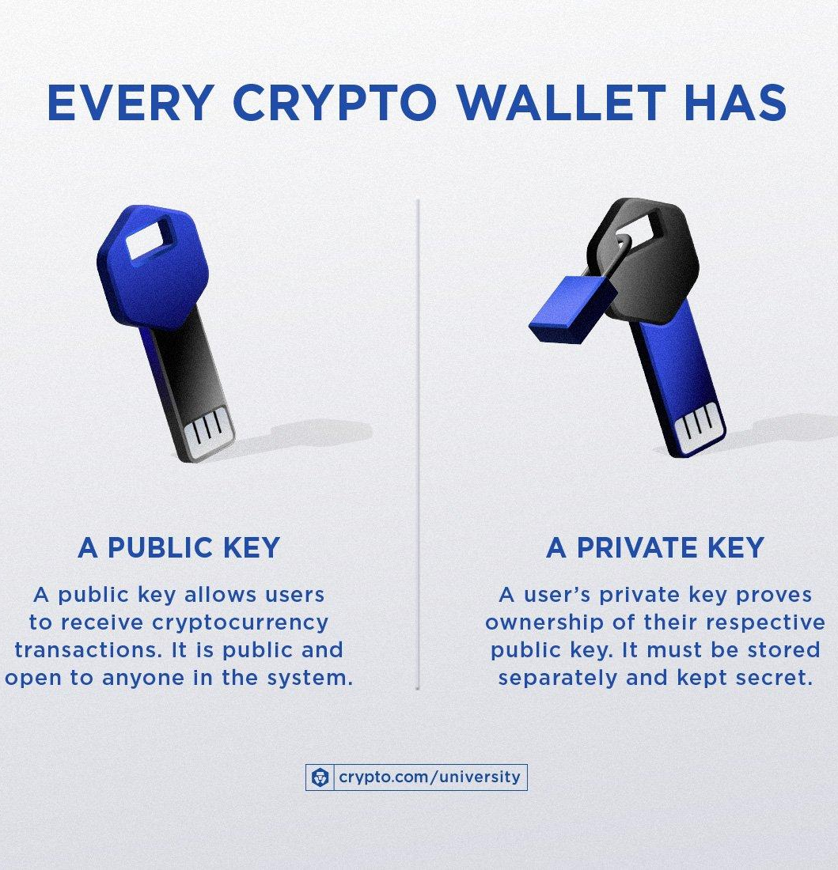
The digital signature of operations in the blockchain system is based on cryptography and has two keys.​
The first key is private, available only to the owner of the assets, and is kept confidential and is never transferred to other people.​
The second key is public. It is needed to conduct, verify and track the Bitcoin transaction. ​
The private key is 32 bytes, the public key is 33 bytes, and the signature is approximately 70 bytes.​
Miners confirm the validity of a financial transaction based on a public key.

Slide 12
A buyer broadcasts to the network that a seller’s Bitcoin address is the new owner of a specific Bitcoin unit. This information is distributed on the network until all nodes are informed about the ownership transfer.
In a Bitcoin network, a transaction is considered completed after six subsequent blocks are found confirming its validation

Slide 13
Bitcoin mining is permissionless.
Anyone can become a miner by downloading the respective software and the most recent copy of the Bitcoin Blockchain.
A miner obtains this fingerprint by computing the block candidate’s hash value using the hash function
For a block candidate to be accepted by all miners, its fingerprint must possess an extremely rare feature: The hash value must be below a certain threshold value—that is, it must display several zeroes at the beginning of the fingerprint. An example of a fingerprint of a block that was added to the Bitcoin Blockchain in 2010 is given in the following example

Slide 14
India and Bitcoin
Using cryptocurrency as a direct method of payment for goods and services is not legal in India as of today.
There are 3 aspects to it:
1. Not Legal Tender: Cryptocurrencies like Bitcoin are not recognized as legal money in India
2. Government Taxes Crypto: Despite the lack of regulations, the Indian government has imposed a 30% tax on crypto gains and a 1% tax deducted at source (TDS) for all crypto transactions since the 2022 Union Budget.
3. Unregulated Market: The Indian crypto market itself is largely unregulated. While you can buy and sell cryptocurrencies on exchanges, there are no specific laws governing their use as a form of payment. Currently, there's no specific legislation governing cryptocurrency use or trading in India.

Slide 15
Investor Risks:
Increased Vulnerability to Scams and Fraud:
Without regulations, there's less oversight on cryptocurrency exchanges and Initial Coin Offerings (ICOs). This can create a breeding ground for scams like pump-and-dump schemes and fraudulent ICOs, where investors lose money due to manipulation or fake projects.
Security Threats
Unregulated exchanges might have weaker security protocols, making them more susceptible to hacking and theft of investor funds.
Limited Dispute Resolution
In the absence of clear regulations, resolving disputes between investors and exchanges can be challenging

Slide 16
Market Risks:
Market Manipulation
The lack of regulations makes the Indian crypto market more susceptible to manipulation by large investors or groups, leading to artificial price swings and increased volatility for smaller investors.
Money Laundering and Terror Financing
Cryptocurrency's anonymity can be attractive for criminals looking to launder money or finance illegal activities. This can destabilize the financial system and pose security risks.
Financial System Instability
The widespread adoption of unregulated cryptocurrencies could potentially impact the stability of the traditional financial system, especially if there's a sudden crash or crisis in the crypto market.

Slide 17
TAXATION OF CRYPTOASSETS
India has included cryptocurrency in the category of Virtual Digital Assets under the Income Tax Act, 1961 vide the Finance Act, 2022.
TDS @ 1% of the transaction U/s 115 BBH has been introduced from 01.04.2022
Flat tax rate @30% has been levied on both short as well as long term holdings.

Slide 18


Slide 19


