Slide 1
Sharing on Ops Wave 3
GST Missing Trader Fraud/
Carousel Fraud
Kong Geok Chin
22 May 2024

Slide 2
Agenda
Illustration of GST Missing Trader Fraud/Carousel Fraud
Where it all begins
Case management
Inter-agency co-operation
Critical Success Factors

Slide 3
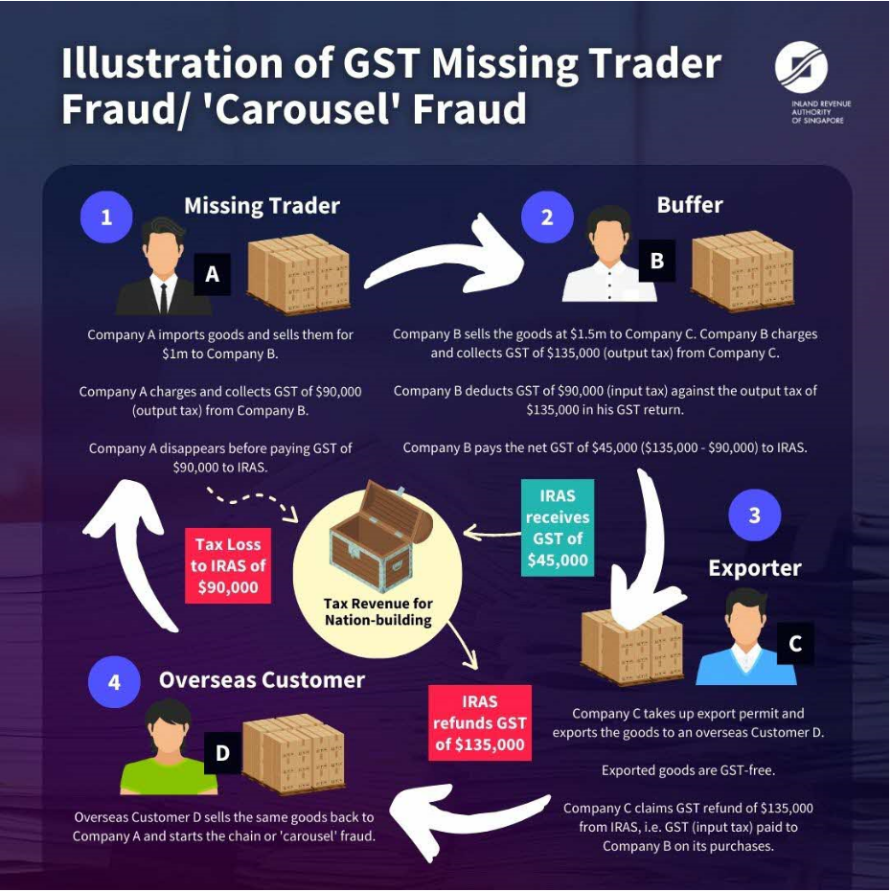

Slide 4
Where it all begins
Local supplier 1
Local supplier 2
Buffer 6
Exporter 1
Overseas Customers
Buffer 7
Exporter 2
MT 1
Buffer 8
Buffer 4
Customer 1
MT 2
Buffer 9
Customer 2
Buffer 1
Customer 3
MT 3
Buffer 2
Buffer 5
Exporter 3
Customer 4
Customer 5
Buffer 3
Buffer 10
Exporter 4
Customer 6
MT 4
Exporter 5
Buffer 11
MT 5
Exporter 6
Customer 7
Buffer 12
MT 6
Exporter 7
Customer 8
Buffer 13
Buffer 14
Exporter 8
Customer 9
Buffer 15
Customer 10
Buffer 16
Customer 11

Slide 5
Case management
Information on hand
Syndicate was suspected to be controlled by one mastermind based overseas and two co-conspirators based in Singapore
Exporters were able to provide all the documents required
Pre-raid preparation
Objectives
Case theories
Resources available
Who to target
Roles and responsibilities of each team member
Formulate a raid plan – risk assessment
Constant communication to all stakeholders

Slide 6
Case management
Investigation
Constant communication among team members and with Lead Investigators on findings
Deviations from the case theories?
Investigation approaches
Update your management

Slide 7



Inter-agency co-operation
+
=
GST Offences
Penal Code Offences
Companies Act Offences

Slide 8
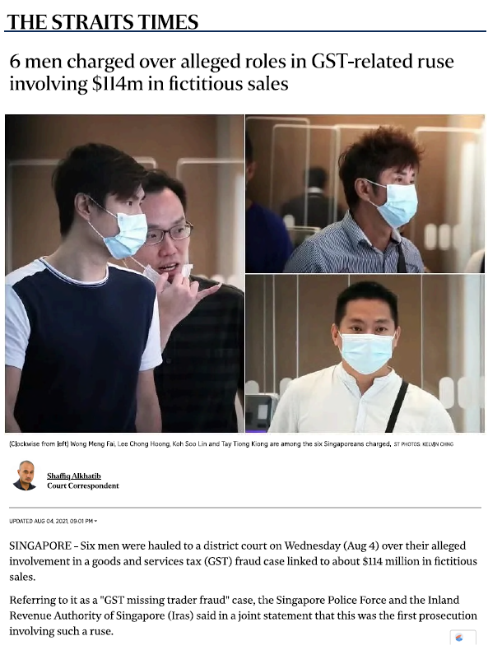
Ops Wave 3
Case 1 – N Coy (a shell company)
Following investigations by the CAD and IRAS, 6 Singaporean men were charged in Aug 2021 for their alleged involvement in perpetrating a Goods and Services Tax (GST) Missing Trader Fraud involving approximately S$114 million in fictitious sales.
This is the first prosecution involving such fraud.
4 men linked to the case were sentenced to between 5 months’ and 4 years’ jail. The alleged accomplices’ cases are before the courts.
4 Convicted

Slide 9
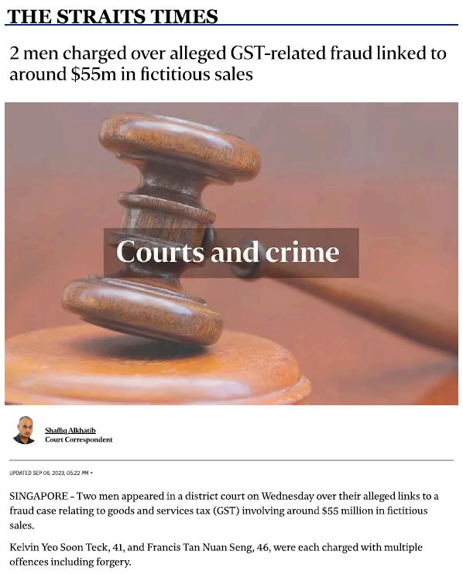
Ops Wave 3
Case 2 – M coy (a shell company)
This is the second prosecution in Singapore involving Missing Trader Fraud.
2 men were charged in Sep 2023 for perpetuating GST Missing Trader Fraud involving S$55 million in fictitious sales.
On 29 Feb 2024, 1 of them was sentenced to 5 years’ jail. The other men’s case is still before the Court.
1 – Convicted
1 – pending

Slide 10

Critical Success Factors
Support from your management
Strong teamwork among team members
Close inter-agency collaboration
Believe in yourself

Slide 11
Thank you

