Slide 1


MAJOR CASE MANAGEMENT
AN ITALIAN PERSPECTIVE
FROM GUARDIA DI FINANZA
Alessandro Lo Bello
Head of Direct Taxation and VAT EOI Unit
Guardia di Finanza General Headquarters

Slide 2

Major Case Management – A GdF perspective
Video GdF

Slide 3
Major Case Management – A GdF perspective
Police Force with a military structure.
Depends directly from the Minister of Economy and Finance
Tax
Economic and financial
Currency
Criminal
Administrative
Public Security
Police
POWERS AND ATTRIBUTIONS
Notes:
The Guardia di Finanza is a police force with a military structure reporting to the Minister of Economy and Finance, which carries out financial and economic police tasks with general competence.
The financial police activity aims at the safeguard of the budget of the State, Regions, Local Authorities and the European Union.
On the other hand, economic police functions protect both the capital market, by preventing and combating money laundering and terrorist financing, and the goods and services market, with the aim of protecting the legal economy from counterfeiting, intellectual piracy and other illicit trafficking in defence of “made in Italy” products.
Therefore, the Guardia di Finanza does not only carry out activities to prevent and repress tax evasion, but also monitors the proper management of public resources, as a privileged partner of the Judicial Authority, both ordinary and accounting, of the European Public Prosecutor's Office (EPPO), of the Department of Public Administration and of the National Anti-Corruption Authority.
In addition to these functions, the Corps contributes to the military defence of the Country and, finally, to the maintenance of public order and security.
For this last activity, the Corps reports functionally to the Minister of the Interior.
The members of the Guardia di Finanza Corps are granted tax police powers (tax police officers and agents) by the relevant tax laws (Law No. 4 of 7 January 1929, Presidential Decree No. 600/1973 and Presidential Decree No. 633/1972) in relation to investigations, accesses, controls, requests for information falling within the competence of the tax Administration, in particular as regards the imposition of taxes, with the power (for tax police officers only) and without prejudice to the provisions of the Code of Criminal Procedure to proceed with searches if they have a well-grounded suspicion of violations of tax laws constituting a criminal offence.
The Corps' members are granted the powers of judicial police provided for by the Code of Criminal Procedure (judicial police officers and agents), in order to obtain information on offences, prevent them from being carried to further consequences, search for their perpetrators, carry out the necessary acts to secure sources of evidence and collect whatever else may be needed for the enforcement of criminal law.
In addition, Law No. 148/1988 granted the members of the Special Currency Police Unit of the Guardia di Finanza the exercise of currency police powers, which consist in the possibility of carrying out controls, inspections and audits of supervised entities (e.g. banks) to prevent and ascertain possible currency violations.

Slide 4
Major Case Management – A GdF perspective
MISSION AND TASKS
FINANCIAL POLICE
Fight against tax evasion, avoidance, frauds and shadow economy
Surveillance on public expenditure
Anti smuggling activity for customs purposes and for energetic products
ECONOMIC POLICE
economic investigation on organised crime groups’ assets and anti-money laundering
Protection of intellectual property and consumer rights
Tackle illicit trafficking

Slide 5
Major Case Management – A GdF perspective
MISSION AND TASKS
PUBLIC ORDER AND BORDER DEFENSE
We contributing, along with other Police Forces, to the maintenance of public order.
POLICE AT SEA
Italian “Sea Police
Maritime Border Surveillance
Contrast to illegal immigration, both in territorial and international waters.

Slide 6
Major Case Management – A GdF perspective
ORGANIZATION
OPERATIONAL COMMANDS
Territorial Units
Special Units
Naval and Air Units
Notes:
Operational Commands are divided into: Territorial Units, Special Units and Naval and Air Units.
Territorial Units control their specific geographical areas of competence, carrying out GDF institutional activities. These commands depend on and report to other controlling commands (Interregional, regional and provincial commands), who are in charge of coordinating, directing and providing the necessary inputs. Overall, the territorial deployment can count on 678 operational commands.
Special Units are established for investigating on peculiar operational areas and I will better develop this point with the following slide.
Naval and Air Units: they are in charge of patrolling not only the land but also the sea area and air space. As the only Police Force at Sea, the Corps can count on 15 Operational Air and Naval Units.

Slide 7

Major Case Management – A GdF perspective
A peculiar «in-house» Whole of Government Approach
Economic and Financial Police Powers
Tax Police Powers
Currency Police
Powers
Judicial Police Powers
We provide a complete service to our customers!
But, often they aren’t so satisfied as we are…

Slide 8
Major Case Management – A GdF perspective
Is there any GdF Handbook on MCM?
Does we provide a specific training on MCM?
NO
Throughout Italy we have different
- Investigative Approaches
- Expertises
Geographical
Economic
Crime
Areas
Judicial Authorities Orientation
Why?
Influenced by many factors

Slide 9


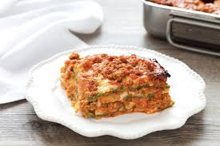
Major Case Management – A GdF perspective
A territory-focused approach, like the Italian regional cuisine:
Often, we have many recipes for the same traditional dish but we focus on the final results: being as yummy as possible!
Anyway,
NO CREAM IN CARBONARA, PLEASE!

Slide 10
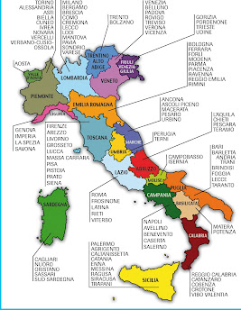
Major Case Management – A GdF perspective
We rely on the operational and investigative structures we developed trough around 100 years of experience in fighting economic and tax crimes.
ECONOMIC-FINANCIAL POLICE UNITS
One in each province
Their «size» and complexity are mainly related to:
economic and criminal dimension of the geographical area of competence;
Public Prosecutor Office relevance.

Slide 11
Major Case Management – A GdF perspective
Complex Economic-Financial Police Unit Organization Chart
COMMAND OFFICE
(HR and Logistics)
---------
Head of Unit
(Responsible for Judicial Police operation for the Province)
--------
OPERATIONS OFFICE
JUDICIAL POLICE SECTION
Operations Section
IT Investigations Section
1st Revenue Protection Group
2nd Revenue Protection Group
3rd Revenue Protection Group
Public Expenditure
Protection Group
Economic and Financial Crime Investigations Group
Goods and Services Market Protection Group
Capital Market Protection Group
Organised Crime Investigation Group
----- Staff
line
Head of Unit and Operations Office have a comprehensive overview of the ongoing administrative and criminal investigations.

Slide 12
Major Case Management – A GdF perspective
Complex Economic-Financial Police Unit Organization Chart
Head of Group
Head of 1st Section
Head of 2nd Section
Head of X Section
Major Case Manager
Head of Squad
Head of Squad
File Coordinator/Primary Investigator
Senior Investigator
Investigator
Investigator…. (8/10)
Senior Investigator
Investigator
Investigator
Investigator (8/10)
File Coordinator Primary Investigator
Field Investigators
Often we cannot choose our employees…
so it is assumed that we have the best available.

Slide 13
Major Case Management – A GdF perspective
The Public Prosecutor Office «sensitivity»/awarness is crucial for the success of the criminal investigation
They formally direct the investigation
They fund the investigative IT tools we need to gather evidences
They can provide crucial information coming from the Ministry of Justice DBs
We should act as advisors for them
If needed, the competent group, interacts with the other groups to form a JIT that covers all possible areas of investigation.

Slide 14
Major Case Management – A GdF perspective
Specialization by doing system
Improvement in the management of major cases is achieved through active interaction among investigators and other stakeholders:
Judicial Authority;
GdF General HQ/Special Departments
Third parties which provide for IT investigative tools
Intelligence Agencies
Other institutions/bodies/agencies (national and international)

Slide 15
Major Case Management – A GdF perspective
Special Departments
Co-delegate in complex cases
Provide tecnical support and help.
Carry out "targeted" operational analyses to detect criminal trends and illegal phenomena.
Cooperate with national supervisory authorities and institutional bodies.

Slide 16

Major Case Management – A GdF perspective
SPECIAL DEPARMENTS
SPECIAL UNITS
CENTRAL O.C. INVESTIGATION SERVICE
ECONOMY AND FINANCE PROTECTION UNITS
Anti-Corruption
Parliamentary Enquiries Commissions
Revenues and Tax Frauds
Currency Police Special Unit
Technological Frauds and Privacy Protection
Goods and Services
Public Expenditureng and EU Frauds Repression
Antitrust
Notes:
In order to counteract the evolution of criminal strategies, the GDF can count on Special Units Command that cooperate with Independent Administrative Authorities on the field of tackling corruption, economic-financial crimes committed through internet and protection of privacy and , moreover, on Economic and Financial Protection Command for protecting public economy and financial markets. They all can be considered as the "beating heart" of the investigative activity, that are also used to develop information and cooperate with the various national supervisory authorities or other important specific institutional bodies.
Special Units carry out, as well, "targeted" operational analysis to counteract the most serious and dangerous illicit phenomena.

Slide 17
Major Case Management – A GdF perspective
HQ Support
At a central level, we give our support by:
Disseminating circular letters, manuals/handbooks for any existing crime area;
Planning refresher courses / workshops
Offering advice from the HQ relevant departments
Sharing Best Practices

Slide 18

Major Case Management – A GdF perspective
HQ - II Dpt
Help desk for cross borders cases
The arrows on our quiver
An integrated approach for gathering evidence on transational investigations
International Cooperation
Police
Mutual Administrative Assistance
Judicial
Intelligence

Slide 19
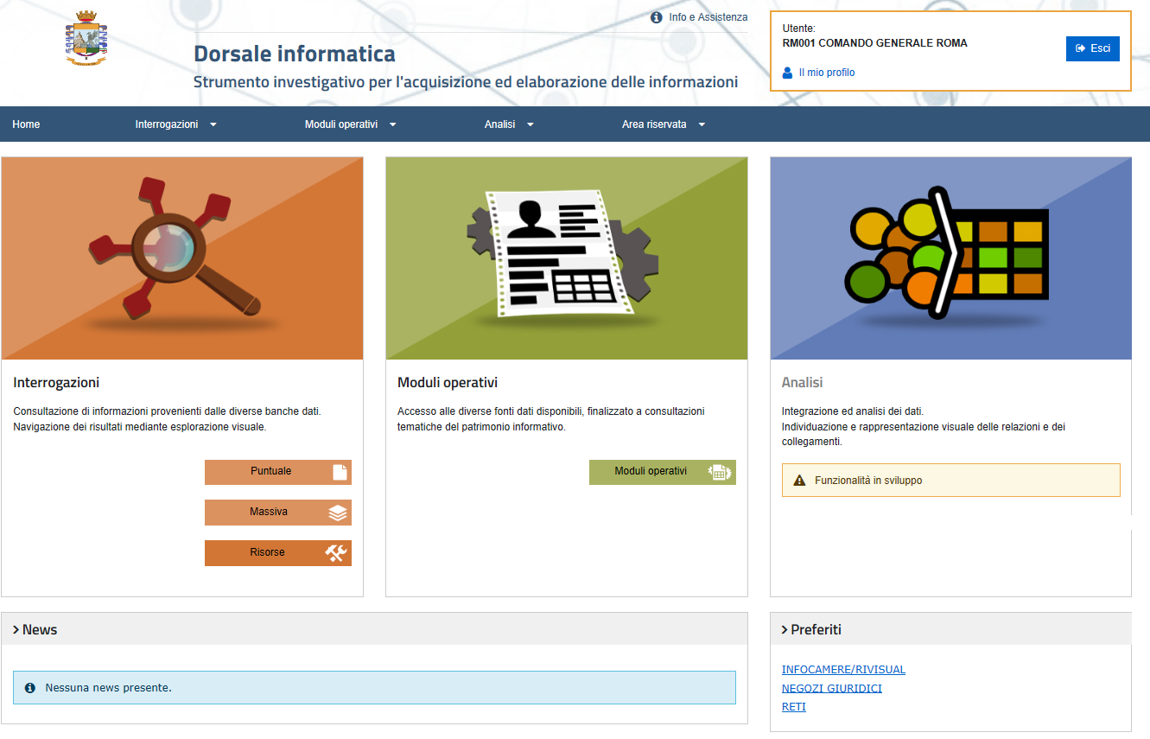
Major Case Management – A GdF perspective
The IT Backbone (Dorsale Informatica)
A huge help in major case and in daily investigations

Slide 20
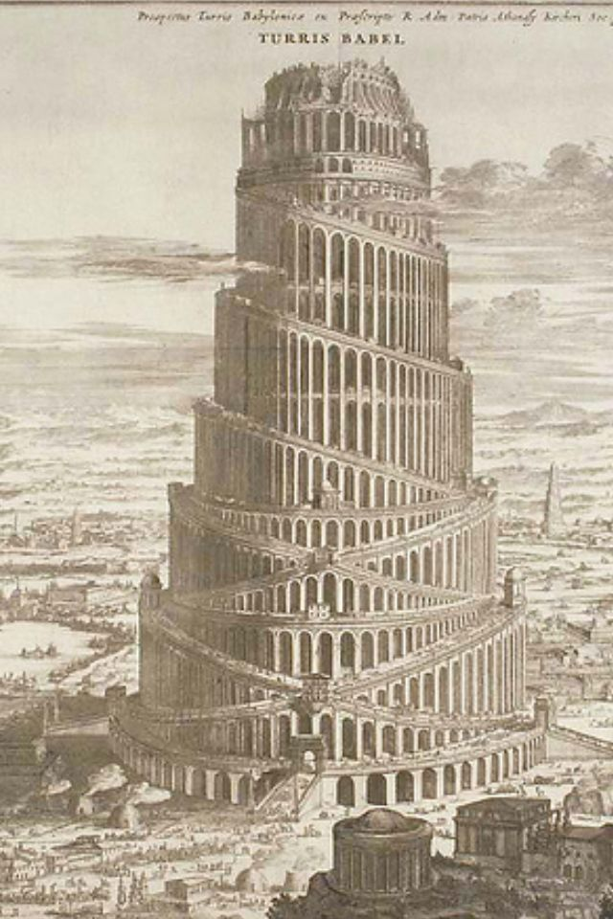
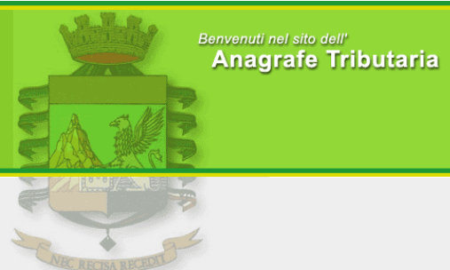




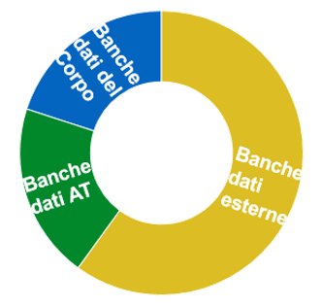




Major Case Management – A GdF perspective
Integrated management of Databases
Simplify the way databases are accessed
Standardize the user interface
Interoperability
Of information system
Integrated Management
DBs
Notes:
La Dorsale ricerca le informazioni su un numero elevatissimo di banche dati – slide che elenca le banche dati e soprattutto il numero di occorrenze in ciascuna di queste presenti - valore da affermare: disponibilità di un numero elevato di banche dati ed elevatissimo di informazioni;

Slide 21
Major Case Management – A GdF perspective
IT Backbone
It is a project aimed at providing a single point of access to all databases used by the GdF members.
It is a multifunctional IT tool that provides functionalities for:
- identifying all available information on the target;
- analyze relationships with other entities;
- monitor the users of the platform.

Slide 22
Major Case Management – A GdF perspective
Advantages
Innovating the information asset management
Strengthening of the investigative capabilities of GdF investigators
Connecting the information of different DBs to address operational decision process
Disseminating knowledge of available resources among DBs users.

Slide 23
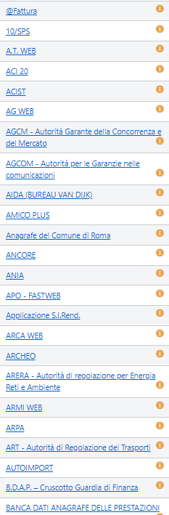
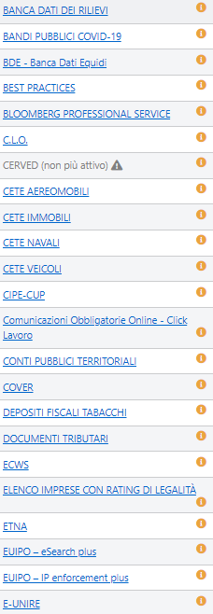
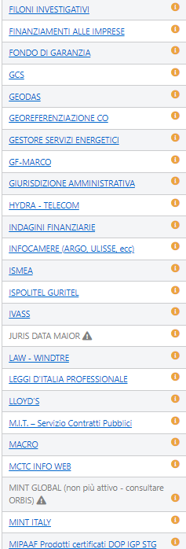
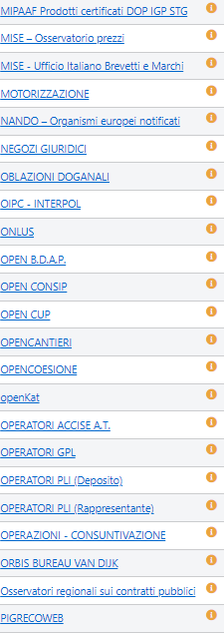
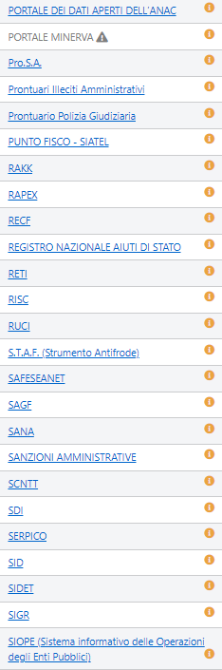
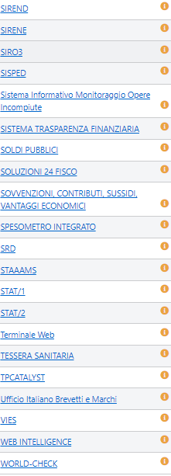
Major Case Management – A GdF perspective
Databases that can be accessed through the Dorsale
200 different sources of informations

Slide 24
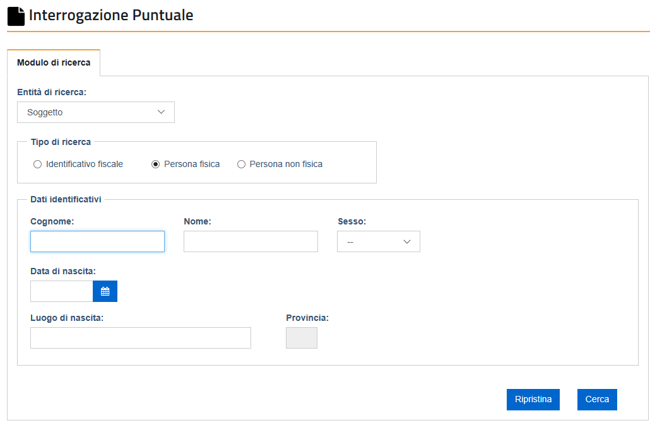
Major Case Management – A GdF perspective
Database Query

Slide 25

Major Case Management – A GdF perspective
I hope you’re all still awake...
Thanks for your kind attention!

