Slide 1




អគ្គនាយកដ្ឋានពន្ធដារ
GENERAL DEPARTMENT OF TAXATION
នាយកដ្ឋានស៊ើបអង្កេតបទល្មើសពន្ធដារ
DEPARTMENT OF TAX​ CRIME INVESTIGATION
VAT FRAUD CASE
THE INVESTIGATION ON TAX CRIME AND MONEY LAUNDERING CASE
Cambodia
24, May, 2024
National Tax College
Wako-shi, Saitama, Japan

Slide 2

Content
COMPANY INFORMATION
TAX CRIME INVESTIGATION
CASE MANAGEMENT
FLOW CHART
INTERAGENCY CO OPERATION
IMPLEMENT OF PRELIMINEARY INVESTIGATION
FINDING
MONEY TRAIL
PROSECUTION AND ASSET RECOVERY
KEY CHALLENGES

Slide 3




WHY VAT FRAUD IS POPULAR?
Purchase goods/service
Company X
Supply goods/service
Company Y
Amount: 1,000
VAT10%: 100
TOTAL: 1,100
Company A
(Legitimate Business)
Amount: 800
VAT10%: 80
TOTAL: 880
Company X pay Tax: 1.VAT:100-80=20
2.TOI:200x20%=40
Total = 60
(Declare Turnover)
Purchase goods/service
Company B
(Unregistered Business)
Amount: 700
VAT10%:0
TOTAL: 700
Company X pay Tax: 1.VAT:100
2.TOI:1000x20%=200
Total = 300
Purchase goods/service
Company Y claim: 1.VAT Input = 100
2.Expense = 1,000
(Not declared Turnover)
Company E
(ក្រុមហ៊ុនសិប្បនិម្មិត)
Amount: 999
VAT10%: 9.99
TOTAL: 1,008.99
(Fake Invoice)
Company X pay Tax: 1.VAT:.0.1
2.TOI:1x20%=0.2
Total = 0.3
(Not declared Turnover)

Slide 4
COMPANY INFORMATION
    COMPANY ៖ B C CO., LTD. (NOT REAL NAME)
    TYPE ៖ PRIVATE LIMITED COMPANY
    BUSINESS ACTIVITY ៖ WHOLESALE OF CONSTRUCTION MATERIALS AND​ TOOLS
    REGISTERED ADDRESS ៖ #52F, PHUM KBAL DOMREI, KHAN POSENCHEY, PHNOM PENH.
    REGISTERED DATE ៖ JULY, 2020 (ONLINE REGISTRATION)
    SHARE HOLDER ៖ MR. BC (CAMBODIAN), OWNS 100% SHARES
    REGISTRATION CAPITAL ៖ 100,000 US DOLLAR
    REGISTRATION DOCUMENT ៖ M&A, ID CARD, OFFICE RENTAL, OFFICE PHOTO, OWNER PHOTO
    THERE IS A TAX AGENT COMPANY NAME XYZ CO., LTD. THAT IN CHARGING OF THE REGISTRATION, FILING MONTHLY/ANNUAL TAX RETURN, REPRESENTATIVE WHEN MEETING WITH TAX AUTHORITY FOR B C COMPANY.

Slide 5
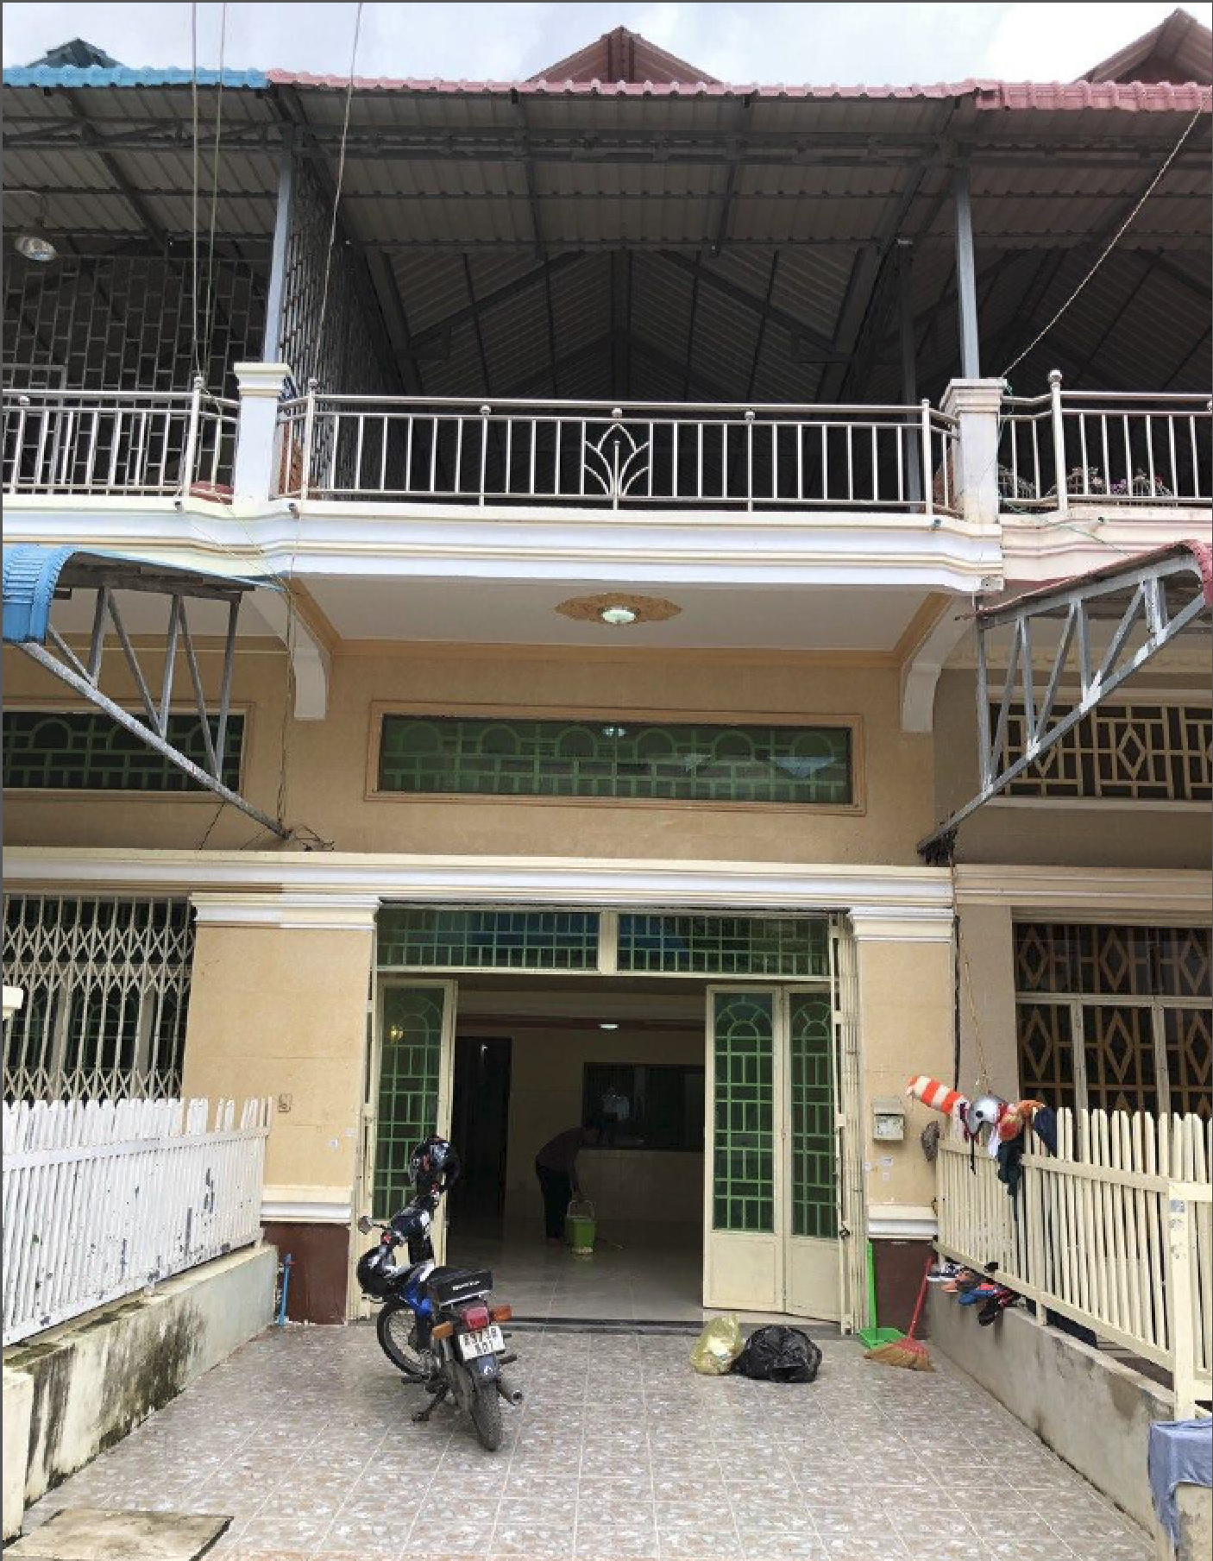
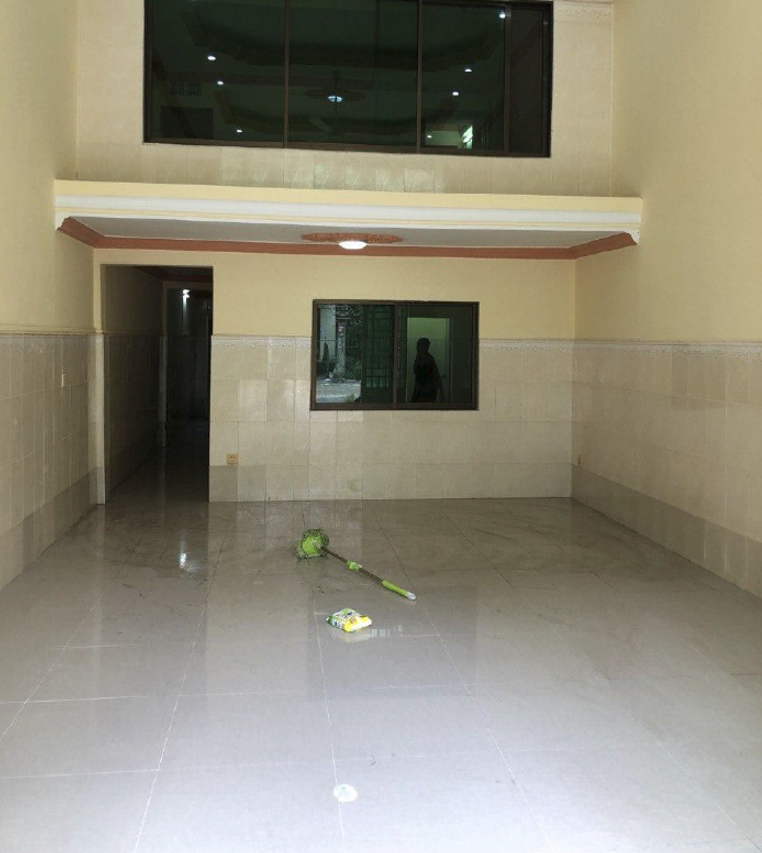
COMPANY INFORMATION (CON.)
    THE COMPANY REGISTERED LOCATION IS THE HOUSE, NOT THE COMPANY PREMISES
    THE COMPANY DID NOT DECLARED ANY TURNOVER FROM THE REGISTRATION DATE OF JULY 2020 ,BUT ONLY WITHOLDING TAX ON OFFICE RENTAL
    THE COMPANY NEGLECTED TO FILE THE TAX RETURN FROM JULY, 2021 WITHOUT INFORMING TO THE TAX ADMINISTRATION

Slide 6
TAX CRIME INVESTIGATION
B C CO., LTD. DID NOT HAVE GOODS OR SERVICES TO SUPPLY (SHELL COMPANY) only)
DATA QUERY FROM THE IT SYSTEM OF GENERAL DEPARTMENT OF TAXATION SHOWN THAT FROM JULY 2020 DECEMBER 2021, THE COMPANY ISSUED 992 FAKE INVOICES TO 211 COMPANIES (MOSTLY ARE CHINESE COMPANIES) IN TOTAL OF APPROXIMATELY 89 MILLION US DOLLARS AND VAT 8.9 MILLION US DOLLARS
THE 211 COMPANIES USED THESE FAKE INVOICES TO CLAIM VALUE ADDED TAX(VAT) 10%, AND TO REDUCE THE PAYMENT OF TAX ON INCOME(TOI) 20%
THE TAX ADMINISTRATION HAD THE TAX LOSSES AS BELOW TABLE:
(Penalty such as Additional Tax and Interest are not included)
TAXES | IN USD (Roughly)
TOI | 17.8 (Max)
VAT | 8.9
TOTAL | 26.7

Slide 7
CASE MANAGEMENT
LEADERSHIP AND TEAM BUILDING
TASK ALLOCATION / ROLES AND RESPONSIBILITIES
  SURVELLIANCE TEAM
  CAMERA AND VIDEO TEAM
  RAID/SEIZED TEAM
  TRANSPORTATION TEAM
  INTERVIEWING TEAM
  FILE CO ORDINATOR TEAM AND REPORTING TEAM
  BACK UP TEAM
COMMUNICATION

Slide 8






CASE FLOW CHART
B C Co., Ltd.
(Shell Company)
ISSUED 992 FAKE INVOCIES AMOUNT OF $ 89 MILLION
MR. B C
(THE STRAW MAN)
COMPANIES USED FAKE INVOICE TO REDUCE VAT/TOI
1. MR. A IS THE CHAIRMAN OF XYZ CO., LTD. HE IS THE REPRESENTATIVE OF B C CO., LTD. WHEN HAVING MEETING WITH TAX INVESTIGATOR
SALE FAKE INVOICES
XYZ CO., LTD.
(Licensed Tax Agent)
211 COMPANIES
CHINESE
USED THE 992 FAKE INVOICES AMOUNT $89 MILLION TO MAKE TAX FRAUD. GDT HAD TAX LOSSES AS BELOW:
VAT = $ 8.9 MILLION
TOI = $ 17.8 MILLION (MAX)
TOTAL = $ 26.7 MILLION
2. MR. B IS A SHAREHOLDER OF XYZ CO., LTD. HE HAS CONNECTION WITH THE CHINESE
COULD SUPPLY GOODS
3.MR.C IS THE XYZ’S STAFF. HE RECEIVED THE PAYMENT FROM THE CHINESE FOR SERVICES FEE AND HE TOOK MR. B C TO UPDATE COMPANY INFORMATION AT GDT
CONNECTED
REAL COMPANY
(UNREGISTERED)

Slide 9



INTER AGENCY CO-OPERATION
A JOINED TASK FORCES BETWEEN THE DEPARTMENT OF TAX CIMRE INVESTIGATION AND THE NATIONAL BANK OF CAMBODIA AND THE POLICE UNIT WERE CONDUCTED.

Slide 10
IMPLEMENT OF PRELIMINEAY INVESTIGATION
SURVELLIANCE ON THE SUSPETS’S LOCATIONS AND DAILY ACTIVITY
IMPLEMENT WARRANT OF SUMMONS/ARREST
  IMPLEMENT WARRANT OF SUMMONS TO 7 SUSPECTS, 4 ARE ARRESTED
  TWO MORE CHINESE SUSPECTS ARE ARRESTED ACCORDING TO THE CONFESSION OF MR. B C (THE STRAW MAN)
IMPLEMENT SEARCH WARRANTS
  RAIDED 3 IMPORTANTS LOCATIONS:
    COMPANY PREMISES OF TAX AGENT COMPANY
    COMPANY PREMISES OF B C TRADING CO., LTD.
    A VILLA WHERE THE CHINESES SUSPECTS WHO SELL FAKE INVOICE ARE STAYING
PHONE CHECK ON THE CONVERSATIONS OF THE SUSPECTS
FREEZE 3 BANK ACCOUNTS OF 2 CHINESE SUSPECTS

Slide 11
FINDING
42 STAMPS OF COPMANY AT XYZ CO., LTD. 3 STAMPS ARE BELONG TO SHELL COMPANIES
PHOTO AND ID CARD OF OTHER 4 PEOPLE WHICH ARE HIRED TO BE THE STRAW MAN OPEN TO SET UP 4 MORE SHELL COMPANIES (3 COMPANIES ARE ALREADY REGISTERED, THE OTHER ONE IS IN THE REGISTRATION PROCESS)
RECEIPTS OF B C CO., LTD. AND OTHER SHELL COMPANIES IN THE CARE OF CHINESE SUSPECT
OPERATION OF CASH TRANSFER IN CHINESE’S MOBILE PHONE
CONVERSATION IN WE-CHAT ABOUT THE SELLING FAKE INVOICES TO LOTS OF COMPANIES
A BALANCE OF 1.2 MILLIONS USD FROM IN THE BANK ACCOUNT OF A CHINESE GUY SUSPECT

Slide 12




MONEY TRAIL
ISSUED 992 FAKE INVOCIES AMOUNT OF $ 89 MILLION
COMPANIES USED VATFAKE INVOICE TO REDUCE /TOI
HAS CONNECTING WITH 211 COMPANIES
B C Co., Ltd. (Shell Company)
ORDER TO TRANSFER CASH
COMPANIES 211
SELL FAKE INVOICES
CASH TRANSFER
SELL FAKE INVOICES
CASH TRANSFER
CASH TRANSFER
SELL REALL GOODS
CASH TRANSFER
CASH TRANSFER
REAL COMPANY
(UNREGISTERED)
CASH TRANSFER
CASH TRANSFER
CASH TRANSFER
CASH TRANSFER
CASH TRANSFER
CASH TRANSFER
TRANSFER CASH TO CHINA BY UNION PAY

Slide 13
PROSECUTION AND ASSETS RECOVERY
6 PEOPLE (4 CAMBODIAN AND 2 CHINESE) AREE ACCUSED OF GUILTY OF MONEY LAUDNERING AND TAX EVAISON. THE COURT SENTECED ALL THE ABOVE ACCUSED PEOPLE FOR 3 YEARS IMPRISONMENT.
AN MLAT REQEST WAS SENT BY THE INVESTIGATIN JUDGE TO CHINA TO REQUESTING IDENTIFICATON OF RELVEVANT BENEFICIARYIES, INFORMATION ON BANK ACCUNTS OWNERSHIP AND BANK STATEMENTS
BANK ACCOUNTS AND ASSETS WITH AMOUNT OF 1.8 MILLION USD WERE FREEZED AND CONFISCATED.
THE 211 COMPANIES ARE SUBJECTED TO TAX REASSMENT DUE TO UISNG FAKE INVOICES WITH THE AMOUNT OF TAX RECOVERED AROUND 15 MILLIONS US DOLLAR.

Slide 14
KEY CHALLENGS
LACK OF EXPERIENCE IN LEADING MAJOR CASE
LEVEL OF ENGAGEMENT AMONG INTER AGENCY COOPERATION
INTERNATIONAL AGENCY COOPERATION

Slide 15


សូមអរគុណ‌!
THANK YOU!

