Slide 1


An IT Analysis Tool than can speed up your Complex Case Investigations
The Use of Intella® Connect
made by Guardia di Finanza
Alessandro Lo Bello
Head of Direct Taxation and VAT EOI Unit
Guardia di Finanza General Headquarters

Slide 2




DIGITAL EVIDENCE IN INVESTIGATIONS
Dematerialisation of information
Exploitation of the information arising from digital data
Information overload

Slide 3
INVESTIGATIVE IT TOOLS AVAILABLE TO
THE GUARDIA DI FINANZA
Guardia di Finanza personnel with the Computer Forensics and Data Analysis (CFDA) qualification intervene in all operational areas (administrative and criminal) where is needed their support, both operational and knowledge-based, in the field of Digital Forensics,
The Guardia di Finanza General Headquarters-IT Department provides a set of tools and software useful for:
the extraction of digital evidence from different devices
the analysis of collected data.

Slide 4
INVESTIGATIVE IT TOOLS AVAILABLE TO THE SPECIAL CURRENCY POLICE UNIT
ACQUISITION OF DIGITAL EVIDENCE
Ufed Touch2
Ufed4pc
Oxygen
Axiom
Smartphones, tablets and other mobile devices
PCs, hard disks and other mass storage devices
Falcon
Axiom
MacQuisition
ANALYSIS OF THE COMPUTER DATA COLLECTED
FTK Toolkit
Encase
Axiom
BlackLight
Oxygen forensics
Ufed Physical Analyzer

Slide 5

INVESTIGATIVE IT TOOLS
MAIN CRITICISMS IN THE ANALYSIS PHASE
IT SKILLS OF THE INVESTIGATOR
the field officer carrying out the analysis (not CFDA) has to learn how to use different software, some of which are very technical and not user-friendly.
USE OF DIFFERENT SOFTWARE
DIFFICULTY WORKING IN A TEAM AND SIMULTANEOUSLY
need to produce multiple copies of the data extracted from the forensic copies, to allow several officers to examine the files at the same time.
impossibility to immediately share searches carried out in the same IT environment, with the consequent risk of unnecessary duplication of activities and a clear need for coordination
(IN)ADEQUACY OF HARDWARE TOOLS
have suitable hardware with excellent computing power for processing large data ➔ the IT equipment of the Department (different from that of the CFDA) includes PCs that are not suitable for that purpose
clear separation of analysis programmes for mobile forensics from those for analysing other mass storage devices ➔ need to use different environments contexts for data analysis.

Slide 6


INTELLA CONNECT
INTELLA® software – Connect version
SINGLE CONTAINER
  Processing of all taken digital evidence, including smartphones and tablets, in a single environment
  Simultaneous analysis and search of all acquired information

Slide 7
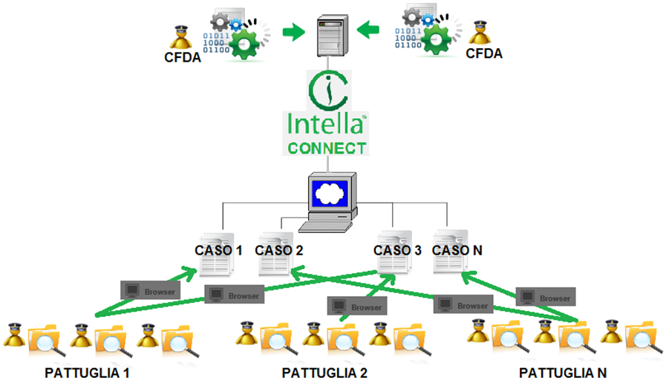
INTELLA CONNECT
ANALYSIS SHARED BY THE INVESTIGATIVE TEAM(S)
  single architectural platform, easily accessible to users via common web-browsers
  analyse multiple investigation cases simultaneously: several teams work on multiple cases at the same time
  analysis and search of digital evidence by each team member in real-time and independently, with immediate sharing of information of interest

Slide 8
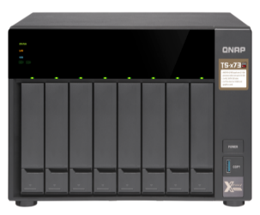
INTELLA CONNECT
STORAGE CAPACITY
  Creation, processing and management of large cases, without capacity limitations
  Intella is currently equipped with a NAS (network-attached storage) having a capacity of 16 Tb
  However, the structure of the software allows the connection of other mass storage media, without any capacity limitation
All queries are processed by the “central” computer and not by those used by the staff members (pc clients), which can therefore be computers with limited performance capabilities
Data are saved exclusively on the NAS, which can be consulted by any staff member, without the necessity of duplicating data on several computer media

Slide 9
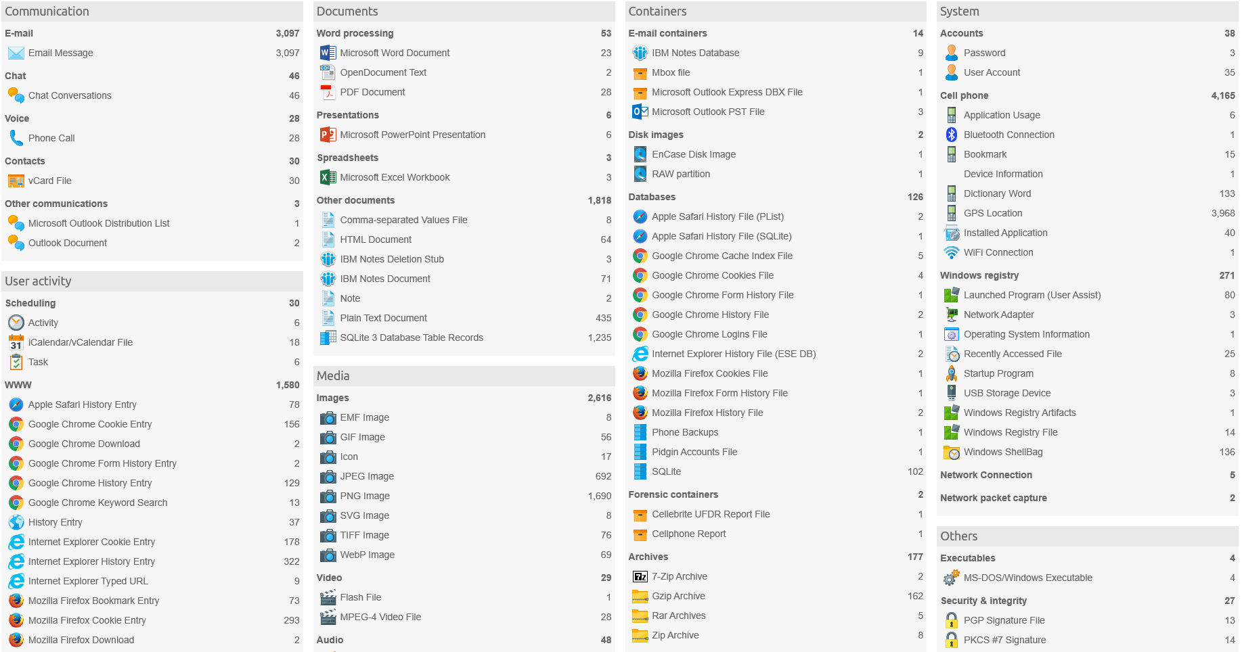
INTELLA CONNECT
INDEXING AND ANALYSIS
  ABILITY TO IDENTIFY AND INDEX A LARGE NUMBER OF ARTIFACTS
Chat
conversations
Browser navigation history and activities

Slide 10
INTELLA CONNECT
INDEXING AND ANALYSIS
Documents
Images and videos
System data

Slide 11
INTELLA CONNECT
INDEXING AND ANALYSIS
E-mails
Cookies and downloads
Hard disk contents
Data from forensic sources

Slide 12
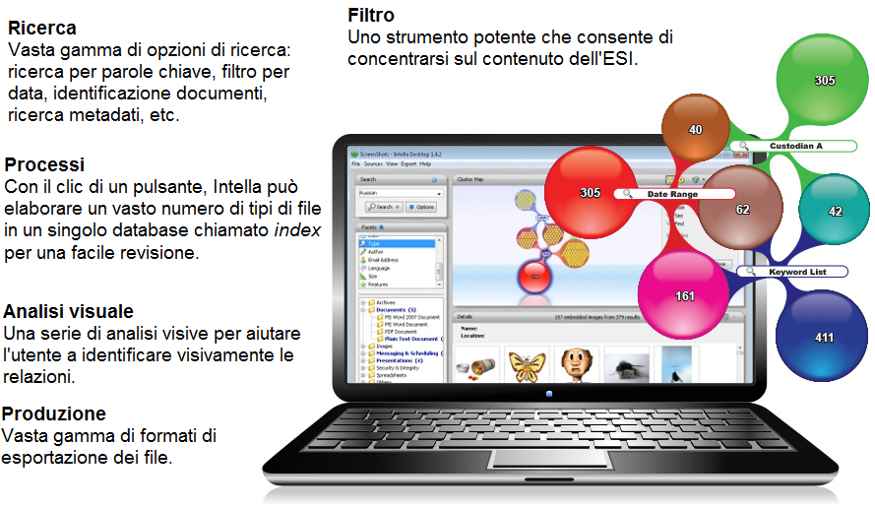
INTELLA CONNECT
APPLICATION FUNCTIONS
Search
Wide range of search options: keyword search, date filter, document identification, metadata search, etc.
Filter
A powerful tool to focus on the ESI content
Processes
With one button click, Intella can process a large number of file types in a single database named index for an easy review.
Visual analysis
A series of visual analyses to help the user to visually identify connections.
Production
Wide range of file export formats.

Slide 13
INTELLA CONNECT
APPLICATION FUNCTIONS
VISUAL ANALYSIS
  Visual analysis allows an instant identification of links between the various cloned computer media

Slide 14
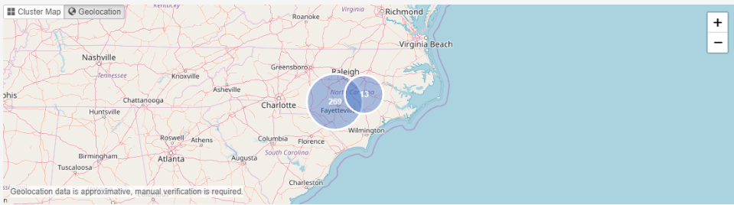
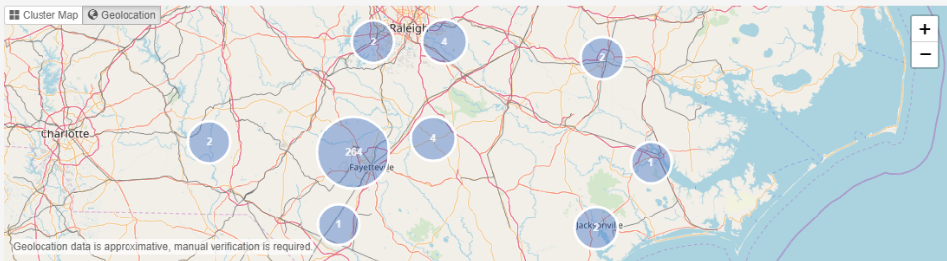
INTELLA CONNECT
APPLICATION FUNCTIONS
GEOLOCATION
  Intella extracts geolocation data from
  images
  mobile phone logs
  e-mails (IP geolocation)
  Google Maps URLs

Slide 15
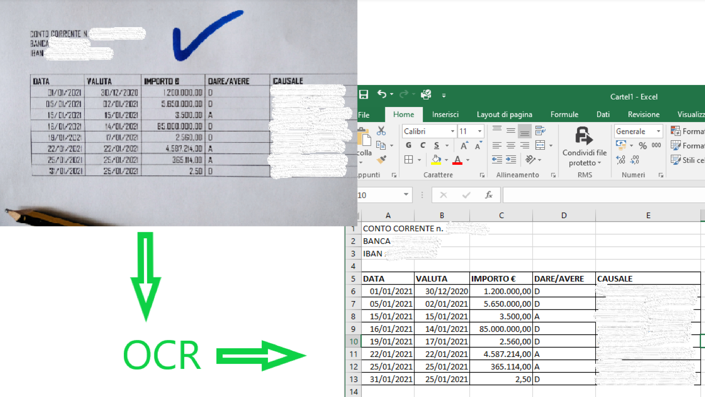
INTELLA CONNECT
APPLICATION FUNCTIONS
Optical character recognition (OCR) function
  Optical character recognition (OCR)
  from scanned documents, photos, etc..

Slide 16
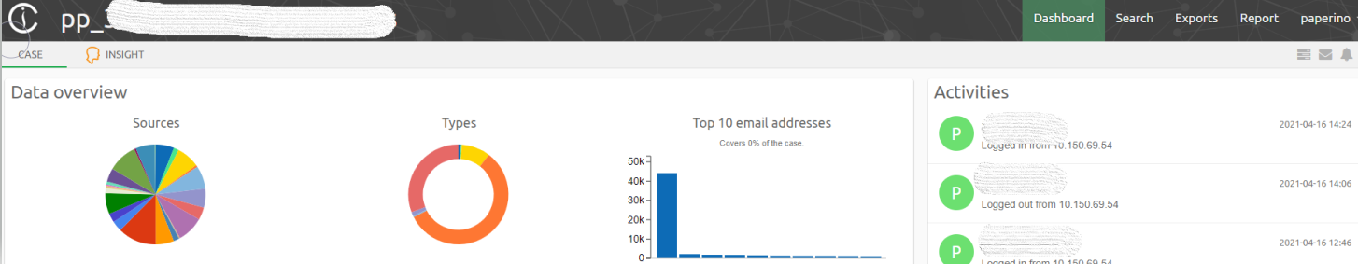
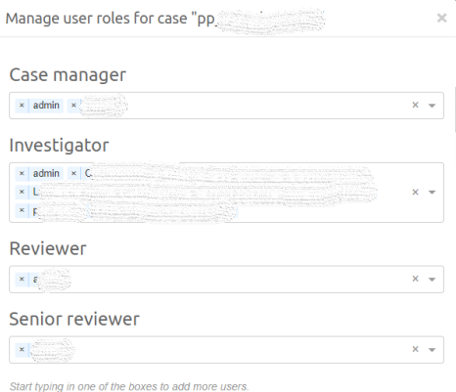
INTELLA CONNECT
APPLICATION FUNCTIONS
DIFFERENT LEVELS OF VISIBILITY
  LEVELS OF VISIBILITY
  The team leader has a number of tools to supervise the work of the investigators, monitor the accesses, correct comments, add notes etc.

Slide 17
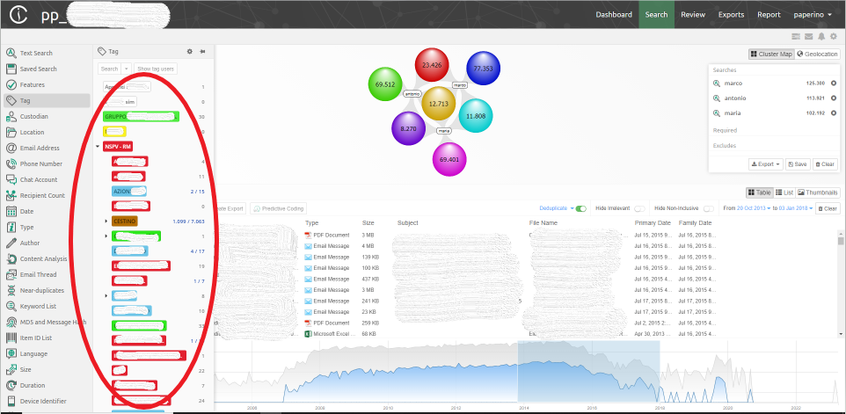
INTELLA CONNECT
APPLICATION FUNCTIONS
ADDING OF TAGS TO FACILITATE TEAMWORK
  Possibility to add tags, also in a nested form

Slide 18
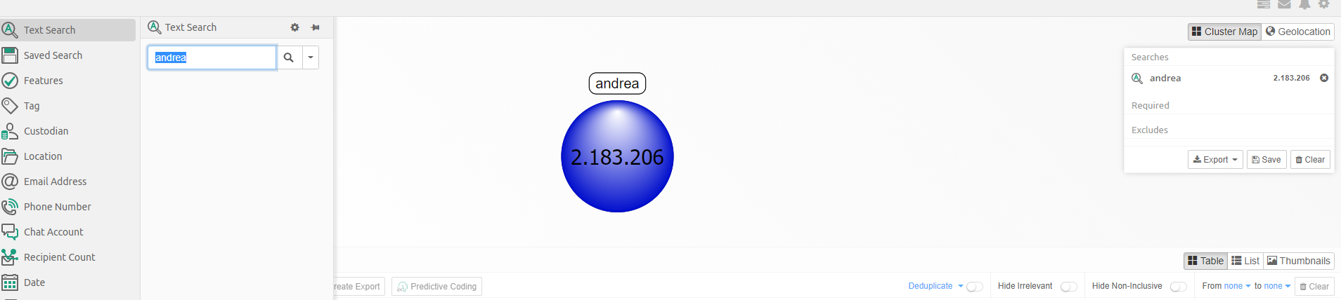
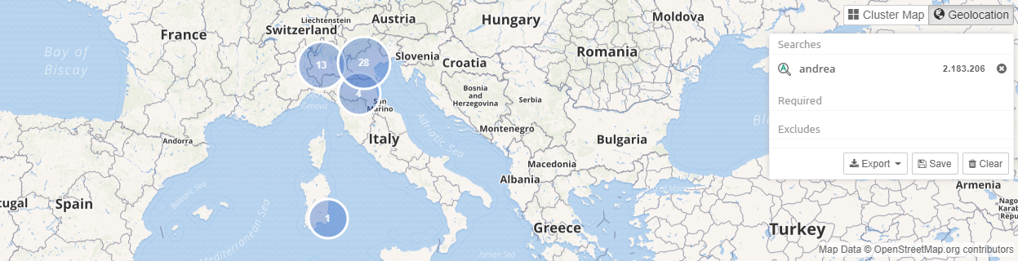
INTELLA CONNECT
APPLICATION FUNCTIONS
PRACTICAL EXAMPLE
Searching the word «Andrea» in the entire database

Slide 19
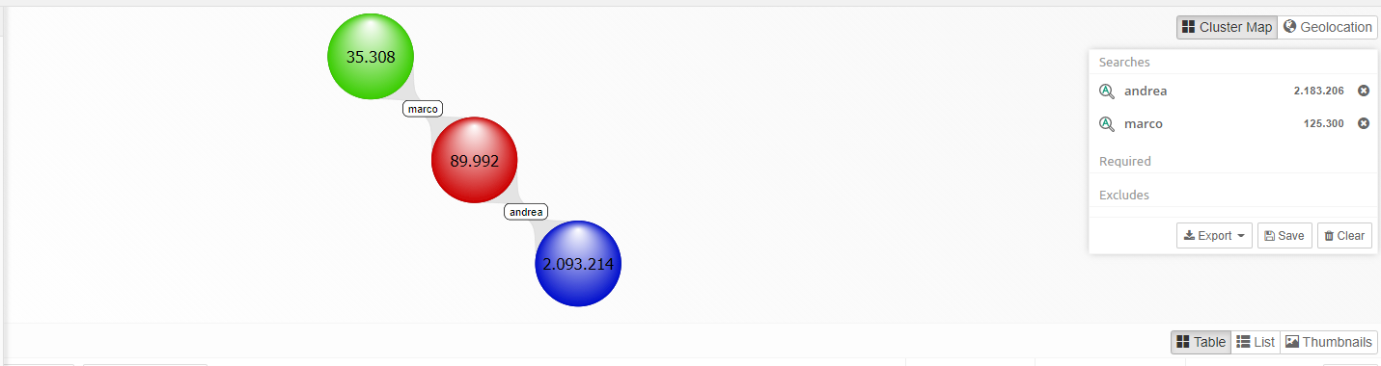
INTELLA CONNECT
APPLICATION FUNCTIONS
PRACTICAL EXAMPLE
Searching the word «Andrea» in the entire database
Adding the word «Marco» in the search

Slide 20
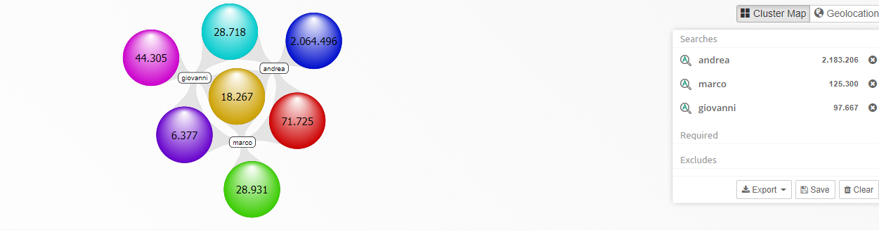
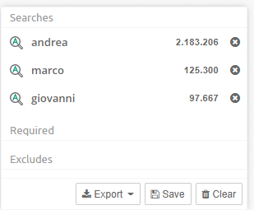
INTELLA CONNECT
APPLICATION FUNCTIONS
PRACTICAL EXAMPLE
Searching the word 'Andrea' in the entire database
Adding the word 'Marco' in the search
Adding the word «Giovanni» in the search

Slide 21
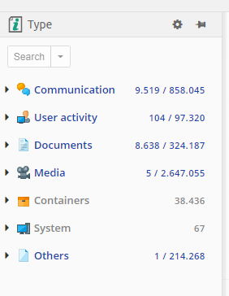
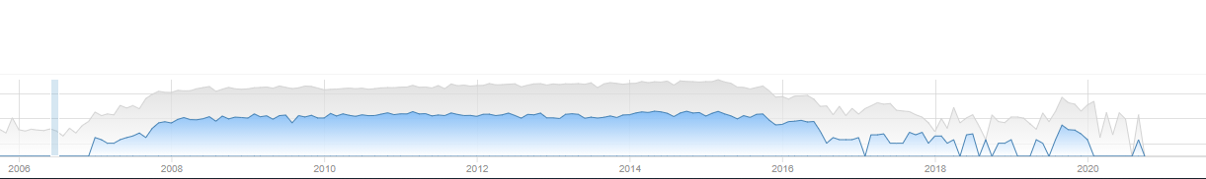
INTELLA CONNECT
Data type results
Time frame

Slide 22
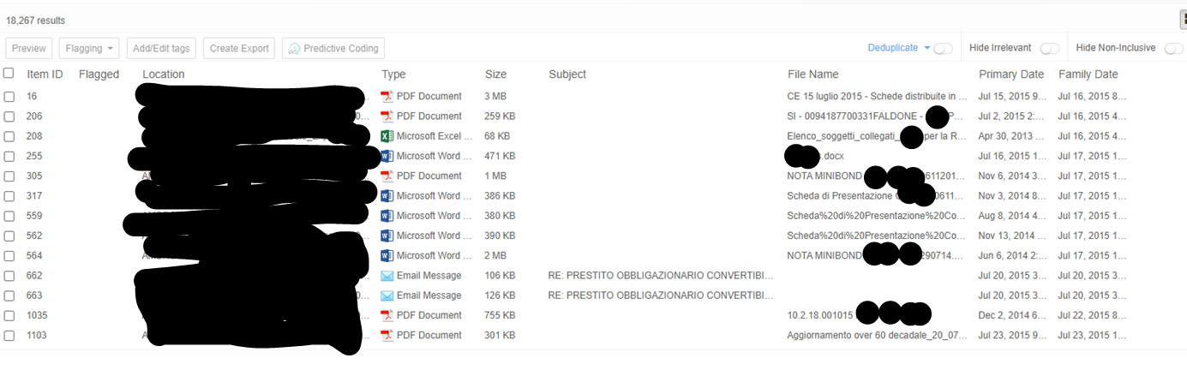
APPLICATION FUNCTIONS
PRACTICAL EXAMPLE
List of results
Item ID
Origin
Data type
File name
Date

Slide 23
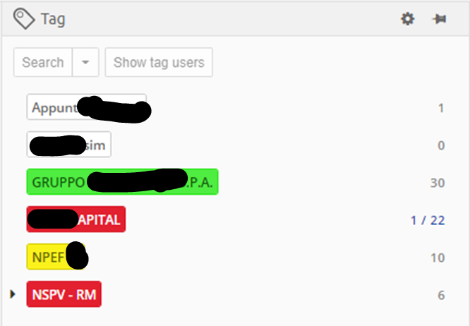
INTELLA CONNECT
APPLICATION FUNCTIONS
PRACTICAL EXAMPLE
Tag

Slide 24
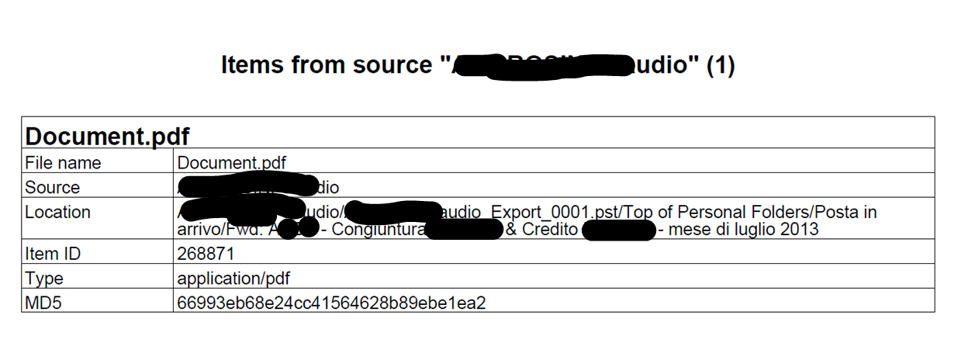
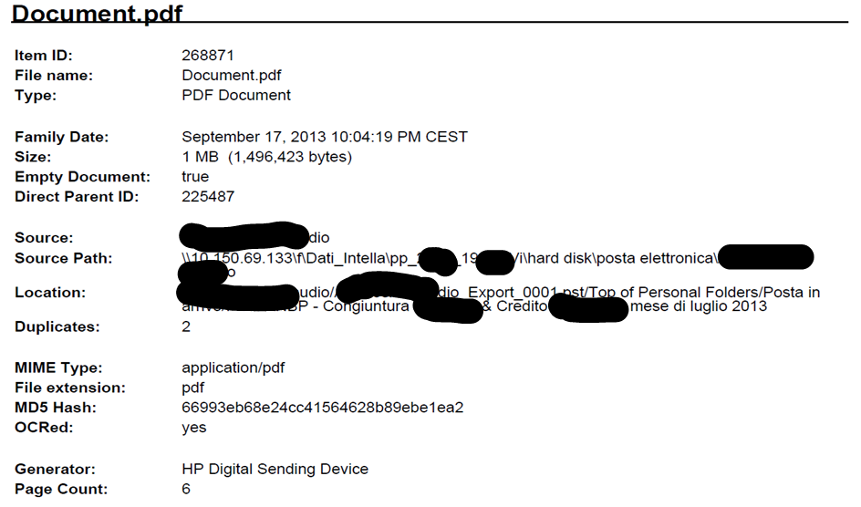
INTELLA CONNECT
JUDICIAL POLICE RECORD REPORT
Document origin

Slide 25
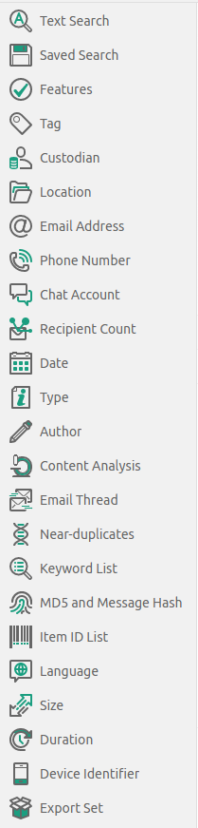
INTELLA CONNECT
Additional search keys

Slide 26

Grazie per l’attenzione!

