Slide 1



The GdF
International
Network
Alessandro Lo Bello
Head of Direct Taxation and VAT EOI Unit
Guardia di Finanza General Headquarters

Slide 2

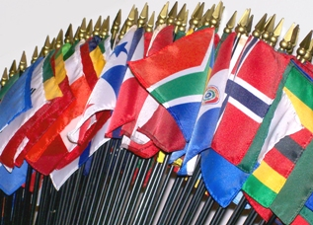


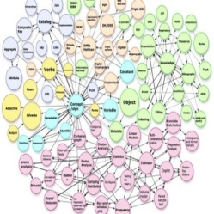

Major Case Management – The GdF international network
International Relations
International Cooperation
The HQ
II Department Structure
for International Relations and Cooperation
Head of the
II Department
Intelligence and Information management
Analysis
Information Security

Slide 3


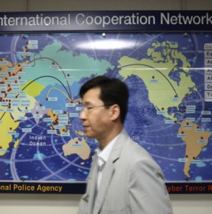
Major Case Management – The GdF international network
GdF Experts and
Liaison Officers
Memorandum of Understading
Channels of Cooperation

Slide 4

Major Case Management – The GdF international network
Info-operational function
Strategic
function
International Relations Office
International Cooperation and Relations with Foreign Counterparts Office
Notes:
Within the broader context of international cooperation, the International Relations Office performs a strategic function: it implements the Corps' international relations in the fields of major institutional interest (essentially the fight against transnational economic-financial crime), promoting contacts and forms of collaboration with foreign Counterparts, also through the development of negotiations aimed at the agreement of Memoranda of Understanding for the exchange of information and international collaboration in economic-financial police matters falling within the Corps' jurisdiction. The result of this activity is then reflected in the info-operational function performed by the International Cooperation and Relations with Foreign Counterparts Office:
This Office, in brief, deals with the following tasks:
Exchange of data, information and news in all the areas of intervention of the Corps with foreign Counterparts (Mutual Administrative Assistance and Police Cooperation).
Connection with International Organisations in charge of information exchange (OECD, OLAF, EUROPOL, WCO)
Support to international operational activities of the Corps' Units (rogatorial initiatives, information coordination meetings, etc.)

Slide 5




Major Case Management – The GdF international network
€
CUSTOM
MONEY LAUNDERING – FIN. TER.
SPONTANEOUS
1
2
3
4
5
POLICE
FISCAL
International Cooperation
Interpol
Europol
Sirene
D.C.S.A.
Through the Ministry of Interior – Service for International Cooperation
Bilateral Agreements and Multilateral Conventions
Reg. CE 515/97 (customs and agriculture)
EU Reg. 389/2012 (excise)
EU Convention “Naples II”
Bilateral Agreements and Conventions . art. 26 OECD Model
EU Directive 2011/16 - D.Lgs 29/2014
Multilateral OECD Convention – Council of Europe
EU Regulation 904/10 EC on VAT matters
Financial intelligence Unit Network:
1. Global (egmont)
2. European (FIU.NET)
Memoranda of Understanding
Specific agreements on institutional areas of interest
Notes:
This slide describes the channels available for establishing and implementing international cooperation and the related legal bases.
Namely, they are:
police cooperation - with its several channels such as Interpol, Europol, the Sirene system, the Asset Recovery Office, Central Department for anti-drugs activities;
administrative cooperation (basically tax and customs cooperation in the framework of the so-called international mutual assistance),
cooperation against money laundering and terrorist financing, which makes use of specific forms of collaboration with the national FIU, thus allowing the access, through the aforementioned National Authority, to the cooperation channels of foreign FIUs.
Spontaneous cooperation through flexible tools such as MoUs or Working Agreements, able to establish an effective cooperation on areas of common interests.

Slide 6
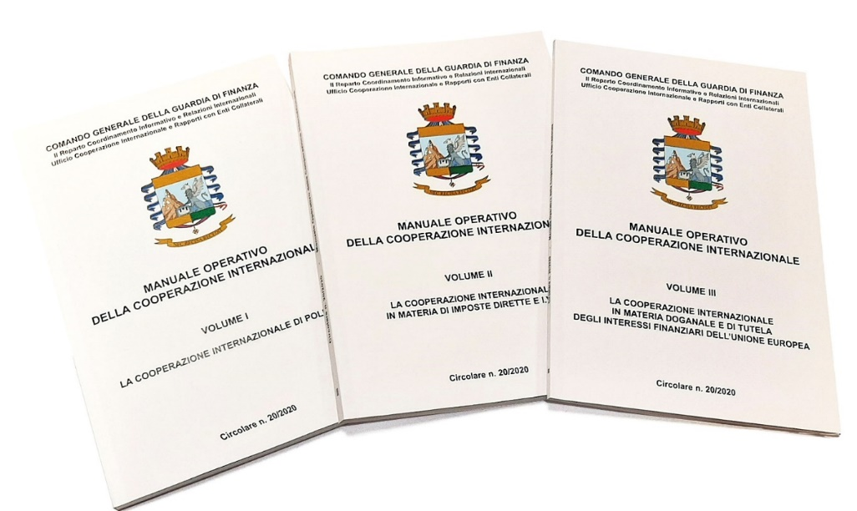
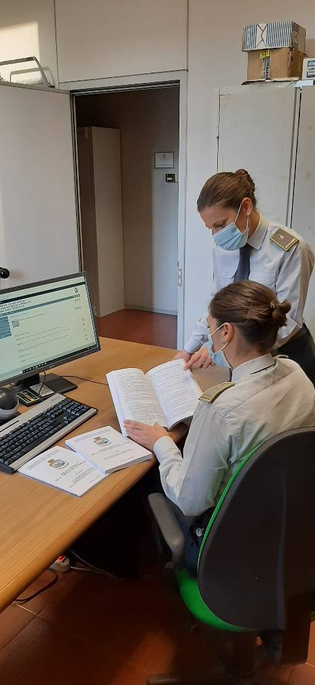
Major Case Management – The GdF international network
Operational Handbook for International Cooperation
3 books:
Police cooperation;
Mutual administrative assistance in tax matters;
Cooperation in customs matters and protection of the financial interests of the European Union.
Notes:
The ever-increasing importance that the international cooperation activities are assuming as an essential tool to fight all trans-national criminal phoenomena resulted in the General Headquarters drafting a specific Operational Handbook, which provides the local Units with an articulate and comprehensive outlook, essentially from a practical-operative point of view, on the specific procedures needed for each cooperation channel. It also provides accurate and exhaustive guidelines, in order to raise awareness and promote international cooperation, thus contributing to the medium/long term strategy of consolidating and strengthening the international outreach of the Corps.

Slide 7

Major Case Management – The GdF international network
The Guardia di Finanza Attachés network
Notes:
The GdF Expert
The action of the expert must naturally be differentiated according to whether he/she operates in a bilateral context, within which he/she takes care of cooperation with the bodies of the Country of reference, or within the Permanent Representations.
The four experts seconded or with competence to the Permanent Representations of Italy (Brussels - EU; Paris – International Organisations; Wien - OSCE; New York - UNO), take part in important multilateral working groups, within which they look after the interests of our Country during the negotiations of instruments of international or supranational law, in the matters most relevant to the prerogatives of the Guardia di Finanza, whose consequences in the internal domain are clearly evident.
I recall, for example, the participation in the UN working groups on the monitoring of illicit financial flows, including those destined to finance terrorist organisations, in relation to which Italy plays a key role this year by virtue of its presence, as a non-permanent member, in the Security Council.
Furthermore, in the EU, I recall the contribution to the work on the revision of European regulatory instruments on money laundering, circulation of cash, terrorist financing, and protection of the Union's financial interests, or finally, in the OECD sphere, to the working groups on the issues of international taxation and fight against money laundering.

Slide 8


Major Case Management – The GdF international network
Legal Framework
Legislative Decree 68/2001:
"The Corps of the Guardia di Finanza promotes and implements ... forms of operational cooperation, at international level, with foreign counterparts, to counter violations in economic and financial matters for the protection of the State and European Union budget"
Law 78/2000:
“economic and financial police functions to protect the State and the European Union budget".
Notes:
The Guardia di Finanza plays a fundamental role at international level, which is, moreover, endorsed by two important regulatory provisions: the delegated law 78/2000, which provided for the Corps to exercise economic and financial police functions to protect the State and the European Union budget and the subsequent legislative decree 68/2001, which established in even more detail that the Guardia di Finanza promotes and implements forms of operational cooperation, at international level, with foreign counterparts, to counter the aforementioned violations.
8

Slide 9
Major Case Management – The GdF international network
GDF EXPERTS AND LIAISON OFFICERS
Diplomatic missions (Embassy/Consulate) and Permament representations
Expert
(Attaché)
Hierarchical and functional subordination to the Head of Mission
Reports to the General Headquarters on activities carried out in relation to institutional matters
Liaison Officer
International organisations dealing with economic and financial matters
Notes:
The Expert and the Liaison Officer
As is well known, Article 168 of Presidential Decree no. 18 of 5 January 1967, which regulates the “Organization of the Administration of Foreign Affairs", also defines the role of the Expert, providing in particular that the Administration of Foreign Affairs may rely, in central offices or diplomatic representations and consular offices, on Experts from other State Administrations belonging to management careers or of equal rank, to carry out tasks requiring particular technical skills, which diplomatic officials cannot perform.
In matters of economic-financial police cooperation, the Expert is introduced for the first time by Legislative Decree no. 68 of 19 March 2001, which in article 4 provides that the Guardia di Finanza may assign its own personnel to work as experts at diplomatic representations and consular offices for the promotion and implementation of forms of operational cooperation, at international level, with foreign collateral bodies, to fight violations in economic and financial matters to safeguard the national and EU budgets, as well as for support and advisory activities in the same sectors.
Our experts, in addition to constituting a single point of reference for the financial administration abroad (therefore - pursuant to Article 12, Paragraph 3a of Law No. 102 of 3 August 2009 - also for the Revenue Agency), contribute to the promotion and implementation of all forms of international cooperation in the sectors of institutional interest and acquire information useful to the identification of the many transnational illicit phenomena, with economic-financial connotations.
The role of the Liaison Officer of the Guardia di Finanza is mainly regulated by Article 4, paragraph 4 of the mentioned Legislative Decree No. 68/2001, which states: "For the same purposes of paragraphs 1 and 2, the Corps of the Guardia di Finanza can allocate its own personnel, with the compensation defined by Law no. 642 of 8 July 1961, and within the limits of the ordinary budgetary allocations, also at the institutional seats competent in the matters mentioned in paragraph 1, in the international and European area". Essentially, these are assigned to foreign territories for the same purposes as the Experts, but employed at institutional offices of foreign counterparts and/or international organisations competent in economic-financial matters.
Unlike the Experts, their employment is normally regulated by a Protocol - stipulated with the Foreign Counterpart to which they are seconded - which also regulates their tasks, functions and limits of exercise.
The duties of the Officers in questions are also the subject of a specific and detailed document which, as I will elaborate further on, was recently approved by the Guardia di Finanza’s highest authority and shared with the Ministry of Foreign Affairs and International Cooperation.

Slide 10



Major Case Management – The GdF international network
TASKS
Ensuring the effectiveness of audits/investigations for tax purposes to prevent and fight the illicit transfer and possession of economic and financial assets abroad
Acquiring information useful for detecting the illicit transfer and possession of economic and financial assets abroad
Fighting international evasion and tax avoidance
Strenghtening of international cooperation

Slide 11
Major Case Management – The GdF international network
Liaison Officer
For the same purposes
- operational cooperation, support and advisory activities –
to safeguard the national and EU budgets
GdF may allocate outside the national territory Liaison Officers
to International and European Organizations competent in economic and financial matters

Slide 12






Major Case Management – The GdF international network
INTERNATIONAL ORGANIZATIONS
Secondary accreditation of the Attaché to the Italian Embassy in Panama
Permanent Representation of Italy to the UN – New York
Permanent Representation of Italy to international organizations - Paris
Permanent Representation of Italy to the OSCE - Wien
World Customs Organization
Permanent Representation of Italy to the EU – Brussels
Notes:
The role of the expert
The activities carried out by the Experts must naturally be differentiated according to whether they operate in a bilateral context, in which they take care of cooperation with the relevant country, or within the Permanent Representations.
The four experts posted to the Permanent Representations of Italy (Brussels - EU; Paris – International Organizations; Wien - OSCE; New York - UN), are included in important multilateral working groups, under which they look after the interests of our Country when negotiating instruments of international or supernational law, in the matters most pertaining to the prerogatives of the Guardia di Finanza.
I woud like to mention, for example, the participation in the UN working groups on the monitoring of illicit financial flows, including those destined to finance terrorist organizations, in relation to which Italy, in the current year, plays a key role as a non-permanent member in the Security Council.
Also, in the EU, I would like to mention the contribution to the revision of the European regulatory instruments on money laundering, cash circulation, financing of terrorism and protection of the EU’s financial interests and, within the OECD, the participation to the working groups on the issues of international taxation and the fight against money laundering.

Slide 13

























Major Case Management – The GdF international network
The Hague
Cologne-ZKA-RILO WE
Bruxelles - WCO
Bruxelles
Berlin
Bern
New York
London
Vienna
Beijing
Paris – (bilateral)
Ankara
Washington, D.C.
Paris- Int. Org..
Belgrade
Tirana
New Delhi
Tokyo
Madrid
Panama City
La Valletta
Tunis
Tripoli
Abu Dhabi
Brasilia
Tel Aviv
NETWORK OF ATTACHÉS AND LIAISON OFFICERS
Buenos Aires
25 Attachés to Italian Missions abroad
1 Supporting Officer: Bruxelles (EU Representation)
Liaison Officers: Bruxelles (WCO) and
Cologne (ZKA-RILO WE)
Attachés
Supporting Officers
Liaison Officers
Notes:
In such framework, since 2004 the Guardia di Finanza employs qualified personnel at diplomatic missions abroad, as “economical-financial” experts, as well as Liaison officers at foreign counterparts and administrations competent in economic-financial matters, at international and European level.
Our experts, other than acting as the single point of contact representing our national tax administration abroad, contribute to promote and implement any forms of international cooperation in the areas of institutional interest and obtain information useful for identifying transnational economic and financial crime.
The continuous strengthening and enhancement of the international network has recently led GdF to reach, by the end of this year, the number of 25 Experts (the office in Tel Aviv was opened at the end of 2023), to which two further positions of Liaison Officers were added, assigned respectively to the Cologne Office of RILO WE and to the World Customs Organization in Brussels.
The duties of the Officers in question are, moreover, the subject of a specific and detailed disciplinary compendium, recently approved by the General Commander and shared with the Ministry of Foreign Affairs and International Cooperation. Such document provides for specific instructions on the functions of the officers of the Corps who serve in the Italian diplomatic consular network abroad, divided into five specific areas, referring to:
GDF experts have the duty to implement:
- The Operational Cooperation;
- Analysis and monitoring of illicit economical-financial phenomena;
- Institutional Relations;
- Technical assistance, capacity building and international training;
- Support and advice on economical and financial matters.
Often, the Corps’ Attachés, alongside the country of principal accreditation, are as well officially operating in neighbouring countries, where they can establish formal cooperation links with other counterparts.
Once the recently established positions are operational, the Corps will be able to cover, worldwide, a total of 87 Countries and 6 International Bodies, such as:
The European Union,
The United Nations,
The OECD - Organisation for Economic Cooperation and Development,
The WCO - World Customs Organization
The OSCE - Organisation for Security and Cooperation in Europe;
The General Secretariat of CIAT - Inter-American Centre for Tax Administration.
(EU, UN, OECD-FATF, WCO, OSCE and CIAT).

Slide 14






Major Case Management – The GdF international network
Organization for Security and Co-operation in Europe
European Union
World Customs Organization
Organisation for Economic
Co-operation and Development
United Nations
Inter‑American Center
of Tax Administrations
GDF NETWORK
PRINCIPAL ACCREDITATION
Countries: 22
International Organizations: 4
SECONDARY ACCREDITATION
Countries: 64
International Organizations: 2
Notes:
Often, the Corps’ Attachés, alongside the country of principal accreditation, are as well officially operating in neighbouring countries, where they can establish formal cooperation links with other counterparts.
Once the recently established positions are operational, the Corps will be able to cover, worldwide, a total of 75 Countries and 6 International Bodies, such as:
The European Union,
The United Nations,
The OECD - Organisation for Economic Cooperation and Development,
The WCO - World Customs Organization
The OSCE - Organisation for Security and Cooperation in Europe;
The General Secretariat of CIAT - Inter-American Centre for Tax Administration.
(EU, UN, OECD-FATF, WCO, OSCE and CIAT).
Al 13/01/2022: Con la partenza degli ultimi 3 Esperti (Berlino, Ankara e Abu Dhabi), tale copertura amplierà la presenza del corpo a livello globale, anche tramite una serie di accreditamenti secondari, che consentiranno la copertura di aree strategiche a livello istituzionale e geo-politico per un totale di 75 Stati e 6 Organizzazioni Internazionali (ONU, UE, OCSE-GAFI, OMD, OSCE, CIAT).

Slide 15
Major Case Management – The GdF international network
ANALYSIS AND MONITORING FUNCTIONS
ANALYSES
DETECTS
local banking system, domestic regulations relevant to national and international tax law and AML
transnational tax offences: aggressive international tax planning, use of trusts for avoidance purposes, illegal reallocation of profits.
bilateral agreements on EOI (TIEAs, DTCs, MoUs)
existence of Free Trade Zones (FTZs) to monitor the presence of Italian companies
financial flows of foreign direct investment (FDI) outcomes of assessments conducted by the FATF, MoneyVal or the FSRBs on AML-CTF

Slide 16


Major Case Management – The GdF international network
Other Italian LEAs Attaché Networks
GDF ATTACHÉ
(Economic and Financial Security Expert)
LAW ENFORCEMENT ATTACHÉS
(Security Affairs Expert)
Notes:
Recent provisions of Article 12, Law No. 102/2009
Renewed distinction of the network pursuant to Art. 4 of Legislative Decree No. 68 of 2001, speciality in the economic and financial sector

Slide 17



THE GDF INTERNATIONAL DEPLOYMENT
Major Case Management – The GdF international network
DIFFERENT SPECIALITY AREAS
LAW ENFORCEMENT ATTACHÉS
(Security Affairs Expert)
within the MOI Department of Public Security
the fight against organised crime and all unlawful conducts, including transnational crime
GDF ATTACHÉs
Polizia di Stato
(State Police)
strenghten
ECONOMIC AND FINANCIAL AREA entrusted by law to the exclusive competence
of GdF
Carabinieri
International police cooperation
Guardia di Finanza
improve
Notes:
the staff of the Corps referred to in Article 4, Legislative Decree No. 68/2001
will continue to work, autonomously, in the ECONOMIC AND FINANCIAL AREA, entrusted by law - among all the police forces - to the EXCLUSIVE COMPETENCE of the Guardia di Finanza.
More specifically:
any initiative that exceeds the mentioned operational area of full autonomy entrusted to the Corps, must be subjected to the expected operational coordination carried out by the Ministry of Internal Affairs - Department of Public Security.

Slide 18
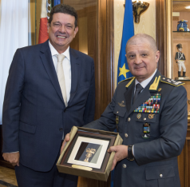
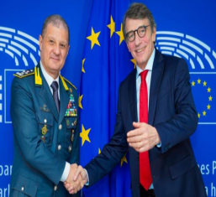
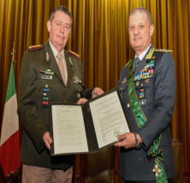
Major Case Management – The GdF international network
International
Relations
Visits of foreign delegations
International
Relations
Section
Missions of GdF
top management abroad
MOUs
Notes:
This Section:
1. sets up contacts and forms of cooperation in areas institutionally relevant with foreign counterparts having similar competences to those of the Guardia di Finanza;
2. handles relations with foreign diplomatic representations in Italy and accredited foreign liaison officers;
3. prepares and develops negotiations aimed at the stipulation of Memoranda of Understanding for the exchange of information and international cooperation in economic-financial police matters falling within the Corps' jurisdiction.

Slide 19
Major Case Management – The GdF international network
MOUs
Instruments of international law (technical understandings) to implement cooperation arrangements
They do not burden the relevant government from a political - legal point of view
They are of a lower level than international agreements or treaties
They are however subject to a strict and complex authorisation process
They fall into the category of direct cooperation on a spontaneous basis
They are distinguished from police info-operational cooperation by the lack of a legal basis to support the exchange carried out
They generate information flows of a strictly classified and confidential nature, the use of which is automatically ruled out
Notes:
Memo no. 4 of 03/03/2008 of the Ministry of Foreign Affairs specifies the characteristics and process of international agreements
International agreements
Bilateral or multilateral acts aimed at creating binding legal positions between States or between States and international organisations.
Interministerial or technical agreements
The purpose is to create technical-administrative cooperation commitments exclusively between the single stipulating Administrations. Agreements are not stipulated by the Government or the Italian Republic as such, therefore they do not appear as parties in these international acts.
They generally become effective upon signature.
It should be noted that in the case of the GDF, draft MOUs are checked by the Ministry of Economy and Finance before being sent to the Ministry of Foreign Affairs for final approval.
The MoU
is a declaration of intent to consult, cooperate and exchange information.
It is adopted to intensify the cooperation in the fight against economic and financial offences that harm the contracting Countries. It does not create any legally binding rights or obligations under international or domestic law.
The MoU is structured in articles containing provisions on :
purpose,
points of contact,
request and disclosure of information,
Resolution of disputes,
effects.
In addition to the information exchange developed and the results achieved, it should be noted that such tools allow the possibility of developing new forms of collaboration, such as the exchange of officers and good practices, as well as the mutual willingness to develop training activities of common interest.
Moreover, the stipulation of such agreements helps to strengthen the Corps' image internationally, enhancing a highly propositional attitude, which facilitates and encourages the secondment of Experts and Liaison Officers in the Countries of their respective accreditation.

Slide 20
Major Case Management – The GdF international network
Facilitating and accelerating the direct exchange of information
Strenghtening strategic relationships
Information not to be used as evidences
29 MoUs signed
European Investment Bank (2022)
Brazilian Federal Police (2023)
Romanian Ministry of Administration and Interior (2005)
Integrity Vice Presidency of World Bank (2013)
Serbian Ministry of Justice (2017)
Indian Central Board of Excise & Customs (2009)
Federal Customs Service of Russia (2013)
Korean National Police Agency (2018)
Hong Kong Customs & Excise Department (2009)
Spanish Guardia Civil (1998, renewed in 2014)
Organization for Security and Co-operation in Europe | OSCE (2018)
US - Alcohol and Tobacco Tax and Trade Bureau - TTB (2010)
French Directorate-General for Customs and Excise (2015)
Georgian Investigative Service of Mnistry of Finance (2019)
Argentina - Federal Tax Administration (2010)
Vatican Gendarmerie (2016)
United Nations Office of Counter-Terrorism – UNOCT (2019)
Kazakhstan Fiscal Commitee, Ministry of Finance (2010)
International AntiCounterfeiting Coalition - IACC (2016)
General Administration of Customs of the People’s Republic of China – GACC (2019)
Serbian Fiscal Police (2012)
Argentinian National Gendarmerie (2017)
Argentine Naval Prefecture (2019)
Inter-American Center of Tax Administration - CIAT (2012)
Argentinian Public Prosecutor (2017)
Andorra Police Department (2020)
European Anti-Fraud Office - OLAF (2012)
OCSE/OECD (2014, renewed in 2017 and 2022)
Portuguese National Republican Guard (2021)
Notes:
To consolidate collaborative relations in the fight against economic and financial crime and training relations with foreign counterparts, the corps’ personnel abroad can propose the signing of memoranda of understanding with foreign counterparts.
the stipulation of memoranda contributes, furthermore, to strenghten the image of the corps internationalLY, ENHANCING A HIGHLY PROPOSITIONAL attitude, which facilitates and ENCOURAGES the SECONDMENT of the experts and liaison officers in the countries of respective accreditation.
these acts essentially consist of a declaration of intent whereby the corps and the foreign counterpart undertake to collaborate, without, however, creating any legally binding rights or obligations under international or domestic law.
as moreover clarified by specific MEMOS OF THE MINISTRY OF FOREIGN AFFAIRS:
- the SUBject of the mou "generally concerns the ascertainment of a factual situation or iS the manifestation of an intention that the contracting ministries express within the scope of their managerial and financial autonomy", such as "to cooperate by carrying out agreed programmes, to exchange visits, information AND MORE";
- the memoranda "do not give rise to binding legal POSITIONS for the italian state under international law" and have a strictly technical and non-intergovernmental content.
The Memoranda, therefore, constitute a mere relationship instrument, which crystallizes an "operative collaboration" (to be understood as an exchange of information) or training, limited only to the subjects within the competence of the Guardia di Finanza, and contribute to favour the direct, and therefore, speedy exchange of precious information with homologous bodies of foreign States on illicit conduct. The information obtained, however, is exclusively for the orientation of the investigations and cannot be used judicially.
In this regard, the Corps is particularly active, suffice it to say that to date, 27 memoranda of understanding have been signed, as can be seen in the slide in projection, and several are under negotiation.
In order of time, the most recent Memorandum of Understanding was signed with the National Republican Guard of Portugal the last 22 July. Signing of today's MoU will bring us to 28 MoUs.

Slide 21
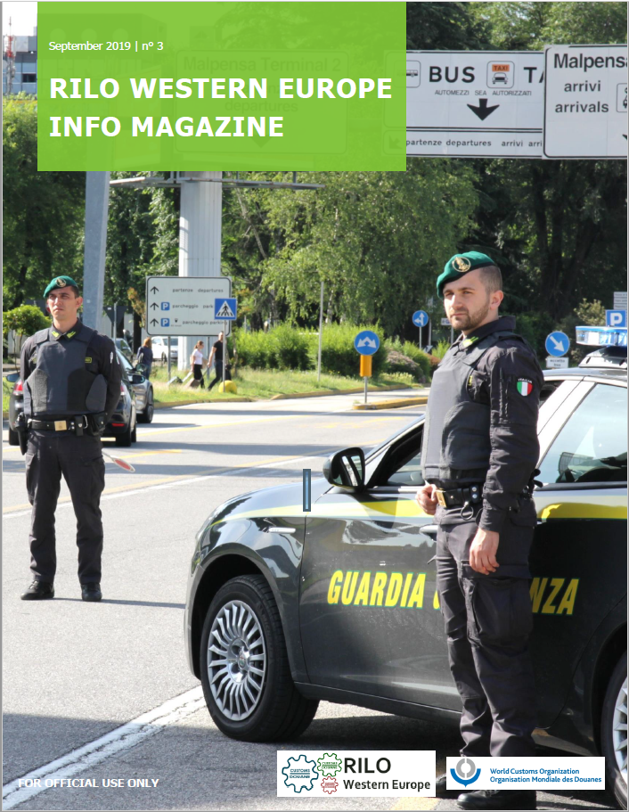
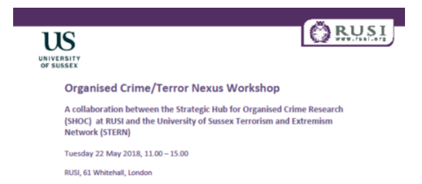
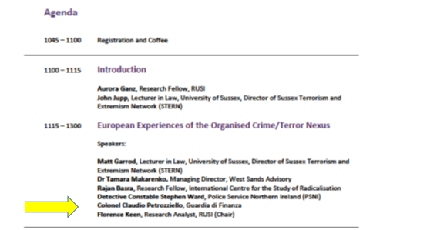
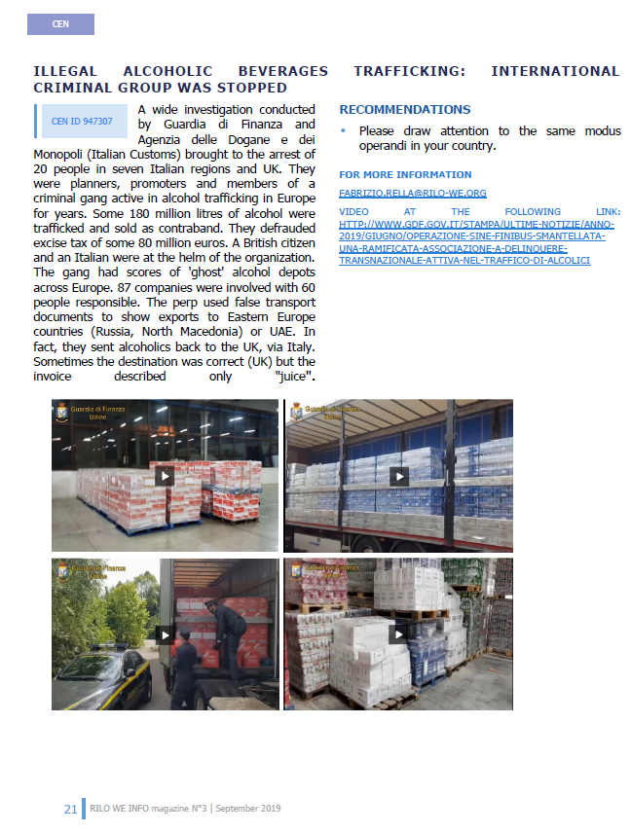
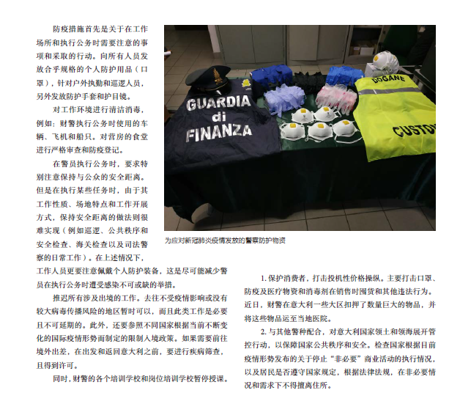
Major Case Management – The GdF international network
International broadcasting and promotion of the Corps' image
Notes:
Among the various functions performed by our Experts, we find the spread and enhancement of the image of the Corps at an international level, also through the media of the host Countries, in order to not only publicise the tasks and prerogatives of the Guardia di Finanza but also to ensure that it is increasingly taken as a model to be followed, also in view of the establishment of a so-called «European Guardia di Finanza».

Slide 22
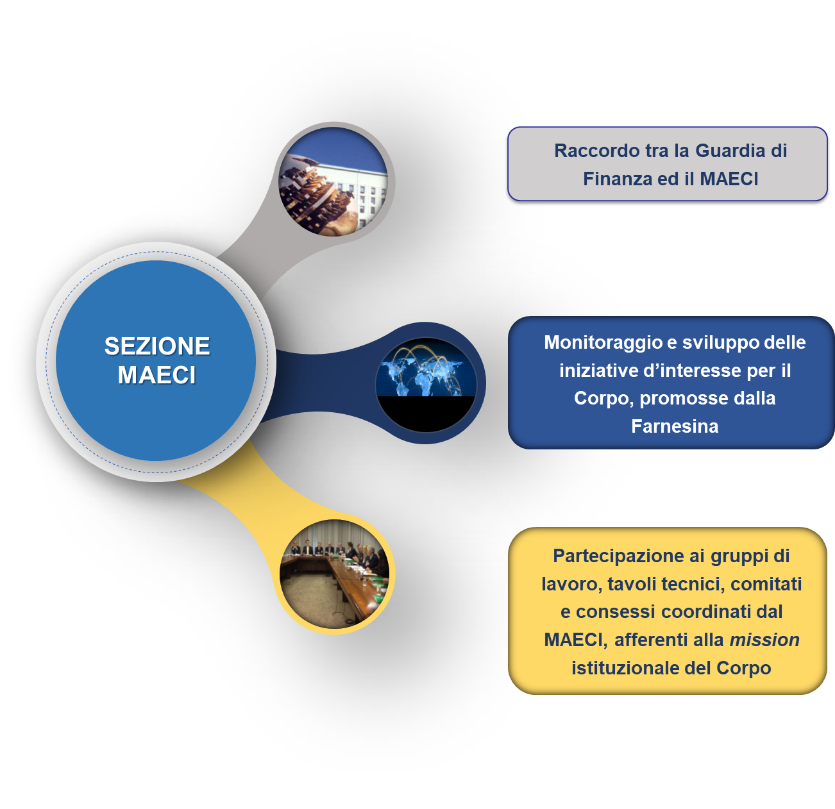
Major Case Management – The GdF international network
Connection between the GdF and the MAECI
Ministry of
foreign affairs
and international cooperation
(MAECI)
Section
Monitoring and development of initiatives relevant to the Corps and promoted by the MAECI
Participation in working groups, technical tables, committees and forums coordinated by the MAECI, relating to our institutional mission
Support to international policy, cooperation and development in partnership with the Ministry of Foreign Affairs
Notes:
Connection between the Guardia di Finanza and the Ministry of Foreign Affairs and International Cooperation.
(the Head of the Section is a Liaison Officer at the Ministry).
Monitoring and development of initiatives relevant to the Corps, promoted by the Maeci.
(bilateral or multilateral training activities; transfer of naval units to foreign States; enhancement of the Corps Officers' Network abroad in the framework of national and EU foreign policy strategies)
Participation in working groups, technical tables, committees and forums coordinated by the MAECI, relating to the Corps' institutional mission.
(including the Inter-institutional Anti-Corruption Coordination Table, the Counter ISIL Working Group, the European "El Paccto" Project for security in Latin America, the G7/G8/G20 with reference to maritime security and police issues, the Working Groups on strategic issues relating to specific geographical areas - Libya, Africa, India, Latin America).

Slide 23
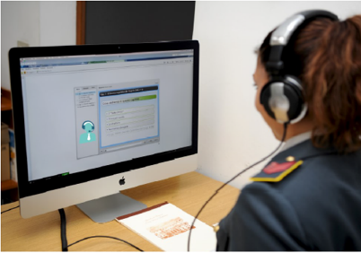

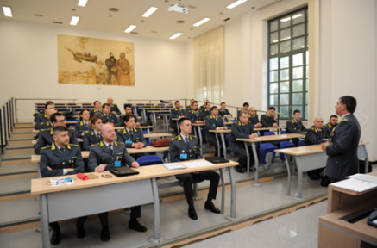
Major Case Management – The GdF international network
INTERNATIONAL CAPACITY BUILDING
STRATEGIC PURPOSES
Promoting a common and shared investigative knowledge
SEZIONE
INIZIATIVE DI COOPERAZIONE ALLO SVILUPPO
Development
Cooperation
Initiatives
Section
Sharing the best investigation approaches
Promoting a more effective dialogue among stakeholders
Notes:
Among the cooperation initiatives, the international training activities are particularly important. They are addressed to members of foreign law enforcement agencies, aimed at promoting a common and shared investigative knowledge and sharing the best investigation approaches, in order to promote a more effective dialogue among stakeholders.
Tasks of the Section:
1. Training activities for personnel from foreign Countries and international organisations
Year 2018: 17 residential courses, trained 450 officers from 40 Countries
2. Technical Assistance and Capacity Building for foreign counterparts
Year 2018: 35 Corps Lecturers/Instructors, experts in the various segments of institutional competence, employed in 20 support/training missions to 20 foreign Countries or to International Organisations

Slide 24
Major Case Management – The GdF international network
TECHNICAL ASSISTANCE AND CAPACITY BUILDING
THE EXPERT
Directives of the Ministry of Foreign Affairs
and the GdF General Headquarters
Directives of the Head of Mission
promotes and organises technical assistance, international training and capacity building initiatives for the benefit of foreign Counterparts
establishes relations with foreign Counterparts and International Organisations (technical agreements) with Guardia di Finanza.

Slide 25
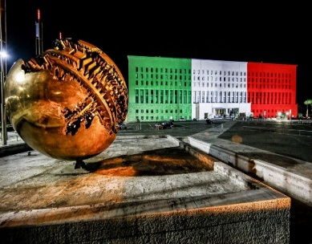

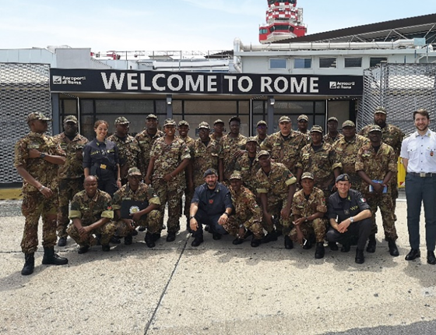
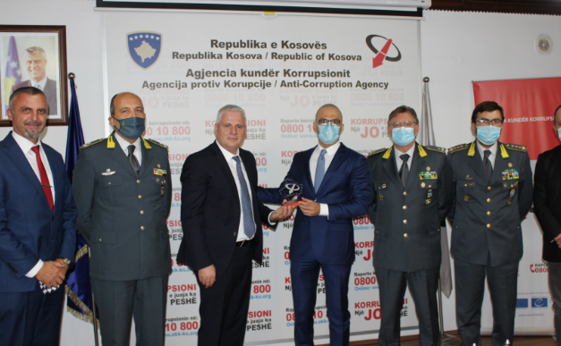

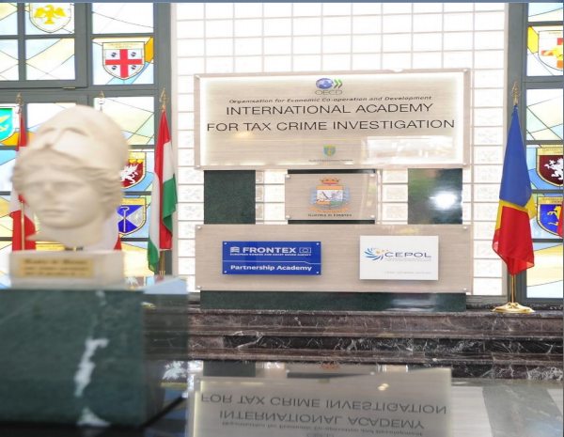
Major Case Management – The GdF international network
RESIDENTIAL CAPACITY BUILDING ACTIVITIES IN PARTNERSHIP WITH THE MAECI
Developing countries
Training activities and
on-site assistance
Economic and Financial Police School:
“OECD International Academy for Tax Crime Investigation"
Diffondere le migliori metodologie d’indagine
Notes:
In this context, particularLY IMPORTANT is the partnership with the Ministry of Foreign Affairs and International Cooperation, through which the Corps promotes the implementation of TRAINING projects for police officers in certain countries considered as strategic and SEEN AS A priority by the mentioned Ministry. During 2020, due to the restrictions connected to the COVID-19 pandemic, this consolidated collaboration saw the realisation of only 2 residential activities, held at the Economic and Financial Police School ,in favour of 49 TRAINEES from the Republic of Nigeria, Ivory Coast, Guinea and Senegal.
The Corps also implements, always in close coordination with the Ministry of Foreign Affairs and International Cooperation, forms of on-site assistance and training in favour of Third Countries through the analysis of training needs, the sharing of best practices, as well as the comparison and analysis of the reference legal context and the organisational set-up of the operational structures TO FIGHT economic and financial crime (among the most recent, we recall the initiatives undertaken with the respective bodies of Colombia, Panama, Kosovo, Albania and Libya).
These activities were, moreover, complemented by a further training project carried out as THE development of one of the points envisaged in the Memorandum of Understanding signed in 2019 with the United Nations - Office on Countering Terrorism (UNOCT) and materialised in 1 course for 23 officials belonging to law enforcement agencies of the People's Republic of Mongolia.
The MENTIONED training institute, in addition to being a recognised centre of KNOWLEDGE and research in legal-economic subjects, following a special memorandum of understanding signed by the OECD in 2014, is the seat of the OECD International Academy for Tax Crime Investigation, a specialised TRAINING centre through which articulated training cycles are organised to Improve THE technical-operational skills of personnel belonging to the Tax Administrations of Member States and non-Member States.

Slide 26
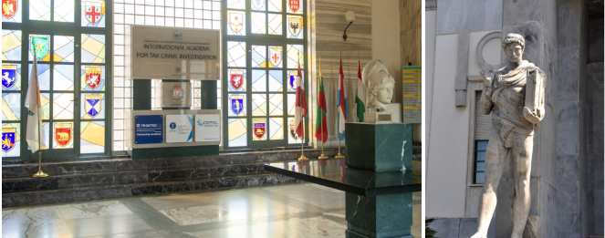
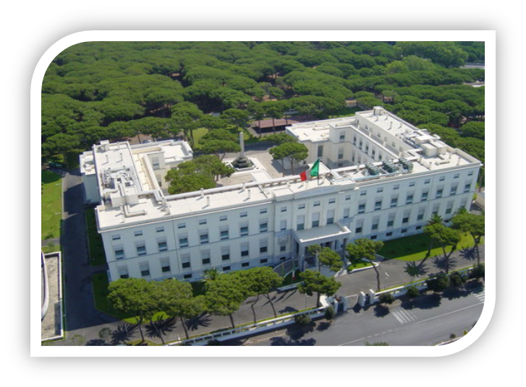
Major Case Management – The GdF international network
OECD Academy for Tax and
Financial Crime Investigation
Lido di Ostia (Roma)
June 17th
2014
June 27th 2017
Signing of the memorandum of understanding on the establishment of the OECD international academy for tax crime investigation
Renewal of the memorandum of understanding

Slide 27

Major Case Management – The GdF international network
Technical and strategic support to national and EU foreign policy
Capacity building and training
Projects development
OECD International Academy for Tax Crime Investigation
CIAT Training
Frontex Academy
Cepol
Collaboration with the Ministry of Foreign Affairs
Collaboration with EU Agencies (EUIPO; Caribbean Export Development Agency; ecc.)
EUROMED POLICE projects by the European Commission
EU- CHINA Police Training
IP KEY
AIRCOP project
€
Others
Technical assistance
Estrategia de Seguridad de CentroAmerica - ESCA
Plan de Apoyo
El Pacto
Tax Police of the Republic of Serbia
Economic-Financial Police of the General Prosecutor's Office of Colombia
Scientific (e.g. Conferences, Seminars, Publications - e.g. OLAF Hercule III)
Academic and Conferential (Designation of Corps Lecturers - e.g. European Law Academy Trier; UNODC; WCO Training)
Exchange of Officers

Slide 28
Major Case Management – The GdF international network
Seconded personnel
GdF may second its own personnel to International Organisations and Bodies, to Agencies or Offices
selected through international call for applications.
different administrative profiles according to the position held.

Slide 29






THE GDF INTERNATIONAL DEPLOYMENT
Major Case Management – The GdF international network
Partnerships with International Organisations.
Seconded personnel
Notes:
In this path, a key driving role has been ensured by the constitution, through the progressive stages of integration, of the European Union (from the Treaty of Maastricht to those of Amsterdam, Nice and Lisbon), within the framework of which several Agencies have been established over time, with the aim of strengthening cooperation between European police forces: these are the Europol, the European Anti-Fraud Office (OLAF), the European Border and Coast Guard Agency (FRONTEX), the European Union Agency for Law Enforcement Training (CEPOL).
In this context, in order to implement and deploy valuable synergies to effectively counter all forms of organised crime capable of crossing national borders, the Guardia di Finanza has proceeded, since the end of the 1980s, to second Officers and Inspectors as permanent officers, temporary agents and national experts to International Organisations, Directorates General and EU Agencies.
Particularly important the Corps' presence in Brussels, central and strategic hub of European policies.
Within the framework of the international cooperation relations between the Guardia di Finanza and the Financial Action Task Force - FATF, and in a context of enhancement of the training initiatives on the subject of countering money laundering and the financing of terrorism, an evaluation has been initiated regarding the possibility of creating a network of Training Institutes recognised as privileged partners for the purposes of specific and targeted education in these matters.
Last April, the Corps hosted a training session for FATF assessors, organised jointly with MONEYVAL for the benefit of around 40 trainees selected by FATF and MONEYVAL, including four Corps officers, for a total duration of five days.
Furthermore, a path of collaboration was started with the International Monetary Fund for the possible involvement of professionalism and expertise of the Guardia di Finanza in the activities that the mentioned International Body conducts in various Countries in terms of:
- assessment of anti-money laundering safeguards, in view of the implementation of the FATF standards;
- support to financial and enforcement institutions;
- technical assistance in the framework of training/educational programmes specifically financed by the IMF.
This type of activity will also entail the need to draw on the qualified expertise of Corps’ personnel for the benefit of foreign agencies and counterparts.

Slide 30

Major Case Management – The GdF international network
Thanks for your kind attention

