Slide 1
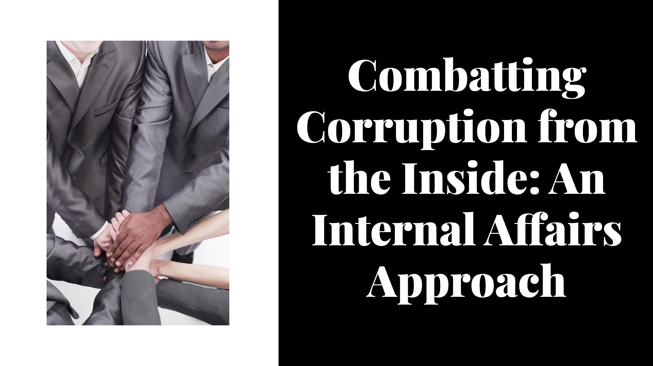

Slide 2


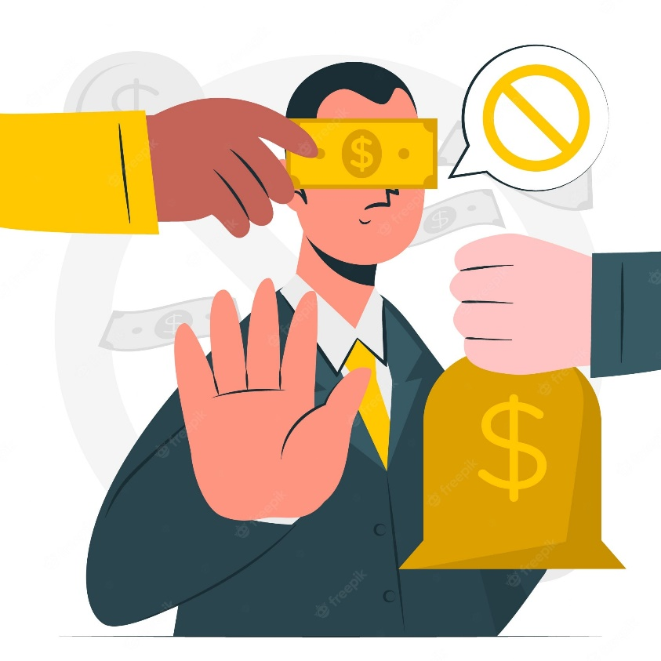
OECD International Academy for Tax Crime Investigation
BRIBERY AND CORRUPTION SPECIALITY PROGRAMME
Daniella Rasera Chiaretto
Federal Prosecutor
Internal Affairs Division
General Attorneys Legal Office - National Treasury Legal Office
Brazilian Government

Slide 3

Agenda
Introduction
What is Corruption?
Impact of Corruption
Corruption Worldwide
Internal Affairs
  Public Agent
  Code of Conduct
  Dilemma Discussion
Can Honest People Act Corruptly?
  The Corruption Experiment (vídeo)
  Why Do People Get Into Corrupt Acts?
Preventing Corruption
Detecting Corruption
  Whistleblower
Law Enforcement System
  Administrative Procedure
  How to Investigate
  Conclusions
  Q&A

Slide 4

Introduction
Corruption is a major challenge that affects governments and companies worldwide.
This presentation will approach the topic through Internal Affairs point of view, the role played by public agents and will encourage participants to discuss the subject through practical cases.

Slide 5


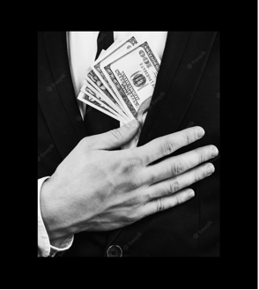
What is corruption?
Notes:
PARTICIPANTS BRAINSTORM

Slide 6
“Corruption is the abuse of power for private gain”
(Transparency International)

Slide 7
Forms of Corruption
SELL SENSITIVE INFORMATION
BRIBERY
COUNTERFEITS
MONEY LAUNDERING
NEPOTISM
VAT FRAUD
ILLICIT TRADE
CONFLICT OF INTEREST
LOBBYING

Slide 8
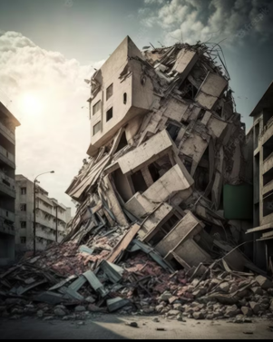

Impact of Corruption
Notes:
PARTICIPANTS BRAINSTORM

Slide 9
Impact of Corruption
ORGANIZED CRIME
TERRORISM
INCREASES SOCIAL VULNERABILITY
POOR PUBLIC SERVICES
CRIMINALITY
INJUSTICE
CORRODE TRUST IN SYSTEMS AND INSTITUTIONS
PERPETUATES POVERTY

Slide 10
Corruption Worlwide

Slide 11
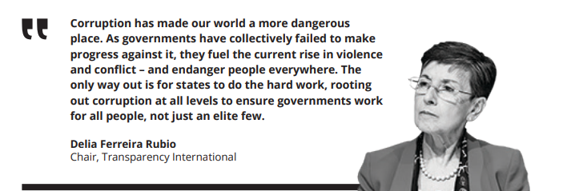

Slide 12
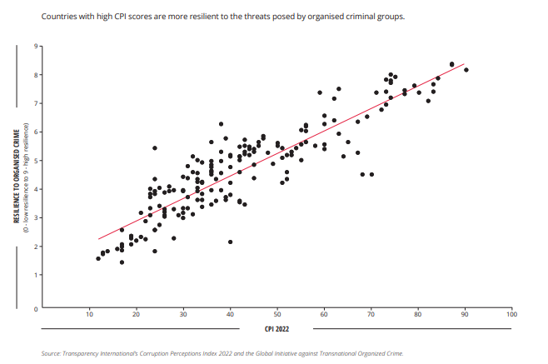
Corruption and Resilience to Organised Crime

Slide 13
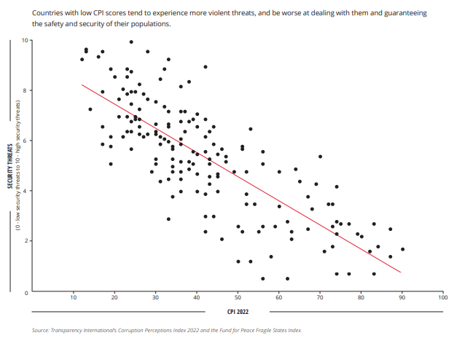
Corruption and Security Threats

Slide 14
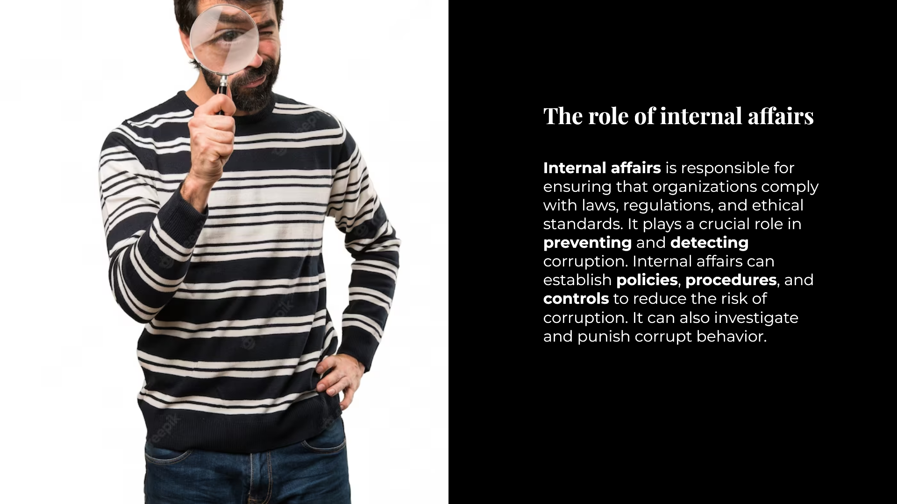
Internal Affairs

Slide 15

Internal Affairs
People are in the center of organizations and governments. They are one of the key elements for the success or failure in companies.
Public Agents are entrusted with protecting the public interest. When engaged in corrupt behavior they can undermine the institutions they serve and its credibility.

Slide 16
Internal Affairs
Public Agents:
Speak for and in the name of the Public Administration
Public Integrity Orientated
Code of Conduct

Slide 17
DO YOU KNOW ABOUT A CODE OF CONDUCT WITHIN YOUR AGENCY?

Slide 18

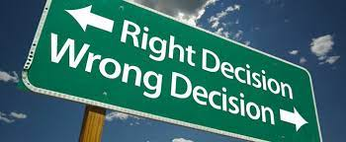
Dilemma Game
Esta Foto de Autor Desconhecido está licenciado em CC BY-NC-ND

Slide 19

CAN HONEST PEOPLE ACT CORRUPTLY?

Slide 20
VIDEO
THE CORRUPTION EXPERIMENT https://youtu.be/2KyavuKmdNE

Slide 21
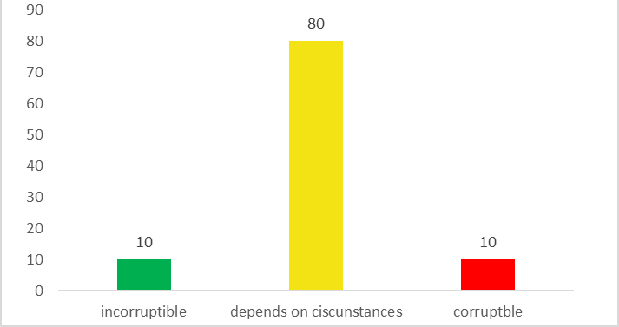
Notes:
Australian´s values alignment model

Slide 22
WHY DO PEOPLE GET INTO CORRUPT ACTS?

Slide 23
Honest People and Corruption – Findings
People are not as ethical as they think
Guilt becomes smaller when shared
Transparency is not an end in itself
Unethical choices are often made by people who want to behave ethically
Social dynamics impact individual behaviour
Making choices in the public interest requires trust in the system
Notes:
Researches found out

Slide 24
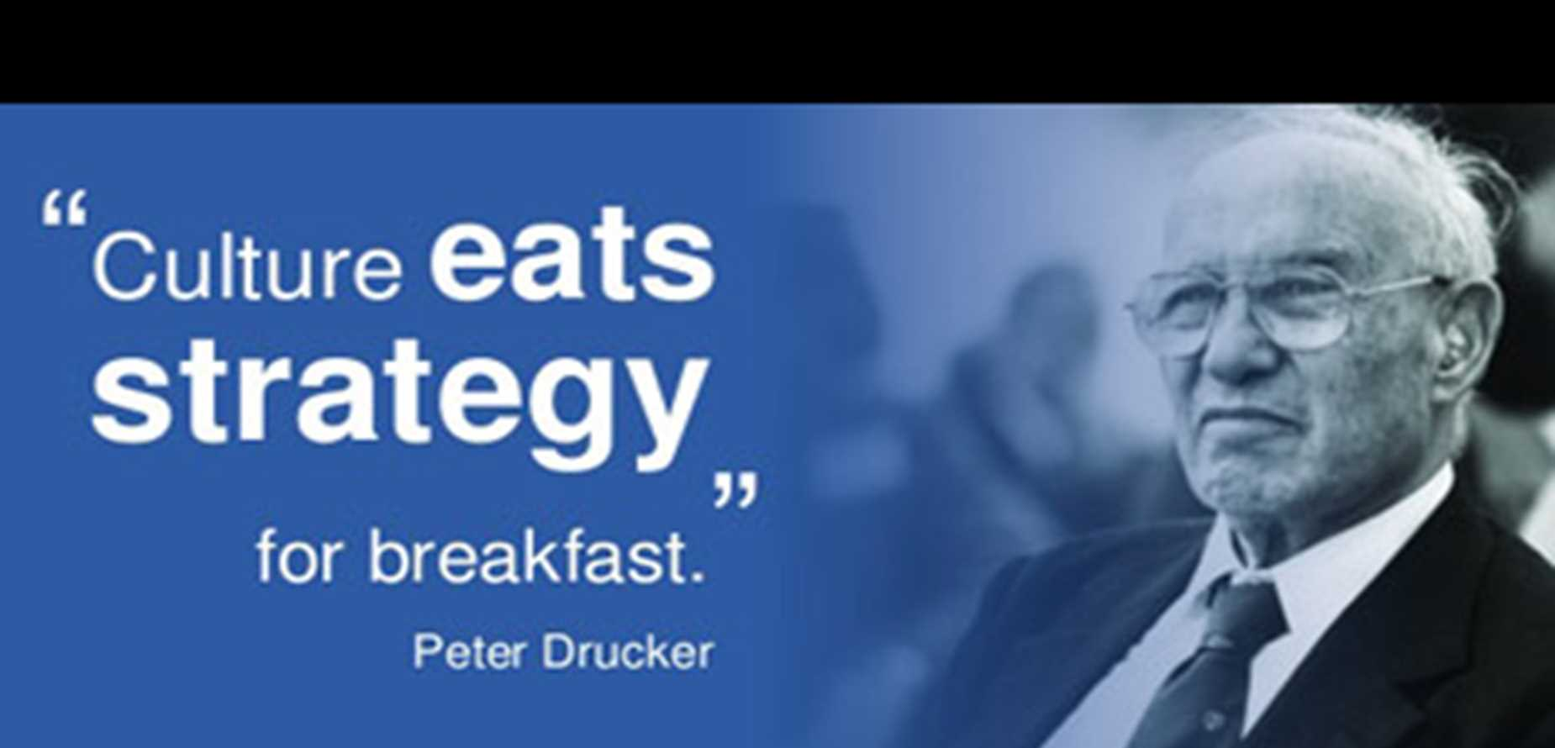
Notes:
no matter how well-designed your strategic plan is, it will fall flat unless your team shares the appropriate culture. At the end of the day, the people who implement the plan matter

Slide 25
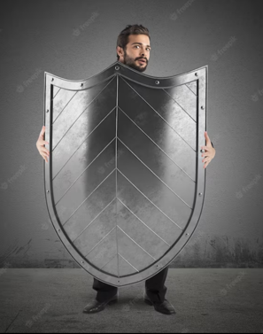
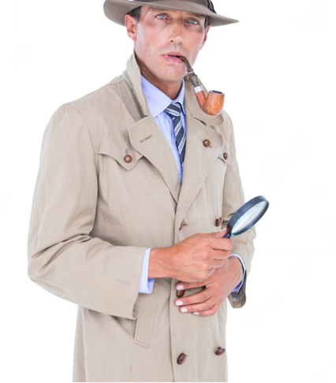
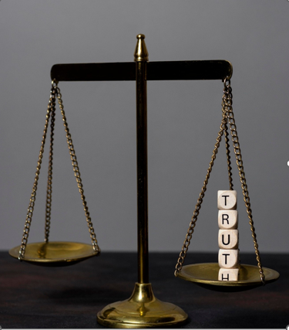
Prevention
Detection
Sanctioning

Slide 26
Preventing Corruption
Notes:
PARTICIPANTS BRAINSTORM

Slide 27
Preventing Corruption
Code of Conduct
Checks and balances
Integrity Program
Compliance
Clear Reporting
Transparency
Engagement of Civil Society
Ombudsman
Regulate Lobbying
School Programme
Quarentine
OECD Public Governance Reports

Slide 28
Preventing Corruption
Behaviours matter
Integrity Program
Tone at the top
Moral reminders (nudge)

Slide 29
HOW DO YOU DETECT/REPORT A CORRUPT PUBLIC AGENT IN YOUR ORGANIZATION?

Slide 30
Detecting Corruption
Internal Affairs procedures
Checks and balances
Ombusman
Senior report
Internal Control
Audit
Whistleblower

Slide 31
Detecting Corruption
Whistleblower

Slide 32
Detecting Corruption – Whistleblower – Definition - 1/6
The International Labour Organization (ILO) defines it as “the reporting by employees or former employees of illegal, irregular, dangerous or unethical practices by employers.”
The Council of Europe Civil Law Convention on Corruption refers to “employees who have reasonable grounds to suspect corruption and who report in good faith their suspicion to responsible persons or authorities.”
OECD Anti-Bribery Recommendation refers to protection from “discriminatory or disciplinary action public and private sector employees who report in good faith and on reasonable grounds to the competent authorities ...”

Slide 33
Detecting Corruption – Whistleblower – Scope of Coverage - 2/6
Persons Afforded Protection – as broad as possible
Subject of Protected Disclosures – ilegal, unethical or dangerous activities

Slide 34
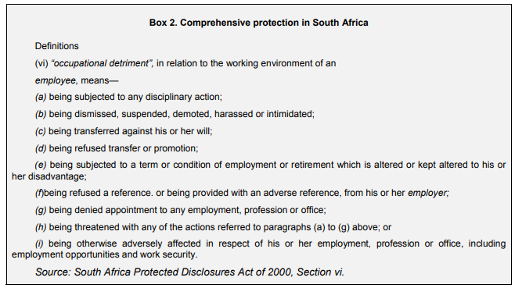
Detecting Corruption – Whistleblower – Mechanisms for Protection - 3/6

Slide 35
Detecting Corruption – Whistleblower – Mechanisms for Protection - 3/6
Anonymity and Confidentiality
*anonymous disclosures: According to Brazil’s Supreme Court an anonymous tip cannot by itself warrant the opening of a criminal investigation. (Supreme Court of Brazil, Inquiry No. 1.957, 11 May 2005)

Slide 36
Detecting Corruption – Whistleblower – Reporting - 4/6
Channels for Reporting
Use of Incentives to Encourage Reporting
Anti-corruption bodies
Ombudsman
Police/Prosecutor
Trade Unions

Slide 37
Detecting Corruption – Whistleblower – Barriers - 5/6
Cultural
Lack of trust in Institutions
Retaliation

Slide 38
Detecting Corruption – Whistleblower – Awareness raising - 6/6
Effective communication
Training
Guidelines
Periodic Reports

Slide 39
Group work:
Based on the Dilemma you discussed with your group, what kind of preventive/detecting corruption measure would you apply for that particular situation?

Slide 40
Law Enforcement - System
Administrative
Civil
Criminal
WHO IS THE CORRUPT PUBLIC AGENT?
Notes:
Legal entities = civil/adm acordos de leniência
Criminal = conducted by prosecutors; suspension/restriction of rights, prohibition of working for the Public Administration, prison – under rule of law and human rights
Civil = Possible sanctions are monetary nature, fine, indemnification

Slide 41
Law Enforcement - System
Possibility of evidences sharing
WHO IS THE CORRUPT PUBLIC AGENT?
Administrative
Civil
Criminal
Notes:
Legal entities = civil/adm acordos de leniência
Criminal = conducted by prosecutors; suspension/restriction of rights, prohibition of working for the Public Administration, prison – under rule of law and human rights
Civil = Possible sanctions are monetary nature, fine, indemnification

Slide 42

Internal Affairs
Administrative Procedure
  Disciplinary nature (agent)
  Direct investigation
  Not public
  Seeks to investigate suposilly corrupt acts

Slide 43
Internal Affairs
Administrative Procedure
Possible Sanctions:
Fine
Warning
Suspension
Dismissal

Slide 44
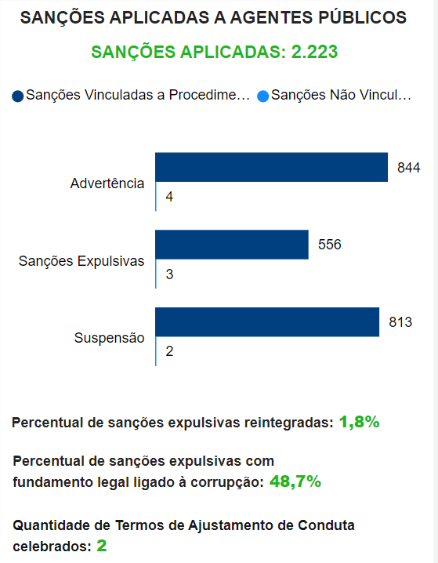
Internal Affairs
Year of 2023 - Brazil
% of dismissive sanctions applied with legal basis related to corruption in the federal public service after administrative proceedings
48,7%
https://centralpaineis.cgu.gov.br/visualizar/corregedorias

Slide 45

How to Investigate
Notes:
PARTICIPANTS BRAINSTORM OF OTHER EXTERNAL SIGNS THEY CAN THINK OF

Slide 46


Slide 47
How to Investigate
Incompatible living stardard for financial compensation as a public agent.
Brazil is a pioneer country in creating rules to comprehensively oblige public agents to annually submit information to the Public Administration about their income and assets.

Slide 48
How to Investigate
Look for external signs (luxury goods such as yachts, watches, vehicles, real estate and property renovations)
Luxury and frequent parties
Works of Art, jewels, etc
Social media and ostentatious lifestyle
Sudden or drastic change in lifestyle or comsumption behaviour

Slide 49

How to Investigate
Watch out for:
  Heritage
  Prizes
  Cross border operations
  Loans/mortgages
  As they may be used to launder illicit funds

Slide 50
How to Investigate
Inter-institutional Cooperation
Participation in international organizations
International Cooperation
Technical cooperation and cooperation networks

Slide 51
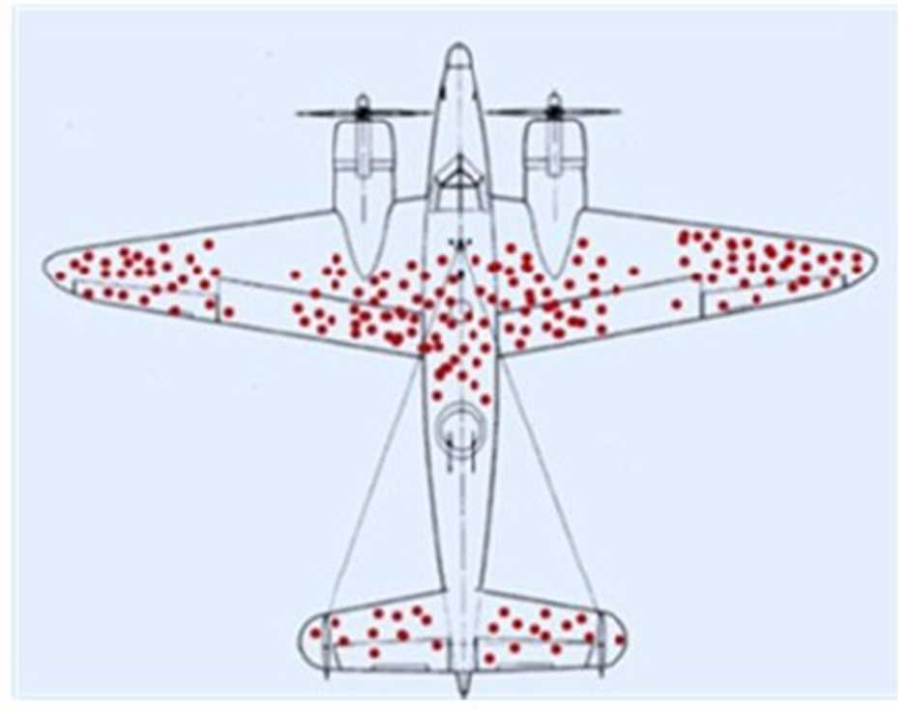
In the Second World War, Abraham Wald's team analyzed every plane returning from battle and highlighted the areas with the most bullet marks.
The distribution of the perforations was not uniform: the marks in red represent the areas most frequently hit on the planes.
Based on this information, where would you reinforce the fuselage?

Slide 52
1) Do not reinforce the worst hit areas;
FINDINGS
2) Shield the areas without any markings (such as the engines);
The planes that received the most shots in the highlighted areas were able to fly back. But those that were hit in the unmarked areas did not even come back.

Slide 53
Survival Bias
Type of selection which consists of the logical error of focusing on things or people that have survived some process while ignoring those that have been eliminated due to their lack of visibility.

Slide 54
Conclusion
Strenghen the invisible parts (agents) through effective prevention corruption methods.
Promote anti corruption culture within organizations in order to achieve high standards of behaviour in Public Administrations.

Slide 55

Thank you very much
Muito Obrigada
Grazie Mille
Daniella Rasera Chiaretto
Federal Prosecutor
Internal Affairs Division
General Attorneys Legal Office - National Treasury Legal Office
Brazilian Government

